Slide 1

System Design & Architecture

Slide 2

Movie Ticket Architecture
Blob Store
Notification Service
Movie Service
Mongo DB
Load Balancer
API Gateway
API Gateway
Book Service
Zookeeper/Keystore
User Service
RDBMS
Key cloak
Theatre Service
RDBMS
Msg Queue
Logging/Monitoring

Slide 3
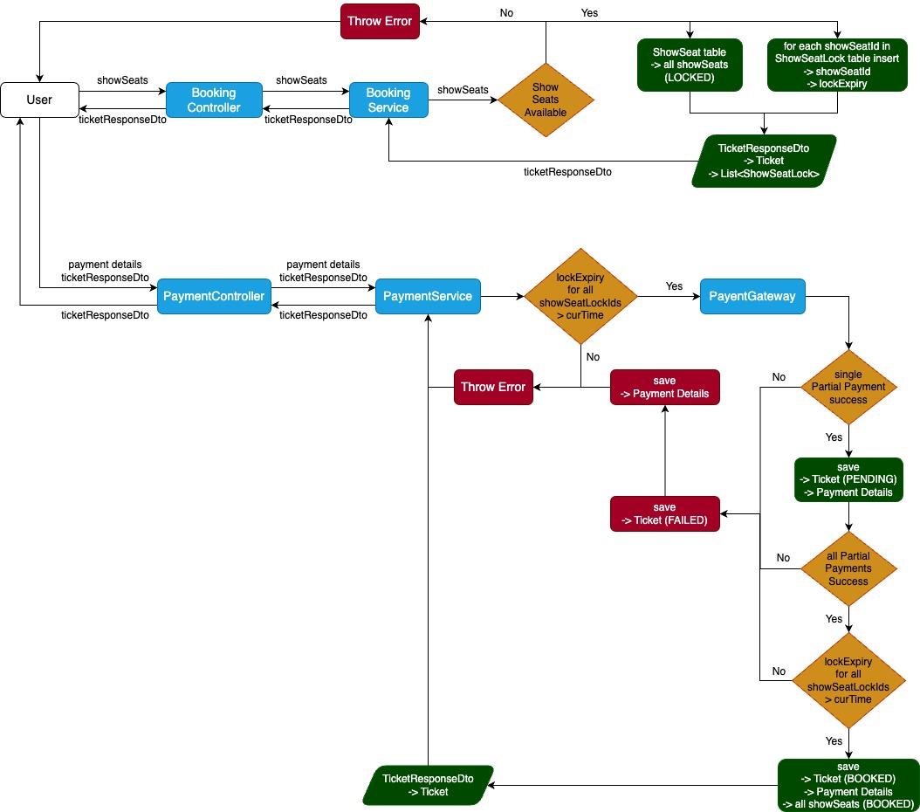
Booking ticket flow chart

Slide 4
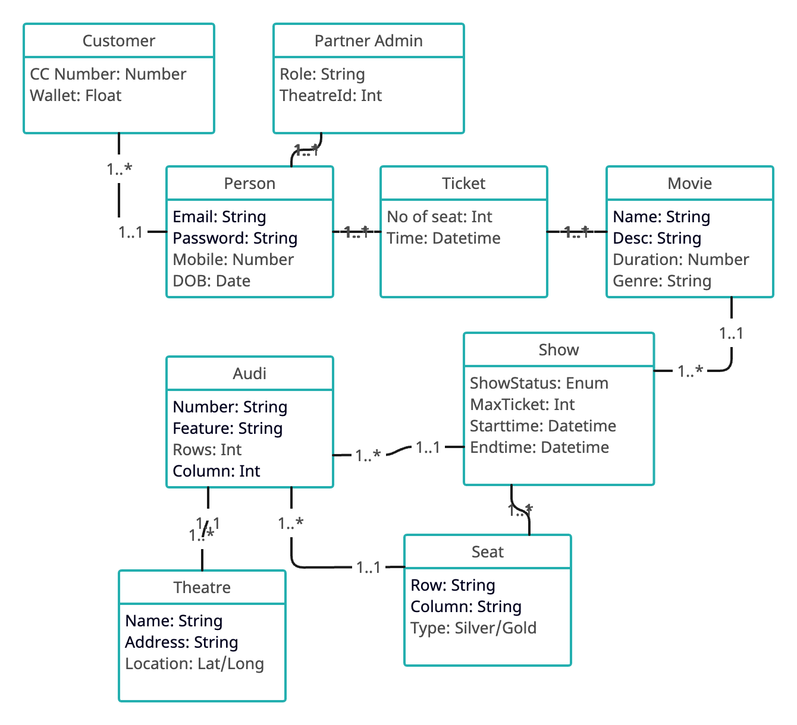
UML Diagram

Slide 5
OSWAP 10
A2 - Crypto Failure:
Example:
Phising/ Virus Attack
Weak Encryption
Prevention:
Multiple Encryption
Remove unwanted data
Disable Caching
A4 - InSecure Design:
Example:
3rd party Attack
predictable URL/Session
Prevention:
Secure the design of session/URL mgmt
Design factor
A1 - Broken Access Control:
Example:
Authorization not in place
Copy paste ID or session to view data
Prevention:
Authorization implementation
A3 - Injection:
Example:
Sql Injection
Command Injection
Prevention:
Santizie Input
Use prepare statement/JPA

Slide 6
OSWAP 10
A6 - Vulnerable Component:
Example:
Old outdated version package
Prevention:
Signed and trusted package
A8 - Data Integrity Failure:
Example:
Compromising Open source
Insecure disposal of data
Hacking forged code
Prevention:
Encrypt Data
Verify and validate the access
A9- Logging & Monitoring
A10- Server Side Request Forgery
A5 - Security Misconfiguration:
Example:
allowing http even https configured
Neglecting/bypass security
Prevention:
Perform threat modeling
Ensure security in all phases
A7 - Broken Authenication:
Example:
Predict Session Id
Weak hash/password
Cookies implementation
Prevention:
Check for password policy
MFA
Secure/Server Cookie

Slide 7
THANKS

