Slide 1





COMPANY
PROFILE
Data, analytics and AI solutions that turn information into business outcomes
Established 2005 • 2000+ analytical projects • Global presence

Slide 2



About Us
WHO WE ARE
20+ years of enabling growth through data
20
2000+
100
Established in 2005, we have over 20 years of experience in driving business growth. Our 100-member strong Offshore Development Center ensures seamless execution, while our team's expertise has led to over 2000 analytical products. We provide tailored data solutions for specific business functions globally and remain dedicated to empowering businesses worldwide.
Years of Enabling Growth
Analytical Projects
Member ODC
Global Presence
Techno Functional Team
Data Products for Specific Functions

Slide 3












Five IT Waves That Shaped Industries Globally
THE CONTEXT
From building technology systems to transforming how people work
2000 – 2007
2007 – 2013
2010 – 2017
2013 – 2022
2022 – PRESENT
INTERNET
MOBILE
CLOUD
DATA & ANALYTICS
AI & AGENTS
Everything becomes connected
Everything becomes always-on
Everything becomes a service
Everything becomes measurable
Everything becomes intelligent
Technology estate transformation
Technology changes the systems through which work gets done
Workforce and work transformation
Technology changes how the work itself gets done
IT-LED ADOPTION IT function is the primary driver and gateway for technology adoption and scale
SHIFT IN FOCUS
USER-LED ADOPTION Business users and individual workers are central to value creation

Slide 4


Weak, fragmented data is why AI initiatives fail to scale
AI & AGENTIC AI – GLOBAL STATISTICS
1
Data silos are a major barrier to AI adoption
2
Most organizations are not AI-ready
3
AI projects without AI-ready data are likely to be abandoned
70%
61%
60%
of IT and business leaders cite data silos as one of the biggest challenges to AI adoption.
of companies say their data assets are not ready for generative AI.
of AI projects unsupported by AI-ready data are predicted to be abandoned through 2026.
70%
find it difficult to scale AI projects using proprietary data.
Source: IDC, 2026 (FutureScape: Worldwide Data and Analytics 2026 Predictions)
Source: Accenture, 2025 (Reinventing with a new wave of generative AI)
Source: Gartner, 2026 (cited in KPMG, 2026 – AI and data readiness: Leadership mandate for CDAOs)

Slide 5








Enterprise AI
AI & AGENTIC AI – THE WHOLE PICTURE
The visible experience is only the tip
What users see AI experiences at the point of work
Copilots
Conversational AI
Enterprise search & Q&A
Task-specific agents
Content & analytics assistants
AI & AGENTS
What makes AI work The enterprise foundation behind the AI experience
ENTERPRISE
FOUNDATION
Data
Context
Governance
Trust
What does AI know?
What does AI understand?
What is AI allowed to do?
Can we depend on it?
Integrated
Quality
Accessible
Governed
Enterprise knowledge
Business processes
Semantics
Real-time context
Policies & guardrails
Access & permissions
Human-in-the-loop
Regulatory compliance
Security & privacy
Accuracy
Explainability
Reliability
Auditability
AI & Agents are what users see. Data, Context, Governance and Trust make them enterprise-ready.

Slide 6



Service Offerings
WHAT WE DO
Data Visualization
Decision Augmenting Solution
Digitization
Data Modeling
Dashboards & Paginated Reports
Insights
Self-service BI
Embedded Analytics
Real-time Analytics
Auto Report – No-code report automation solution
Auto Insights – AI-powered insights engine
AppsIQ – AI assistant for transactional systems
Process Consultation
Process Automation
Process Optimization
Digital Experience for External Stakeholders
No Code / Low Code Development
Our Core
Services
Data Engineering
Data Science
Data Modernization
Data Strategy
Data Pipeline
Data Governance
Data Enrichment / Market Data Capture
Predictive Analytics
Prescriptive Analytics
Gen-AI / LLM
Agentic AI

Slide 7
Enterprise AI: The Visible Intelligence Is Only the Tip
LOGESYS VALUE CHAIN
Logesys builds the data, context, intelligence and workflows that make enterprise AI work.
LAYER
ROLE IN ENTERPRISE AI
EXAMPLES
LOGESYS OFFERINGS
ACTION
AI experiences that augment how people work
Agents execute and drive outcomes
AI Assistants (Copilots)
Enterprise Search & Q&A
Conversational Analytics
Auto Insights | Apps IQ | Enterprise AI Agents
4
AI & Agent Experiences
Task-specific Agents
Content Generation
What users see
INTELLIGENCE
Enterprise context and orchestration to turn data into intelligence and action
AI turns data and context into insights and actions
Advanced Analytics
Generative AI / LLM Integration
RAG & Knowledge Solutions
Data Science | GenAI & Agentic AI | Auto Insights | Apps IQ
3
Intelligence & Action
Agent Development
Decision Augmentation
What makes AI useful
CONTEXT
Processes, workflows and applications to connect AI to the business
Connected to processes, applications and business rules
Process Redesign
Workflow Automation
Enterprise Application Integration
Digitization Services | Process Optimization | Intelligent Automation
2
Process & Enterprise Context
Digital Experiences
Low-code / No-code Solutions
What makes AI relevant
DATA
Data, technology and governance foundation to make AI enterprise-ready
Reliable, governed data foundation
Data Ingestion & Integration
Lakehouse / Data Warehouse
Data Quality & Governance
Data Engineering | Databricks | Microsoft Fabric | Data Modernization | Governance & Unity Catalog
1
Data & Trust Foundation
Cloud Platforms (Databricks, Azure, AWS)
Security & Access Controls
What makes AI scalable and trusted

Slide 8
Data is at the core of our focus
D
A
D.A.T.A
Discovery
Approach
T
A
and it holds a unique significance for us.
Technology
Adoption

Slide 9





CLASP Principle: Problem Finding over Problem Solving
D
A
T
A
D – DISCOVERY
We start by understanding the business before proposing any technology.
C
L
Like
What works & stays
S
Current System
Success
Existing data landscape & flows
A
Alter
What must change
Business outcomes, defined value
P
PAINT THE PICTURE
Clear execution blueprint and priorities

Slide 10





Business Outcomes First, Technology Second
D
A
T
A
A – APPROACH
A five-step path from business objectives to solutions that scale.
1
2
3
4
5
Objectives
Constraints
Transformational Impact
Blueprint
Build & Scale

Slide 11



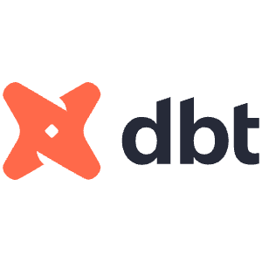











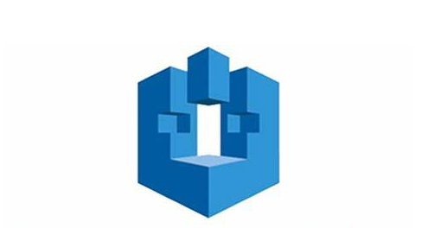


We Work Only with Best-of-Breed Technology Vendors
D
A
T
A
T – TECHNOLOGY
Data Engineering
Azure
Microsoft Fabric
Snowflake
dbt
Azure Data Factory
Databricks
Data Visualization
Power BI
Qlik Sense
Tableau
Spotfire
Digitization
AWS Bedrock
Microsoft Power Platform
n8n
Copilot Studio
Data Science
Azure Machine Learning
Amazon SageMaker
Large Language Models
Python

Slide 12



PACE for a Winning Race
D
A
T
A
A – ADOPTION
P
A
C
E
PURPOSE
AUDIENCE
CONTEXT
EXPERIENCE
What? And Why?
Who? And How?
Industry, business scenario, local variables and outcomes
Simple, intuitive, easy to understand
RESULT: Data transforms from “information” to “insight”

Slide 13



Our Value Proposition
WHAT YOU GET
01
02
03
04
Unified, governed data
across multiple sources and storages with compliance, access control, lineage, and privacy by design.
Real-time + historical insights
at enterprise scale to support BI, ML, and GenAI use cases.
Accelerated time-to-value
via proven service offerings in Data Engineering, Business Intelligence, Data Science, and Digitization.
Outcome-centric delivery
that connects technology choices to tangible business impact.

Slide 14













































Trusted by Organisations Across the Globe
OUR CLIENTS
Retail • Manufacturing • Supply Chain & Logistics • Life Sciences • Media • Food & FMCG

Slide 15
Service Offerings
Data Engineering
01
Business Intelligence
Data Science
Digitization
Detailed Overview

Slide 16







Data Engineering
SERVICE OFFERINGS
Services
Delivery Models
Data modernization
Data pipelines
Data ingestion
ETL/ELT processes
Data CI/CD
Data governance
Data cataloguing
Data lake, warehouse and lakehouse architectures
Time & Material Model
Defined set of resources at agreed rates deployed for project execution.
Monthly Engagement Model
A fixed monthly sum arrived at based on a fixed combination of resources required to meet the project objectives.
TECHNOLOGY
COVERAGE

Slide 17

Data Engineering
PROJECT APPROACH
SOLUTION PHASE
20–30 working days for simple to medium complexity
VALUE PHASE
Support Bundle
Business & Data Workshop
Data Flow Diagrams
Build & QC
Go-Live
Pipeline Monitoring
1
2
3
4
5
6
7
Cost Optimisation
Performance Fine-tuning
Business Requirement Document
+ Cloud Cost Estimation
Data Warehouse Design
Performance Tuning
Pipeline Enhancements

Slide 18
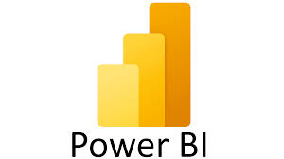



Business Intelligence
SERVICE OFFERINGS
Services
Delivery Models
Data modelling
Dashboard building
Paginated reports
Embedding dashboards into custom apps or portals
Row-level security
Data refresh management
Solution Augmentation and Maintenance Plan (SAPM)
Fixed-Bid Approach
When requirements are clear and a concise BRD is available.
Time & Material Approach
When requirements are fluid.
Monthly Engagement Model
Fixed outflow based on a fixed set of resource combinations. Suitable for agile deliveries.
TECHNOLOGY
COVERAGE

Slide 19


Business Intelligence
PROJECT APPROACH
EDUCATION PHASE
SOLUTION PHASE
Typical duration: 4–6 weeks per dashboard (simple to medium)
VALUE PHASE
SAPM Model
Business Workshop
Data Mapping & Testing
Build & QC
UAT & Go-Live
Pre-built industry-specific demo
Standard Maintenance
1
2
3
4
5
6
7
New Visuals Add-ons
New Analysis
Proof of concept using client's own data
Business Requirement Document
Wireframes
Data Refresh & RLS
Monthly Insights
Waterfall or Agile delivery models

Slide 20





Data Science
SERVICE OFFERINGS
Services
Delivery Models
Data enrichment and capture through web scraping
Azure ML models
Custom ML models using Python
Python programming for data wrangling
Auto Insight generation (Data Product)
Auto reports through email / MS Teams channel (Data Product)
Auto stories generation in PPT format (Data Product)
Gen AI / LLM – Bots + Data Products
Agentic AI
Data Products
SaaS offerings with subscription models.
For Services – Monthly Engagement Model
Based on the objective, a predefined set of teams is deployed at a fixed monthly cost.
TECHNOLOGY
COVERAGE

Slide 21


Data Science Approach
PROJECT APPROACH
⇄ Iterative feedback loop between Modelling and Data Engineering
Business Use Case
Data Engineering
Modelling / ML
Business Objective
Data Requirement
Modelling
Analytics Approach
Data Collection
Evaluation
Data Preparation
Feedback
Data Understanding
Deployment
ROLES
ROLES
ROLES
Domain Expert
Business User / Sponsor
Data Scientist
Project Coordinator
Data Engineer
Data Analyst
Data Expert
Project Coordinator
ML Engineer
Data Scientist
Domain Expert
Business User / Sponsor

Slide 22


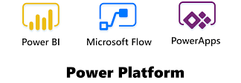
Digitization
SERVICE OFFERINGS
Services
Delivery Models
Low-code / No-code app development
Digital process automation
Process mapping
External portal development
No-code SharePoint development for workflow automation, document management, project management and employee portal
Automation trigger from Power BI dashboards
Fixed-Bid Approach
Based on process mapping and automation requirement.
Subscription
For predefined out-of-the-box processes.
Time & Material
For process consulting and documentation.
TECHNOLOGY
COVERAGE

Slide 23
Digitization
PROJECT APPROACH
EDUCATION PHASE
SOLUTION PHASE
Typical duration: 3–4 weeks per automation in case of LC/NC
VALUE PHASE
Engagement Models
Process Workshop
Integration Build
Conference Room Pilot
Pre-built industry-specific demo
AMC Model
1
2
3
4
5
6
Subscription Model
Proof of concept using client's own data
Process Document
Process Build
Go-Live

Slide 24








Microsoft Data Analytics Platform
PLATFORM EXPERTISE
Intelligent data foundation
Data Factory
Data Engineering
Data Warehouse
Data Science
Real-Time Intelligence
Databases
Industry Solutions
Power BI
Powered by AI with Copilot in Microsoft Fabric
OneLake
Microsoft Purview
UNIFIED
SaaS product experience
Security and governance
Compute and storage
Business model

Slide 25




Why Clients Trust Logesys
WHY LOGESYS
Domain Knowledge
Predictable Delivery
Consultative Approach
Strong domain knowledge in Retail, Manufacturing, Supply Chain and Life Sciences.
Predictable delivery model, perfected over a 20-year span, working with multiple organizations, markets and geographies.
Consultative approach, rather than executing what is being told to us.
Value Creation
Technology Agnostic
KPI Library
Value creation and value realization as our core principle and guiding ethos.
We choose the right technology for the problem, not the other way around.
Cross-industry / cross-functional KPI library built and fine-tuned on an ongoing basis.

Slide 26


Case Studies / Demos
02
Real outcomes across industries

Slide 27


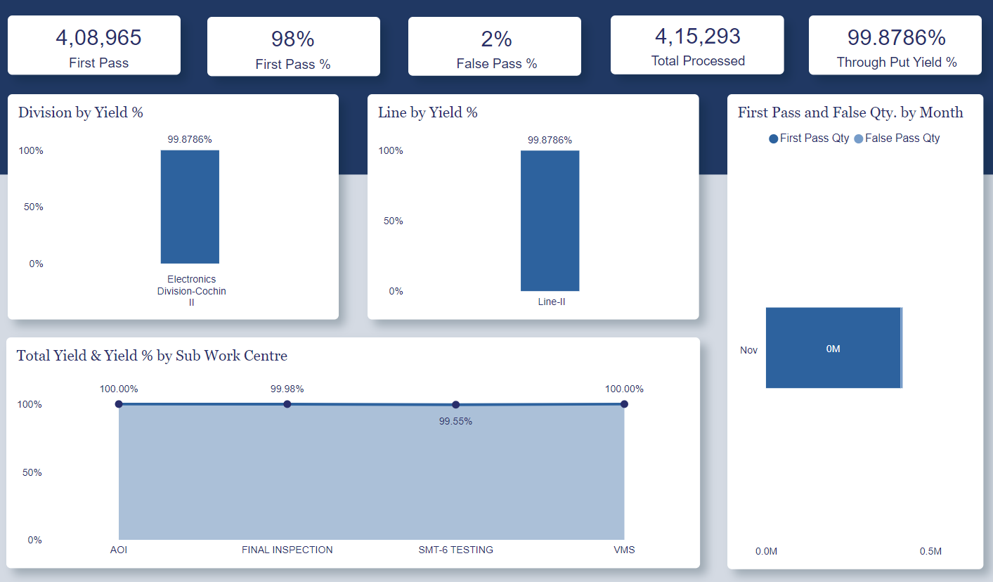
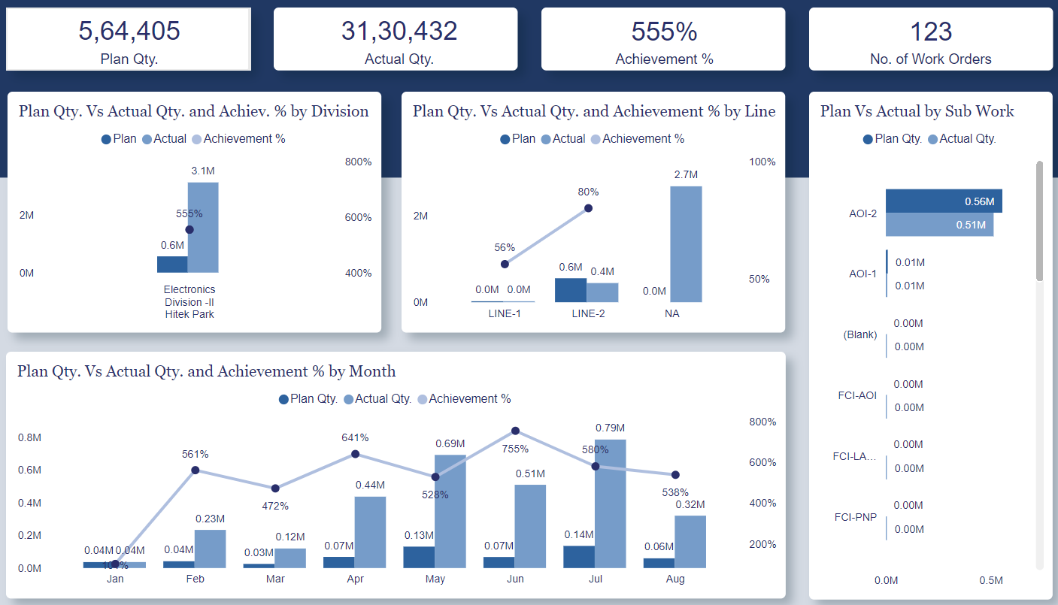
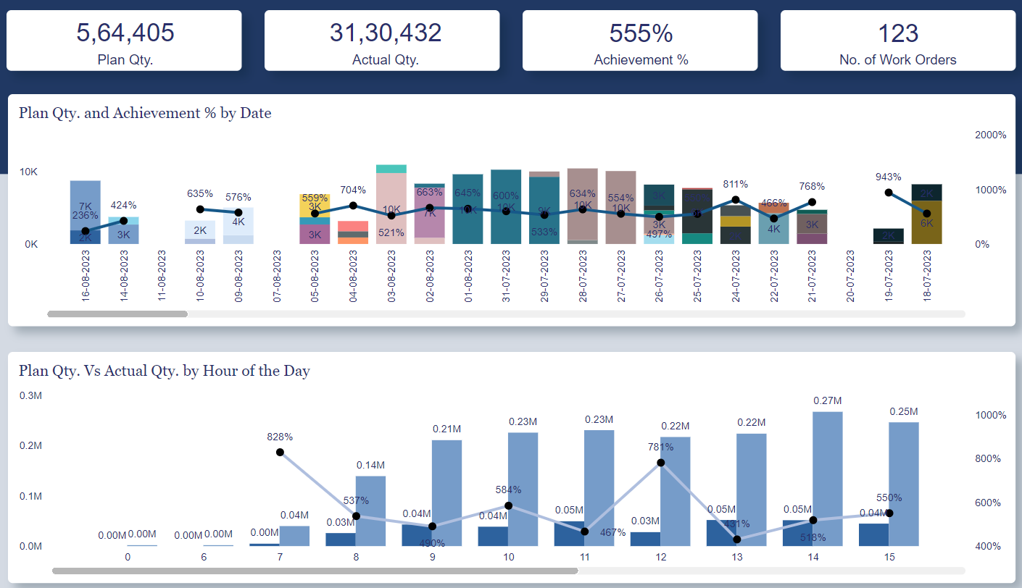
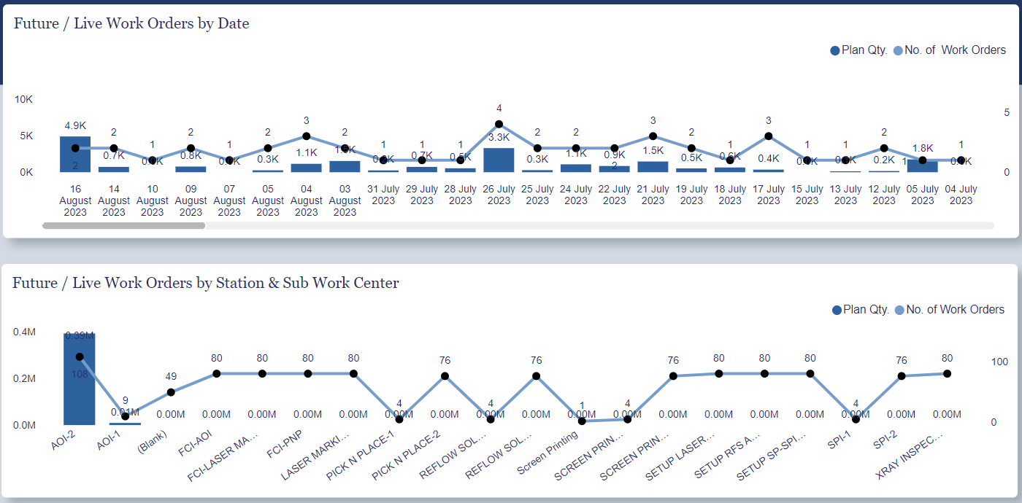



Manufacturing Domain
CASE STUDY – SFO TECHNOLOGIES
BACKGROUND OF THE CLIENT
SOLUTION
Leading microprocessor manufacturer for the aviation industry
Original Design Manufacturing (ODM) solution partners
Revamped data pipelines
Integrated data across all units onto the cloud
Implemented automated batch refreshes for smooth data flow
Implemented real-time data monitoring
Created dashboards for timely reports
PROBLEM STATEMENT
The current data pipeline lacks resilience
Need to demonstrate real-time productivity
The databases for all units are not interconnected
There were delays in extracting reports
BENEFIT
TECHNOLOGIES
Centralized data repository
Sturdy data pipelines
Smooth data integration
Timely accessibility of reports
Risk mitigation and swift action
Data pipelines: Azure Data Factory / ADLS Gen 2
Visualizations: Power BI

Slide 28
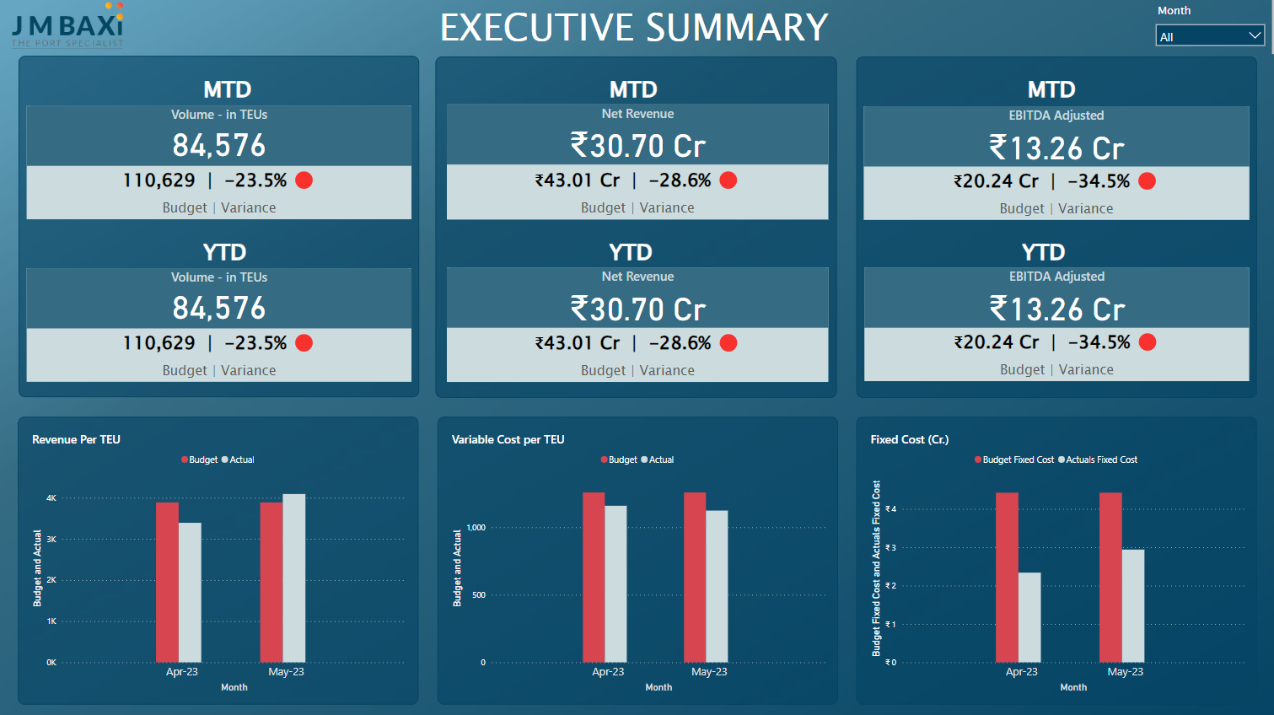
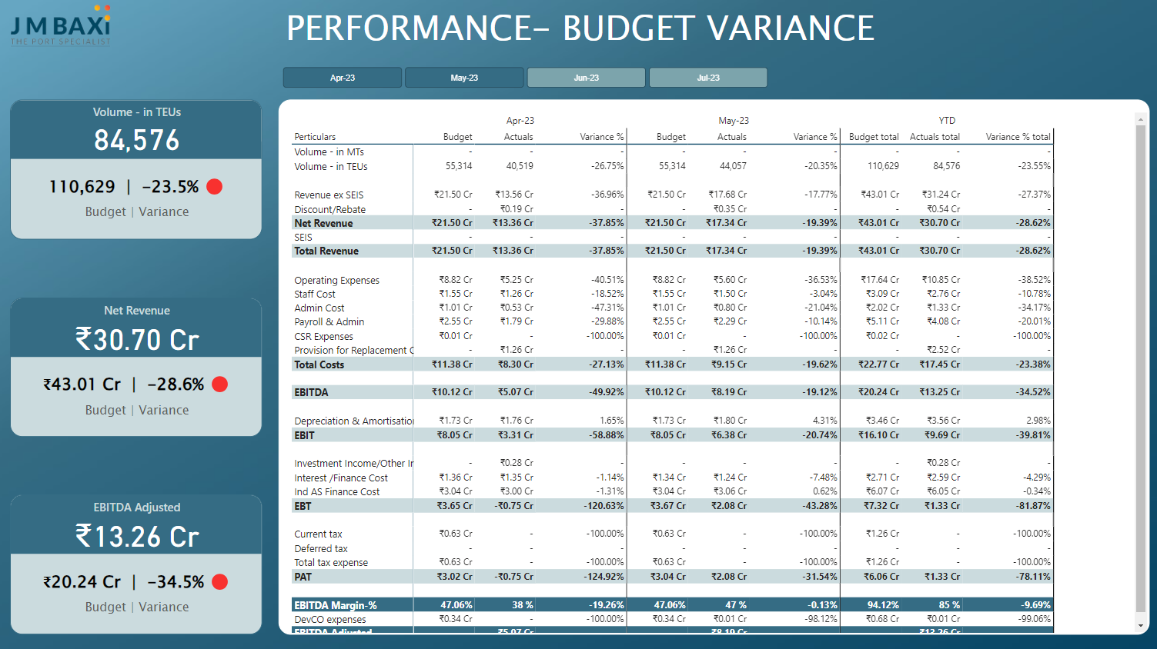
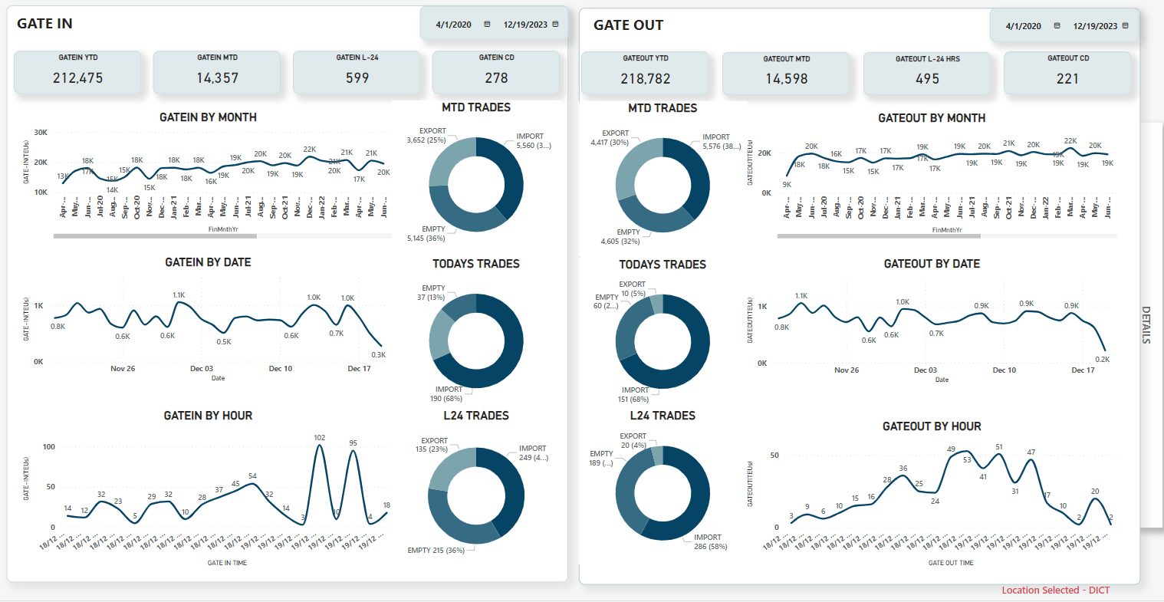
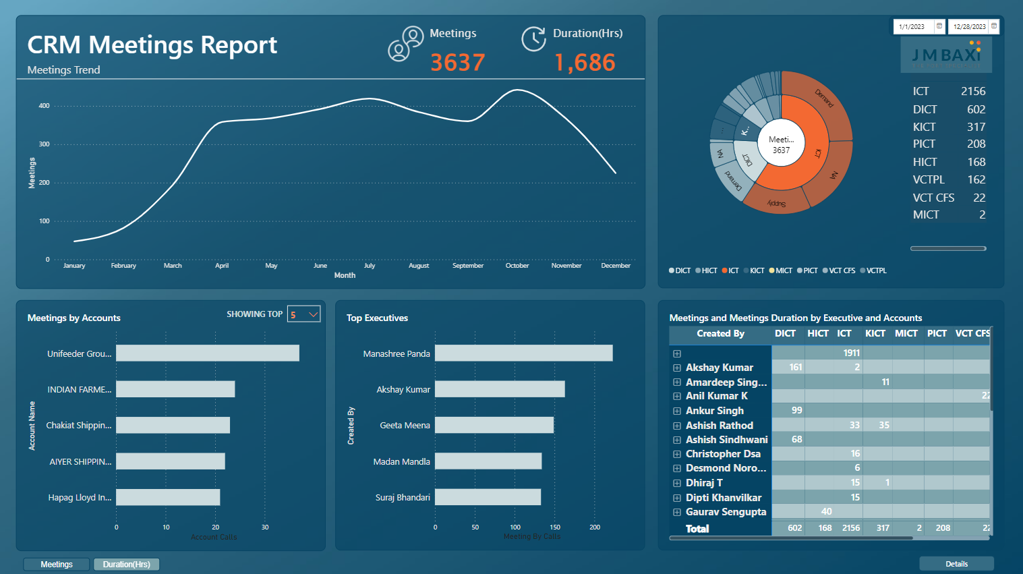
Marine and Shipping Domain
CASE STUDY – JM BAXI
BACKGROUND OF THE CLIENT
SOLUTION
Marine services, ship agency, container agency
Container and multi-cargo port terminals
Cruise and naval ships calling
ADF merges diverse sources into Azure SQL Database efficiently
Azure SQL enables complex analysis and automation capabilities
Centralized SQL data warehouse fosters smoother management collaboration
Implemented automated batch refreshes for smooth data flow
Created Power BI dashboards for timely reports
PROBLEM STATEMENT
Struggles with large datasets, leading to performance problems
Basic analytics, inadequate for complex data interpretation
Errors and inefficiency due to manual data entry
Challenges in real-time sharing and syncing of files
Automation challenges
BENEFIT
Data integration across terminals
Robust data conduits
Scalability and performance
Timely accessibility of reports
Efficient reporting
Enhanced collaboration
TECHNOLOGIES
Data pipelines: Azure Data Factory / Azure SQL DB
Visualizations: Power BI

Slide 29
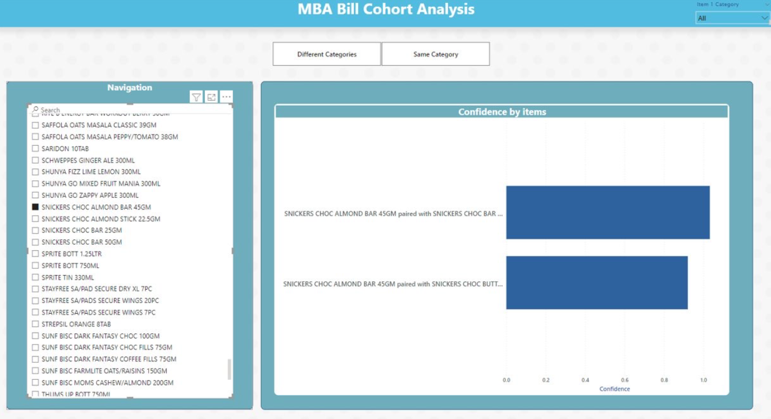
Market Basket Analysis
CASE STUDY – WELLNESS FOREVER
BACKGROUND OF THE CLIENT
SOLUTION
Wellness Forever is India's third-largest retail pharmacy and wellness products chain in terms of revenue, operating a large omnichannel and hyperlocal retail network of 24x7 stores.
The Apriori algorithm is used for finding frequent item sets in a dataset using Boolean association rules
Apriori was built using Python to get the output for Market Basket Analysis
The output file is stored in an Azure storage account from which Power BI fetches the data
PROBLEM STATEMENT
To analyze and understand which products go well together so that bundle offers can be rolled out, market share can be increased and promotions can be initiated.
BENEFIT
TECHNOLOGIES
The client successfully identified the best-selling product combinations and designed bundle offers and promotions accordingly
With these, sales are expected to increase
Python
Azure Databricks
Azure Blob Storage
PySpark
Power BI

Slide 30
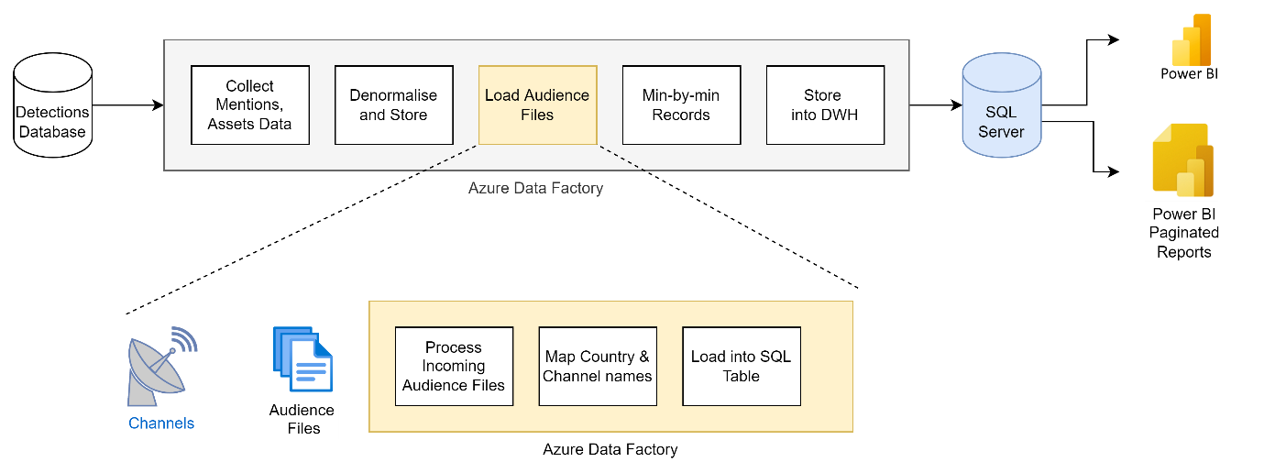
Olympics Broadcast & Audience Analysis
CASE STUDY – KINETIQ: PROGRAMS, CHANNELS & AUDIENCE
BACKGROUND OF THE CLIENT
SOLUTION
IQ Media Corp (IQM) offers media intelligence services including ad detection, audience analysis, sentiment analysis, and more.
Developed a mapping table to standardize country and channel names in audience files automatically
Implemented intelligent data formatting in pipelines
Configured ADF pipelines to automatically handle re-sending of audience files by channels
Created pre-aggregated tables to generate reports in specific formats and granularities
PROBLEM STATEMENT
To analyze and understand which products go well together so that bundle offers can be rolled out, market share can be increased and promotions can be initiated.
BENEFIT
Achieved business objectives while implementing a scalable design for future Olympics, minimizing the need for major changes
Fully automated solutions enable real-time treatment of audience data, rapid report generation and easy accommodation of revisions, alongside visually appealing dashboards in the Power BI portal
TECHNOLOGIES
Azure Data Factory
Microsoft SQL
Power BI
Power BI Report Server
Azure Logic Apps
Power BI API

Slide 31
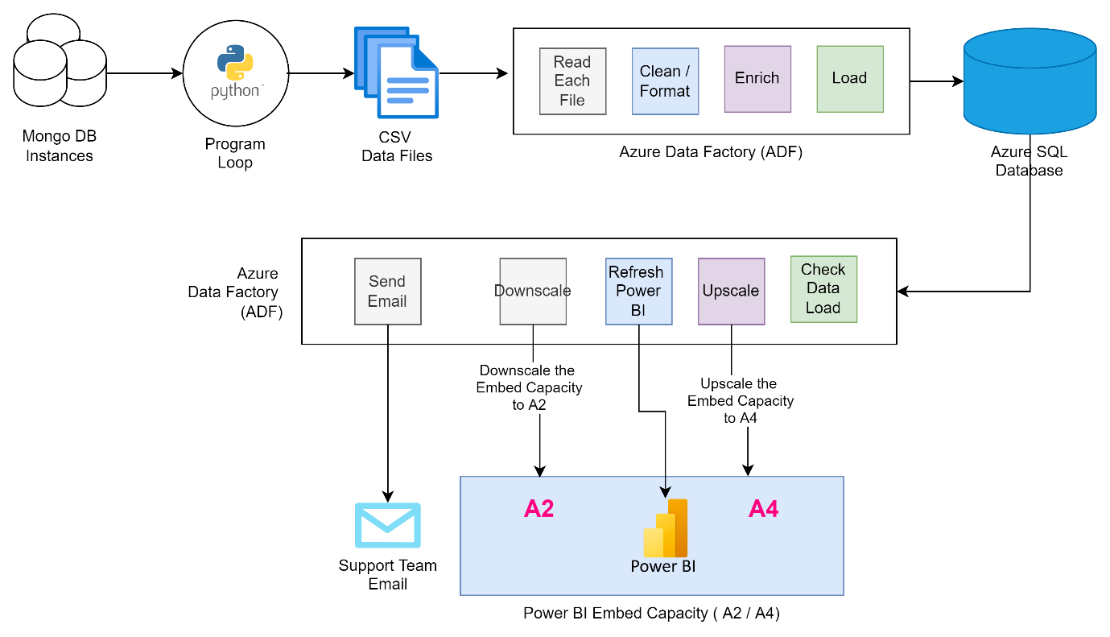
Automating Business Review Metrics
CASE STUDY – DELIVERY SOLUTIONS
BACKGROUND OF THE CLIENT
SOLUTION
Delivery Solutions (DS) is a US-based company with IT operations in India. It aggregates delivery service providers onto a platform where B2B business owners can find suitable partners to deliver orders to customers seamlessly.
Developed a Python script to loop through each tenant DB for data extraction, due to lack of parameterized connection in ADF to MongoDB
Fine-tuned the data model and DAX queries to address performance issues with a final data model exceeding 3 GB
Implemented an ADF pipeline to automatically upscale Power BI embedding capacity to A4 before data refresh and downscale to A2
PROBLEM STATEMENT
BENEFIT
Extract data from each tenant's MongoDB instance and load it into a reporting database
Transform, clean and enrich the data before loading it into the reporting database
Create Power BI reports using this consolidated data
Embed the Power BI report in the customer portal
Efficiently meet business objectives with daily MBR/QBR reports accessible via the customer portal, enhancing decision-making and customer experience
Fully automated Azure-based solution minimizes IT support load, with end-to-end data flow automation and technical team oversight via daily automated notifications and pipeline restart capability
TECHNOLOGIES
Virtual machine (EC2 in AWS)
Data extractor Python program
Azure Data Factory
Azure Database for PostgreSQL
Power BI
Azure Logic Apps
Power BI API

Slide 32
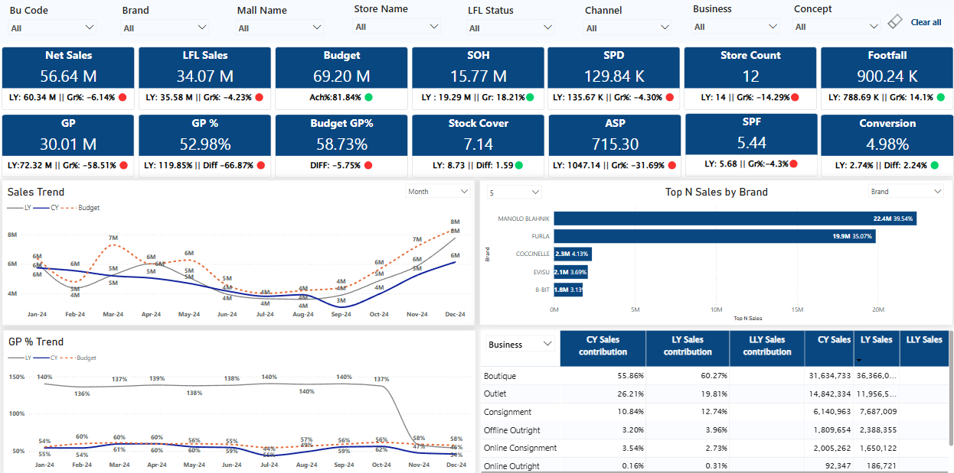
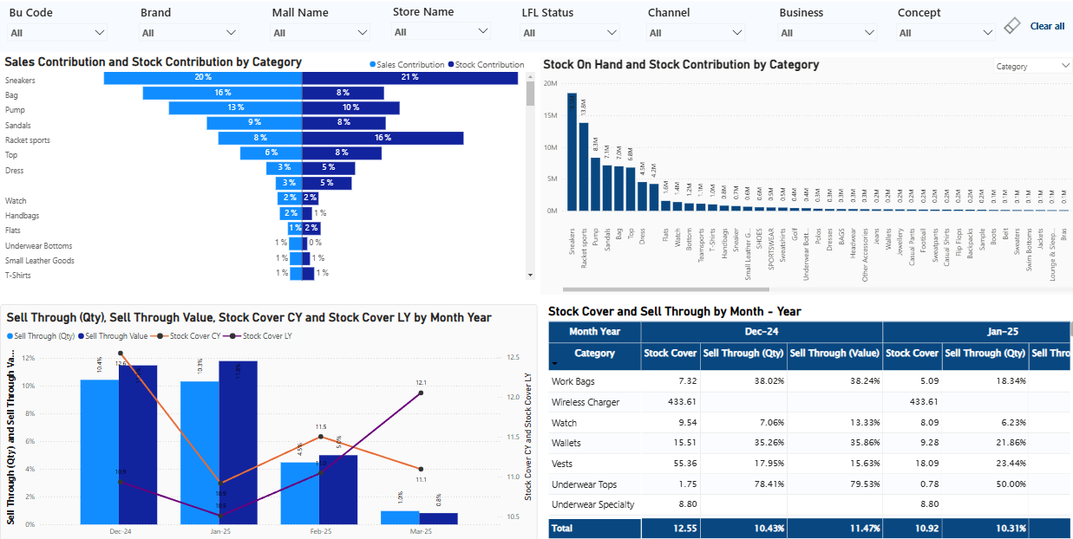
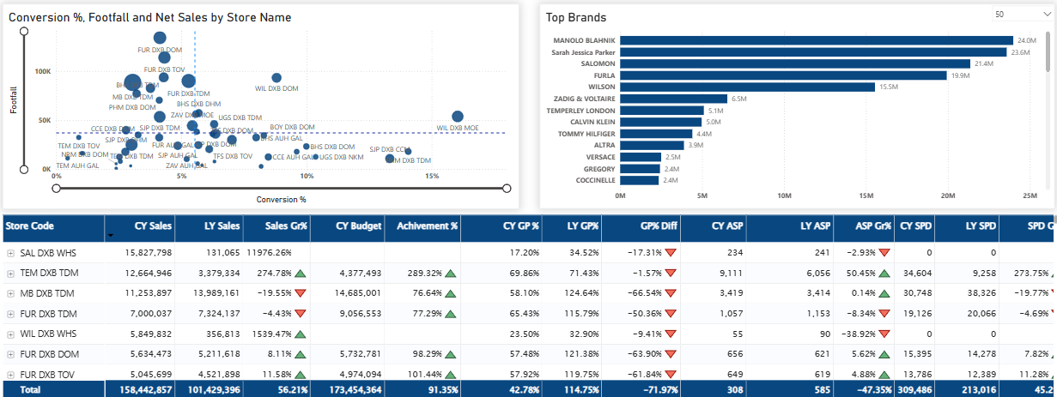
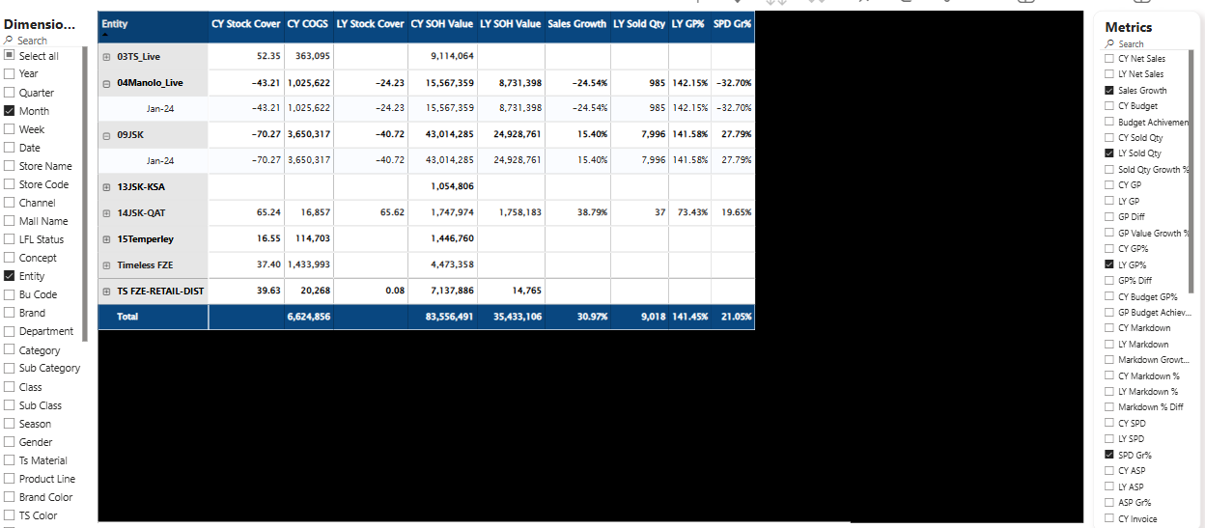
Retail Operations & Management
CASE STUDY – TIMELESS
BACKGROUND OF THE CLIENT
SOLUTION
Leading multi-brand fashion retail company
Product portfolio spanning apparel, footwear & fashion accessories
Built data pipelines to sync data from ERP seamlessly
Integrated data across all business divisions onto the cloud
Implemented automated batch refreshes for smooth data flow
Created dashboards for timely reports & a self-service BI facility for power users
PROBLEM STATEMENT
Manual sets of reports being prepared by business teams
Data dumps to be extracted from the ERP system for report compilation
Data across business divisions consolidated manually for management reporting
Daily reporting / data automation not in place
BENEFIT
TECHNOLOGIES
Centralized data repository
Robust data pipelines
Smooth data integration
Timely accessibility & verified reports
Data pipelines: Azure Data Factory / ADLS Gen 2
Visualizations: Power BI

Slide 33
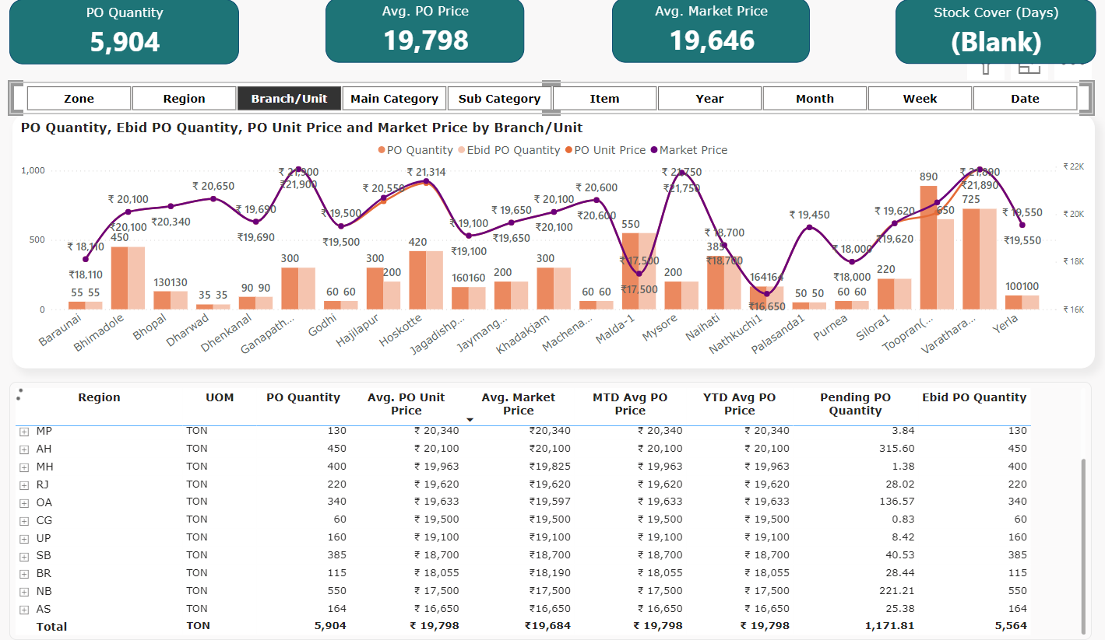
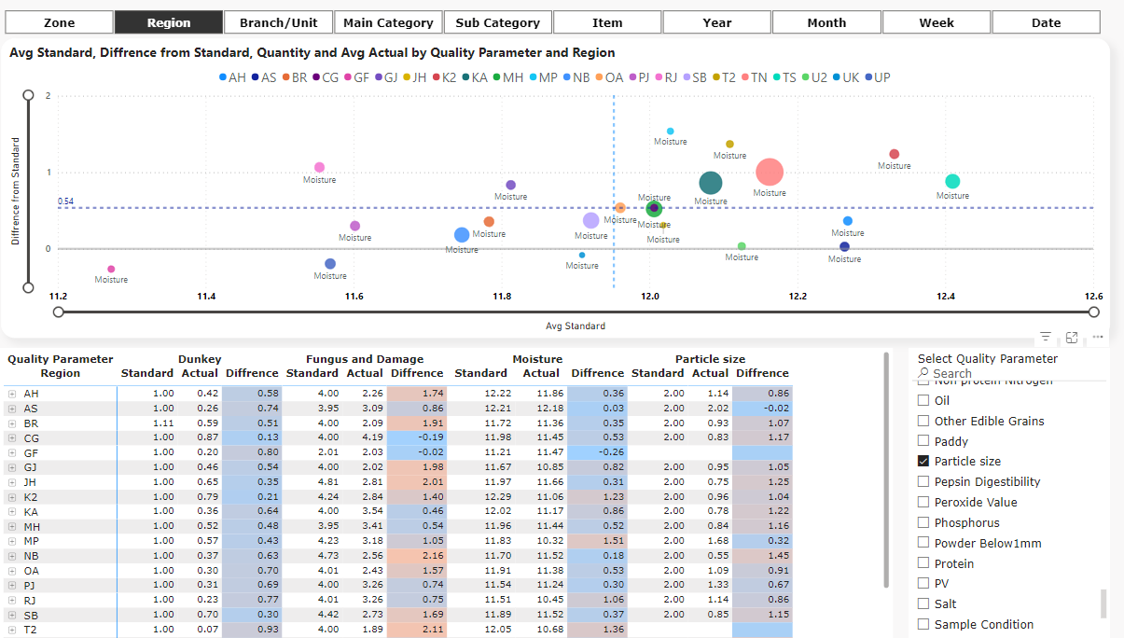
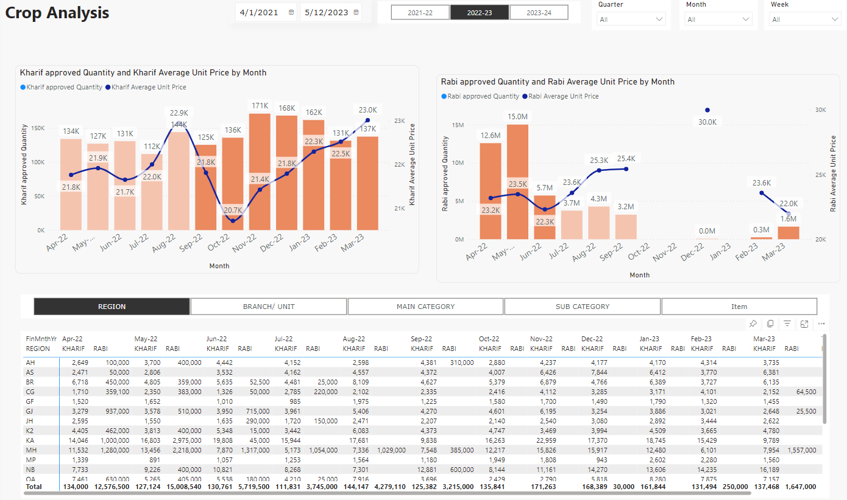
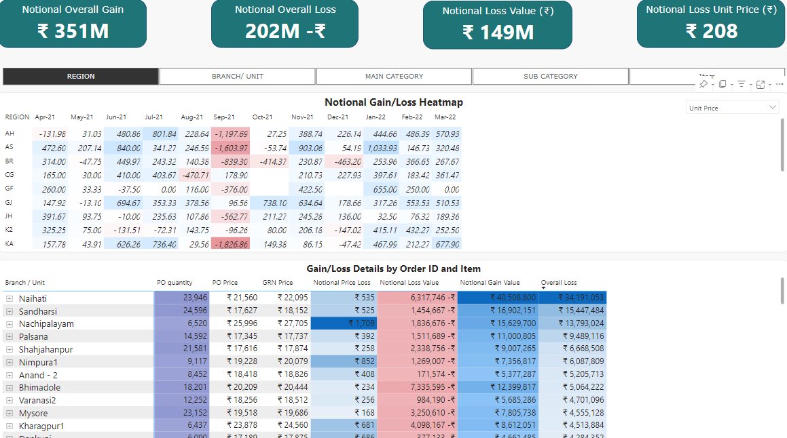
Sales & Operational Intelligence
CASE STUDY – SUGUNA FOODS
BACKGROUND OF THE CLIENT
SOLUTION
Multinational food products company
Pioneer in poultry farming & broiler producer
Streamlined datamart built on top of Oracle E-Business Suite DB
Integrated data across business divisions in a reporting DB
Implemented automated batch refreshes for smooth data flow
Created powerful dashboards across business functions & provided a self-service BI facility for key users
PROBLEM STATEMENT
MIS reports were being prepared by consolidating multiple data sources
Dataset from Oracle ERP being fetched via multiple views
No automated data sync batches to support daily / periodic updates
BENEFIT
TECHNOLOGIES
Centralized data repository
Robust data pipelines with incremental data sync
Data integrity & seamless flow across stages for reporting
Timely accessibility & verified reports
Data pipelines: Oracle E-Business Suite & automated views
Visualizations: Power BI

Slide 34
Thank You
Let's turn your data into business outcomes.
www.logesys.com

