Slide 1
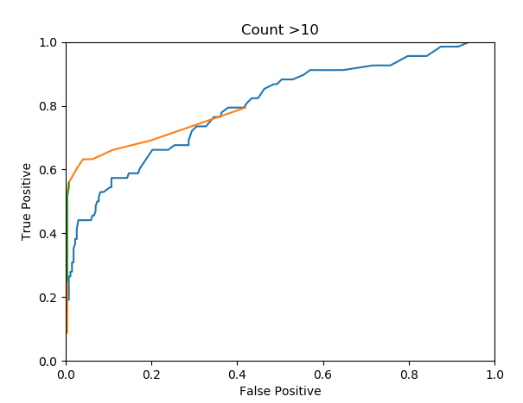
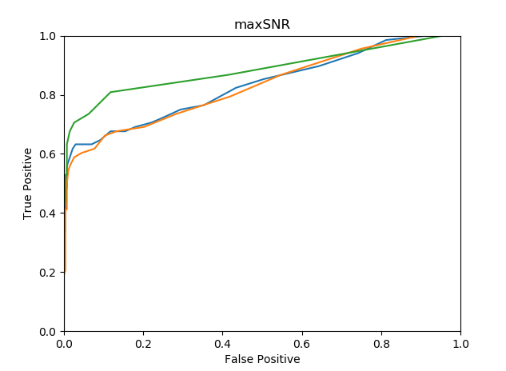
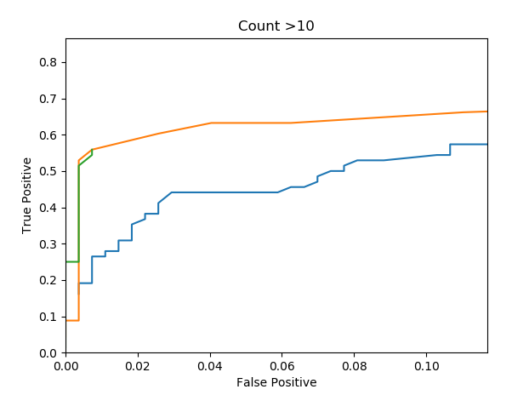
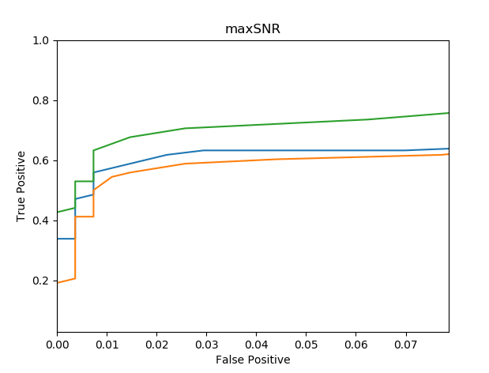
Palma Sola analysis: 20% of files from 1 day contain whistles
Blue: SNR= peak amplitude / average reference range
Orange: SNR = peak amplitude / max reference range
Green: SNR = 5 point moving average (peak/max ref)
Count bins SNR>10
Max SNR

