Slide 1
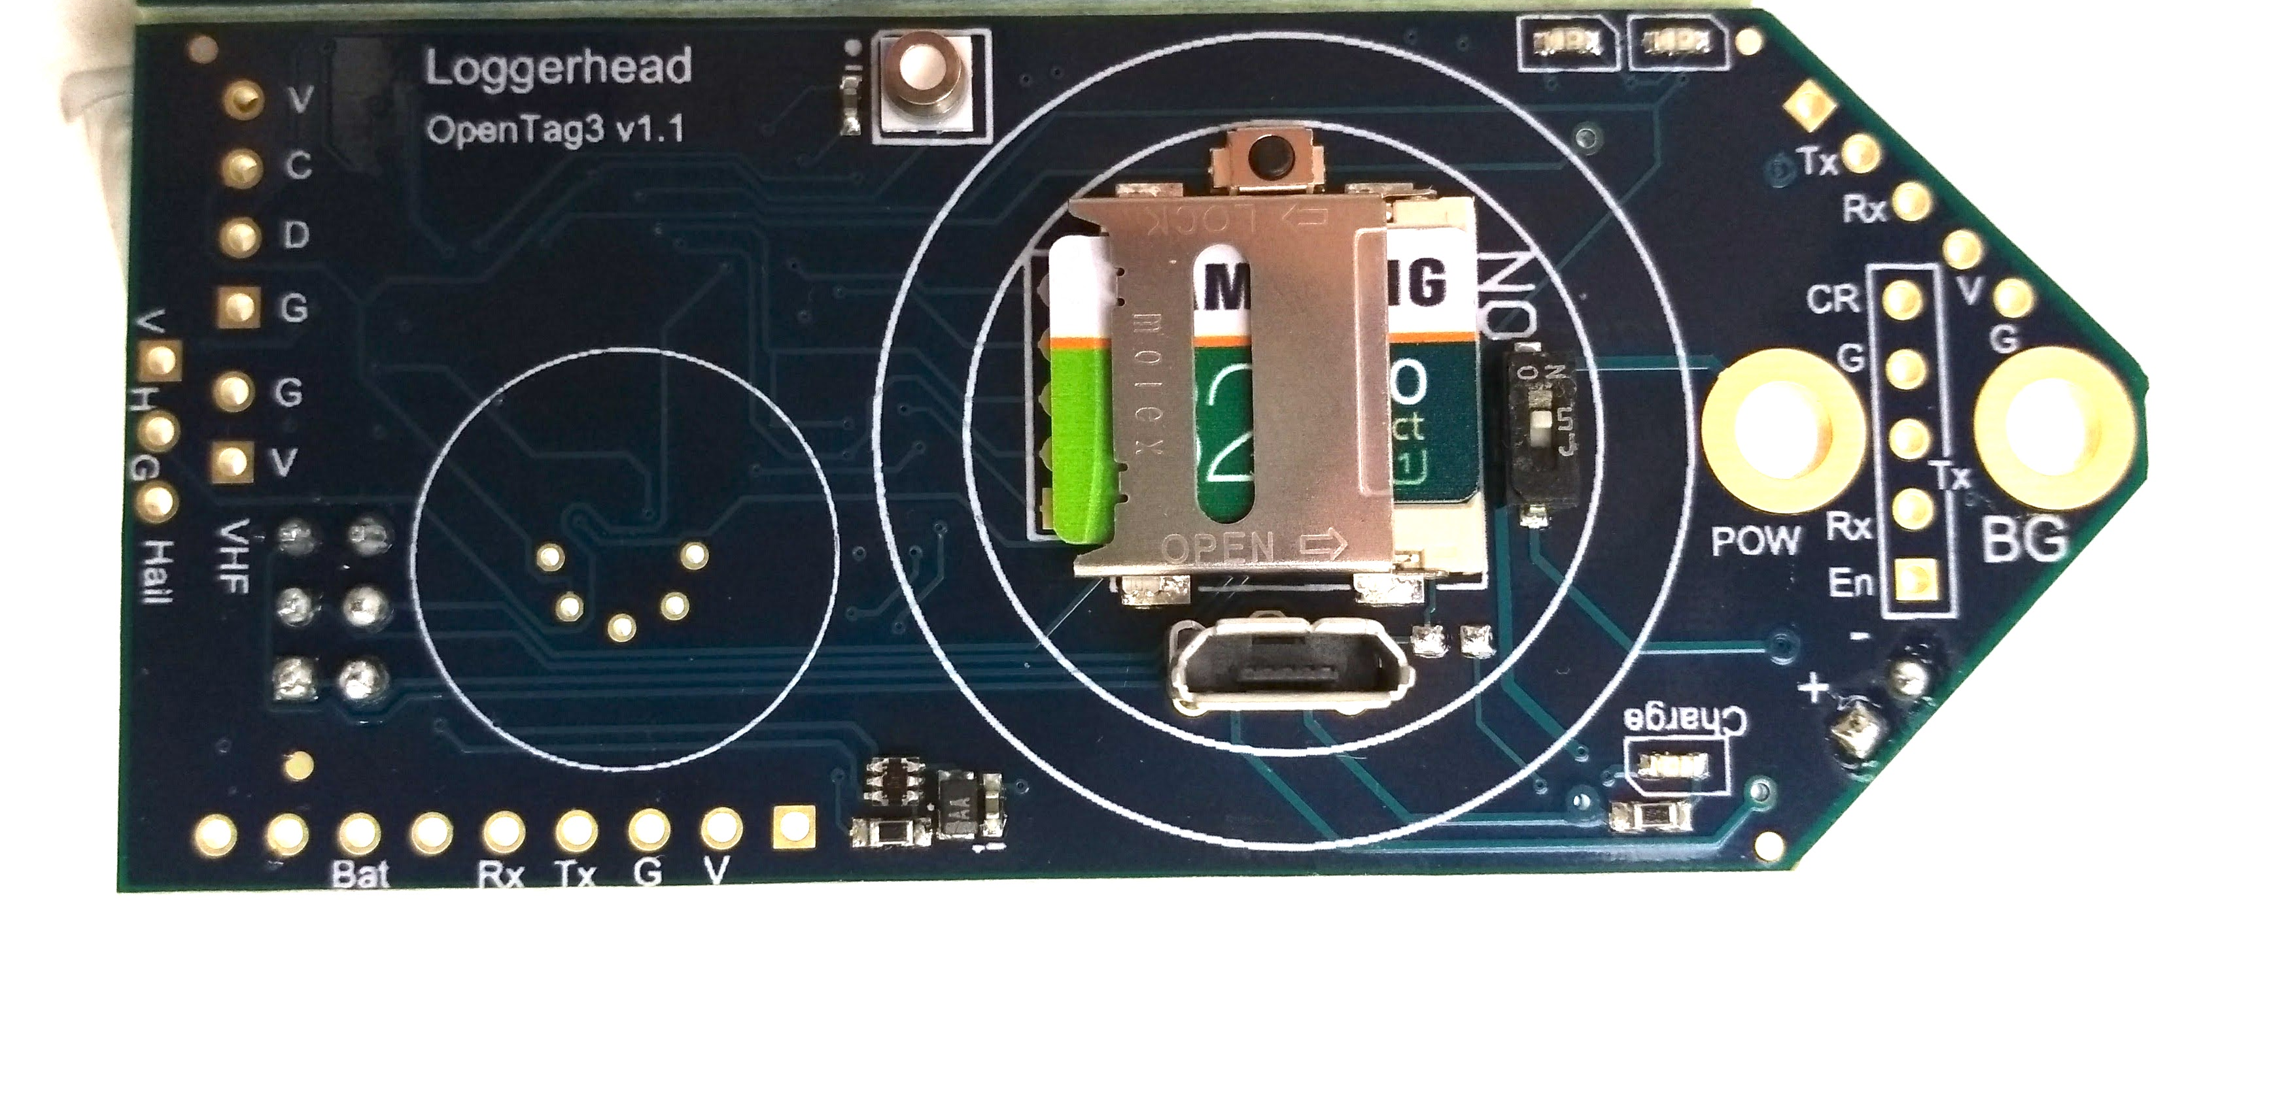
Pressure
Temperature
Status LEDs
Stop
On/Off
Burn Ground
+ Battery
Red when charging
Light
Sensor
microUSB charger
microSD

