Slide 1
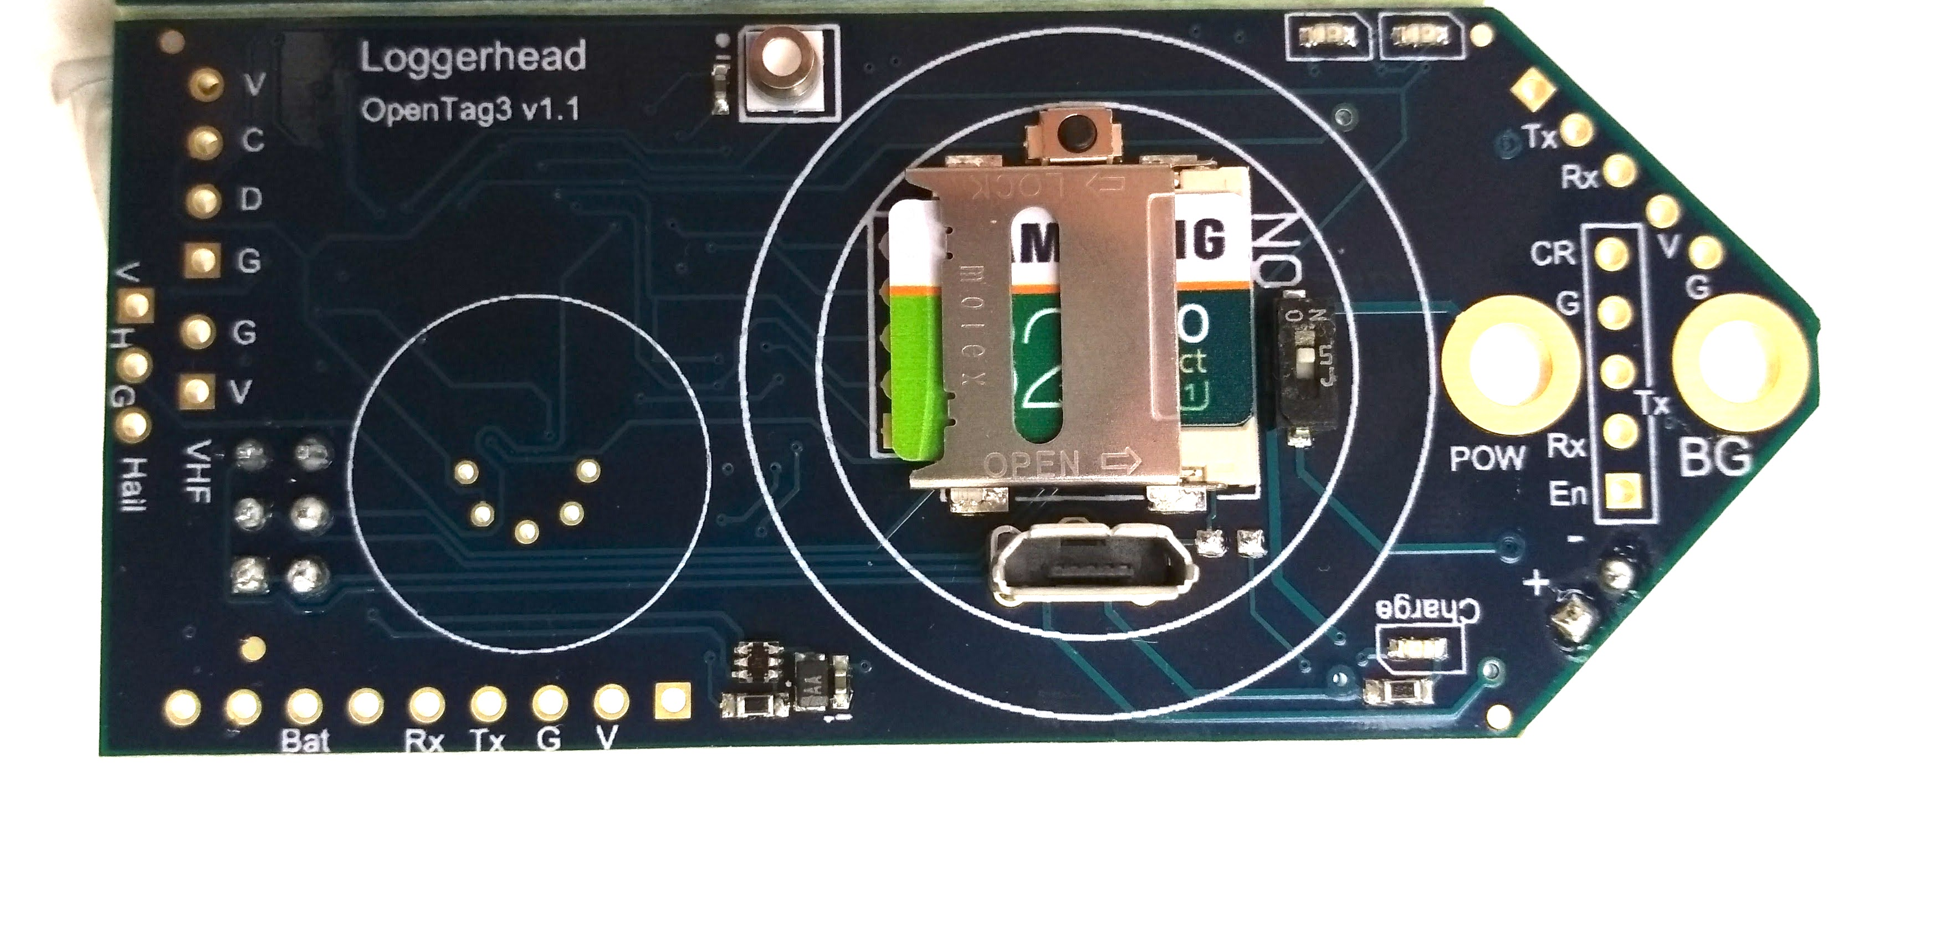
Pressure
Temperature
Status LEDs
Stop
On/Off
Z (down)
X
Burn Ground
Y
+ Battery
Red when charging
Light
Sensor
microUSB charger
microSD

