Slide 1
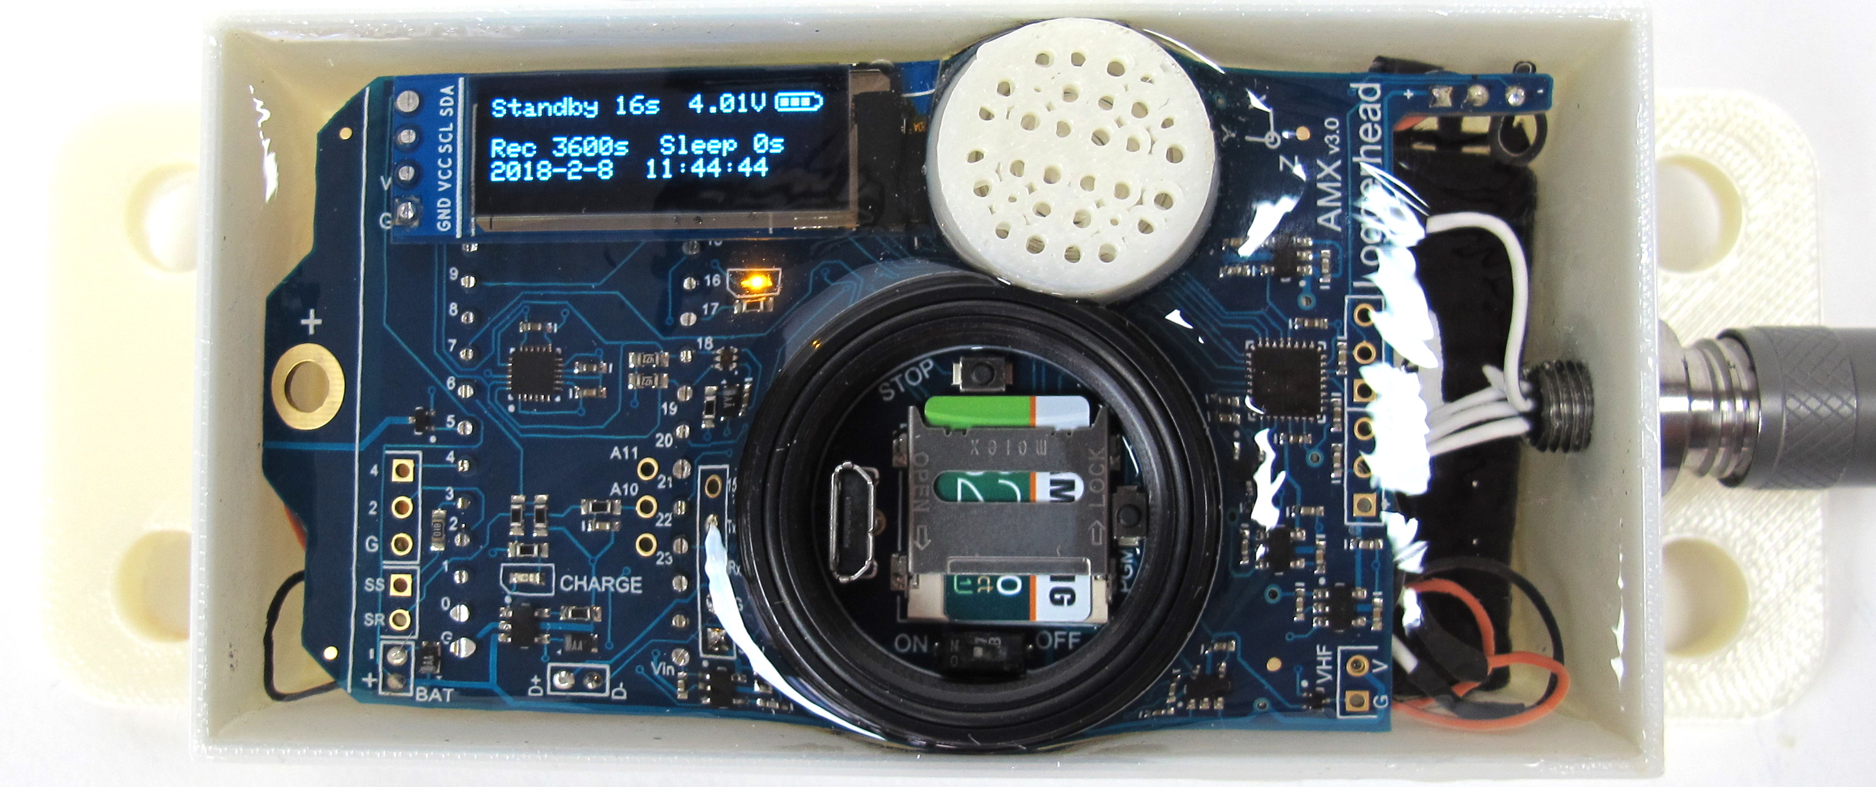
microUSB
Pressure/Temperature
Hydrophone
Tag orientation for heading calculation used by amxEuler.m
East
Light sensor
North
Motion sensor
Charge LED
(turns off when charged)
microUSB
On/Off Switch
microSD card
Slide and flip up to remove

