Slide 1
Updating Firmware
Download Teensy loader program from: https://www.pjrc.com/teensy/loader.html
Run Teensy Loader
File Menu: Open Hex
Choose amx.ino.hex (It may say file is too big...ignore)
Remove microSD card from AMX
Connect microUSB cable to the AMX board
Turn AMX power switch to on
Short the two pads to force reprogramming. This should cause the firmware to upload.

Slide 2
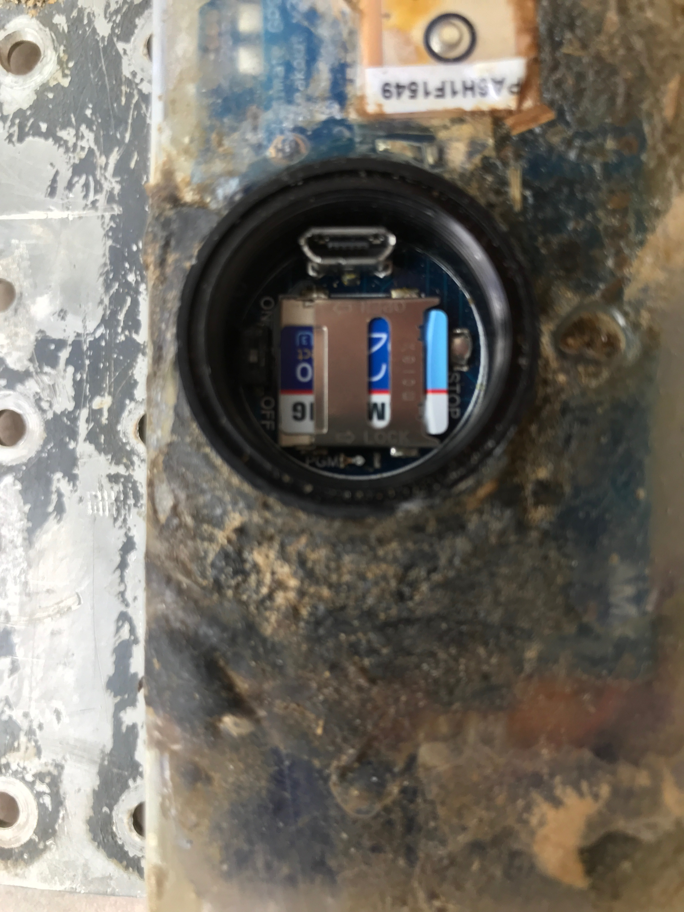
Connect these two pads with a wire to force reprogramming

