Slide 1

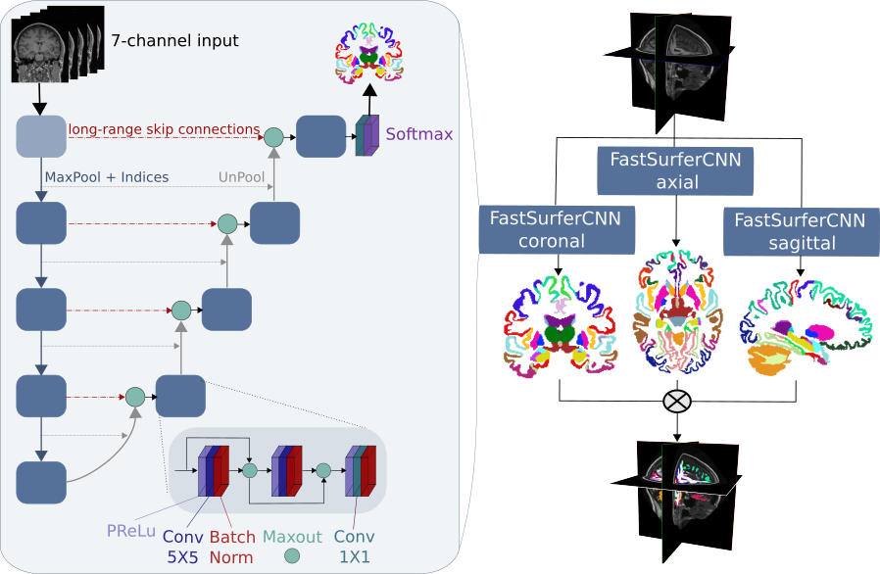
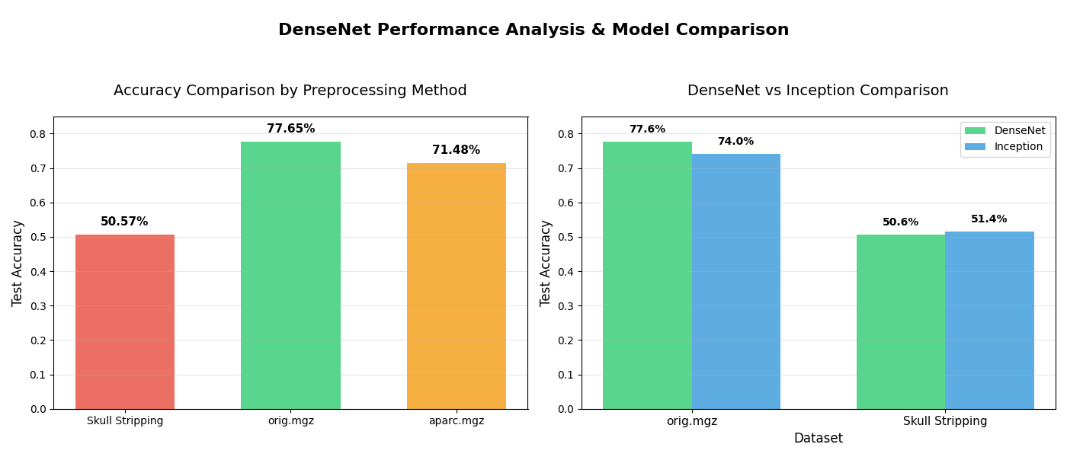
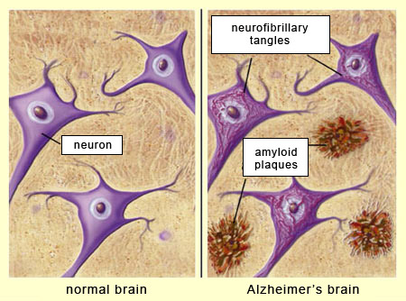
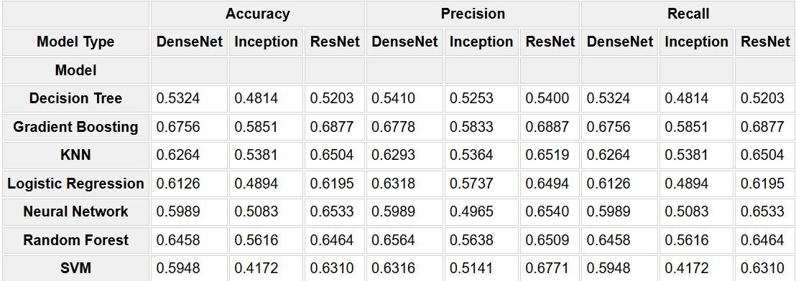
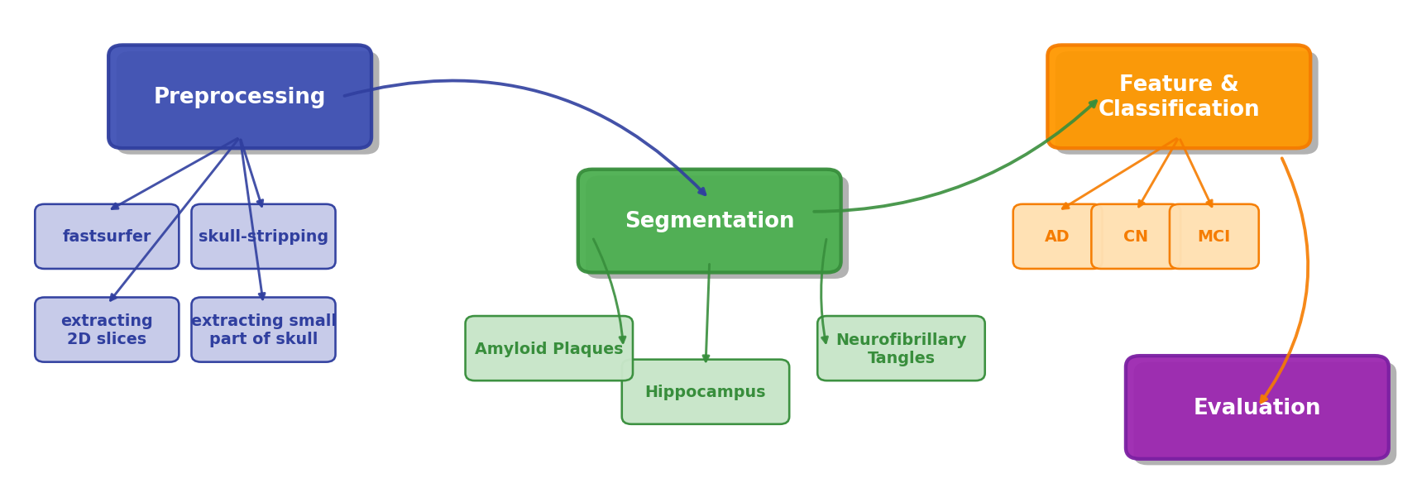
DEEP LEARNING-BASED MRI IMAGING ANALYSIS FOR ALZHEIMER’S DISEASE DETECTION
YILDIZ TECHNICAL UNIVERSITY
FACULTY OF ELECTRICAL AND ELECTRONICS
DEPARTMENT OF COMPUTER ENGINEERING
LOGHMAN ORUJOV, ŞEHMUS YAKUT, Lect. PhD Ahmet ELBİR
sehmus.yakut@std.yildiz.edu.tr, loghman.orujov@std.yildiz.edu.tr, aelbir@yildiz.edu.tr
Özet
Bu çalışma, Alzheimer hastalığının erken tanısını desteklemek amacıyla, T1‑ağırlıklı beyin MRI görüntülerinden oluşan ADNI veri setinin üç sınıfa ayrılmış verileri kullanılarak derin öğrenme temelli sınıflandırma modelleri geliştirilmesini kapsamaktadır. FastSurfer ve skull‑stripping ile yalnızca beyin dokusu izole edilerek gerçekleştirilen kapsamlı ön işleme sürecinin ardından, DenseNet, Inception3D ve ResNet3D gibi ileri üç boyutlu mimariler, sınırlı işlem gücü ve veri hacmi koşullarında eğitilmiştir. Elde edilen model performanslarının karşılaştırılması, veri ön işleme stratejileri ve model tasarımlarının başarısına dair önemli çıkarımlar sunmaktadır.
Abstract
This study covers the development of deep learning-based classification models using the three-class data of the ADNI dataset of T1-weighted brain MRI images to support the early diagnosis of Alzheimer's disease. After extensive preprocessing using FastSurfer and skull-stripping to isolate only brain tissue, advanced three-dimensional architectures such as DenseNet, Inception3D and ResNet3D were trained under limited processing power and data volume conditions. The comparison of the obtained model performances provides important insights into the success of data preprocessing strategies and model designs.
Figure 3. FastSurfer architecture
III. Experimental Results
I. Introduction
Alzheimer’s disease (AD) is a progressive neurodegenerative disorder responsible for 60–70 % of the 55 million global dementia cases, predominantly affecting individuals over 65 and exhibiting higher prevalence in women[1]. Early diagnosis is essential to mitigate cognitive decline and preserve patient quality of life, leveraging clinical assessments, biomarkers, and neuroimaging techniques alongside emerging artificial intelligence–based solutions[2]. In this study, we employ advanced preprocessing (FastSurfer segmentation and skull stripping) on T1‑weighted 3D MRI scans from the ADNI cohort, followed by deep learning–driven classification using convolutional neural networks, transfer learning, and ensemble strategies[3]. Our approach aims to enhance diagnostic accuracy and accessibility in resource‑constrained settings by integrating state‑of‑the‑art image analysis with robust machine learning methodologies.
Table 1. DenseNet and Inception performance analysis
Table 2. Models performance analysis on machine learning algorithms
Significance: DenseNet‑121 achieved 84.1 % precision and 71.5 % accuracy on preprocessed ADNI MRI data, demonstrating that careful segmentation and QC markedly improve early AD detection.
Practical Use: Models can be integrated into routine MRI workflows for rapid screening and deployed on modest hardware via feature‑extractor fine‑tuning.
Limitations: ADNI’s research cohort may not mirror all clinical populations, and single‑modality MRI excludes complementary PET/DTI biomarkers.
Future Directions: Fuse multimodal data, validate on external hospital datasets, automate quality control, and enhance model explainability for clinical adoption.
Figure 1. Healthy and Alzheimer human brain
II. System Design
Image Preprocessing Module: Enhances the quality of MR images by
applying noise removal, contrast enhancement, normalization, and skull
stripping.
Segmentation Module: Detects specific brain regions (e.g., the
hippocampus) related to AD.
Feature Extraction and Classification Module: Uses deep learning techniques
(both supervised and semi-supervised learning, as well as curriculum
learning) to extract features and classify the stages of the disease.
Performance Evaluation Module: Assesses the model’s performance using
metrics such as k-fold cross validation, ROC curves, and F1 scores.
Conclusion
The study leverages the ADNI cohort’s multimodal dataset—including T1‑weighted MRI, PET, DTI, and fluid biomarkers—from cognitively normal, MCI, and AD participants (ages 55–90) to train and evaluate deep learning classifiers. FastSurfer–based preprocessing (brain segmentation, morphometry, and rigorous quality control) ensured high‑quality inputs, after which DenseNet‑121 and ResNet‑50 architectures were fine‑tuned via feature‑extractor and gradual‑unfreezing strategies. Optimized hyperparameters yielded top performance with DenseNet achieving 84.1 % precision and 71.5 % accuracy, outperforming Inception models whose training instability highlighted the critical impact of data quality and training protocols. Comparative analysis underscores that robust preprocessing and architecture choice are pivotal for reliable Alzheimer’s classification in resource‑constrained settings.
References
[1] Mielke, M. M., Vemuri, P., & Rocca, W. A. (2014). Clinical epidemiology of Alzheimer’s disease: Assessing sex and gender differences. (2014). Clinical Epidemiology, 6(1), 37–48.
[2] Ben, M. A., Taoufik, Y., & Ben, R. A. (2020). MRI images analysis method for early stage Alzheimer’s disease detection. (2020). International Journal of Computer Science and Network Security, 20(2), 38–45.
[3] Basaia, S., Agosta, F., Wagner, L., Canu, E., Magnani, G., Santangelo, R., Filippi, M., & the Alzheimer’s Disease Neuroimaging Initiative. (2019). Automated classification of Alzheimer’s disease and mild cognitive impairment using a single MRI and deep neural networks. (2019). NeuroImage: Clinical, 21, 101645.
Figure 2. System design/architecture

