Slide 1
Whither NFS?
Brian Pawlowski
Chief Technical Officer
Network Appliance
beepy@netapp.com

Slide 2
“There is a fine line between humor and bad taste.”
Steve Kleiman, 1999

Slide 3
Whither NFS?
Whence?
Where?
Whither?

Slide 4
Whence

Slide 5
Distributed File System Evolution
Sun ND
‘80
‘90
‘00

Slide 6
NFS Version 1

Slide 7
NFS Version 2 (1983)
The 95% solution
  Not all UNIX semantics supported (write sharing)
“Stateless” design inherited from Sun’s ND simplified error recovery
  No one used locking – didn’t work anyway
Widely implemented
  Almost freely licensed

Slide 8
Distributed File System Evolution
SMB
Sun ND
stateless
NFS V2
RFS
AFS
‘80
‘90
‘00

Slide 9
NFS Version 3 (1992)
Finally forced by DEC
  64 bit ready
  Solved write bottleneck for large files
  Transfer sizes relaxed
“Stateless” design maintained
  No one used locking – didn’t work anyway
Widely implemented
  An easy step over NFS Version 2

Slide 10
Distributed File System Evolution
SMB
SMB ‘95
Sun ND
stateless
NFS V2
NFS V3
RFS
AFS
DCE DFS
‘80
‘90
‘00

Slide 11
Where

Slide 12


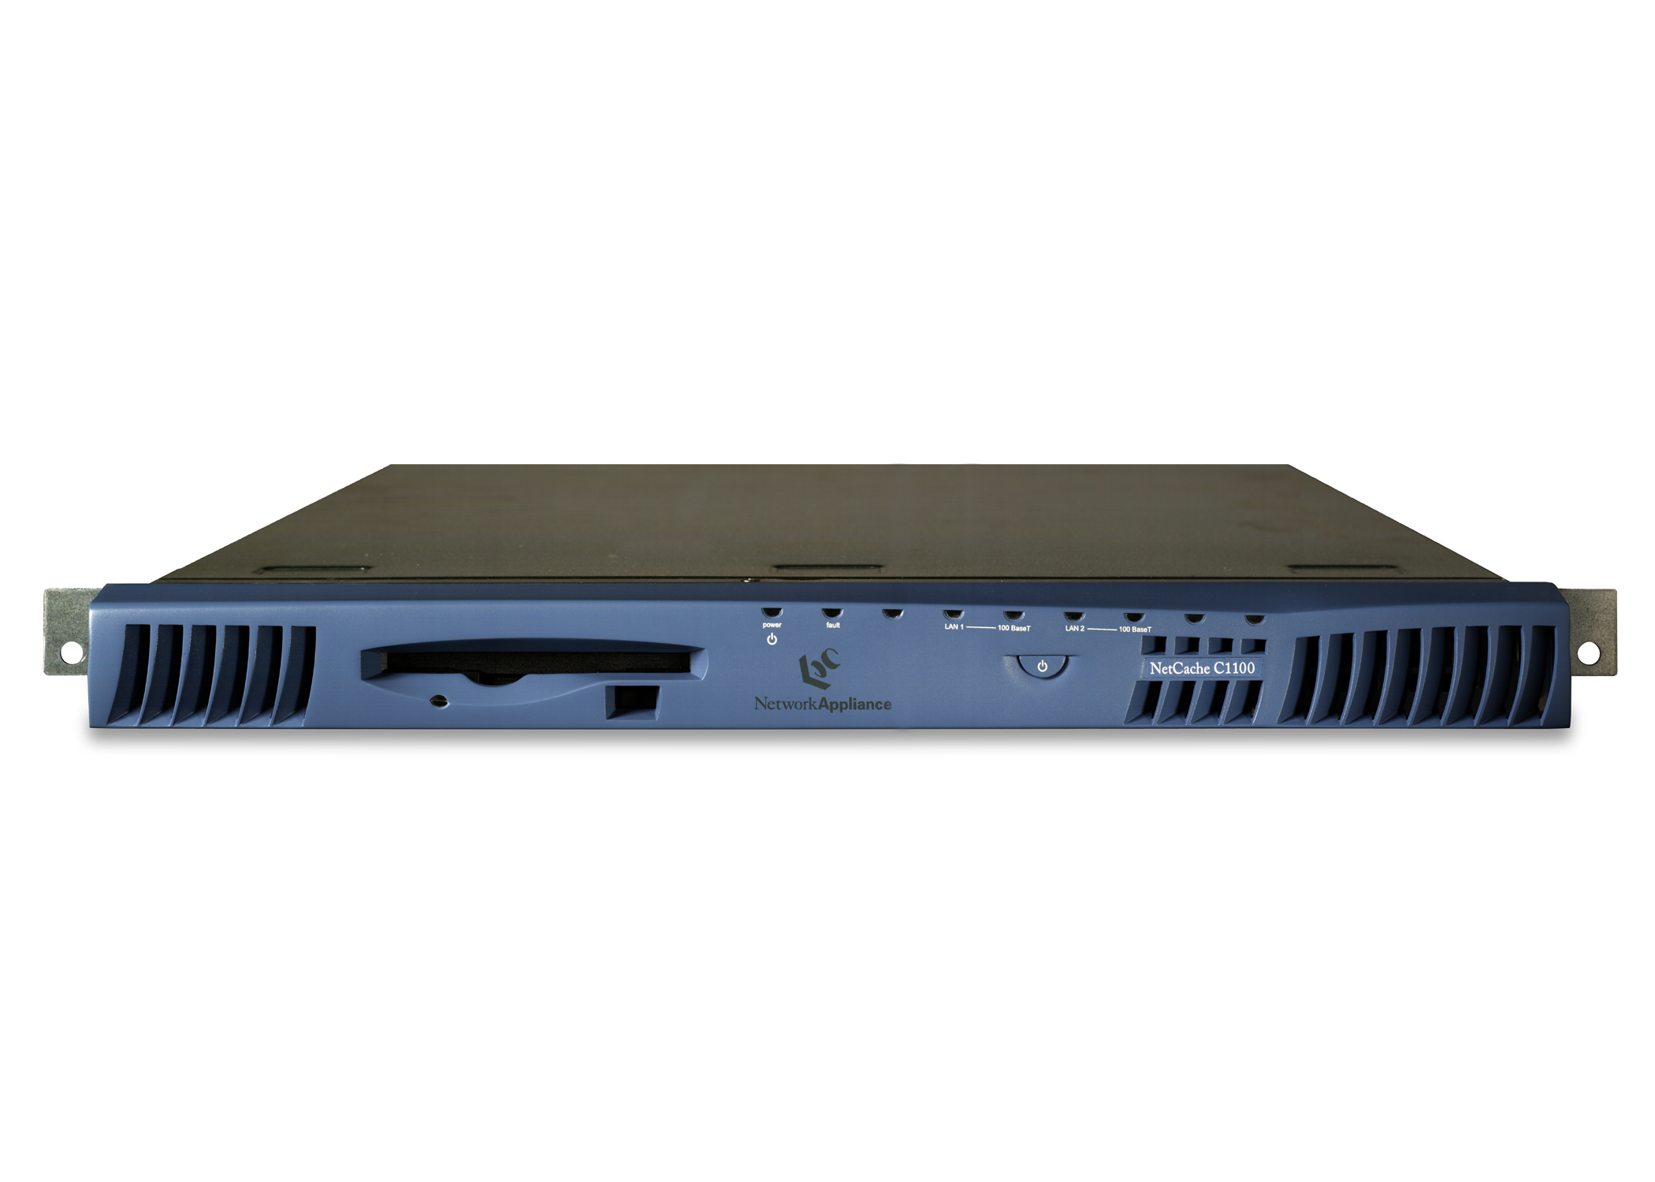
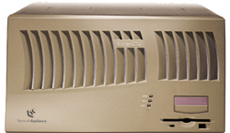



End-to-End Solution
Streaming Media
Remote
backup
Branch Office
Internet POP
Filer
Stream
Splitting
NetCache
NetCache
As experience is gained with a particular application, management by farms (collection of CPUs, storage and applications) where you add a farm for say 100,000 users can simplify planning.
End-to-End
Content Management
Internet
Intranet
Web site
acceleration
Web site
acceleration
Remote Mirroring

Slide 13
Regrets, I have a few
ACCESS procedure design in NFS Version 3
  Latency loss to fix edge condition uid mapping bug
Lack of common ACL protocol
  But would’ve required ACL definition – preventing NT ACL model acceptamce in V4?

Slide 14
Can’t see the forest…
# nfsstat –c
Client rpc:
Connection oriented:
. . .
Connectionless:
. . .
Client nfs:
. . .
Version 2: (56 calls)
. . .
Version 3: (119737271 calls)
. . .
Client nfs_acl:
Version 2: (1 calls)
. . .
Version 3: (4 calls)

Slide 15
Regrets, I have a few
Locking
  Does locking suck? Yeah, big time.
  As NFS enters more applications (database) this hurts more and more

Slide 16
Regrets, I have a few
Performance (more later)
  Windows sizes in TCP
  Transfer sizes – large sizes, aggressive read-ahead good for sequential
  Oddity that for database NFS Version 2 provides higher performance

Slide 17
Whither

Slide 18
The IETF process and NFS
1998
Sun/IETF Agreement
BOF, working group forms
Strawman Proposal from Sun
Meetings, writing, e-mail
1999
Prototyping by 5 organizations
Working Group Draft
Additional prototyping
Six working group drafts
Working Group Last Call
2000
IETF Last Call
IESG Review
Assign RFC number
Proposed Standard
Two independent implementations
2001
IETF review
Draft Standard
Internet Standard apotheosis

Slide 19
NFS Version 4 (1998)
Big of me, big of you, big of all of us
  But biggest of Sun – who gives NFS to IETF
“Stateless” – Ha!
  Locking, delegations, open state
More implementations in progress than for Versions 2 and 3
  A giant leap over NFS Version 2 and 3

Slide 20
NFS Version 4 (1998)
Sun Java and Solaris (both)
Hummingbird Communications (both)
UMich OpenBSD and Linux (both)
NetApp (server)
EMC (server)
OpenBSD by Rick Macklem (no bake-off participation yet)

Slide 21
NFS Version 4 (2000)
Achieved Proposed Standard status
  Yeah Spencer!
  Should have an RFC number betting pool
Open process
  Like this meeting

Slide 22
NFS Version 4
Stateful (OPEN/CLOSE)
Strong security required
  Kerberos, Public Key (via LIPKEY)
COMPOUND operation allows flexibility
Extensible file attribute model

Slide 23
NFS Version 4
Integrated file locking
Lease based recovery
Delegation for aggressive caching
Migration and Replication
UTF8 for names and protocol strings

Slide 24
Distributed File System Evolution
SMB
SMB ‘95
SMB NT/CIFS
Sun ND
CIFS
stateless
OpLocks,ACLs, Compound
NFS V2
You are
here!
NFS V3
X
NFS V4
RFS
Replication/
migration
DAFS
AFS
DCE DFS
‘80
‘90
‘00

Slide 25
The horror,the horror
As I see more apps creak under CIFS statefulness…
  My concern for V4 goes up
NFS Versions 2 and 3 had a certain naïve robustness
  A client will retry a request until the sun grows cold

Slide 26
The horror,the horror
Like ACCESS (?) – be careful what you ask for…
  I wonder how leases will look in the cold light of morning…
  COMPOUND solves my ACCESS problem – one point to Version 4
Performance issues remain
  And COMPOUND and complexity add more

Slide 27
Significant to dos
Implementations
Implementation RFC
IETF review of Proposed Standard
Migration/replication strawman

Slide 28
My position
The NFS Version 4 specification should change
  If it cannot support current applications of NFS
But functionality additions are cut off

Slide 29
Recommendations
An NFS 2 and 3 compatibility mode
  Long leases, retry connections and session reestablishment forever
Study interaction of transfer sizes and various workloads
  Before shipping NFS Version 4

Slide 30
Recommendations
Define utilities in separate note
  Locking statistics, command to kill session, graceful termination of NFS Version 4 sessions
  No more invisible lock function

Slide 31
Recommendations
NT ACL compatibility
  Implementation note defining how compatible
Migration/Replication
  Work on server-server protocol now
  Avoid a replay of the UNIX ACL protocol debacle

Slide 32
Recommendations
Review specification with eye towards cluster failover readiness
  I think we’re okay – but verify session semantics and lock ordering and recovery

Slide 33
?
?
?
?
?
?
?
?
?
?
?
?

Slide 34



