Slide 1
Impact of NAS and SAN on Distributed File Systems
Steve Widen
Research Director, Storage Software
IDC
swiden@idc.com

Slide 2
Agenda
What is a Distributed File System?
What is NFS?
Distributed files systems revenues and forecast
Storage software trends
NAS Vs. SAN and distributed file systems
Customer drivers

Slide 3
What is a Distributed File System (DFS)?
“DFS software allows systems or nodes to appear to access a common file system even though the actual storage devices may be located on another system or node.”
IDC, 2000

Slide 4
Examples of Distributed File Systems
Sun (NFS)
Common Internet File System (CIFS)
Novell (NetWare File System)
Transarc (AFS and DFS)

Slide 5
What is NFS?
Created by Sun Microsystems in 1987 as an open standard distributed file system
Open specification adopted by most workstation/PC vendors
Allows workstations to share a file system that exists on a central server

Slide 6
1999 DFS Revenue by Operating Environment
Source: IDC, 2000

Slide 7
1999 DFS Revenue by Region
Source: IDC, 2000

Slide 8
DFS Revenue Forecast
($M)
1999
2000
2001
2002
2003
2004
Source: IDC, 2000

Slide 9
Storage Software Trends
SAN acceptance continues
Competing SAN management frameworks
  CA and SAN Integrated Technology Initiative (SANITI)
  Sun and Federated Management Architecture Specification (FMA) = Jiro from Sun
  VERITAS V3 SAN Initiative = SANPoint

Slide 10
Storage Software Trends
Virtualization, data sharing and file systems
Growth of xSP Market

Slide 11
Storage Software Trends
Four SAN Management Models
  Server centric (Sun)
  Storage centric (EMC)
  SAN appliances (Compaq)
  SAN switches and routers

Slide 12
Storage Software Trends
SAN Vs. NAS
  Are they mutually exclusive?
  Does a SAN need to be FC?
  Storage over IP

Slide 13
NAS Vs. SAN and DFS

Slide 14
NAS Vs. SAN
SAN is a network while a NAS is typically file server or intelligent file-aware device
SAN implies dedicated network as I/O channel between storage and servers

Slide 15
NAS Vs. SAN
SAN can include block (SCSI) and file-oriented (NAS) storage
NAS products can connect to storage devices over a SAN

Slide 16
NAS Topology
Ethernet
Operating
System
Integrated storage
Clients
NAS server

Slide 17
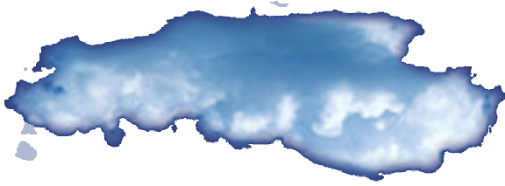
FC SAN Topology
FCP
FCP
Storage
network
Server
FCP
FC channel storage subsystems

Slide 18
IP SAN Topology
IP
IP
Storage
network
(NFS or
CIFS)
Server
IP
NAS servers
(NFS or
CIFS)
IP
(NFS or
CIFS)

Slide 19
NAS and SAN Topology
IP
NAS server
Ethernet
network
Storage
network
TCP/IP
Server
IP or
Serial
SCSI
Serial
SCSI
Storage
device
Clients

Slide 20
Customer Drivers
Storage management solutions need to revolve around the application
Requirement of a full solution, no longer accept point products in most cases
Storage software solutions need to be based on standards

Slide 21
Customer Drivers
Need to solve the availability of data issue which is critical to running the business
Need to access different data types from different operating environments
Lack of trained IT staff, ex PC Helpdesk and FC SAN expertise

Slide 22
Questions

Slide 23



