Slide 1


OPERATING SYSTEMS & SYSTEMS PROGRAMMING (25CS2104E)
2026–27, Term-I | KLH Bachupally, Hyderabad
PROJECT TEAM MEMBERS
G. Jothi Ganesh
Roll No: 2520030252
Process Monitoring & /proc Telemetry
Linux Service and
Process Supervisor
A Lightweight Multithreaded C Supervision Engine & Real-Time Web Console for Automated Process Lifecycle Control, Signal Dispatch, POSIX IPC & /proc Telemetry
V. Nitish Chowdhary
Roll No: 2520030179
Signals, Control & Auto-Restart Engine
P. Santhosh
Roll No: 2520030330
Web UI, Event Logging & Testing
Section: S9 | Team No.: 22 | Course Outcomes Covered: CO-1 to CO-6
Faculty Guide: Dr. Y. Harika Devi
GitHub Repository
KLH_CSE_Y25_SEC9_22

Slide 2
SECTION 01 • OVERVIEW
Abstract & Executive Summary
Project Abstract
Motivation: In multitasking Linux environments, critical background services and daemons execute concurrently. Manual CLI monitoring (ps, top, kill) is error-prone and leads to silent service downtime, zombie processes, or uncontrolled memory consumption.
Proposed Solution: Linux Service and Process Supervisor is a lightweight C systems programming platform paired with a real-time Web Console that centralizes process creation, monitoring, signal dispatch, IPC, and automated fault recovery.
Core Linux / POSIX Mechanisms: Built in modular GNU C11 using fork(), execvp(), getpid()/setpgid(), waitpid(WNOHANG), sigaction()/kill(), anonymous pipes, named FIFOs (/tmp/supervisor_fifo), POSIX shared memory (shm_open/mmap), 4-worker pthread pools, and /proc VFS inspection.
Practical Benefit: Automatically detects unexpected process termination (SIGKILL/SIGSEGV) within 200 ms and restarts failed services according to policy while streaming live telemetry to both CLI and browser interfaces.
64 Services — Concurrent Managed Processes
Configured declaratively via services.conf with priority & command specs
< 200 ms — Crash Detection & Auto-Restart
Dedicated watchdog thread using waitpid(WNOHANG) & SIGCHLD handler
12 C Modules — Modular POSIX Engine (~2,100 LOC)
Integrated with C HTTP socket (:8080) & React/Node WebSocket UI (:3000)
CO-1 → CO-6 — Full OSSP Syllabus Alignment
Covers Processes, Scheduling, IPC, Memory, /proc VFS & Pthread Sync
Linux Service & Process Supervisor | OSSP (25CS2104E) | Team 22, Section S9 | Guide: Dr. Y. Harika Devi | KLH Bachupally
2 / 13

Slide 3
SECTION 02 • PROBLEM DEFINITION
Problem Statement, Objectives & Scope
Problem Statement
In a multitasking Linux OS, multiple background services run simultaneously and can terminate unexpectedly, hang, leak memory/FDs, or fail to restart after a crash. Without centralized automated supervision, maintaining high service availability and clean process reaping is difficult.
Objective 1: Process Creation
Spawn & execute managed daemons cleanly using fork(), execvp(), and process group isolation setpgid().
Objective 2: PID & /proc Tracking
Identify & monitor live process state, VmSize, VmRSS, threads, and FDs via getpid() and /proc/[pid] VFS.
Objective 3: Lifecycle Control
Provide Start, Stop, Restart, Pause, Resume, & Kill operations via SIGTERM, SIGSTOP, SIGCONT, and SIGKILL.
Objective 4: Crash Auto-Restart
Detect unexpected exits asynchronously via SIGCHLD + waitpid(WNOHANG) and auto-respawn failed services.
Objective 5: Multi-Channel IPC
Capture child stdout via pipe()/dup2(), accept external commands on /tmp/supervisor_fifo, & sync /supervisor_shm.
Objective 6: Unified Interfaces
Deliver both a 40-option interactive C CLI and a real-time Web Console (C HTTP :8080 & React/Node :3000).
Project Scope & Boundaries: Targets single-host Linux / Ubuntu & WSL2 user-space service supervision (up to 64 concurrent processes, Priority/RR/FCFS scheduling, 4-worker pthread pool); excludes kernel-space module patching or multi-host cluster orchestration.
Linux Service & Process Supervisor | OSSP (25CS2104E) | Team 22, Section S9 | Guide: Dr. Y. Harika Devi | KLH Bachupally
3 / 13

Slide 4
SECTION 03 • COMPARATIVE ANALYSIS
Existing Approach vs Proposed Supervisor
Aspect | Basic / Existing Approach | Proposed Linux Service & Process Supervisor
Process Handling | Manual execution & CLI lookup (ps, pgrep, top, kill) requiring constant operator presence. | Automated C engine (fork() + execvp()) managing 64 configured services (services.conf) with 8-state FSM.
Inter-Process Comm. | Isolated background processes with no unified output capture or external control channel. | Anonymous pipe() stdout capture, /tmp/supervisor_fifo named pipe commands, & POSIX shm_open() dashboard.
Resource Monitoring | Ad-hoc manual inspection; high risk of zombie processes and unclosed file descriptors. | 4-worker pthread pool + rwlock continuously parses /proc/[pid]/status, maps, & fd (VmRSS, page faults).
Failure & Error Handling | Crashed services stay offline silently until manually noticed and restarted by a human. | 200ms watchdog + SIGCHLD + waitpid(WNOHANG) distinguishes intentional stops vs crashes & auto-restarts.
Control Interface | Disconnected terminal-only commands with no visual telemetry or structured audit trail. | 40-command C CLI + Built-in C Socket Web Console (:8080) + React/Express WebSocket Dashboard (:3000).
Linux Service & Process Supervisor | OSSP (25CS2104E) | Team 22, Section S9 | Guide: Dr. Y. Harika Devi | KLH Bachupally
4 / 13

Slide 5
SECTION 04 • STACK & ENVIRONMENT
Tools, Platforms & Technologies Used
1. Systems Programming Core
Language: GNU C11 (12 modular .c & .h files)
Compiler: GCC (-Wall -Wextra -g -lpthread -lrt)
Build Automation: GNU Make (Makefile build/run/clean)
Debugging: GDB & structured supervisor.log
2. Linux OS & Kernel Interfaces
OS Platform: Ubuntu Linux 22.04 LTS / WSL2
Virtual FS: Linux /proc/[pid]/{status, maps, fd, stat}
POSIX Libraries: unistd.h, signal.h, sys/wait.h, sys/mman.h
Concurrency: POSIX pthreads, mutex, rwlock, semaphores
3. Web Console & API Gateway
Native C Server: POSIX TCP Socket HTTP server (:8080)
Node.js API: Express.js REST + express-ws (:5000)
React Frontend: React 18 + Tailwind CSS 3 (:3000)
Live Streaming: 200ms atomic JSON & WebSocket push
4. Configuration & DevOps
Service Config: Declarative data/services.conf
IPC Endpoints: /tmp/supervisor_fifo & /supervisor_shm
Version Control: Git & GitHub structured repository
IDE & Shell: VS Code & Bash test scripts
Linux Service & Process Supervisor | OSSP (25CS2104E) | Team 22, Section S9 | Guide: Dr. Y. Harika Devi | KLH Bachupally
5 / 13

Slide 6
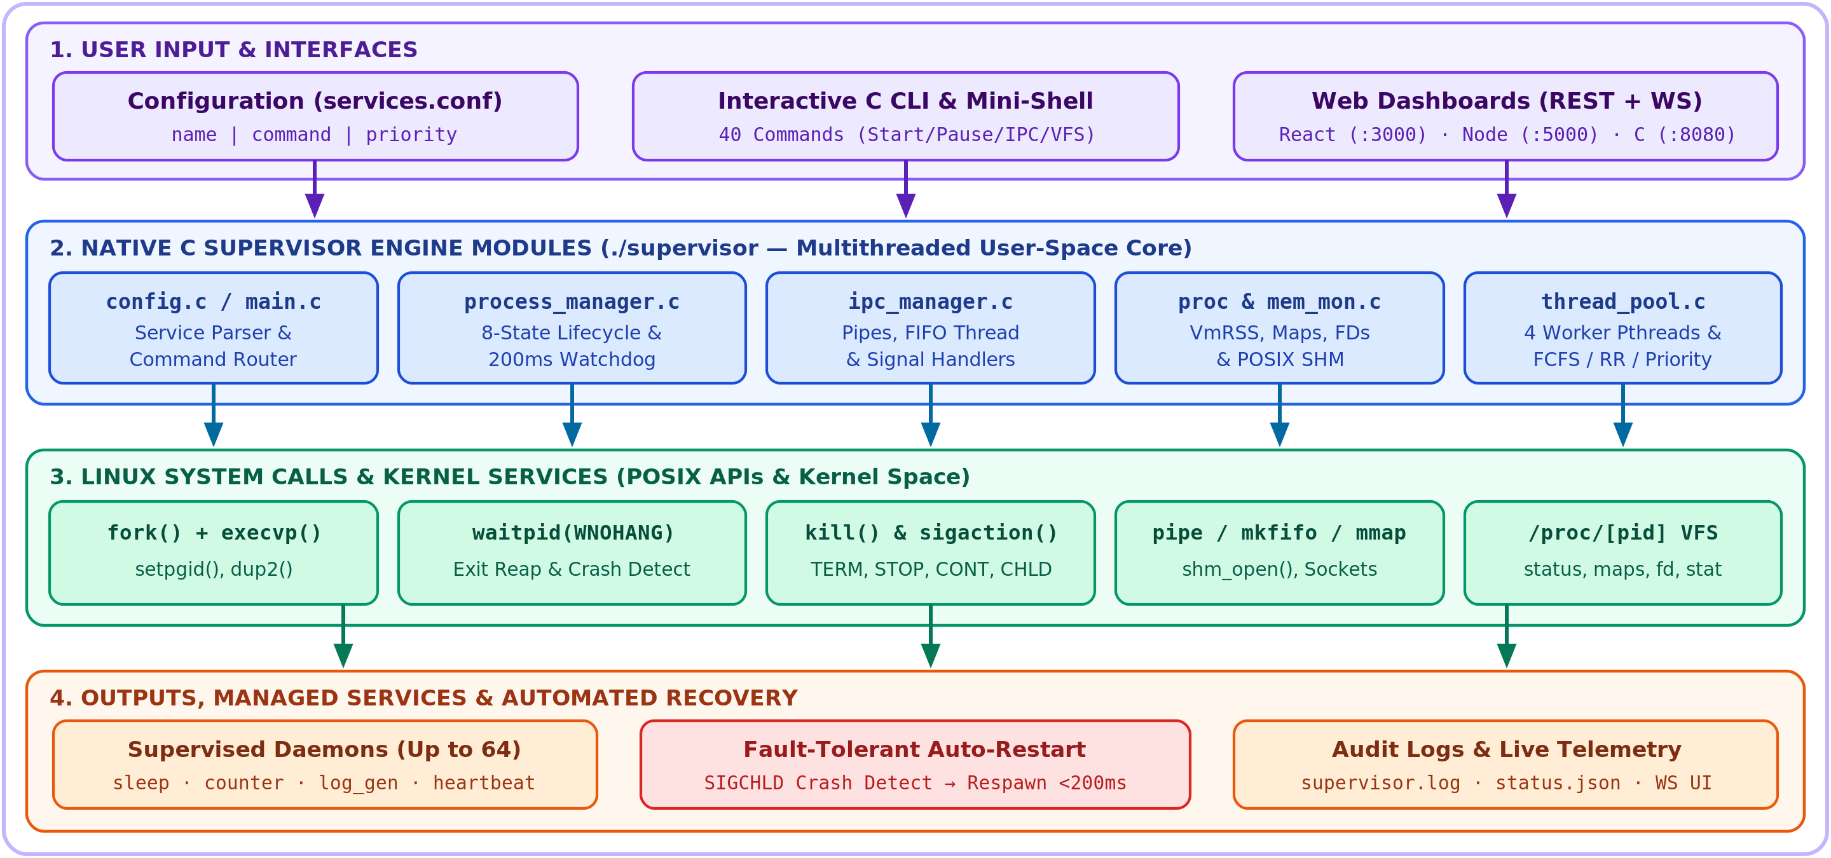
SECTION 05 • SYSTEM DESIGN
System Workflow & 4-Tier Architecture
End-to-End Supervision Architecture (Input → C Engine → Kernel Syscalls → Recovery)
9-Step Execution Pipeline
1. Load Config: Parse services.conf (name, cmd, priority).
2. Init Subsystems: Setup SIGCHLD, /tmp/supervisor_fifo, /supervisor_shm, & 4-worker pthread pool.
3. Spawn Service: fork() child, bind pipe_fd[2] via dup2(), & execvp().
4. Watchdog Loop: Poll waitpid(WNOHANG) every 200 ms.
5. /proc Telemetry: Worker threads update VmRSS, maps & FDs.
6. Signal Control: Dispatch SIGSTOP, SIGCONT, SIGTERM, SIGKILL.
7. Crash Detection: Identify abnormal exit when intentional_stop == 0.
8. Auto-Restart: Transition FAILED → RESTARTING → RUNNING.
9. Audit & Stream: Log to supervisor.log & push JSON/WebSocket.
Key Takeaway: Clean user-to-kernel separation—user interfaces invoke C modules, which execute POSIX syscalls and stream telemetry back in real time.
Linux Service & Process Supervisor | OSSP (25CS2104E) | Team 22, Section S9 | Guide: Dr. Y. Harika Devi | KLH Bachupally
6 / 13

Slide 7
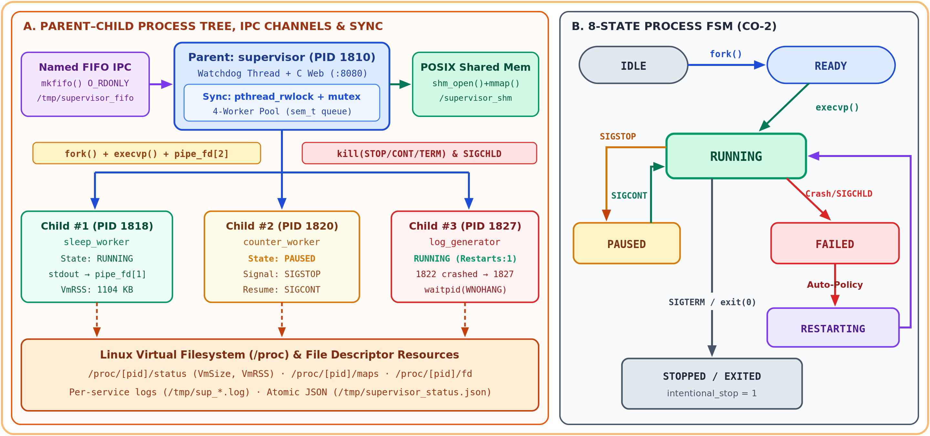
SECTION 06 • PROCESS & IPC ENGINEERING
Process Tree, IPC Channels & 8-State Lifecycle FSM
Parent–Child Hierarchy, POSIX IPC Endpoints & ProcessState FSM
Key Design Mechanisms
ManagedProcess Struct: User-space PCB tracking pid, pgid, state, priority, restart_count, VmRSS, page faults, & pipe_fd[2].
Anonymous Pipes: Each child's stdout/stderr redirects via dup2() into non-blocking O_NONBLOCK pipe_fd[0].
Named FIFO IPC: Dedicated listener thread reads external control commands on /tmp/supervisor_fifo.
POSIX Shared Memory: shm_open('/supervisor_shm') + mmap() exposes zero-copy live counters across processes.
Thread Synchronization: pthread_rwlock_t protects process table reads; mutex + sem_t coordinates 4 worker threads.
Crash vs Stop Logic: intentional_stop flag prevents unwanted restarts on user-requested SIGTERM stops.
Key Takeaway: Combines 4 IPC mechanisms (anonymous pipes, named FIFO, POSIX shared memory, & signals) with an 8-state fault-tolerant FSM.
Linux Service & Process Supervisor | OSSP (25CS2104E) | Team 22, Section S9 | Guide: Dr. Y. Harika Devi | KLH Bachupally
7 / 13

Slide 8
SECTION 07 • KERNEL APIS & SYLLABUS MAPPING
OS Concepts, Linux System Calls & CO-1 to CO-6 Mapping
Course Outcome | OS Concept | Linux System Calls / APIs | Role in Supervisor Project
CO-1 | OS Architecture & Build | GCC, Make, getpid(), getpgrp(), syscall ABI | Modular compilation, supervisor bootstrap, & mini-shell architecture demos.
CO-2 | Process & CPU Scheduling | fork(), execvp(), waitpid(WNOHANG), setpgid() | Child service spawning, 8-state FSM, zombie-free reaping, & FCFS/RR/Priority queues.
CO-3 | Signals & IPC | sigaction(), kill(), pipe(), dup2(), mkfifo() | SIGSTOP/SIGCONT/SIGTERM/SIGCHLD control, stdout capture, & FIFO command listener.
CO-4 | Memory Management | shm_open(), ftruncate(), mmap(), /proc/maps | POSIX shared-memory dashboard, VmSize/VmRSS tracking, CoW & page-fault demos.
CO-5 | Virtual Filesystem & I/O | open(), read(), stat(), opendir(), /proc/[pid]/fd | Kernel VFS process inspection, inode metadata, FD table audit, & atomic JSON logs.
CO-6 | Concurrency & Sync | pthread_create(), mutex, rwlock, sem_wait() | 4-worker telemetry thread pool, watchdog concurrency, & race/deadlock avoidance.
Linux Service & Process Supervisor | OSSP (25CS2104E) | Team 22, Section S9 | Guide: Dr. Y. Harika Devi | KLH Bachupally
8 / 13

Slide 9
SECTION 08 • CODEBASE STRUCTURE
Modular C Engine & Full-Stack Repository Layout
12 Native C Engine Modules (src/)
src/main.c & config.c: 40-option interactive CLI loop, subsystem bootstrap, & services.conf parser.
src/process_manager.c: 500-LOC core managing fork()/execvp(), signal actions, 200ms watchdog, & JSON export.
src/ipc_manager.c: SIGCHLD/SIGINT sigaction handlers, non-blocking pipes, cmd1|cmd2 chain, & FIFO server.
src/proc_monitor.c & memory_monitor.c: /proc/[pid]/status & maps parsers, shm_open() dashboard, CoW & page-fault demos.
src/filesystem_monitor.c: Open FD inspection (/proc/[pid]/fd), stat() inode info, & mmap vs buffered I/O.
src/thread_pool.c & scheduler.c: 4-worker POSIX pthread pool (sem_t queue) + FCFS, Round-Robin & Priority ready queues.
Sample data/services.conf
# name | command | priority
sleep_worker|sleep 300|5
counter_worker|while true; do echo tick; sleep 5; done|6
log_generator|while true; do date >> /tmp/log; sleep 3; done|4
cpu_monitor|while true; do uptime; sleep 10; done|7
heartbeat|while true; do echo heartbeat; sleep 2; done|8
Dual Web Supervision Stack
src/web_server.c (:8080): Zero-dependency multithreaded C TCP socket server serving /api/status & HTML UI.
src/backend/ (:5000): Node.js + Express REST controllers & live WebSocket telemetry broadcaster.
src/frontend/ (:3000): React 18 + Tailwind CSS dashboard for Services, Processes, & Live Logs.
Linux Service & Process Supervisor | OSSP (25CS2104E) | Team 22, Section S9 | Guide: Dr. Y. Harika Devi | KLH Bachupally
9 / 13

Slide 10
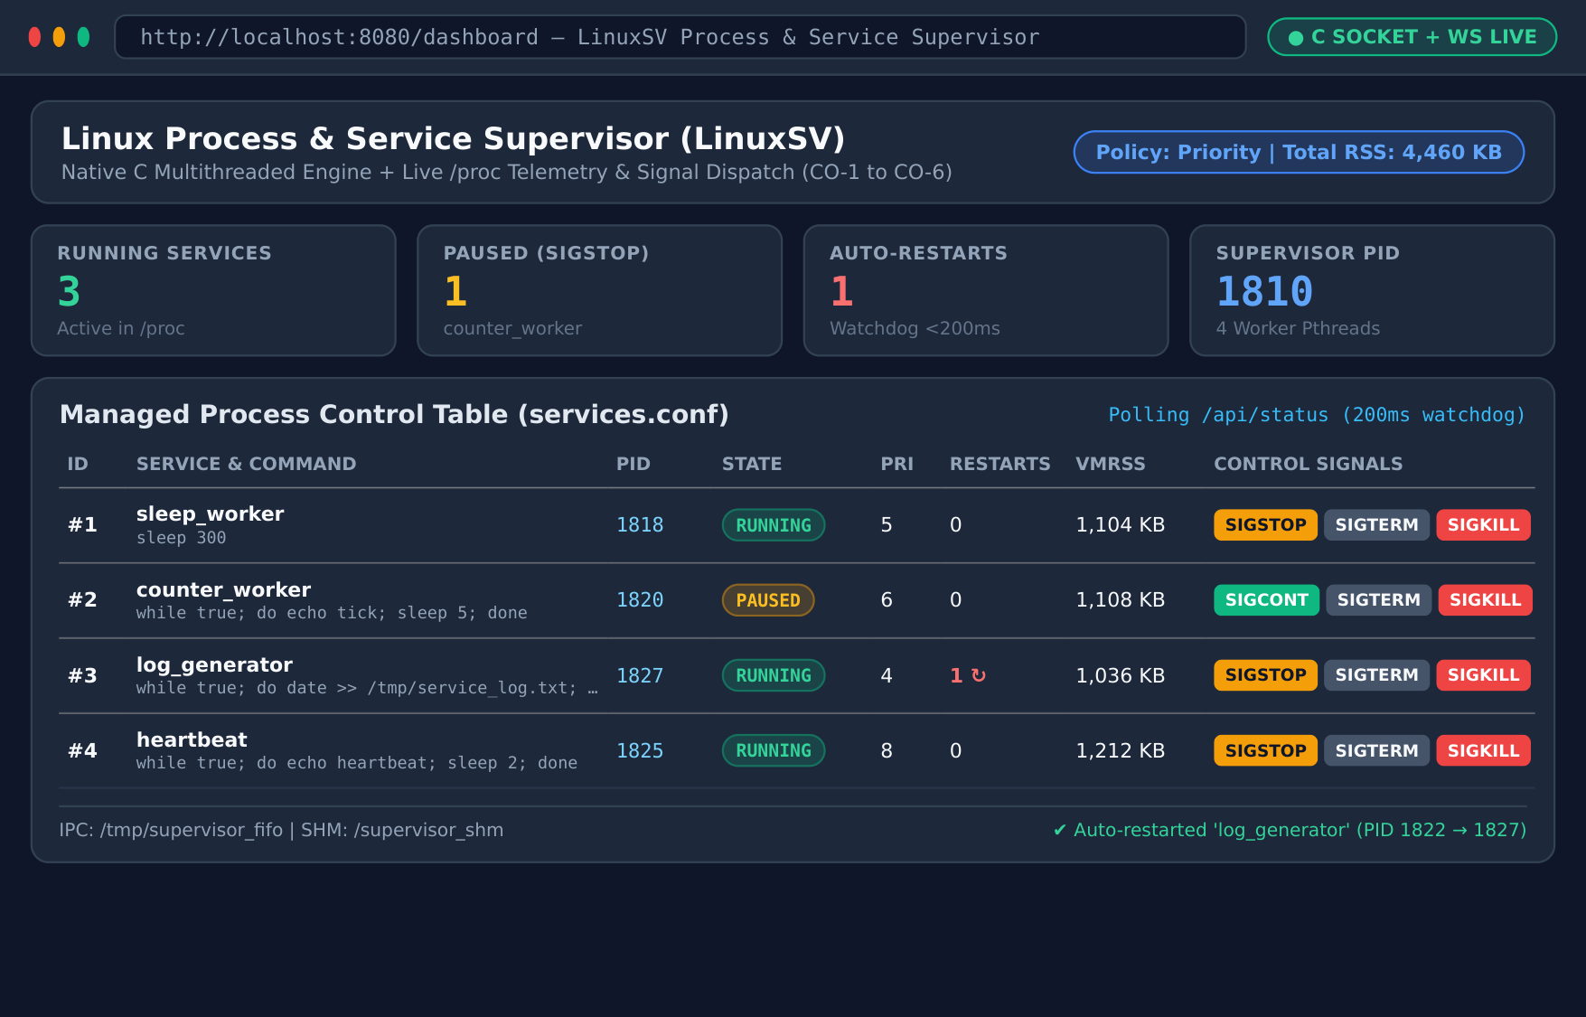
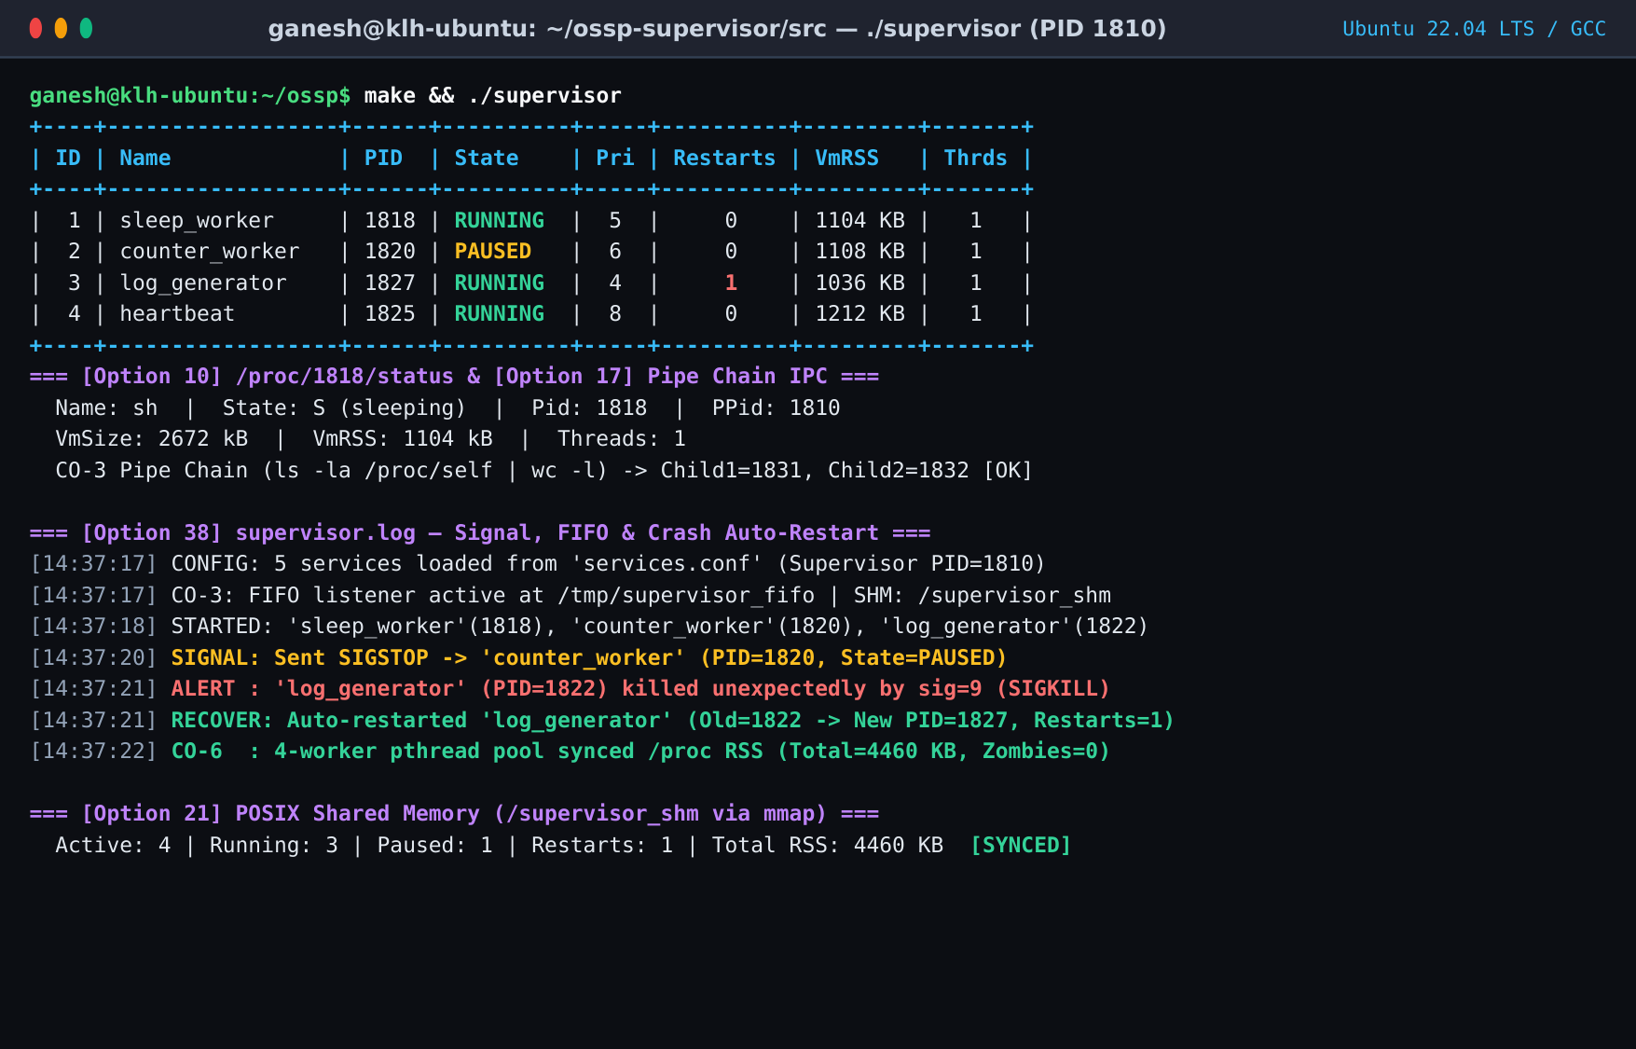
SECTION 09 • LIVE IMPLEMENTATION
Execution Screenshots — Web Console & C Supervisor CLI
1. Live Web Console (http://localhost:8080)
2. Native C CLI, /proc Telemetry & Auto-Restart Log
• Displays Supervisor PID 1810, 3 RUNNING services, 1 PAUSED service (counter_worker via SIGSTOP), and 1 Auto-Restarted service (log_generator PID 1827).
• Interactive SIGSTOP, SIGCONT, SIGTERM, and SIGKILL buttons dispatch real-time POSIX signals.
• Live /proc/1818/status inspection (VmSize: 2672 kB, VmRSS: 1104 kB) & CO-3 Pipe Chain (ls | wc -l).
• Proves fault tolerance: external kill -9 1822 detected immediately and respawned as PID 1827 (Restarts=1, Zombies=0).
Linux Service & Process Supervisor | OSSP (25CS2104E) | Team 22, Section S9 | Guide: Dr. Y. Harika Devi | KLH Bachupally
10 / 13

Slide 11
SECTION 10 • VALIDATION & VIABILITY
Testing Results & 4-Dimensional Feasibility Study
Experimental Results & Edge-Case Testing
Normal Lifecycle Spawn: 5 services loaded from services.conf; fork()+execvp() spawn time < 2 ms per worker.
Signal State Transitions: SIGSTOP cleanly transitions RUNNING → PAUSED; SIGCONT restores RUNNING; SIGTERM performs graceful stop without triggering false auto-restart.
Crash Recovery Benchmark: Injected unexpected SIGKILL (kill -9 1822) on log_generator; watchdog reaped exit status and respawned PID 1827 within < 200 ms.
IPC & Shared Memory Sync: Verified non-blocking pipe reads (EAGAIN on empty pipe), named FIFO commands, and /supervisor_shm RSS totals (4,460 KB).
Boundary & Cleanup Safety: Validated invalid PIDs/choices, MAX_PROCESSES=64 cap, and SIGINT shutdown leaving 0 orphan/zombie processes.
Feasibility Study
Technical Feasibility: Uses standard POSIX C11 APIs, GCC, and Linux /proc VFS—natively supported across Ubuntu, Debian, Fedora, and WSL2.
Economic Feasibility: 100% free & open-source toolchain with zero licensing/cloud fees and < 5 MB RAM footprint.
Operational Feasibility: Simple services.conf text config; intuitive 40-option CLI + browser dashboard usable without root privileges.
Schedule Feasibility: Delivered on time within 10-week semester plan (Design → C Core → IPC/Pthreads & Web → Testing).
Linux Service & Process Supervisor | OSSP (25CS2104E) | Team 22, Section S9 | Guide: Dr. Y. Harika Devi | KLH Bachupally
11 / 13

Slide 12
SECTION 11 • OUTCOMES & ROADMAP
Team Contributions, Conclusion & Future Scope
G. Jothi Ganesh (2520030252)
Process monitoring engine, /proc/[pid] VFS status/maps/FD telemetry, memory dashboard & C core.
V. Nitish Chowdhary (2520030179)
Process lifecycle control, POSIX signal dispatch (STOP/CONT/TERM/CHLD), watchdog & auto-restart.
P. Santhosh (2520030330)
Web Console & React/Node UI integration, structured event logging, edge-case testing & docs.
Conclusion
Summary: Successfully designed and implemented a multithreaded Linux Service & Process Supervisor in C (~2,100 LOC across 12 modules) paired with a live HTTP/WebSocket management console.
OSSP Mastery: Demonstrates cohesive real-world application of CO-1 to CO-6: fork()/execvp() process management, signal-driven state machines, pipes/FIFO/shared-memory IPC, /proc VFS inspection, and pthread synchronization.
Future Scope & Enhancements
1. Kernel Resource Quotas (cgroups v2): Enforce per-service CPU%, RAM, and I/O limits using Linux cgroups v2, setrlimit(), and namespaces.
2. Event-Driven Kernel Monitoring: Replace 200ms polling with epoll() + pidfd_open() for zero-overhead instant kernel exit events.
3. Distributed & Secure Supervision: Add exponential-backoff restart policies, SQLite/Prometheus historical metrics, TLS RBAC auth, & multi-node agent clustering.
Linux Service & Process Supervisor | OSSP (25CS2104E) | Team 22, Section S9 | Guide: Dr. Y. Harika Devi | KLH Bachupally
12 / 13

Slide 13
SECTION 12 • REFERENCES & SOURCE CODE
References, GitHub Repository
Academic & Technical References
[1] Linux Programmer's Manual (man7.org) — fork(2), execve(2), waitpid(2), kill(2), sigaction(2), pipe(2), mkfifo(3), shm_open(3), proc(5), pthreads(7).
[2] A. Silberschatz, P. B. Galvin, and G. Gagne, Operating System Concepts, 10th Edition, Wiley.
[3] W. R. Stevens and S. A. Rago, Advanced Programming in the UNIX Environment, 3rd Edition, Addison-Wesley.
[4] GNU C Library (glibc), GCC Compiler & IEEE Std 1003.1-2017 (POSIX.1) Official Documentation.
Project Source Code (GitHub)
Scan QR to Open GitHub Repo
github.com/logicCrafter320/
KLH_CSE_Y25_SEC9_22_Linux-Service-
and-Process-Supervisor
Thank You! — Questions & Live Demonstration
Team 22 (Section S9): G. Jothi Ganesh · V. Nitish Chowdhary · P. Santhosh
Guided by: Dr. Y. Harika Devi | KLH Bachupally
Linux Service & Process Supervisor | OSSP (25CS2104E) | Team 22, Section S9 | Guide: Dr. Y. Harika Devi | KLH Bachupally
13 / 13

