Slide 1
PopQuiz!
And Me
Johnnie Hernandez
By:
Anna Reese
And Over here
A joint Effort
Between
ECU & UNC
Students
By BubbaJoe
www.github.com/mista-j/popquiz

Slide 2
PopQuiz!
The Problem!
Are you ready for a PopQuiz?
The path of learning is often one that is
Shrouded in the difficulties of time and effort
“Intellectual growth should commence at birth and cease only at death” -Albert Einstein

Slide 3
The Solution
If you can’t get to the knowledge we will bring it to you
How:
We bring it to your pocket and your home
By hitting your Computer and your phone
PopQuiz!
PopQuiz!

Slide 4
The Mechanics
Have the user choose
What it is that they want to learn
As users regularly answer questions correctly then begin engaging them with more difficult questions
Engage the user with
Questions periodically throughout the day based off of their preferences

Slide 5
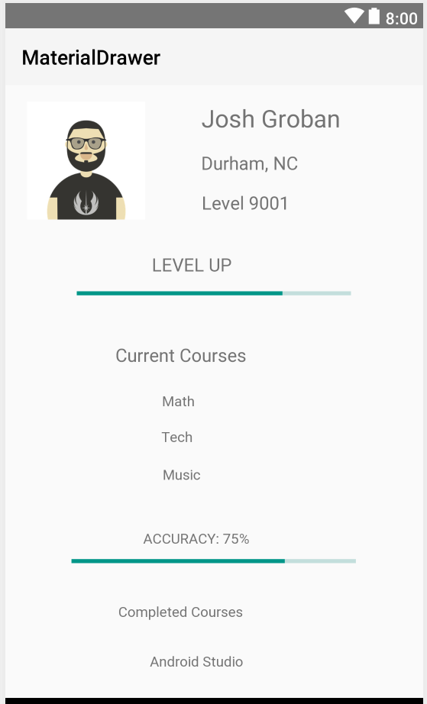
It’s over 9000
Ask the user what kind of Information they would like to learn
Meet Josh Groban:
He lives in Durham, NC and has a level of 9001.
He is interested in Math, Tech and Music.
He has also spent a heavy amount of time studying Android Studio and while he can always learn more he is marked complete
Record the average of correct answers

Slide 6
Ask the user what kind of Information they would like to learn
It’s over 9000
Either when the user check’s their phone
Or at periodic time intervals ask the user questions about a field
Record the average of correct answers

Slide 7
The tenants of pop quiz
Learning through repetition
Maintaining time management skill
Engage the user so the user doesn't have to engage us

Slide 8
For the Math behind the Product…
Ew, math...
Sorry I will keep
it short
In order to accurately help people we need to keep in mind
The average of each “student’s” answers
The average of each “expert’s” answers
A distribution of All students averages vs the expert averages of courses

Slide 9

The Geometric Mean
Um… sure that
Looks right
N = is the total number of inserts
Ai = The average answers correct from
user i
This allows greater accuracy towards a
Central tendency of a set of data, especially when dealing with small values or fractions

Slide 10
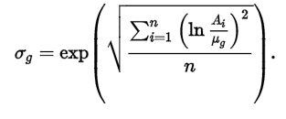

The Geometric Standard Deviation
N: is the total number of averages
Ai : is the user average of value i
: is the geometric mean of the data set
This allows us to determine a suitable expectation of where a user should be before they are presented questions in the next level of difficulty.

Slide 11
Here take a look at our live demo
White
Is the color of milk and fresh snow, the color produced by the combination of all the colors of the visible spectrum.
Black
Is the color of coal, ebony, and of outer space. It is the darkest color, the result of the absence of or complete absorption of light.

