Slide 1
CROPS THAT SHOULD BE GROWN FOR MAXIMUM PROFIT
By Mantasha Akhtar
and Bhanu pratap
Mishra

Slide 2
CONTENT
PROBLEM STATEMENT
INTRODUCTION
REQUIREMENTS
PLANNING STEPS
PURPOSE
OBJECTIVES
SCOPE
REFERENCES
OVERALL DESCRIPTION
PRODUCT FEATURES
MODULES
USER DOCUMENTATION
ASSUMPTIONS AND DEPENDENCIES
FUNCTIONAL REQUIREMENTS
LIFE CYCLE MODEL
USECASE DIAGRAM
CLASS DIAGRAM
THANKING PAGE

Slide 3
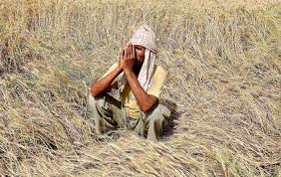
PROBLEM STATEMENT
Irony : Even being a self sufficient country in crop production and one of the potential consumer market of crops, our Farmers commits suicide.
Casues : They are not growing what they need to, therefore an overflow of non demanding crops and hence less earning, so they are bound to commit suicide

Slide 4
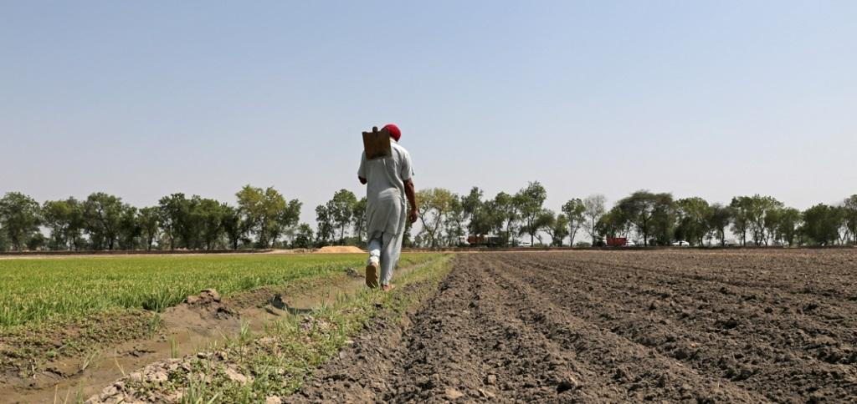
PROBLEM STATEMENT
Assumption : It has been assumed that an average farmer sell their crops in nearby areas or markets which are mainly consumed by the nearby consumer cities(NCC).
Our Notion: If we tell farmer which crops are mainly consumed in his NCC which also suits his means, then he can grow only that crops which results in meeting demand with appropriate supply and results in proper earning of our farmers

Slide 5


INTRODUCTION
What we do : CGMP will tell the farmer based on his location, soil, forecast, budget and resources available to him that which crop he should grown in the next cropping season.
How we do :
1)Web scraping : We scrap data from sites such as data.gov.in, zomatto, swiggy etc. About which cousines are consumption and then use scraping again to find the ingriedient crops of cuisines scraped

Slide 6

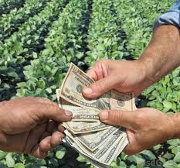
INTRODUCTION
2)Machine learning: Machine learning concepts are then used to generate the trends about crops which are effectively in consumption.
3)Making trends affordable: Obtained trends would be further optimised as per farmers means, forecast, and soil capabilities by Machine learning concepts.
The farmer only have to submit his location, budget and resources available, to know the CROPS THAT HE SHOULD GROWN FOR MAXIMUM PROFIT.

Slide 7
REQUIREMENTS
HARDWARE REQUIREMENTS
Processor -Dual Core or above
RAM -1 GB
Disk space -500 GB
Monitor -15”
Others -Keyboard, mouse, Internet connection

Slide 8
REQUIREMENTS
Software Requirements
Web Browser (Google Chrome, Firefox, IE9 or above)
Windows 7 or above / Linux
Pycharm IDE 2019
Sqlite Manager
Python 3.7, Flask

Slide 9
PLANNING STEPS
Task | 4Jan-30Jan | 31Jan-9Feb | 10Feb-12Mar | 13Mar-16Apr | 17Apr-22Apr | 23Apr-28Apr
Develop project proposal | 27 days
Analysis |  | 10 days
Designing |  |  | 30 days
Coding |  |  |  | 34days
Unit Testing |  |  |  |  | 5 days
Implementation |  |  |  |  |  | 5 days

Slide 10
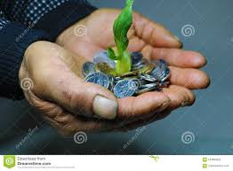
PURPOSE
The main purpose is to increase farmer income.
To boost country’s economy.
To create more employments .
To improve government policies regarding farmer.
To upgrade farming technology.

Slide 11

OBJECTIVES
Increase Farmer’s Income : As this project aims to increase the farmers income and this would be done by providing him the latest trends of the thing whose demand is at the peak in their regional area.
Data Scraping : To scrap the data from various websites and refine them to obtain the essential data from them.
Graphical Representation : To represent the obtained trend Graphically via interactive graphical plots(such as pie chart, bar graph).
Boost Agriculture Sector : We aim to boost the Agriculture sector of our country by raising the farmer’s Income through our project.

Slide 12
SCOPE
Crop Trend Predictor : This project can be used as a crop trend predictor.
Crop Planner : This project will help farmers in deciding which crop they should grow for maximum profit
Trendy Cuisines Predictor : Since in this project we first calculate the trendy cousines, so this can be use as a Trendy cuisines predictor.
Ingriedients Finder : As in this project we have a module to find ingridients of the cuisines, so it can be use as a Ingridients finder.
Policy maker assistant : This project can help governments to make their policies regarding farmers.

Slide 13
REFERENCES
http://www.medium.com
http://www.tutorialpoint.com
http://www.scoop.it

Slide 14
OVERALL DESCRIPTION

Slide 15
PRODUCT FEATURES
Efficient: The main features of this project is that it only on the basis of location and budget of the user it is going to tell that which is the trendy crops .
Cheap: Moreover it is a project which is quite cheap .
Exhaustive: This project is considering all the major factors that is going to effect the crop and its irrigation process.
Boost economy: This project will boost the country’s economy.
Portable: It is a web based project therefore there is no system requirements for users to run this application even it can be used with an android device.

Slide 16
MODULES
View Display Manager – Dynamic coding that will display the UI Flask Framework
Data Wrangling System -Handles all the functions related to cleaning, conversion, and modification of Data Frame
Web Crawler and Data Collection – Deals with smart web crawlers that will data from different websites into suitable forms

Slide 17
MODULES
Data Visualization System – Generates interactive plots on the interface for the User to better understands the Data/Info
Prediction and Suggestion System – This gives the resulting output on the Dashboard to inform what crop will be more beneficial regarding the Trends and Demands
Database Manager – Handles all the queries using Python code for SQ lite .
Settings System– Deals with all the required settings.

Slide 18
User Documentation
User manual and CD will be made available for troubleshooting and help.
Also this will represent as a full backup of the system.
The user will contain detailed information about the usage of the product from a layman perspective to an advanced network/system administrator.

Slide 19
Assumptions and Dependencies
The project is designed to work in internet background as a web based application.
The user is assumed to have knowledge of atleast working on a web browser.
User will store data for future use.
Internet is assumed to be available at working destination of user.
A single user can at once perform one querry on a opened web app only.

Slide 20
Functional Requirements
Sr.No.---- | Req. No. | Priority | Requirement
1. | R1 | R | User Input
2. | R2 | R | Data crawling and cleaning
3. | R3 | R | Data analysis
4. | R4 | R | Trend prediction
5. | R5 | C | Generate Interactive plots
6. | R6 | R | Effective representation and Display of results
7. | R7 | O | User feedback
R – Required ; C- Conditionally Required; O-Optional.

Slide 21
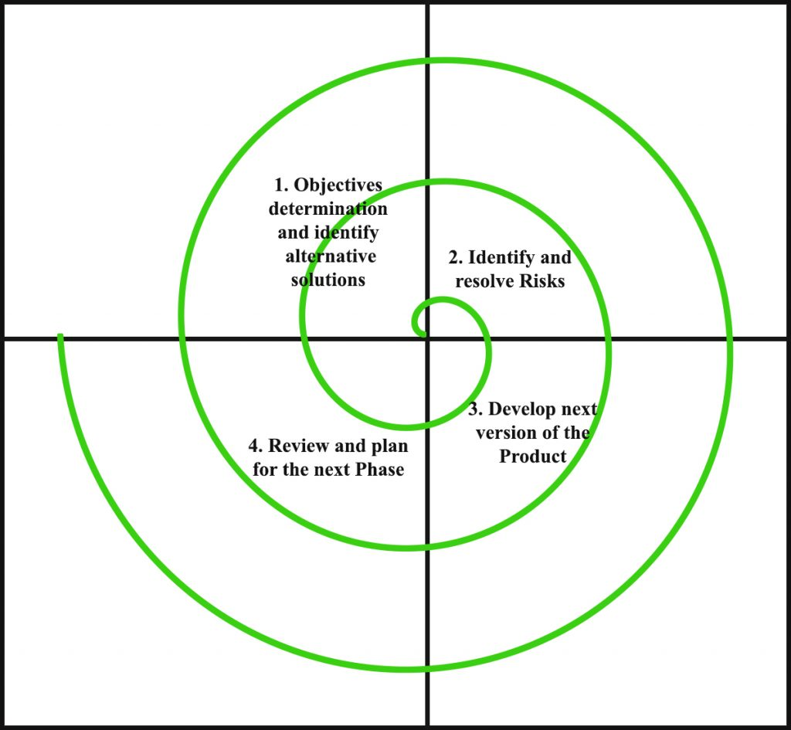
Lifecycle Model : Spiral

Slide 22
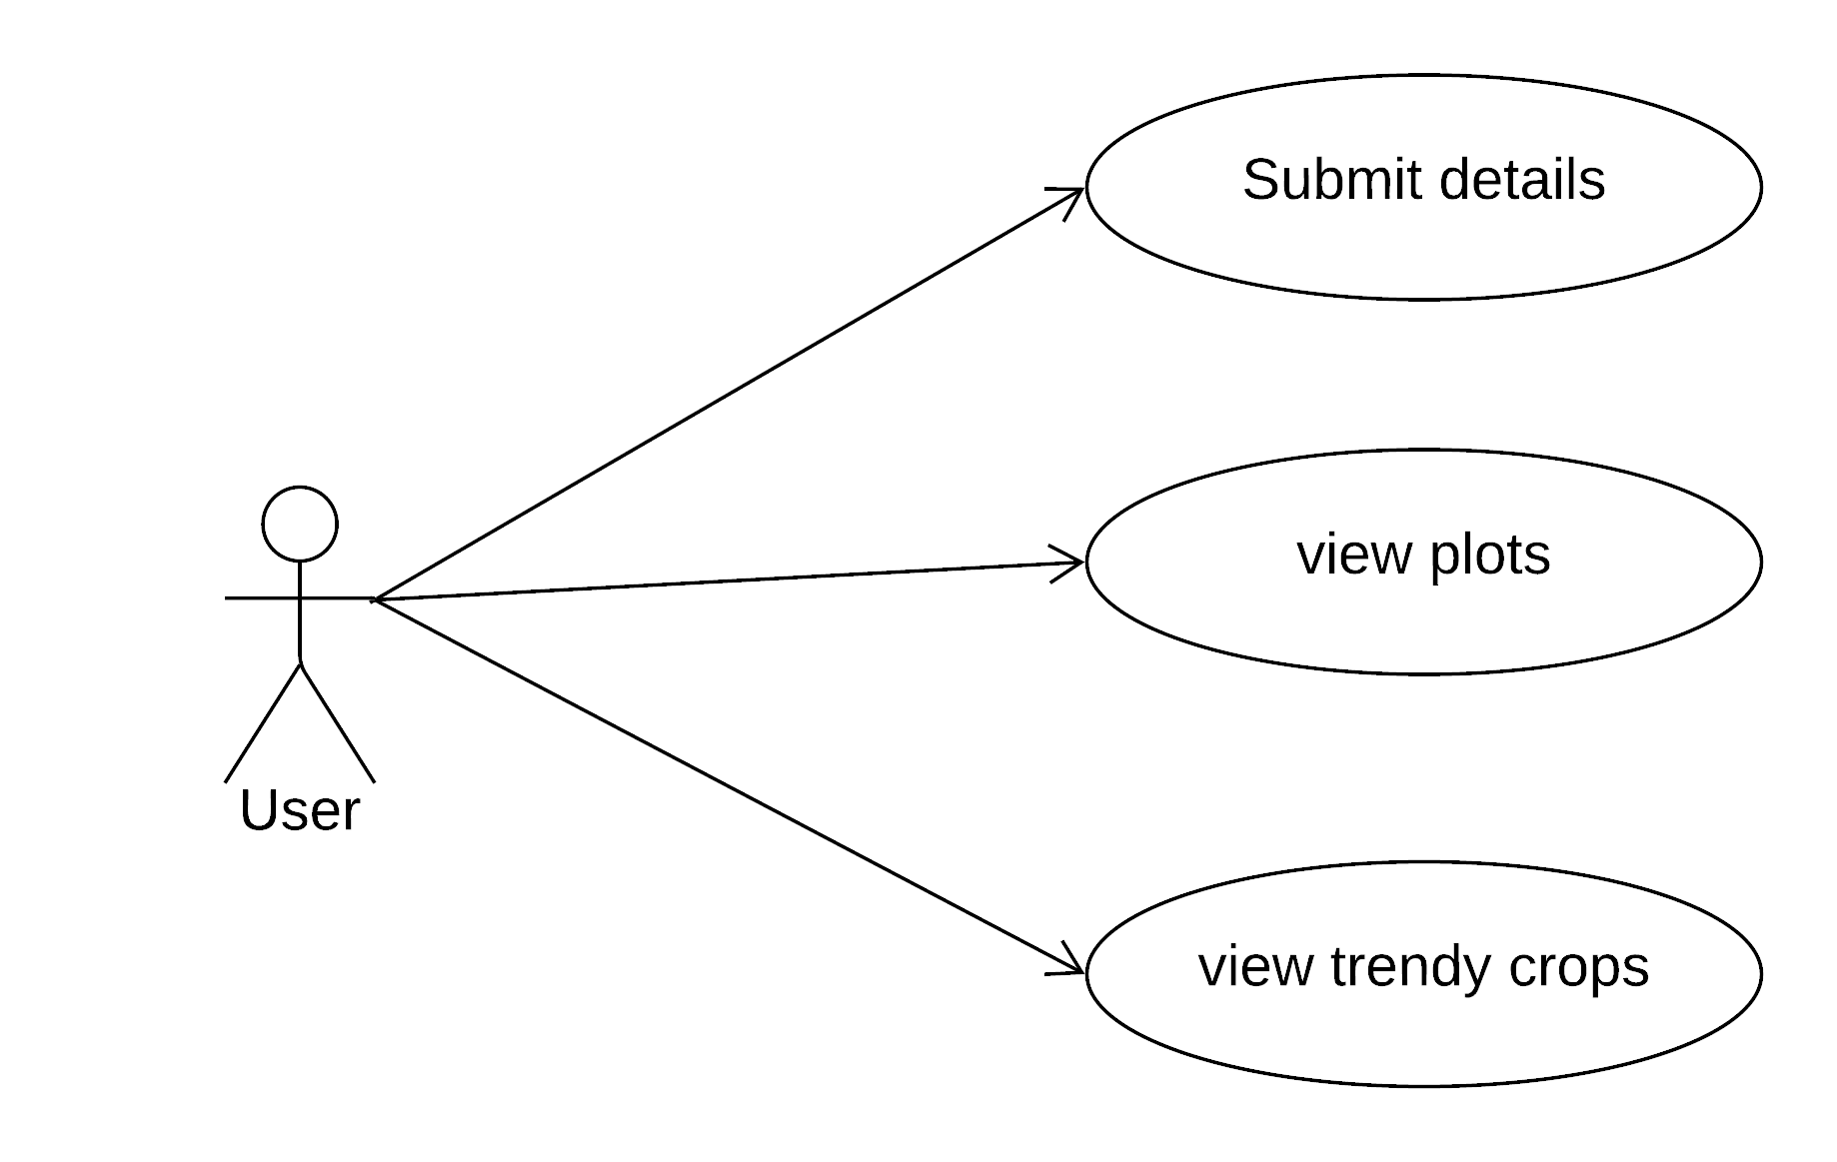
Use Cases
Use cases from User perspective

Slide 23
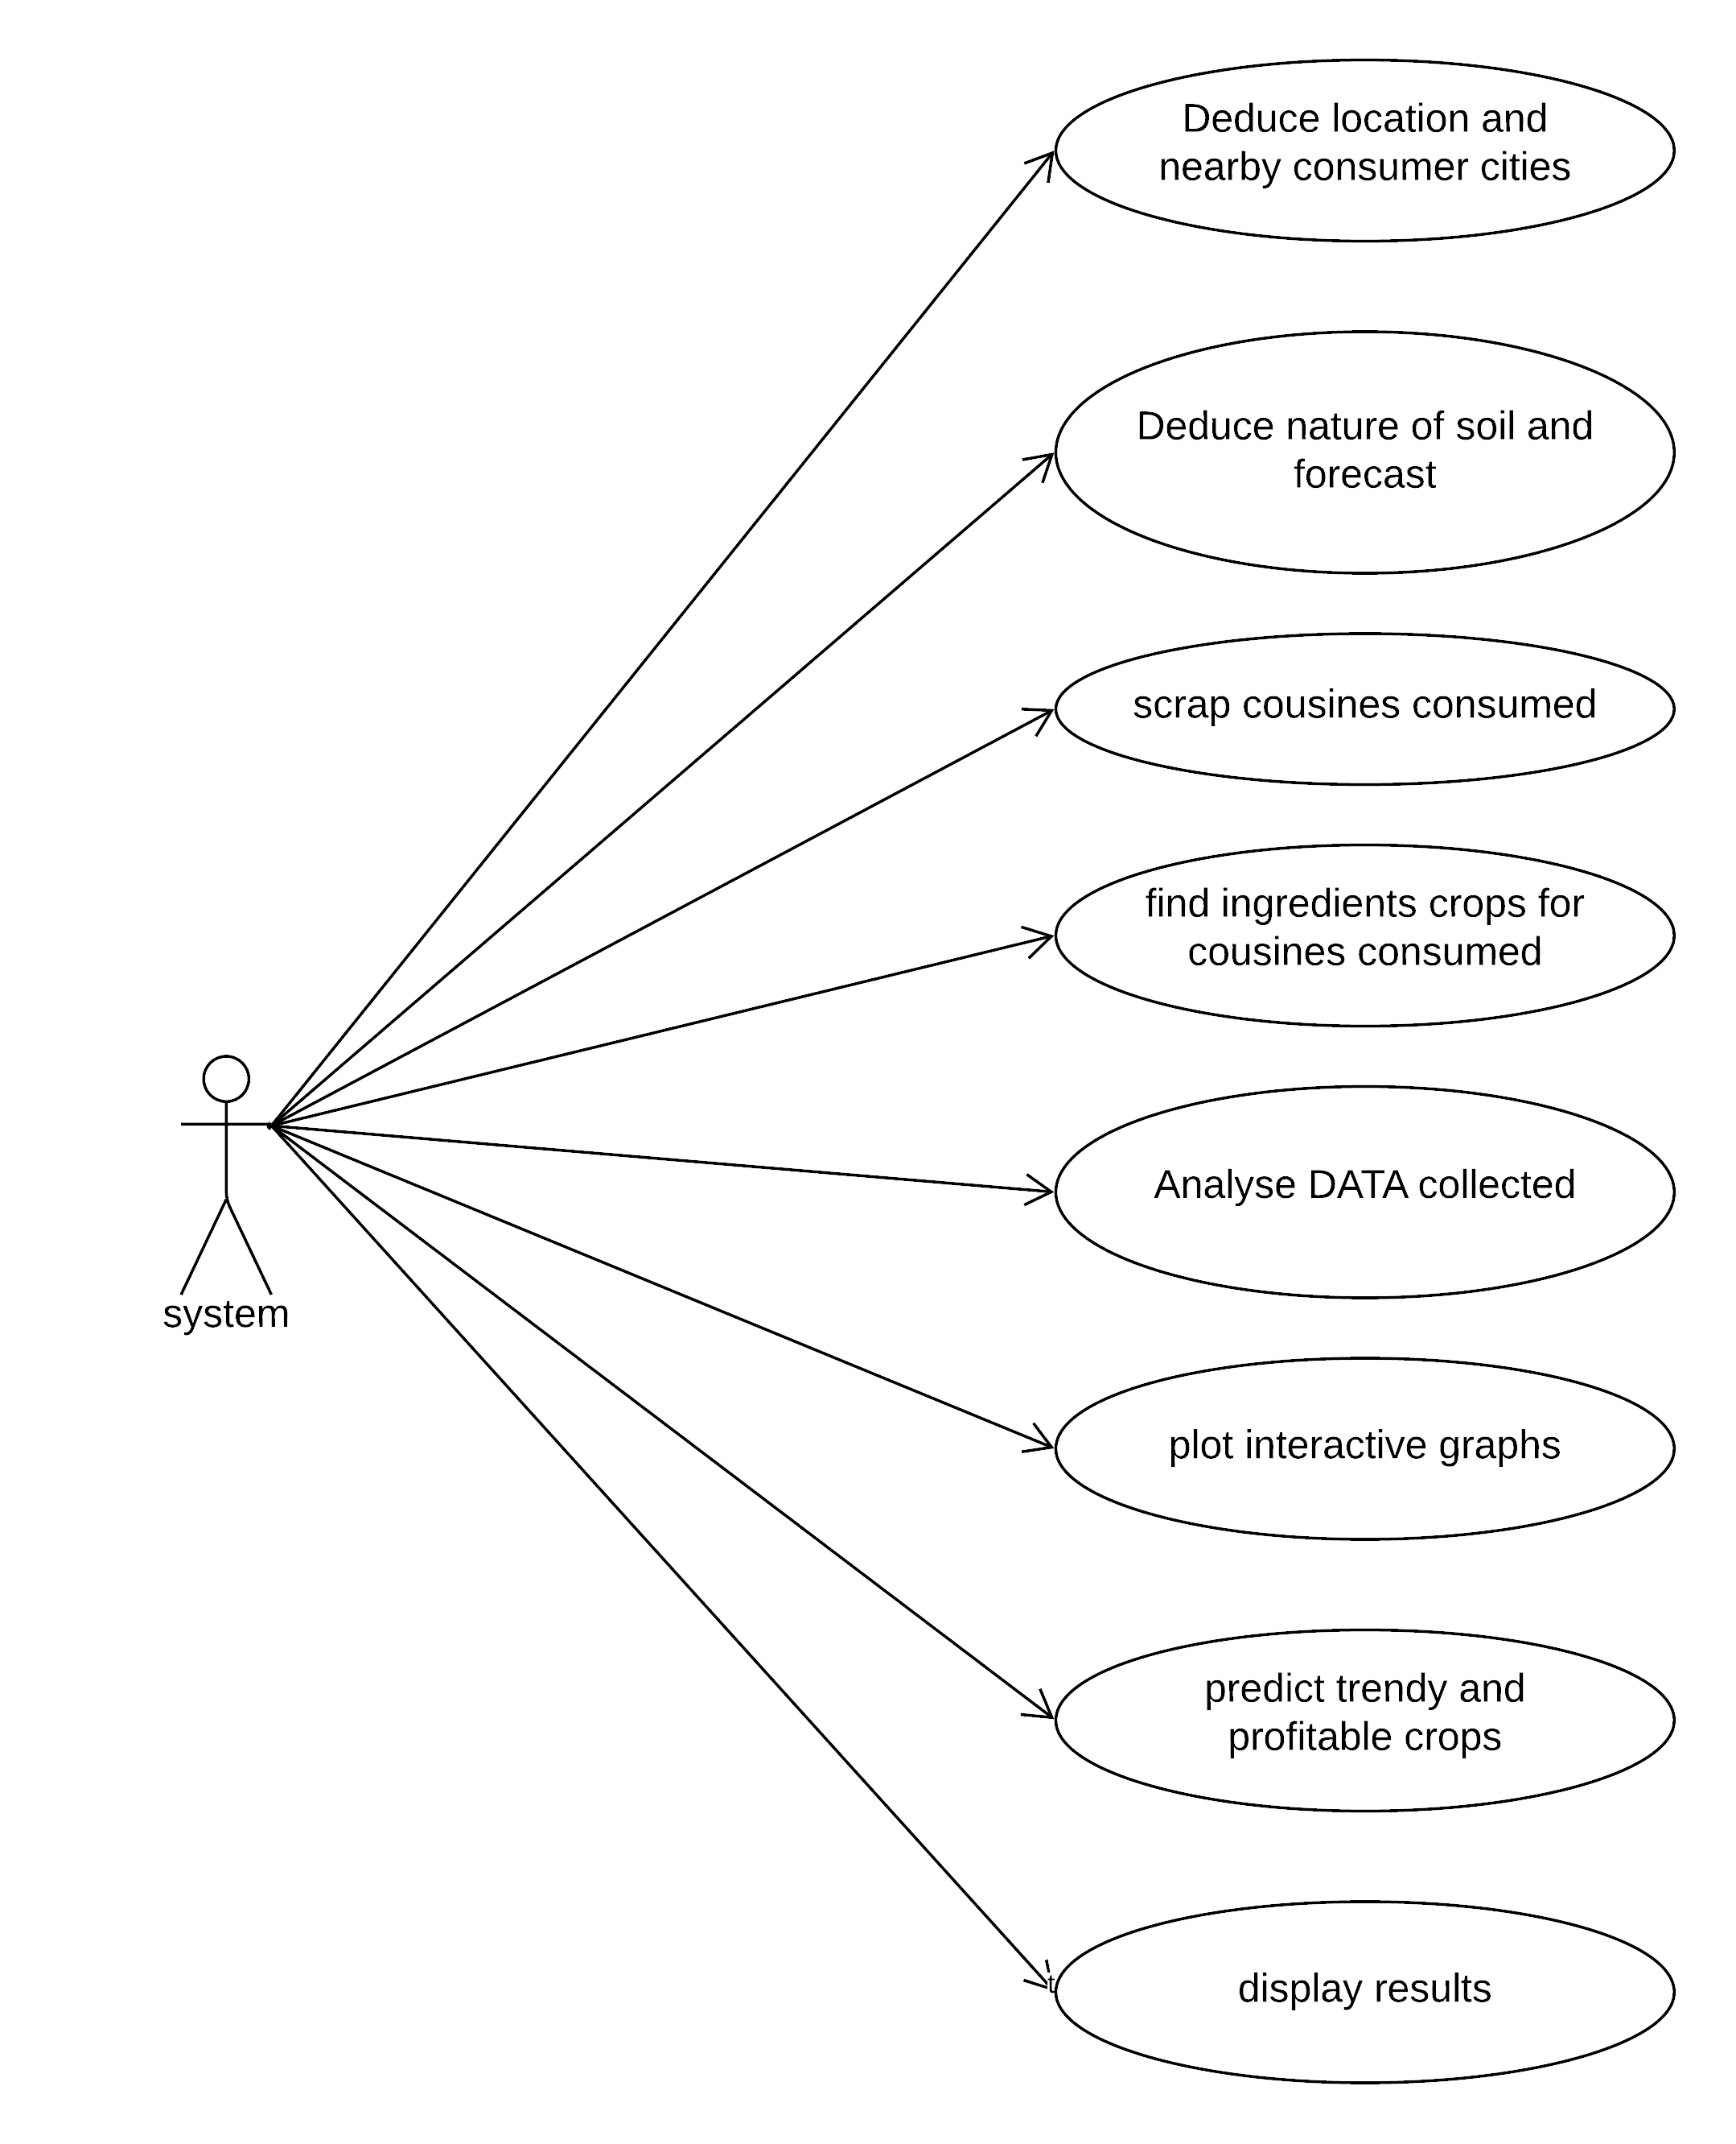
Use cases from System perspective

Slide 24
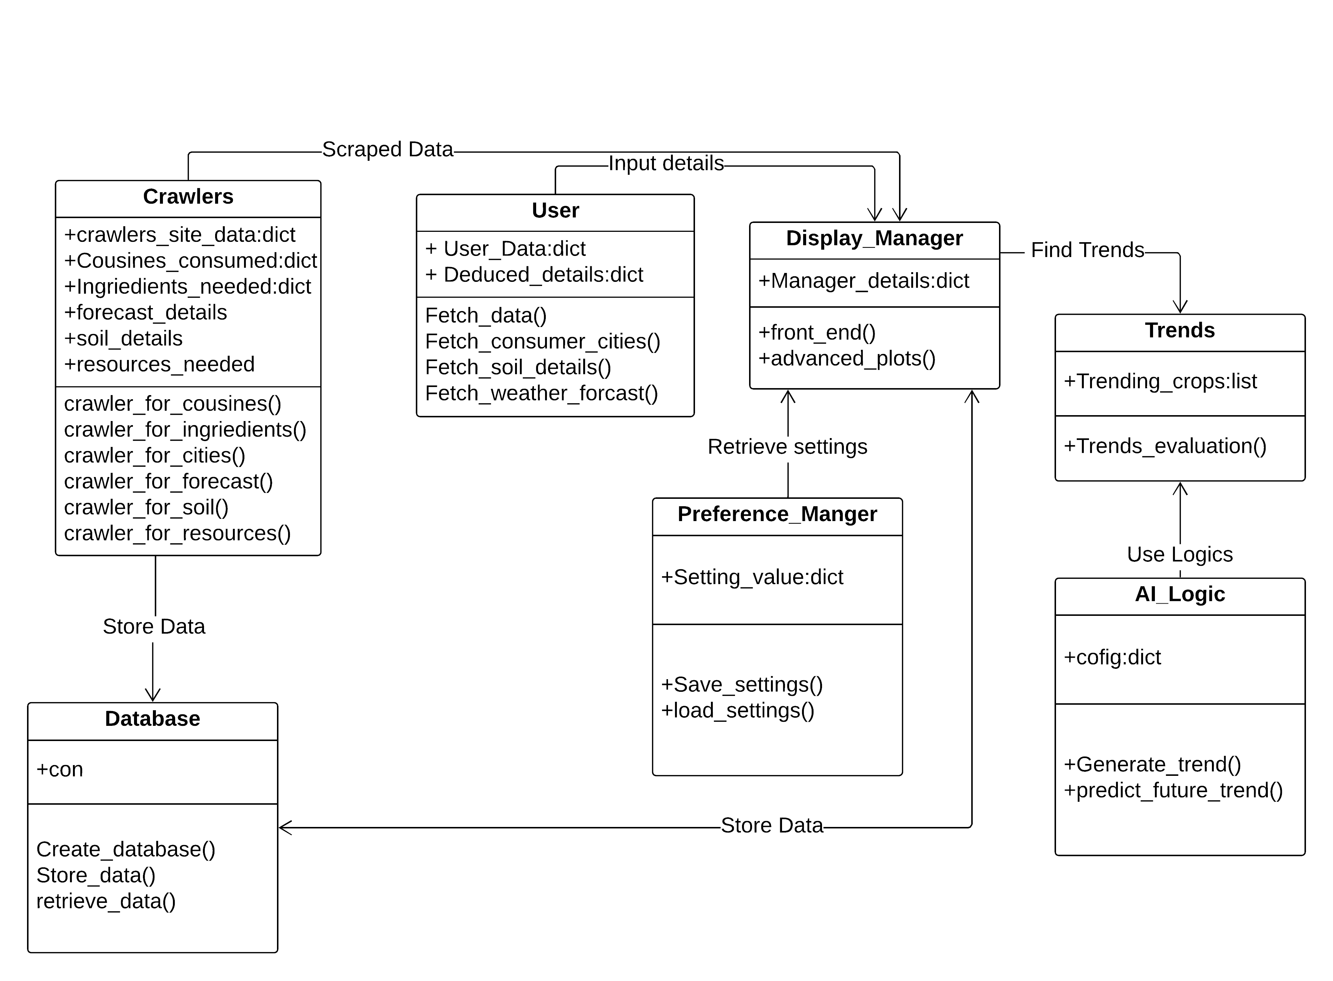
Class Diagram

Slide 25
CONCLUSION
This project is ultimately aims to maximize the farmer’s profit by informing him about latest trends of the raw food items in demands and predicting the possible demands in near future .
That would make him capable to fulfill the desired demands in his local region as per his resources and budget

Slide 26



