Slide 1
6.1 Assembly language

Slide 2
Objectives
show understanding of the relationship between assembly language and machine code, including symbolic addressing符号地址 and absolute addressing, directives指示符 and macros宏指令
describe the different stages of the assembly process for a ‘two-pass’ assembler for a given simple assembly language program

Slide 3
Machine Code
Computers work and understand only machine code（object code） because the computer only recognizes 0 or 1
Machine code instruction(指令) is a binary code(二进制) with a defined number of bits that comprises an opcode (操作码) and one operand(操作对象)
Opcode |  |  | Operand
Operation | Address mode | Register addressing
4 bits | 2 bits | 2 bits | 16 bits

Slide 4
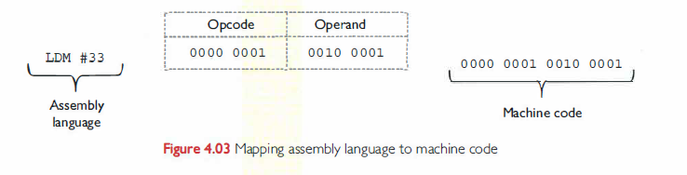
Machine Code
Every instruction in assembly language program code is translated into exactly one instruction in the machine code.

Slide 5
Opcode
Opcode denotes the operation to performe, such as ADD,
The opcode is actually the instruction serial number指令序号, which is used to tell the CPU which instruction to execute(the opcode determines what to do)
Examples
addition opcode： ADD ADC (ADD with Carry进位)

Slide 6
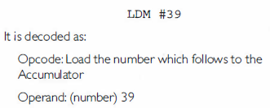
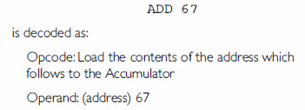
Operand
The opcode refers to the object of the instruction: data or the address of the data.

Slide 7
Operand
In the field of the operand, you can put the operand itself, you can also put the operation address, and you can also calculate the operation address.
BA
Segment address
Examples Mov AX 5678H opcode is AX 5678H

Slide 8
Assembler (汇编器)
Translate the assembly language into machine code
The process by which the assembler translates assembly language into machine language is called assembly.

Slide 9
The features in an assembly language
Advantage
Easy to read memory status and hardware I/O interface接口 conditions情况.
The code you write can be run at almost time because it requires very little compilation.
Scalable(可扩展) as a low-level language
Disadvantage
The code is lengthy and difficult to write
Prone to容易产生 bugs
Poor code compatibility兼容性

Slide 10
Comparison between machine code and assembly language
A machine code consists of an opcode and an operand
An assembly language program contains assembly language instructions and directive that provide information to the assembler

Slide 11
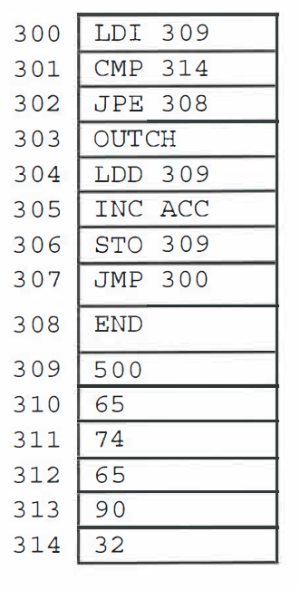
Absolute addressing
A sequence of instructions with the first instruction loaded at address 300 is as follows:

Slide 12
Absolute addressing
If the machine code shows the absolute address values, then the program executed must be loaded to start at address 300.
In fact, the assembler could calculate all the addresses as relative values.
Then when the program is loaded and executed, it can occupy占据 any area in the memory space.

Slide 13
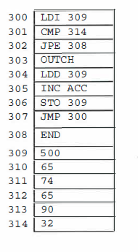
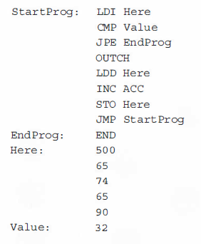
Symbolic addressing
Symbolic addressing: use symbols to represent addresses
The symbolized address has a label

Slide 14
Directives
Assembler directives指示 are informations that direct the assembler to do something, such as:
set aside留出 space for variables.
include additional附加的 source files, e.g. INCLUDE "File56 .LIB"
state the start address for the program, e.g. ORG 0300.

Slide 15
Assembly Language
In assembly language, the mnemonic represents the operands of machine instructions and the address symbol represents the address of operands.
Assembly language is converted into machine instructions by the assembly process.

Slide 16
Assembly Language
Using machine code instructions would be a very time-consuming(耗时) and error-prone(容易出错) process for human, thus, we use assemble language.
Assembly language includes a mnemonic(助记符) for the opcode and a characters representation for the operand
mov H , L
mov is opcode
H,L are operands
Notes:
由于汇编语言的指令与机器语言的指令大体上保持一一对应的关系，汇编算法采用的基本策略是简单的。
通常采用两遍扫描源程序的算法。第一遍扫描源程序根据符号的定义和使用，收集符号的有关信息到符号表中；
第二遍利用第一遍收集的符号信息，将源程序中的符号化指令逐条翻译为相应的机器指令。
翻译工作可归纳为如下几项：用机器操作码代替符号操作；用数值地址代替符号地址；将常数翻译为机器的内部表示；分配指令和数据所需的存储单元。
除了上述的翻译工作外，汇编程序还要考虑：处理伪指令，收集程序中提供的汇编指示信息，并执行相应的功能。为用户提供信息和源程序清单。汇编的善后处理工作，随目标语言的类型不同而有所不同。有的直接启动执行，有的先进行连接装配。
如果具有条件汇编、宏汇编或高级汇编功能时，也应进行相应的翻译处理。
假定汇编语言中规定符号的应用一定出现在定义之后，则两遍算法可容易地合并成一遍算法加以实现。

Slide 17
Macro(宏)
Macro is a pseudo instruction (伪指令)
It is a program code with independent独立的 functions in the source program.
user-defined instructions. When programming, the function that is used multiple(重复) times is replaced with a macro.

Slide 18
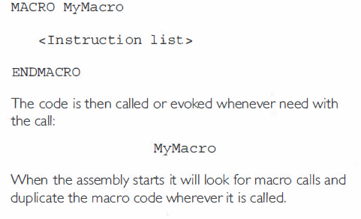
Macro(宏)

Slide 19
The assembly process for a 'two-pass' assembler
The first pass：An assembly language program contains features that are used to help the programmer. In the first pass of the two-pass assembler, all of these features are processed. Typical actions are:
removal去除 of comments
creation of a symbol table containing the binary codes for symbolic names and labels
creation of a literal table常数表 if the programmer has used constants in the program
expansion of macros
identification识别 of system calls调用 and subroutines子程序 used.
Why do we need this process?

Slide 20
The assembly process for a 'two-pass' assembler
The second pass of the assembler generates the machine code. This involves replacing symbolic addresses with absolute addresses.
Why do we need this 'two-pass' process?
machine can't understand symbolic representation, it can only execute machine code.
it is not convenient for human to use machine code
so a translater is essential
the assembly languege code involves some features to make coding easier, but these features are not helpful to computer
so we need an assembler to modify these features

Slide 21
Addressing mode(寻址方式)
Addressing mode | Operand
Immediate | The value to be used in the instruction
Direct | An address which holds the value to be used in the instruction
Indirect | An address which holds the address which hold the value to be used in the instruction
Indexed | An address to which must be added what is currently in the index register (IX) to get the address which holds the value in the instruction

Slide 22
The processor's instruction set 指令集
The set of basic machine operations the processor can carry out执行 are called the instruction set.

Slide 23
Assembly language instructions
Data movement
Instruction opcode | Instruction operand | Explanation
LDM | #n | Immediate addressing loading n to ACC
LDR | #n | Immediate addressing loading n to IX
LDD | <address> | Direct addressing, Load the content of <address> to ACC.
LDI | <address> | Indirect addressing, the content of <address> is an address, copy the content of the second address to ACC
LDX | <address> | Indexed addressing, the address comefrom <address> + the contents of the index register = absolute address. Copy the contents of this calculated address to ACC.
STO | <address> | Storing the content of ACC

Slide 24
Assembly language instructions
Arithmetic operations(算术运算)
Instruction opcode | Instruction operand | Explanation
ADD | <address> | Add the content of <address> to the content in the ACC
INC | <register> | Add 1 to the value stored in the specified register (ACC or IX).
DEC | <register> | Subtract减去 1 to the value stored in the specified register (ACC or IX).

Slide 25
Assembly language instructions
Comparisons and jumps
Instruction opcode | Instruction operand | Explanation
JMP | <address> | Jump to the address in <address>
CMP | <address> | Compare the ACC content with the content of <address>
CMP | #n | Compare the ACC content with n
JPE | <address> | Jump to the address if the result of the previous comparison was TRUE
JPN | <address> | Jump to the address if the result of the previous comparison was FALSE

Slide 26
Assembly language instructions
Input and output
Instruction opcode | Instruction operand | Explanation
IN |  | Input a denary number from the keyboard and store in ACC
OUTCH |  | Output the character corresponding to the ASCII character code in ACC

Slide 27
Tracing an assembly language program
Consider some program instructions are contained in memory locations from 100 and some eight-bit binary data va lues are contained in memory locations 200 and onwards. For illustrative purposes the instructions are shown in assembly language form. At the start of a part of the program, the memory contents are as shown in Figure:

Slide 28
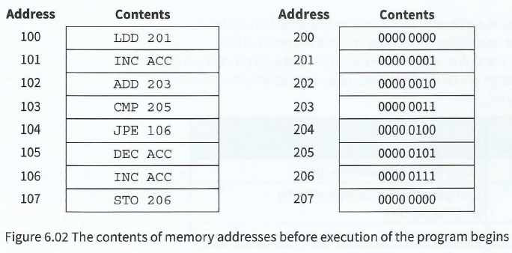
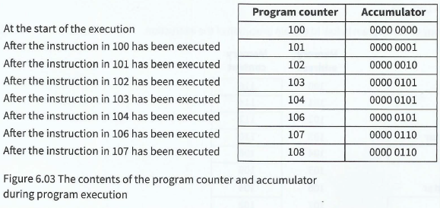
At the start of a part of the program, the memory contents are shown in Figure 6.02.
opcode table:
https://wenku.baidu.com/view/416b0553f01dc281e53af0b0.html
The values stored in the program counter and in the accumulator as the program instructions are executed are shown in Figure 6.03.

Slide 29
Tracing an assembly language program
http://peterhigginson.co.uk/LMC/

