Slide 1
5.3 The fetch-execute cycle

Slide 2
Objectives
describe the stages of the fetch-execute cycle
show understanding of ‘register transfer(寄存器转移)’ notation 标记
describe how to handle interrupts(中断)

Slide 3
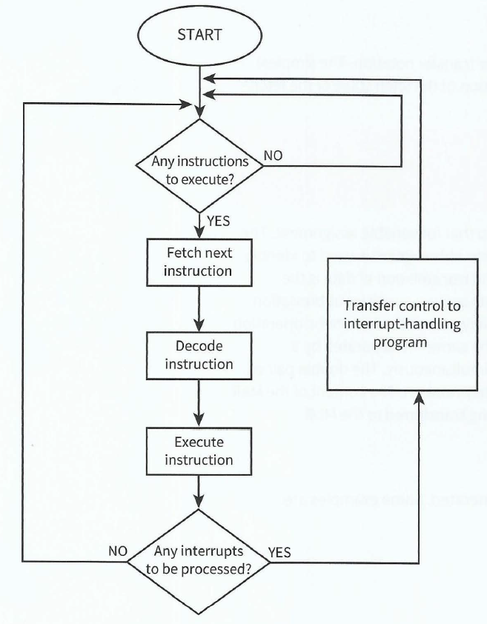

Slide 4
Interrupt
An interrupt is a signal for the CPU to stop what it is doing and instead carry out the interrupt task, once the task is complete, the CPU goes back to what it was doing.
The reasons for an interrupt：
A fatal重大 error in a program
A hardware fault
A need for I/O processing to begin
User interaction交互
A timer定时器 signal

Slide 5
The actions of the processor when an interrupt is detected
At the end of the cycle for the current instruction the processor checks if there is an interrupt.
If the interrupt flag is set, the register contents are saved, the address of the Interrupt Service Routine (中断服务例行程序，ISR) is loaded to the Program Counter (PC) and when the ISR completes, the processor restores the register contents.

Slide 6
This jumping of instructions from current CPU operations to the ISR and then back again is called 'context switching上下文切换'

Slide 7
Review of Terms
A CPU contains a number of 'registers'.
A register is a small section of on-chip memory having a specific purpose.
Registers range from 8 bits wide on an 8 bit CPU to 64 bits and beyond.
PC——The Program Counter holds the address of the next instruction to be fetched.
MAR——Memory Address Register
MDR——Memory Data Register
MBR——Memory Buffer Register
CIR——Current Instruction Register

Slide 8
Fetch
Memory
CPU
PC incremented by 1
Copy of instruction in memory address held in MAR
PC
Copy of address of next instruction
MAR
MDR
Instruction
CIR

Slide 9
Decode
CPU
PC
MAR
MDR
CIR
Split instruction into operation code (Opcode) and operation object (Operand). Then decode the operation code.

Slide 10
Execute
CPU
PC
MAR
MDR
Execute instruction
CIR

Slide 11
Register transfer notation
MAR [PC]
PC [PC]+1; MDR [[MAR]]
When two operations are placed on the same line separated隔开 by a semi-colon分号 this means that the two transfers take place发生 simultaneously同时地.
The content of the MAR is an address; it is the content of that address which is being transferred to the MDR.
CIR [MDR]

Slide 12
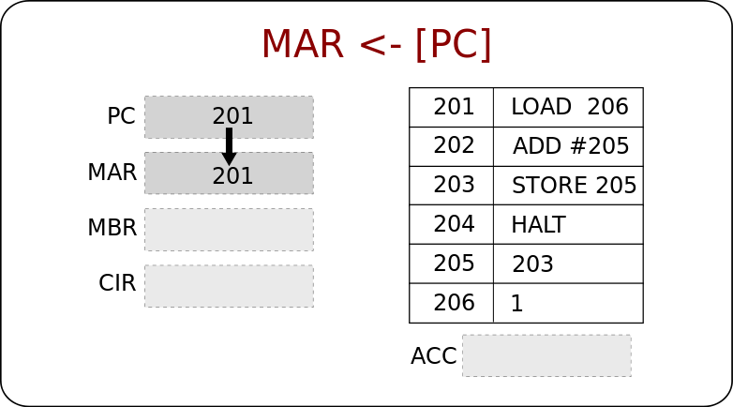
MAR<-[PC] means obtain the content in PC, then feed it to MAR

Slide 13
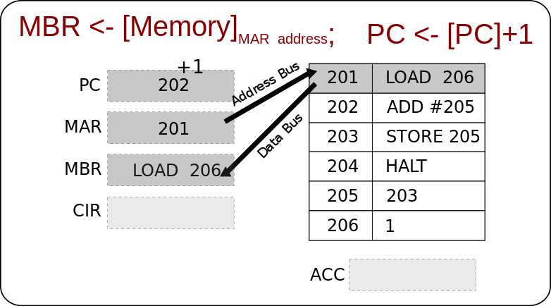

Slide 14
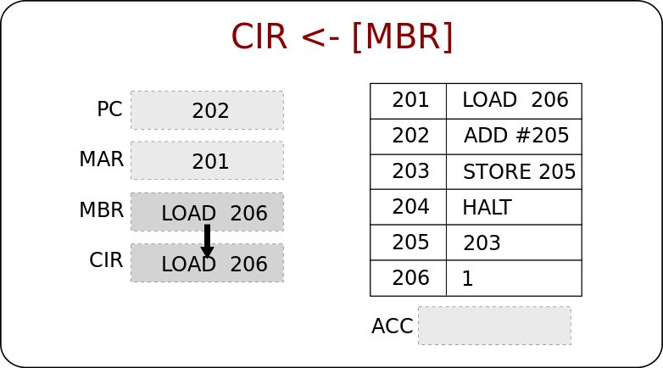

Slide 15
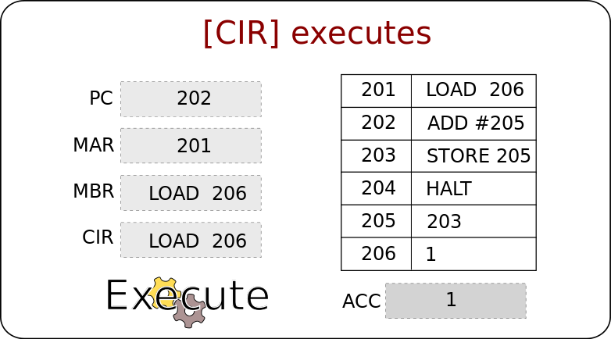
Accumulator(ACC)：intermediate 中间的 arithmetic 算术 or logic results are stored in this register

Slide 16
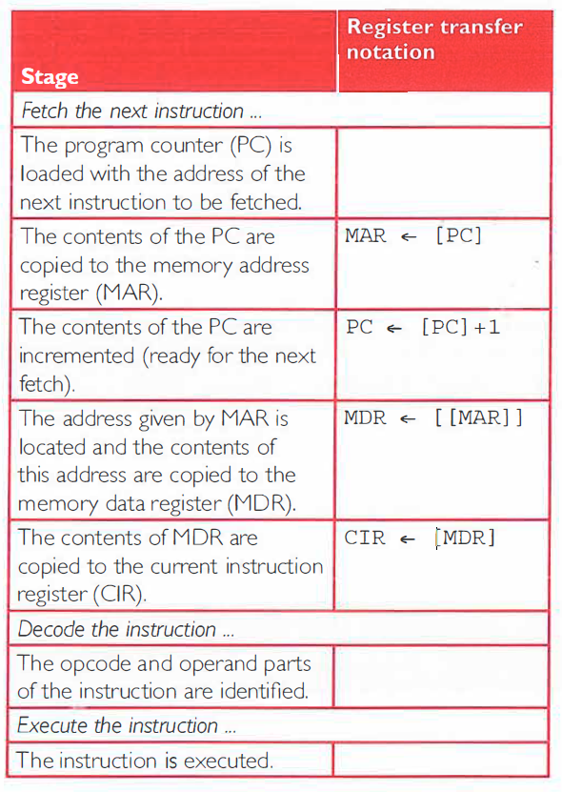

Slide 17
The fetch-execute cycle
http://www.teach-ict.com/as_as_computing/ocr/H447/F453/3_3_3/fetch_execute_cycle/miniweb/pg4.htm

Slide 18
Instructions
Jump
Input / Load (number directly)
Input / Load (from memory)
Store
Add (a number directly)
Add (a number from memory)
Output (directly from accumulator)
Output (from memory)

Slide 19
Jump instruction
Execute Diagram

Slide 20
Execute
CPU
Jump
PC
MAR
MDR
Address
CIR
Back to list of instructions

Slide 21
Input / Load (number directly) into accumulator instruction(累计器指令)
Execute Diagram

Slide 22
Execute
Input / Load (number directly) into accumulator
CPU
PC
MAR
MDR
Number in MDR
Accumulator
Number inputted
CIR
Back to list of instructions

Slide 23
Load (from memory) instruction
Execute Diagram

Slide 24
Execute
Memory
CPU
Load (from memory)
Data obtained form the address
PC
MAR
MDR
Address of data to be loaded.
Data in MDR
Accumulator
CIR
Back to list of instructions

Slide 25
Store instruction
Execute Diagram
Assume data has either been inputted, loaded (directly or from memory) or a calculation has been performed.
Any of the above will mean there is data in the accumulator and this data will be stored.

Slide 26
Execute
Memory
CPU
Store
PC
MAR
Put the data into the address
Address
to store in
MDR
Data in accumulator
Accumulator
CIR
Back to list of instructions

Slide 27
Add (a number directly) instruction
Execute Diagram
Assume a number has already been inputted or loaded (directly or from memory) into the accumulator.

Slide 28
Execute
Add (a number directly)
CPU
PC
MAR
MDR
Add number in MDR and number already in accumulator together.
ALU
Accumulator
Number to be added.
CIR
The ALU now does the arithmetic.
Accumulator value is now the result of the addition.
i.e. Accumulator = Accumulator + contents of MDR
Back to list of instructions

Slide 29
Add (a number from memory) instruction
Execute Diagram
(Assume a number has already been inputted or loaded into the accumulator.)

Slide 30
Execute
Memory
CPU
Add (from memory)
Number in the memory address obtained from MAR
PC
MAR
Address of number to be added.
MDR
Add number in MDR to number already in accumulator.
ALU
Accumulator
CIR
NB. The ALU now does the arithmetic.
Accumulator value is now the result of the addition.
i.e. Accumulator = Accumulator + contents of MDR
Back to list of instructions

Slide 31
Output (directly from accumulator) instruction
Execute Diagram

Slide 32
Execute
Output (directly from accumulator)
CPU
PC
MAR
MDR
Output data
Accumulator
CIR
Back to list of instructions

Slide 33
Output (from memory) instruction
Execute Diagram

Slide 34
Execute
Memory
Output (from memory)
CPU
MAR
Data in memory address held in MAR
PC
MDR
Output data
Address of data to output.
Data
Accumulator
CIR
Back to list of instructions

Slide 35
Reset
CPU
PC
Cycle is reset by passing control signal back to the PC.

Slide 36
Load the address of next instruction in the PC into the MAR.
So that the control unit can fetch the instruction from the right part of the memory.
Copy the instruction/data that is in the memory address given by the MAR into the MDR.
MDR is used whenever anything is to go from the CPU to main memory.
Increase the PC by 1.
So that it contains the address of the next instruction, assuming that the instructions are in consecutive locations.
Load the instruction/data that is now in the MDR into the CIR.
Thus the next instruction is copied from memory -> MDR -> CIR.
Contents of CIR split into operation code and address if present e.g. store, add or jump instructions.
Decode the instruction that is in the CIR.
Fetch
Decode

Slide 37
Execute the instruction but what is involved in this depends on the instruction being executed (there are several different instructions you need to know about).
If the instruction is a jump instruction then
Load the address part of the instruction in the CIR into the PC.
If the instruction is an input / load (directly) instruction then take data input and place in accumulator.
If the instruction is a load (from memory) instruction.
Copy address part of the instruction (to load from) in the CIR into MAR.
Copy data from memory address held in MAR to MDR.
Copy data in MDR into accumulator.
Execute

Slide 38
If the instruction is a store instruction then:
Copy address part of the instruction (to store in) in the CIR into MAR.
Copy data in accumulator to MDR.
Copy data in MDR into memory address held in MAR.
If the instruction is an add instruction then:
Copy address part of the instruction (of number to add) in the CIR into MAR.
Copy number from memory address held in MAR into MDR.
Add number in MDR to number in accumulator (accumulator will now hold the result).
If the instruction is an output (directly from accumulator) then output number in accumulator.
Execute

Slide 39
If the instruction is an output (from memory) instruction then:
Copy the address part of the instruction in CIR into MAR.
Output contents of MDR.
Cycle is reset (restarted) by passing control signal back to the PC (step 1).
Execute
Reset

Slide 40
Review

Slide 41
2
(a) Four points from:
The Program Counter (PC) holds the address of the next instruction to be fetched
The address in the Program Counter (PC) is copied to the Memory Address Register (MAR)
The Program Counter (PC) is incremented
The instruction is copied to the Memory Data Register (MDR) from the address held in the Memory Address Register (MAR)
The instruction from the Memory Data Register (MDR) is copied to the Current Instruction Register (CIR)

Slide 42
2(b)
At the end of the cycle for the current instruction B
If the interrupt flag is set, D, A and C
The interrupted program continues its execution
At the end of the cycle for the current instruction the processor checks if there is an interrupt.
If the interrupt flag is set, the register contents are saved, the address of the Interrupt Service Routine (ISR) is loaded to the Program Counter (PC) and when the ISR completes, the processor restores the register contents.

