Slide 1
Out of Band Management
HP Lights Out Technology

Slide 2

Introduction
I own a small consulting company located in NE Portland.
I Have worked for startups, medium and large companies with various hardware and datacenters.
Recently moved from Atlanta, GA
Started as a Unix Admin back in 2003 after graduating with a CS degree.

Slide 3
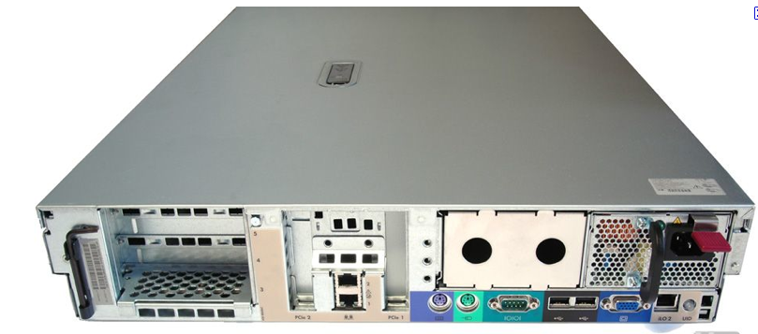
Out of Band Management
Involves the use of a dedicated management channel for device maintenance.
It allows a system administrator to monitor and manage servers and other network equipment by remote control regardless of whether the machine is powered on.

Slide 4
Ilo2 Management Features
Remote power management
Remote media
Hardware watchdog (auto reboot)
Remote Console (with advanced license)
Ssh/telnet/https connectivity
LDAP integration
Ssh key or cert authentication
Online firmware upgrades for ilo
Access to temperature sensors, fan speeds and other sensors
Power consumption usage

Slide 5
Similar Technologies
DRAC (Dell Remote Access Connection)
iLOM (Sun integrate lights out manager)
IMM (IBM Integrated Management Module)

Slide 6
Virtual Media
Load a usb, floppy or cdrom image virtually over a LAN/WAN connection.
Can use image from your machine or load from Webdav server.
Support Virtual media scripting (autoload usb keys, change boot options)
Use hplovm to control boot options and connected media

Slide 7
IPMI
Out-of-band management standard created by Intel
Was supposed to allow users control a heterogeneous environment with one tool
Supports
power control
SOL (Serial over LAN)
virtual media
Access to thermal and fan sensors
Hardware watchdog
Access Hardware Logs
Manufactures don’t abide by the standard 100%
IPMI BMC shares connection with Ethernet port

Slide 8
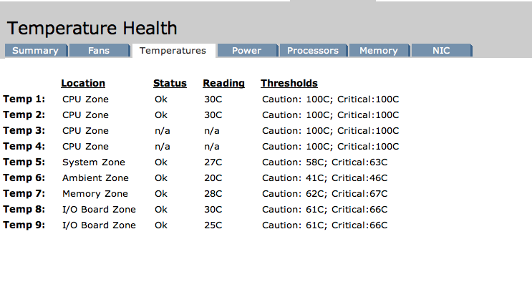
Sensor Information

Slide 9
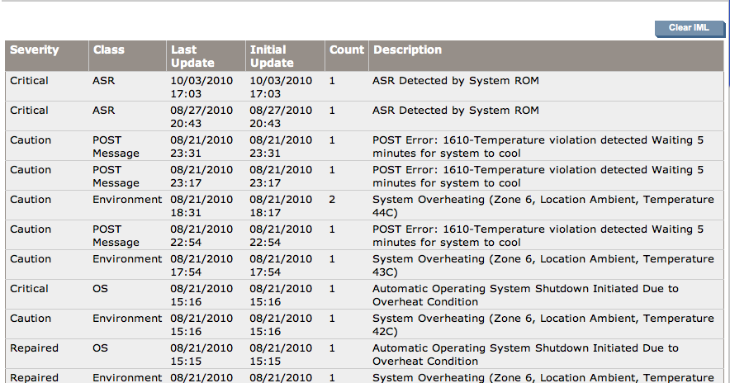
IML

Slide 10
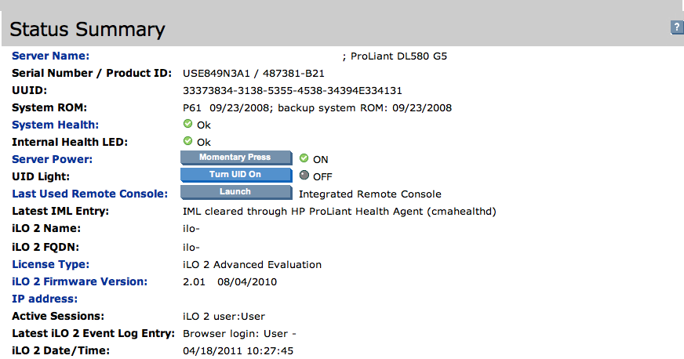
Quick status and UID Light

Slide 11
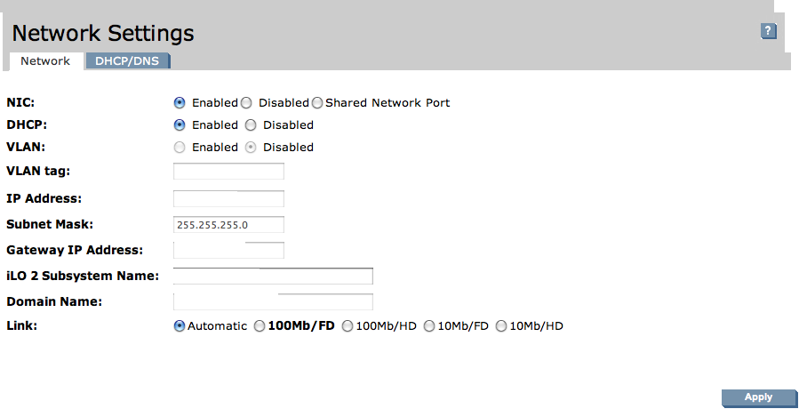
Share network Port

Slide 12
Ilo3
Bigger, faster, better
Uses JSON
As fast or faster than KVM console
800% faster than ilo2
Management device runs linux (of course)
Remote console built into .Net framework for windows
Jave interface for non-windows users

Slide 13
Advanced iLO3
Dynamic Power Capping
Phase shedding (Voltage Regulator)
Power profiles
Power Consumption usage (snmp section enabled)
License required ($300)

Slide 14
Advanced ilo Topics
SSH Key Authentication
LDAP or AD Authentication
Certificate Authentication

Slide 15
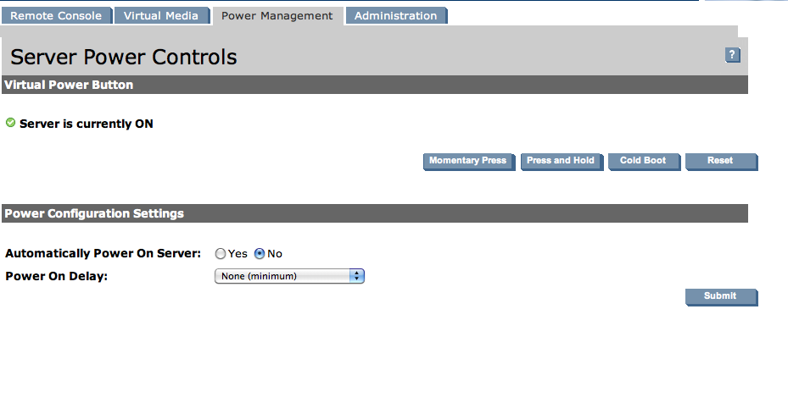
Server Power Controls

Slide 16
Deploying ilo
Basic workflow for deploying ilo:
Get unique password for each system (as the default)
Plug ethernet cable in to ilo port
Use nmap to find unique ilo-serial dns name
Goto http://ilo-ip
Enter unique password and configure from web console
Repeat for each server you have

Slide 17
Scripting Toolkit and RIBCL
XML Language used to configure ilo2 interfaces
<RIBCL VERSION="2.0">
<LOGIN USER_LOGIN="adminname" PASSWORD="password">
<SERVER_INFO MODE="write">
<SERVER_NAME value ="${HOST}"/>
</SERVER_INFO>
<RIB_INFO MODE="write">
<MOD_NETWORK_SETTINGS>
<REG_DDNS_SERVER value="Yes"/>
<DHCP_DOMAIN_NAME value="Yes"/>
<DHCP_ENABLE value="Yes"/>
<DNS_NAME value="ilo-${HOST}"/>
<DHCP_GATEWAY value="Yes"/>
<DHCP_DNS_SERVER value="Yes"/>
<DHCP_WINS_SERVER value="Yes"/>
<DHCP_STATIC_ROUTE value="Yes"/>
</MOD_NETWORK_SETTINGS>
</RIB_INFO>
</RIBCL>

Slide 18
Automating ilo Deployment
Install Proliant Support Pack (you need this regardless)
See readme before installing in your environment (HP likes to compile drivers for you)
Your Lpfc devices will disappear on RHEL 5.5+ and RHEL6
Make sure hponfig, hp-health and ilo device driver are installed
Write a XML file using the RIBCL XML Definations
Use hponfig to configure your ilo from the command line (no password needed!)
Send XML over https if you know the password
User your favorite language to automate sending XML over https

Slide 19
hponfig
Upgrade ilo firmware
Write current config in RIBCL
Upload RIBCL script to configure your ilo
NO PASSWORD NEEDED

Slide 20
Ilo Type for puppet
Very possible to create type in order to automate your ilo deployment.
Hponfig would be the provider. However, https can also be used.
ilo { “ilo2.0”:
ribclversion => “2.0”,
provider => “hponfig”,
hponfigpath => “/opt/hp/hponfig”
username => admin,
password => shhh_secret,
shared_network => true,
usedhcp =>true,
ip => “${someip},
}

Slide 21
Trade Secrets
Get a 60 day eval Advanced ilo license if you need Remote console.
Update your ilo firmware from the OS, SIM, or SMH
Might be able to use the shared network port feature
Use Static address
Stick on separate network / VLAN (Management Network)
Older ilos don’t support newer RIBCL commands

Slide 22
Helpful Links
ilo3
http://h20000.www2.hp.com/bc/docs/support/SupportManual/c00190541/c00190541.pdf
ilo2
http://h20000.www2.hp.com/bc/docs/support/SupportManual/c00553302/c00553302.pdf
Ilo2 Active Directory integration
http://www.techietips.net/Configure-Windows-ADS-Authentication-for-HP-iLO-2-card
HP Insight Foundation Page
http://h18004.www1.hp.com/products/servers/management/core-management-100.html

Slide 23
Contact and Source Code
Corey Osman – corey@logicminds.biz
git://github.com/logicminds/devops.git

Slide 24
Questions
?

