Slide 1
SNMP Management
Gateway to the monitoring world
Corey Osman
corey@logicminds.biz

Slide 2
Simple What? (.1.3.6.1)
Industry standard tool for retrieving information from a device or software stack on a network.

Slide 3
SNMP Breakdown
Agent (net-snmp, systemEDGE, others)
Client (net-snmp, rubysnmp, pysnmp,…)
Mibs
Oids
Monitoring Software (Software that uses a client)

Slide 4
Mibs
Database of all oids you can access
You must download a Mib to resolve the oid to a meaningful name.
Provided by Hardware or Software vendor
Jboss, Oracle, HP, Dell, Cisco

Slide 5
Object Identifier (OID)
Object that holds a single value
Tables
String, Numbers, boolean

Slide 6
Monitoring Software
Opennms -- open source
Nimsoft -- Adobe Flash/Flex framework frontend
Solarwinds -- Good for advanced beginners
Whats up Gold – Good for small shops
Nagios – open source

Slide 7
SNMP Monitoring Basics
Monitor values of OIDS (Polling)
Watch for specific values
Draw graphs of OID values over time
SNMP traps (easy way to receive data without polling)
Listen for traps

Slide 8
Quick Demo of SNMP

Slide 9
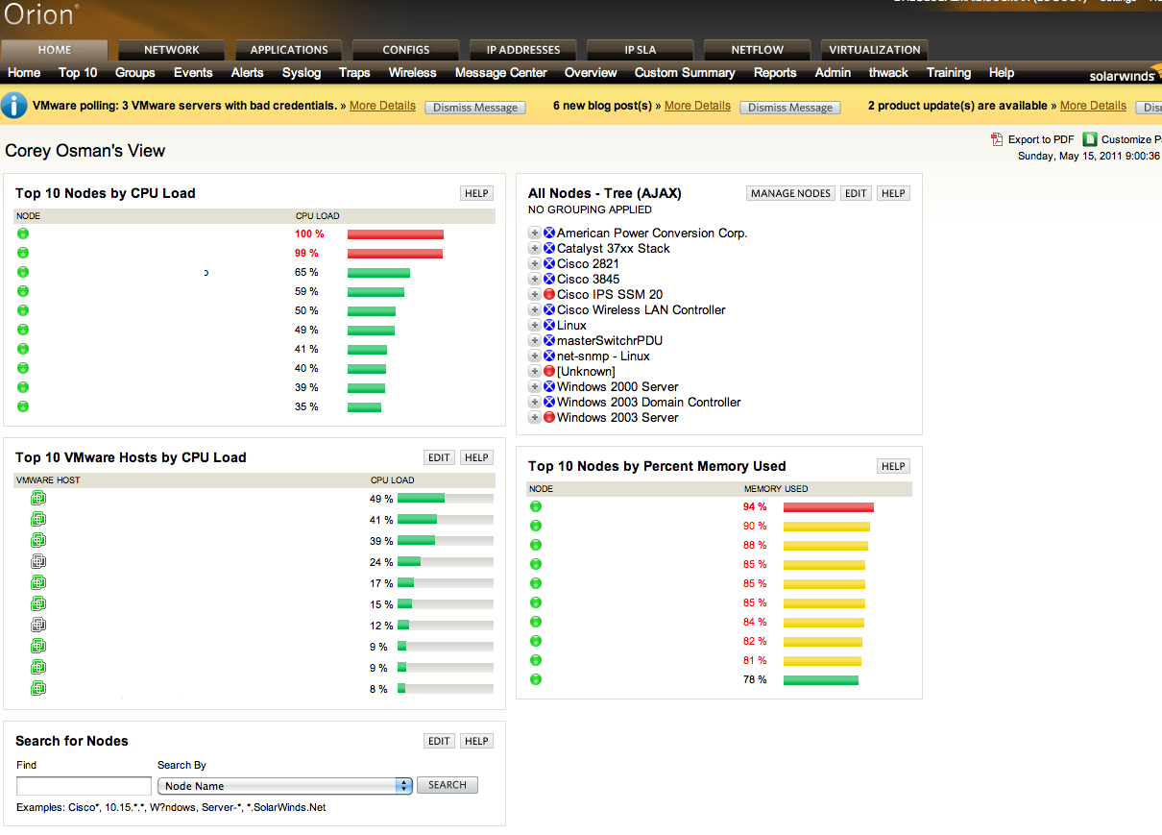

Slide 10
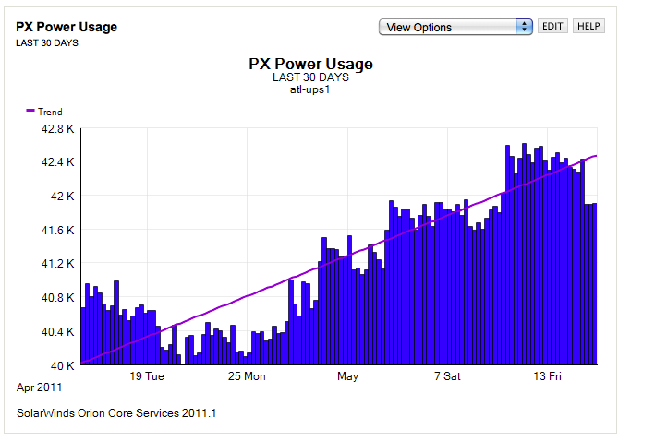

Slide 11
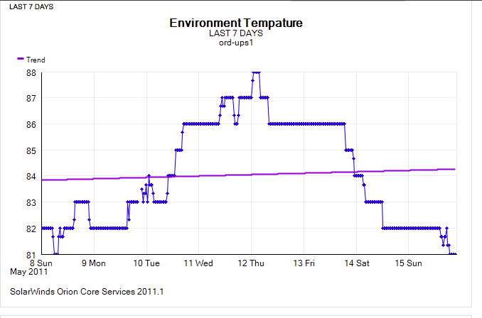

Slide 12
My Basic Needs
Device Dependency
Excellent Alerting Engine
Excellent Reporting Engine
RRD Like Graphs (multiple datapoints on a graph)
Easy to setup and backup
Support for 3rd party (API)

Slide 13
Helpful Tidbits
Users who demanded a nice GUI are only end users.
Don’t Judge a book by the cover.
Integration and well thought out API are key.
Alerting, Reporting and Configuration should be well designed.
Most used interface is SMTP

Slide 14
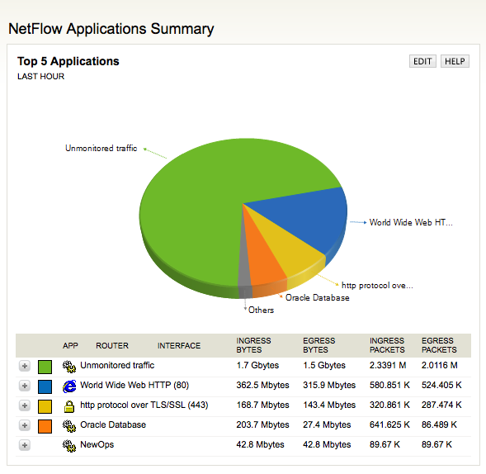
NetFlow

