Slide 1
ENTERPRISE SSD
Corey Osman
Logic Minds Corp
corey@logicminds.biz
Boost your infrastructure’s performance with SSD!
Notes:
In this presentation I want to show you how SSD helped solve my disk IO bottlenecks. In addition, I will talk about what to look for when shopping for SSD and the experience I went through after using SSD for 30 days.
With SSD now available at somewhat affordable prices, more companies are implementing SSD in their infrastructure to meet heavy IO demands.

Slide 2

I.T. Consulting Services
Remote Sys Admin Services
Datacenter Automation Services
Green I.T. Services

Slide 3
Preface
Only tested with RHEL 4 and OS X
Did not use Solaris or ZFS
Some numbers are approximations
Always be sure to do your own research and due diligence before implementing any solution

Slide 4
The IO Bottleneck Problem
Oracle DB was saturating a RAID 1+0 of 6 SAS drives (3G) during peak
IO wait times averaged10-24ms
Disk Percent Usage reached 100%
Memory/CPU was never an issue
IOSTAT was used to measure these metrics

Slide 5
Possible Solutions
Add expensive SSD
Add Tray of Disks and bigger controller
Add 2nd server
Use different filesystem (XFS, ASM)
Use direct access
Tune filesystem

Slide 6
Getting your Team on Board
Consider the lifetime of card after careful calculation
Concentrate on latency factor and increased performance
Consider a hybrid approach with current disk infrastructure if cost is a factor
Flash cache
Separate data

Slide 7
How Fast is SSD?
Let’s do a quick test…

Slide 8
Data Usage
Oracle DBA said 100GB for daily change write
Actual usage is approximately 2 TB daily
SSD card went from lasting 109 years to 5.47 years

Slide 9
Power Utilization
Fusion IO card
Min 5W – Max 25W
Intel 510 SSD
380 mW (active)
100 mW (idle)
Consider a PCI solution vs. 6 SSD drives and Raid controller

Slide 10
SSD vs. Magnetic
Metric | SSD | 15K SAS Magnetic
Latency | 26 microseconds | 2000 microsecs
Price | $2 - $20 / GB | $0.05 - $0.20 / GB
Bandwidth | 250 – 800 MB/s | 200 MB/s
IO | 30K – 511K IOPS | 210 IOPS
Seek time | 26 microseconds | 3400 microsecs

Slide 11
SSD vs. Magnetic: Differences
No moving parts
Lower power usage by 33%-50%
Not affected by Magnets as much
Potentially longer life span
Much higher IO rate
Low latency
SSD doesn’t get carsick (provided it’s removed from PCI slot)

Slide 12
SSD vs. Magnetic: Similarities
SSD and Magnetic media do not perform well in excessive heat (over 170 degrees)
Both have drivers to configure (PCI version)
Both can be monitored via snmp or S.M.A.R.T.

Slide 13
Enterprise vs. Consumer
Wear limit
Number of sensors
Warranty period
Auto shutdown on heat issues
Read-only mode after wear limit

Slide 14
HP SSD
Size | Type | Cycles | Cost | Time | RW
200GB | SLC | 21 PB | $4,800 | 12.9 years | 350/160
400GB | SLC | 42 PB | $6,200 | 20.1 years | 415/180
200 GB | MLC | 2.23 PB | $2,400 | 3.4 years | 320/100
400 GB | MLC | 4.5 PB | $4,200 | 4.7 years | 310/110
800 GB | MLC | 6.8 PB | $11,000 | 6.8 years | 400/130
No block size was given for these calculations

Slide 15
Value Enterprise SSD
Axium Memory - difficult to see the value
Block size at 128K
Size | Type | Cycles | Cost | Time | RW
60 GB | MLC | 22 TB | $250 |  | 250/170
120 GB | MLC | 22 TB | $450 |  | 250/220
240 GB | MLC | 22 TB | $800 |  | 250/220
32 GB | SLC | 1 PB | $600 |  | 250/170
60GB Up to 31K IOPS – Random Read @ 4K blocks Up to 11K IOPS – Random Write @ 4K blocks
120GB & 240GB Up to 31K IOPS – Random Read @ 4K blocks Up to 20K IOPS – Random Write @ 4K blocks

Slide 16
SSD vendors
Vendor | Common Use
Fusion IO | Enterprise Grade
OCZ | Enterprise, Consumer
OWC | Consumer Mac
Intel | Consumer

Slide 17
Life expectancy
SSD have a max cell cycle count (wear limit)
Easy to estimate when SSD will die
Media status: Healthy; Reserves: 100.00%, warn at 10.00%
Lifetime data volumes:
Physical bytes written: 52,811,538,026,560
Physical bytes read: 51,021,930,005,880

Slide 18
Types of Flash
MLC
Cheaper
Older technology
SLC
Expensive 2x cost
2x performance
10x wear limit

Slide 19
SSD Form Factors
PCI express
Standard drive form factors (3.5”, 2.5”)

Slide 20
Interface Bottleneck
SSDs can easily saturate an Interface because of their speed
Sata 3G is not enough
Controllers may be a bottleneck too
P400 has max 2GB/s
PCI express cards resolve the bottleneck issue
Require at least 4 lanes
Sits directly on the PCI Bus (lower latency)
32 total lanes for 16GB/s total throughput

Slide 21
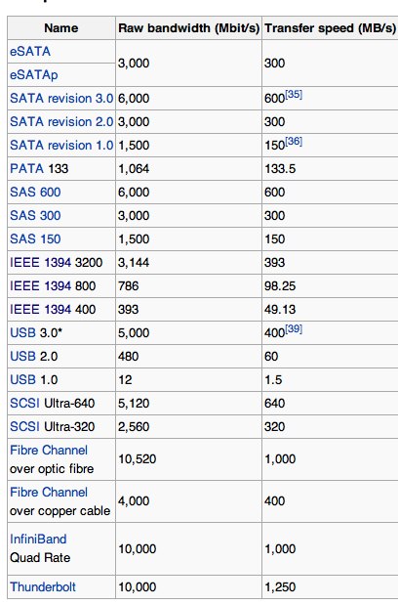

Slide 22
Reliability
Slows down when gets hot
Goes into read only mode when heat threshold is met
Goes into Read-only when wear limit is reached
No moving parts

Slide 23
Fusion IO Fault Tolerance
Status LEDs on PCI slot to show when the SSD has issues
Sends alerts via snmp traps
Intelligently marks bad cells
Provides health status
Great monitoring tools provided by Fusion IO

Slide 24
Latency
One of the biggest advantages of SSD over magnetic media
26 microseconds vs. 3000 microseconds
Reaches the data 115x faster!

Slide 25
Longevity
Varies from product to product
Measured in total bytes written or cycle counts
Product | Limit
Fusion IO MLC | 4-8 PB
Fusion IO SLC | 50 PB
Fujitsu SSD (MLC) | 30 TB

Slide 26
Cost
Product | Cost
Fusion IO 320 GB MLC | $7,000
Fusion IO 320 GB SLC | $15,000
OWC Extreme Pro 240GB | $529
OCZ Revodrive 2 | $600
OCZ 1TB VeloDrive PCI | $5,500

Slide 27
Choosing the Right SSD
PCI or SATA
Consumer or Enterprise grade
MLC vs. SLC
Total cycle count
Supported Operating Systems
On board controller( sandforce)
Fusion IO or rebranded (HP, Dell, …)
Total IOPS
Total Bandwidth
Latency

Slide 28
Benchmarking
IOSTAT (part of Sysstat package)
FIO tool (Raw Disk performance)
Watch IOWait times
System commands are not good to test RAW performance

Slide 29
Problems with SSD
Difficult to understand all of the differences
Some people want to use SSD just like a magnetic disk
Most people are quick to blame the unknown

Slide 30
Block Size
Size that the filesystem will use to read and write data
Larger block sizes will help improve disk IO performance when using large files, such as databases
Smaller block sizes require more IOPS to push the same amount of data
More IOPS require additional CPU, Memory

Slide 31
Block Size is Important
A SAS 15K drive can do 300MB/s too at 1MB block size
An SSD can do 300MB/s at virtually any block size (4K plus)
SSDs can perform great because of the high number of IOPS. 40,000 IOPS vs 300!

Slide 32
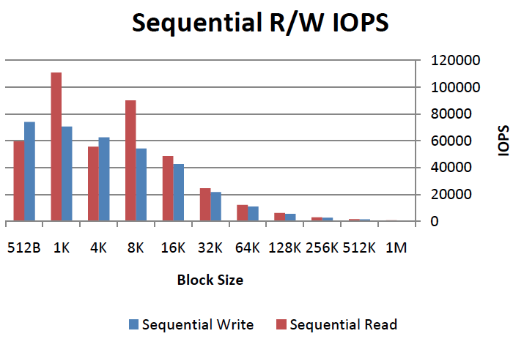
IOPS Chart

Slide 33
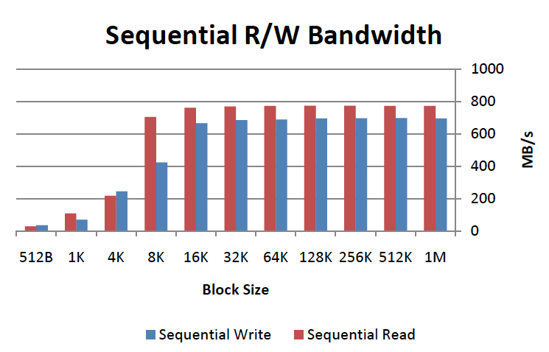
Bandwidth Chart

Slide 34
Page Cache
Filesystem pre disk cache used to speed up access to files on disk
Block size cannot be bigger than the disk page cache

Slide 35
Filesystem Bottlenecks
Block size can be a limiting factor
Max of 4K on EXT3
XFS gives better options
Number of IOPS
EXT4 allows up to 64K block size for x86_64 systems

Slide 36
RAID and SSD
Striping is good
Redundancy decreases performance
Redundancy removes TRIM support
Avoid using Volume Manager
Integrated controllers are a better option but add latency
All drives in RAID will die at the same time

Slide 37
Usage with Oracle
Use oracle ASM for direct control of SSD drives
Use XFS filesystem for improved performance
Use raw devices with Oracle (within 3%)
Use DirectIO with Oracle with EXT3
Try different sized block sizes within Oracle
At least 32K
raw /dev/raw/raw1 /dev/sda
raw /dev/raw/raw2 /dev/md1
raw /dev/raw/raw3 /dev/vol1

Slide 38
Need IO (not a blank check)
The cost of a new server far exceeds the cost of an SSD card
Physical Server (most costly)
OS license
Oracle license
Shipping
Adds environment cost (space, power, networking, cooling)

Slide 39
Problems Solved
Low latency, IOWAIT averages less than 1ms
Programmers can continue to write bad code (to some extent)
No need to purchase additional server with additional licenses

Slide 40
Flash Cache in front of SATA
Cost-effective way to add high-performance storage
Add SSD flash drive in Netapp filer
Acts as a huge cache for SATA drives
Can be as fast as FC 15K drives
This method can also work in a server

Slide 41
Hypervisor Use
Greatly speed up VM storage
Use SSD as swap storage for VMs

Slide 42
Questions?
Contact:
corey@logicminds.biz
LinkedIn: Corey Osman

