Slide 1
Simulation and Knowledge Acqusition using ResearchCyc
CyN-D and BURC
By Kino Coursey and Douglas Miles
at Daxtron Labs and University of North Texas
(kino@daxtron.com)

Slide 2
Overview
CyN-D
  History
  Goals of research
  Architecture of CyN-D
  Applying Cyc to AIML and Doom
BURC: Reading and finding connections
  What is Common Knowledge
  One method to mine for it using Cyc
  Results of results
  Next steps
How they fit together
Future Goals

Slide 3
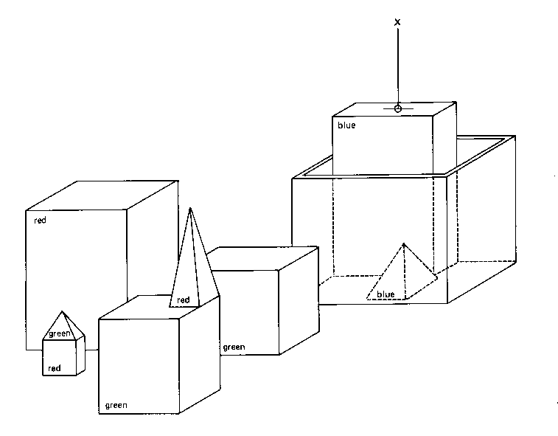
THEN: SHRDLU (1970)

Slide 4
SHRLDU Dialog
What does the box contain?
THE BLUE PYRAMID AND THE BLUE BLOCK.
What is the pyramid supported by?
THE BOX.
How many blocks are not in the box?
FOUR OF THEM.

Slide 5
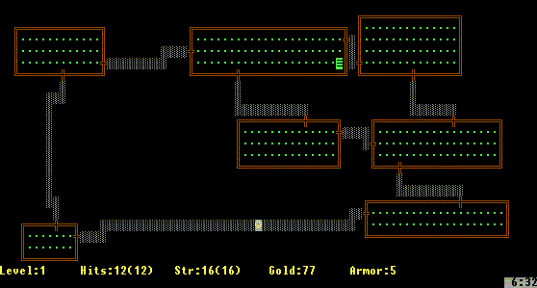
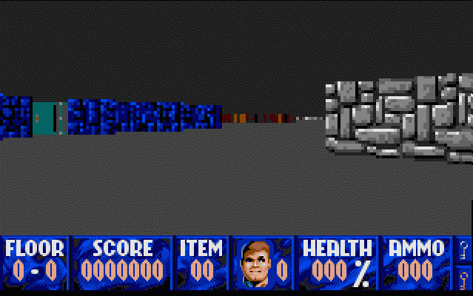
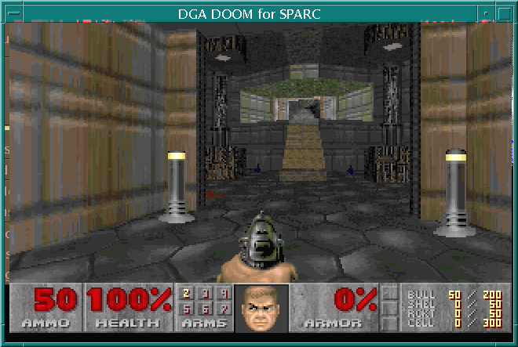
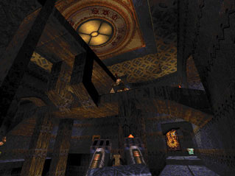
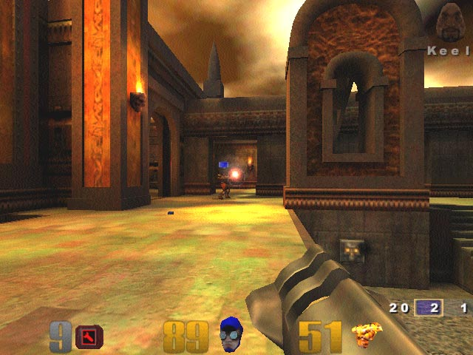
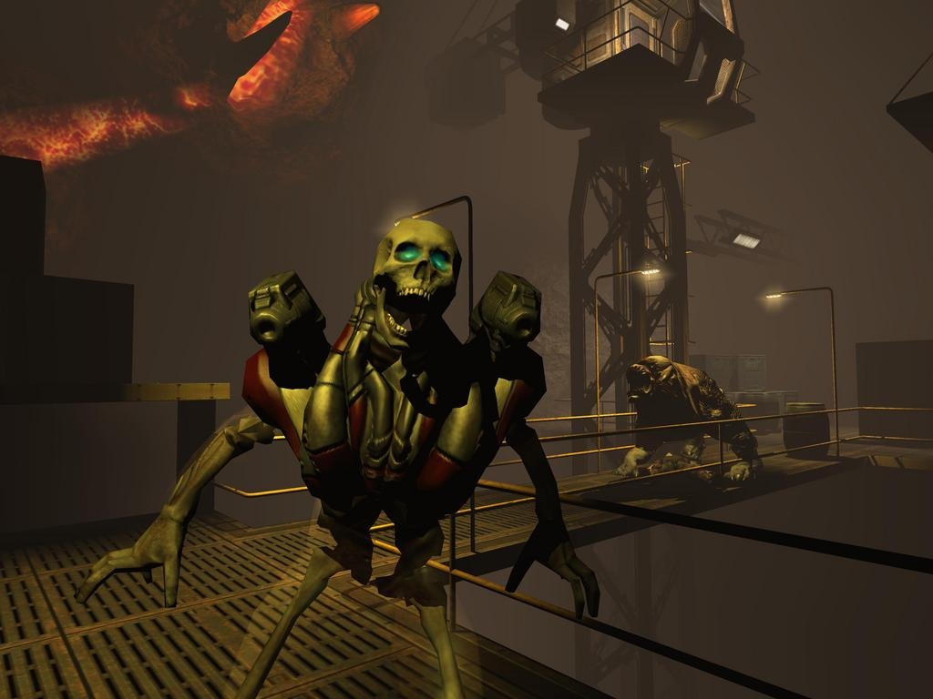
The Dramatic Improvement in Desktop Game Realism
(1983)
(1991)
(1994)
Rogue-Adventure
Wolfenstein 3D by id
DOOM by id
(1999)
(2004)
(1996)
Quake by id
Quake III by id
DOOM 3 by id
http://agents.media.mit.edu/projects/videogame/

Slide 6
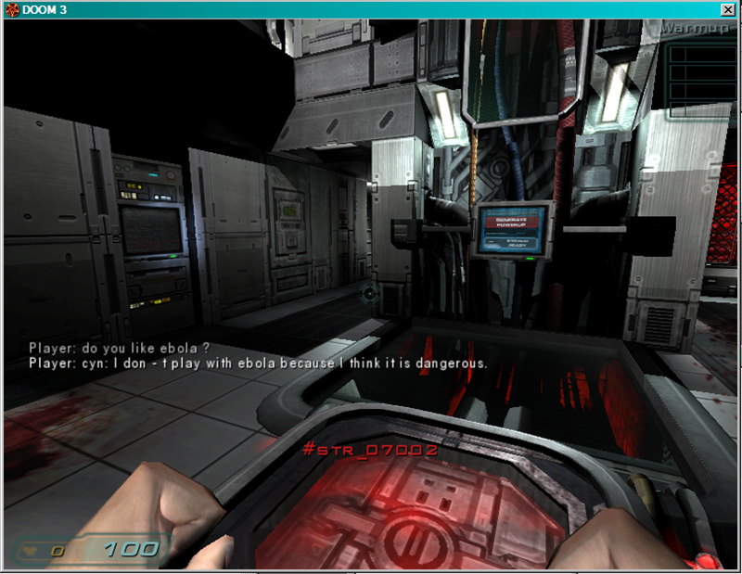
NOW : CyN in Doom3 (2005)

Slide 7
Basic Idea
What would SHRDLU 2005 look like?
Use modern inference engines, natural language processing and simulation
  ResearchCyc version of Cyc commonsense reasoning engine
  CyN AIML driven language front-end
  Doom3 game engine for 3D environment
Integrating all of them ‘properly’ is the real challenge
Develop an easy to use, interactive agent system in a 3D environment that is extendable

Slide 8
CyN-D development Goals (1)
provide a pattern based parser for use with Cyc tools suitable for chatbots / virtual human experimentation and basic knowledge entry of logical relationships
be an interpreter that allowed an easy way to interface AIML to Cyc tools
create a set of example AIML categories to answer questions using Cyc tools
provide a toolkit for experimentation with both systems

Slide 9
CyN-D development Goals(2)
provide a natural language front-end ahead of the current Cyc tool release schedule
be a tool capable of creating a “personality” for Cyc systems
be scaleable (AIML sets have 40,000 language patterns and full Cyc has 1.6 million facts)
be a tool that can be integrated with other systems
be low-cost and open.
The original CyN is open source
Cycorp adopted white paper “Living in CyN : Mating AIML and Cyc Together in Program N”
  http://www.cyc.com/doc/white_papers/Cyn_description.pdf

Slide 10


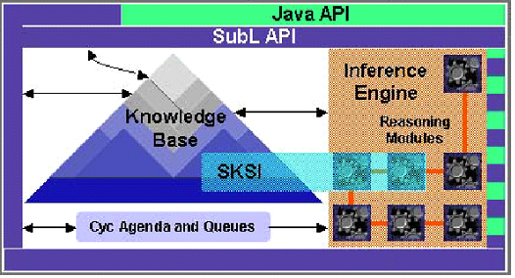


CyN-D Environment
Editor / Object Browser
Cyclograph Viewer
Jinni Prolog Interpreter
AIML Interpreter
Cyc API in Java
Java Virtual Machine
Doom 3 World Simulation System
Doom3 Rendering Engine

Slide 11
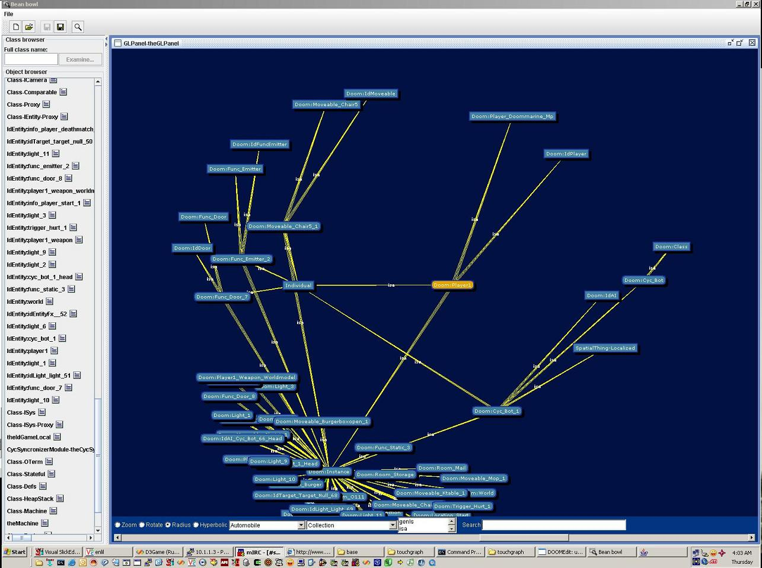
Cyclograph browser

Slide 12
What is Cyc?
“the world's largest and most complete general knowledge base and commonsense reasoning engine”
Started in mid 1980’s (“should take only 10 years….”)
Logic Based
LISP oriented
For WordNet users, each Concept ≈ Synset
Available from http://www.opencyc.org
http://researchcyc.cyc.com
Big (ResearchCyc v0.8)
  Constants 89,379
  Assertions 968,985
  Deduction 361,185
Sample Collection Extents
  EnglishWord 18,007
  Event 6,050
  PartiallyTangible 24,387
  Microtheory 1,688

Slide 13
What is AIML
“The HTML of Chatbots”
Alicebot is the best known example, as the Lobner Prize winner. “Eliza 2005”
Simple XML format for specifying surface linguistic patterns and responses.
Very easy to learn, hence its popularity
Includes recursive decomposition and topic / context sensitive features
CyN restores original capability to execute arbitrary programs in addition to generating responses

Slide 14
AIML using Cyc for Q/A
AIML Code fragment activated by question
  <category>
    <pattern>DO YOU LIKE *</pattern>
      <guard>
      (fi-ask '(#$genls <cycterm><star index="1"/></cycterm> #$DangerousThing) #$EverythingPSC) </guard>
    <template>
    I don't play with <star index="1"/> because I think it is dangerous.
    </template>
  </category>
The system uses Cyc’s knowledge of things to express an opinion. In this case it doesn’t play with items Cyc thinks are dangerous. This is a quick way of specifying agent responses based on Cyc’s knowledge of things.

Slide 15
Asking a D3 character about dangerous things
Do you like Ebola?
I don't play with Ebola because I think it is dangerous.

Slide 16
Semantic Patterns using Denotational Mapper and Genls
<category>
<pattern>WHO IS THE * OF *</pattern>
<guard>(<cycterm filter="BinaryPredicate“ ><star index="1"/></cycterm>
<space/> <cycterm><star index="2"/></cycterm> ?REPLY)</guard>
<template>
I believe <cycsystem>(cyc-query '(<cycterm filter="BinaryPredicate“ ><star index="1"/></cycterm> <space/> <cycterm><star index="2"/></cycterm> ?REPLY) #$EverythingPSC)</cycsystem> defines the <cycterm filter="BinaryPredicate"><star index="1"/></cycterm> of <cycterm><star index="2"/></cycterm>.
</template>
</category>

Slide 17
KB lookup
who is the spouse of Bill Clinton ?
[ I believe (((?REPLY . #$HillaryClinton))) defines the #$spouse of #$BillClinton. ]
what is the population of Sweden ?
[ I believe (((?REPLY . 8865051))) people live in Sweden. ]
who is the wife of Bill Clinton ?
[A 20th century celebrity of some sort?]
who is the mate of Madonna ?
[ I believe (((?REPLY . #$SeanPenn))) defines the #$mate of #$Madonna. ]

Slide 18
Cyn-D Keypoints
Characters can utilize Cyc and AIML in their natural language processing
Game events and data are reflected in the ontology
The ontology is used to generate and infer game information
Character planning using Cyc’s representation of the world
Multiple tools co-exist in the Java VM space utilizing both Cyc and Doom as needed

Slide 19
BURC: Bootstrapping Using ResearchCyc
Goal: To extend Cyc’s knowledge base using “relationships implied to be possible, normal or commonplace in the world”
Prior work with Cyc knowledge entry has been manually oriented
How will we collect commonsense without a body and manual labor…?
Read, Parse, Mine!
Proposal: Read text, Parse into a database, Extract relations between words, Propose hypothetical relations between concepts

Slide 20
What Is Common Knowledge ?
Using an information channel model
  Information the Sender considers the Receiver to already know
  If the Sender does sends the info then …
    Receiver will consider the Sender to ‘lack intelligence or experience’ (The sender is stupid).
    Receiver will believe the sender thinks the Receiver ‘lacks intelligence or experience’ (The sender thinks I’m stupid, and needs to tell me)
    Possibly the Sender is clarifying which among many possible common options they mean in this case
  Since both parties know the information to send it would generate negative information content / wasted bandwidth
Explains why it is hard to find common sense on the Internet!

Slide 21
BURC: Basic Analogy
The Shotgun approach to the Human Genome
Extract millions of fragments
Knit them back together by finding commonalities
Will it work for the Human Menome?
James Burke: ‘Mr. Connections’

Slide 22
Bootstrapping with ResearchCyc
Cyc has vocabulary about objects in the world and relationships
However it always can use more
BURC uses what Cyc already has + lots of parsed text to create new Cyc entries for common relationships found in the text
Lenat’s Bootstrap Hypothesis: once Cyc reaches a certain level/scale it can help in its own development and start using NLP to augment its knowledge base
BURC should help test this hypothesis

Slide 23
The BURC Process:
From seeds…Hypothe-seed’s
Use the Rosetta link grammar parser for bulk parsing of text, primarily narratives based in ‘worlds like ours’. Other text styles could be included.
Operates in two directions:
  Forward from text to CycL
  Backwards from existing CycL to the text to find new forward patterns

Slide 24
BURC Process - 2
Load the link fragments into a database (1 and 2 link fragments), and compute frequency of fragment occurrences. The database will be in a SQL format so multiple queries can be formed dynamically. [Read Once/Use Many]
Using Cyc knowledge as a starting point (the seeds), extract knowledge for use in Cyc:
  Given a set of seed facts in Cyc, identify how those facts are represented as link fragments in the database
  Generate conjectures as to new knowledge AND new knowledge extraction patterns using the fragment patterns.

Slide 25
BURC Process - 3
Use Cyc knowledge directly to conjecture new statements:
  Cyc has lexical knowledge, which can be used as templates against the DB to form new statements
  For example, common adjectives applied to noun classes
  Cyc knows “WhiteColor” and “Blouse” but does not know that white is a common blouse color, although it becomes apparent after reading some text
Optionally, gather supporting background statistics for hypothesis verification using other sources:
  Perhaps Google desktop with a larger than fully parsed corpus
  Perhaps check against answer extraction engines

Slide 26
Mining Adjective Knowledge Example
“white blouse” as factoid fragment
In Link Grammar format [white.a | a | blouse.n]
Potentially test using an internal or search engine relevancy metric [GC=70400]
(adjSemTrans White-TheWord 11 RegularAdjFrame (mainColorOfObject :NOUN WhiteColor))
Hypothesis : (plausibleValueOfType Blouse mainColorOfObject WhiteColor)

Slide 27
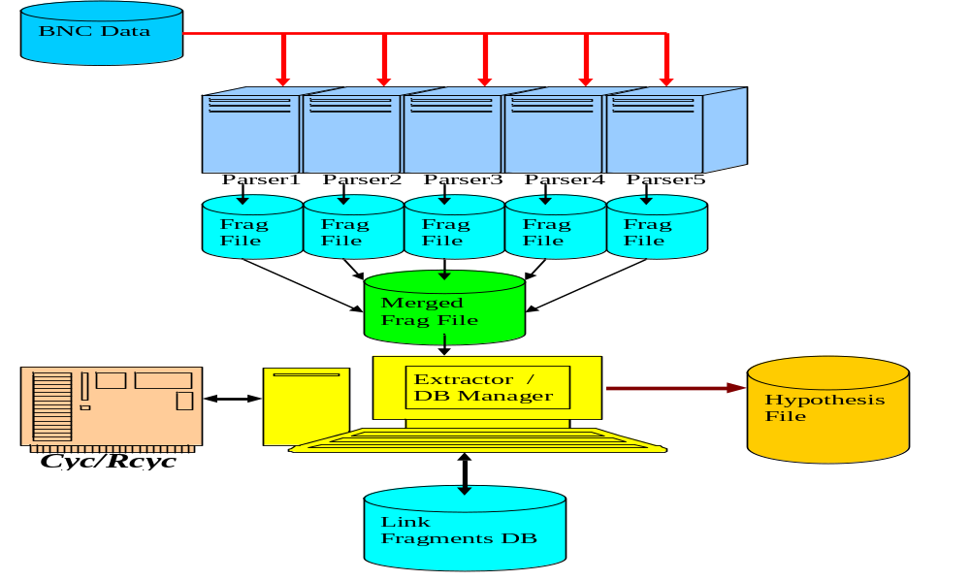
Flow of Processing

Slide 28
Running the system
Used a filtered set of the BNC (650 Meg of data)
5 parsers running in parallel for 70 hours generated 1.91 Gig of output
Reduced to 1 Gig of unique records with counts
783 Meg or 22 million fragments

Slide 29
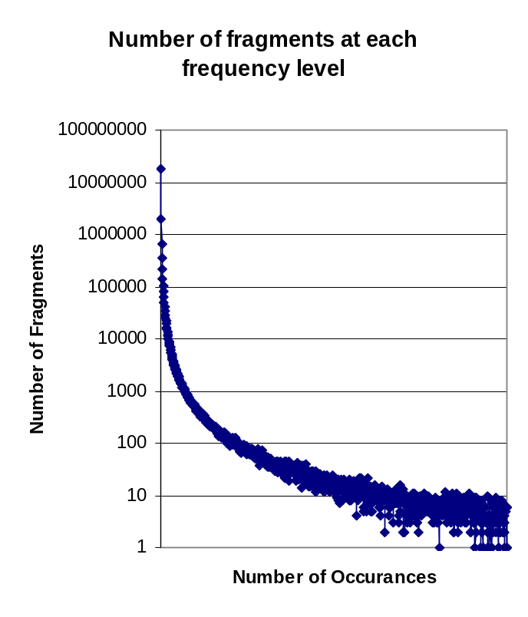
Frequency of Fragments
The distribution of fragments follow a smooth curve in log space
Similar to zipf distribution for words, characters and n-grams

Slide 30
The Hunt for Common Fragments
Forward mining was run over adjective links with more than one fragment and subject-verb with more than two fragments
In both cases this was approximately the top 15% for each search class

Slide 31
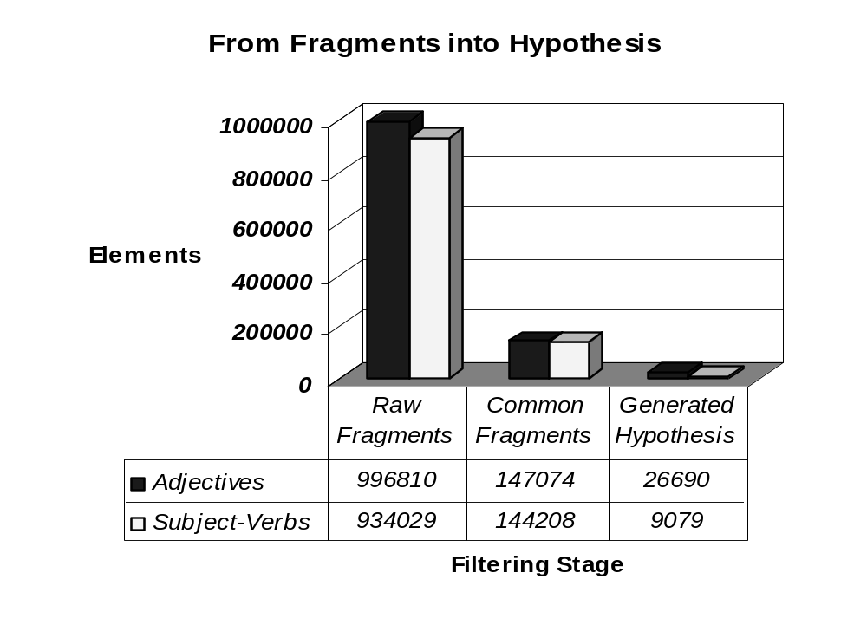
Reductions

Slide 32
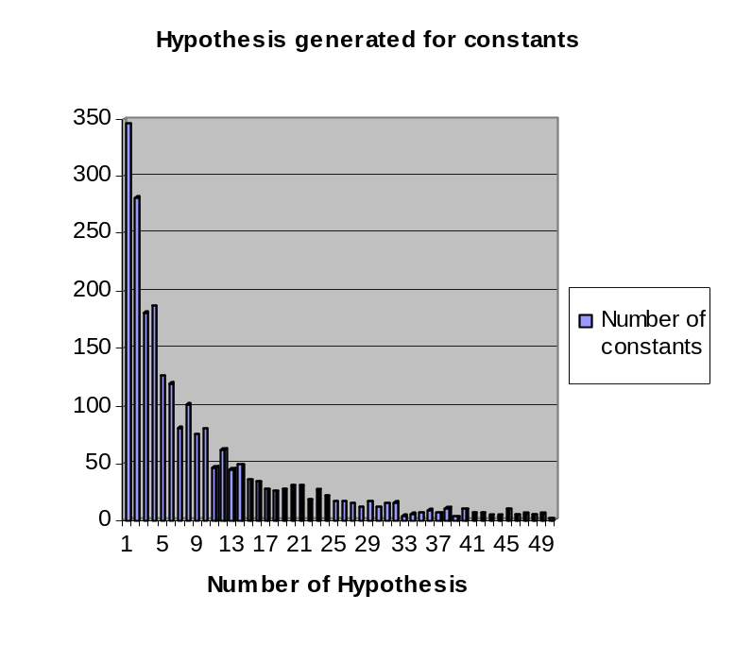
A source of potential knowledge
The various versions of Cyc have 10 to 20 assertions per constant
BURC generates 14.29 hypothetical assertions per constant
Need to quantify the quality of BURC knowledge

Slide 33
Semantic Filtering
BURC can use Cyc’s knowledge of what things can perform what actions or have what attributes to filter out implausible relationships.
  (#$behaviorCapableOf #$Finger #$CausingAnotherObjectsTranslationalMotion #$doneBy)
  (#$behaviorCapableOf #$Finger #$ChangeOfResidence #$performedBy)
  (#$behaviorCapableOf #$Finger #$Inspecting #$performedBy)
  (#$behaviorCapableOf #$Finger #$Movement-TranslationEvent #$primaryObjectMoving)
  (#$behaviorCapableOf #$Finger #$MovementEvent #$primaryObjectMoving)
  (#$behaviorCapableOf #$Finger #$PushingAnObject #$providerOfMotiveForce)
  (#$behaviorCapableOf #$Finger #$Sliding-Generic #$objectMoving)
  (#$behaviorCapableOf #$Finger #$Sliding-Generic #$primaryObjectMoving)
  (#$behaviorCapableOf #$Finger #$Slipping #$objectMoving)
  (#$behaviorCapableOf #$Finger #$Slipping #$primaryObjectMoving)
Cyc can help in its own knowledge entry process. 62% of hypotheses can be filtered out using semantic filtering.

Slide 34
BURC Future Work -1
Modify Cyc to utilize the extracted knowledge
  Question generation (curiosity ?)
  Noticing exceptions
Update parser and generate data in other knowledge formats (i.e. OpenMind/ConceptNet)
Generate better filtering methods for polysemous words in fragments
Use synonyms and antonyms to expand hypothesis using WordNet
Examine effect of reporting the unusual instead of the usual

Slide 35
BURC Future Work -2
Define admissibility criteria. How much evidence is necessary to consider a fact worthy of addition to the KB as commonplace?
Determine performance relative to and in conjunction with volunteer commonsense knowledge entry projects.
Create an interface for quick review of hypothesis by humans.
Utilize knowledge and experience on the backwards miner

Slide 36
Can we ever be “Done” ?
Explore definition of semantic coverage metrics for unmapped domains.
The space of 2.4K of binary predicates applied to 85K constants provides a 16 trillion combination search space, only a fraction of would be considered part of ‘common knowledge’.
It is a big space, but finite and within range of current technology

Slide 37
BOOM: How does it all fit?
From the web common sense is mined using knowledge extraction and verified with simulation and interaction
Web
D3Sim / Mirror World
BURC
BURC DB
Objects
RCyc
OCyc
AI Proxy
.script
CyN
AIML KB
AI character
.script
Body
Proxy

Slide 38
Overall Benefits (1)
BURC lets Cyc do what people always wanted: have the AI expands its knowledge by reading texts
Concrete cross domain training environment
  Opens Cyc to the simulation, gaming and chatbot programmer communities
  Provides Cyc users with chatbots and 3D engines
Be a test bed to answer: Is this a good interface model?
The Big Language Test: Can more people, describe and solve more problems, more easily with computers?
Isn’t this what Turing was really after ?

Slide 39
Overall Benefits (2)
Moves towards the goal of “Holodeck characters” as an interface
Expands Cyc’s representation and interface capabilities
  Representing the D3 environment in Cyc
  Spatial and other planning can be simulated in the D3 engine
  Potential for Cyc to “show” the user the results of its logic
  Dealing with a ‘messy’ environment
Provides Cyc with personality
Provides chatbots with first-order logic

Slide 40
CyN-D and BURC Goals
Develop applications of ResearchCyc
Modify and expand the KB using natural language
Provide multiple interaction methods
Control internal and external processes
Given a goal , develop plans to achieve them
Be aware of its capabilities and limitations
Explain its reasoning (more completely through the web interface)

