Slide 1
Introduction to SWI-Prolog
Class Project overview
Session starts at 6pm PDT
(about 5 minutes from now)

Slide 2
Once upon a time there was a brave little girl named Alice.
One day Alice baked a fresh pie to give to her grandmother, who lived in the woods. ....

Slide 3
3 Phase Project
Build a STRIPS type planner
Use the planner to build a TALESPIN story generator
Put it on the web, make it customizable

Slide 4
Planner
Initial conditions
Goals
apply actions until you reach the goals

Slide 5
Actions
PreReqs [object_in(Thing, Location),
player_in(Location)]
NegPreReqs [carrying(_)]
Add [carrying(Thing)]
Remove [object_in(Thing, Location)].
Description'player picks up ~w in location ~w'- [Thing, Location]

Slide 6
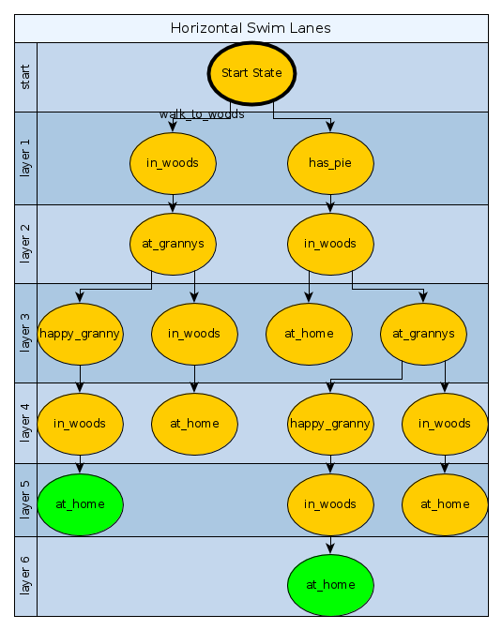
Shortest Plans First

Slide 7
Open and Closed
Put newly discovered states on a queue called the Open set.
After all children are on the queue, add the state to the closed set.
Never put states in the closed set back on the queue
explore states on the front of the queue

Slide 8
Explore states
Am I at the goal?
Am I at a dead end?
figure out what children I have (what can I do here?) and add the unique ones to the Open set.

Slide 9
TALESPIN
make a plan using the planner

Slide 10
TALESPIN
make a plan using the planner
Simulate - At each step, roll a die. Sometimes have ‘events’ happen

Slide 11
TALESPIN
make a plan using the planner
Simulate - At each step, roll a die. Sometimes have ‘events’ happen
If an event happens, change the outcome of the action

Slide 12
TALESPIN
make a plan using the planner
Simulate - At each step, roll a die. Sometimes have ‘events’ happen
If an event happens, change the outcome of the action
Make a new plan based on new state

Slide 13
TALESPIN
make a plan using the planner
Simulate - At each step, roll a die. Sometimes have ‘events’ happen
If an event happens, change the outcome of the action
Make a new plan based on new state
Go to step 2

Slide 14
Goals
When we make a plan, we need goals
Could make a ‘live happily ever after’ goal to some done state
if you encode a goal as part of the state you can avoid complexity [at_home, goal(at_store)]

