Slide 1

Python For Beginners
Logicops Lab

Slide 2
Roadmap
Python installation
Strings and Variable
Math and Numbers
Conditionals and Booleans
Functions
Lists
Dictionaries
Tuples
Files
Modules and play around Python Library

Slide 3
Before you start you must know
History
Advantages
Python 2 vs Python 3
Which one you should learn?

Slide 4

History of Python
Released in 1991
Created by Dutch programmer Guido Van Rossum
Current version 3.9.0
One of the most commonly used and learned languages today.
Netflix, Uber, Reddit, Spotify, etc

Slide 5
Advantages
Flexibility
Automatic Memory Management
Huge and expansive library
Readability
Open-source
Simplicity and Ease of usage
Interpreted Language
Portability

Slide 6
Python 2 vs Python 3
Python 3 is a multi-paradigm language, Python 2 lacs a lot
Syntax differences
Eg - Print “hello” in Python 2 becomes print (“hello”)
Python 2 is not forward compatible
Dividing numbers
Python 2 would round down to the nearest whole number in integer division (5 divided by 2 returns 2), while Python 3 gives the exact number (5 divided by 2 returns 2.5).

Slide 7
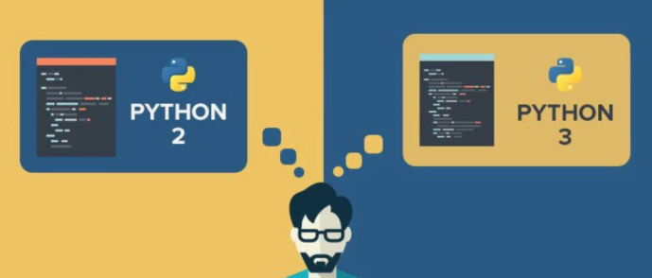

Which one you should learn?
Python 3 is clearly a winner

Slide 8
Getting started
Python installation
Writing python programs
Running python programs

Slide 9
Variables
Variable
a) Storage location with a name
b) A pair of a name and it’s value
Syntax : dog = ‘husky’, dog = ‘Shiba Inu’
Things to remember
a) Case sensitive (Husky, husky, HuSkY are all different variables, but allowed)
b) MUST start with a letter but can contain numbers (7Seven is wrong, Seven7 is right)
c) Underscores are allowed other special character, NOPES! (my_age is just fine)

Slide 10
Strings
Strings
a) Declared in “” or ‘’ (Quotes)
b) Text representation
Syntax : dog = “husky”, dog = ‘Shiba Inu’
To include quotes in Strings
para = ‘Hey, there! “Did you get my pizza?”’
para = “Where’s my PIZZA??”
single_quotes_in_a_sentence = “He asked, \”Where’s my PIZZA??\””
double_quotes_in_a_sentence = ‘He asked, “Where\’s my PIZZA??”’

Slide 11
Strings (Contd)
Strings has its own Indexing
dog = ‘husky’
String : h u s k y
Index : 0 1 2 3 4
h = [0] Index
s = [2] Index
y = [4] Index
How to access a character in a String?
Eg : last_char = dog[4]

Slide 12
Functions
A function is a group of statements/commands that together perform a task
It is reusable and can be called any number of times
Function is declared with a name and is called/executed by that name only
A function may or may not have any arguments to accept or return any data.
Types
a) Built-in : Already available functions
b) User-defined : Created by users to get a certain result
c) Anonymous : Also called as Lambda functions

Slide 13
Functions (Syntax)
Types
a) Built-in : print(), len()
Link - https://docs.python.org/3/library/functions.html
b) User-defined : Created by users to get a certain result
Syntax - def my_function(): print("Hey! I am a function") my_function()
c) Lambda functions – Small anonymous function that can take any number of arguments, but can have only one expression
Syntax – lambda arguments : expression
Eg : x = lambda a : a + 20 print(x(10))

Slide 14
Functions – With or Without Parameter
Parameter Vs Arguments
Parameters are the names used when defining a function or a method, and into which arguments will be mapped. In other words, arguments are the things which are supplied to any function or method call, while the function or method code refers to the arguments by their parameter names.
Eg :
def sum(a, b) : Here, a and b are the Parameters
While calling sum(10, 20) : Here 10 and 20 are the arguments passed
Non parameterized function is the one to which no arguments are passed, and it contains no parameters while declaration

Slide 15
OOPS – Object Oriented Programming
Object-Oriented Programming(OOPs), is all about creating “objects”. An object is a group of interrelated variables and functions.
Object-Oriented programming is famous because it implements the real-world entities like objects, polymorphism, inheritance, etc in programming. It makes visualization easier because it is very close to today’s real-world scenarios.

Slide 16
OOPS – Concepts
Class
Objects
Polymorphism
Encapsulation
Inheritance
Abstraction

Slide 17
OOPS – Class
A Class is a collection of Objects. It is just a blue print or a prototype.
Created by keyword ‘class’
Attributes are always public and can be accessed using the dot (.)
a) Myclass.Myattribute
b) object.Myattribute
Syntax
class class_name:
class body (Can have methods and statements)

Slide 18
OOPS – Object
When we define a class only the description or a blueprint of the object is created. There is no memory allocation until we create its object. The objector instance contains real data or information.
Syntax : obj = ClassName()
An object has : (Class : Dog)
a) State : Like breed, age, etc
b) Behaviour : Barking, Sleeping, etc
C) Identity : Name

Slide 19
OOPS – The Self
Class methods must have an extra first parameter in the method definition. We do not give a value for this parameter when we call the method, Python provides it
If we have a method that takes no arguments, then we still have to have one argument.
Self represents the instance of the class. By using the “self” keyword we can access the attributes and methods of the class in python.

Slide 20
OOPS – Polymorphism
Polymorphism simply means having many forms. For example, we need to determine if the given species of birds fly or not, using polymorphism we can do this using a single function.
An object has : (Class : Dog)
a) State : Like breed, age, etc
b) Behaviour : Barking, Sleeping, etc
C) Identity : Name

Slide 21
OOPS – The __init__ method and pass
__init__ : Similar to constructors in Java & C++. It is run as soon as an object of a class is instantiated. The method is useful to do any initialization you want to do with your object.
__init__ : It is one of the reserved methods in Python. In object oriented programming, it is known as a constructor. This method can be called when an object is created from the class, and access is required to initialize the attributes of the class.
Pass : In Python, pass is a null statement. The interpreter does not ignore a pass statement, but nothing happens and the statement results into no operation. The pass statement is useful when you don't write the implementation of a function but you want to implement it in the future.

Slide 22
OOPS – Encapsulation
The idea of wrapping data and the methods (that work on the data) within a single unit.
Why do we need it?
Restricts variable access and methods directly
Prevents accidental modification of data
You can still do the changes using Private variables

Slide 23
OOPS – Inheritance
Inheritance is the capability of one class to derive or inherit the properties from another class. The class that derives properties is called the derived class or sub class and the class from which the properties are being derived is called the parent or super class
Why Inheritance?
a) Good for real world relationships
b) Reusability
c) Transitive

Slide 24
OOPS – Abstraction
Abstraction is used to hide the internal functionality of the function from the users. The users only interact with the basic implementation of the function, but inner working is hidden. User is familiar with that "what function does" but they don't know "how it does.“
Eg : Mobile phone or a Car
Why do we need Abstraction?
To hide irrelevant data or a class in order to reduce the complexity
syntax :
from abc import ABC
class ClassName(ABC):

Slide 25
String Methods
Python has a set of built-in methods that you can use on strings.
Link - https://docs.python.org/3/library/stdtypes.html#string-methods
Note – Every string method does not change the original string instead returns a new string with the changed attributes.

Slide 26
Methods
lower(): Converts all uppercase characters in a string into lowercase
upper(): Converts all lowercase characters in a string into uppercase
title(): Convert string to title case
capitalize() : Converts the first character of the string to a capital (uppercase) letter
casefold() : Implements caseless string matching
center() : Pad the string with the specified character.
count() : Returns the number of occurrences of a substring in the string.
encode() : Encodes strings with the specified encoded scheme
endswith() : Returns “True” if a string ends with the given suffix
expandtabs() : Specifies the amount of space to be substituted with the “\t” symbol in the string

Slide 27
Methods (Contd)
find() : Returns the lowest index of the substring if it is found
format() : Formats the string for printing it to console
format_map() : Formats specified values in a string using a dictionary
index() : Returns the position of the first occurrence of a substring in a string
isalnum() : Checks whether all the characters in a given string is alphanumeric or not
isalpha() : Returns “True” if all characters in the string are alphabets
isdecimal() : Returns true if all characters in a string are decimal
isdigit() : Returns “True” if all characters in the string are digits
isidentifier() : Check whether a string is a valid identifier or not
islower() : Checks if all characters in the string are lowercase
isnumeric() : Returns “True” if all characters in the string are numeric characters
isprintable() : Returns “True” if all characters in the string are printable or the string is empty

Slide 28
Methods (Contd)
isspace() : Returns “True” if all characters in the string are whitespace characters
istitle() : Returns “True” if the string is a title cased string
isupper() : Checks if all characters in the string are uppercase
join() : Returns a concatenated String
ljust() : Left aligns the string according to the width specified
lower() : Converts all uppercase characters in a string into lowercase
lstrip() : Returns the string with leading characters removed
maketrans() : Returns a translation table
partition() : Splits the string at the first occurrence of the separator
replace() : Replaces all occurrences of a substring with another substring
rfind() : Returns the highest index of the substring
rindex() : Returns the highest index of the substring inside the string

Slide 29
Methods (Contd)
rjust() : Right aligns the string according to the width specified
rpartition() : Split the given string into three parts
rsplit() : Split the string from the right by the specified separator
rstrip() : Removes trailing characters
splitlines() : Split the lines at line boundaries
startswith() : Returns “True” if a string starts with the given prefix
strip() : Returns the string with both leading and trailing characters
swapcase() : Converts all uppercase characters to lowercase and vice versa
title() : Convert string to title case
translate() : Modify string according to given translation mappings
upper() : Converts all lowercase characters in a string into uppercase
zfill() : Returns a copy of the string with ‘0’ characters padded to the left side of the string

Slide 30
Operators
Arithmetic
Comparison
Logical
Bitwise
Assignment
Identity
Membership
Precedence
Associativity

Slide 31
Arithmetic Operators
Operator | Description | Syntax
+ | Addition: adds two operands | x + y
– | Subtraction: subtracts two operands | x – y
* | Multiplication: multiplies two operands | x * y
/ | Division (float): divides the first operand by the second | x / y
// | Division (floor): divides the first operand by the second | x // y
% | Modulus: returns the remainder when the first operand is divided by the second | x % y
** | Power: Returns first raised to power second | x ** y

Slide 32
Comparison Operators
Operator | Description | Syntax
> | Greater than: True if the left operand is greater than the right | x > y
< | Less than: True if the left operand is less than the right | x < y
== | Equal to: True if both operands are equal | x == y
!= | Not equal to – True if operands are not equal | x != y
>= | Greater than or equal to True if the left operand is greater than or equal to the right | x >= y
<= | Less than or equal to True if the left operand is less than or equal to the right | x <= y

Slide 33
Logical Operators
Operator | Description | Syntax
and | Logical AND: True if both the operands are true | x and y
or | Logical OR: True if either of the operands is true | x or y
not | Logical NOT: True if the operand is false | not x

Slide 34
Bitwise Operators
Operator | Description | Syntax
& | Bitwise AND | x & y
| | Bitwise OR | x | y
~ | Bitwise NOT | ~x
^ | Bitwise XOR | x ^ y
>> | Bitwise right shift | x>>
<< | Bitwise left shift | x<<

Slide 35
Assignment Operators
Operator | Description | Syntax
= | Assign value of right side of expression to left side operand | x = y + z
+= | Add AND: Add right-side operand with left side operand and then assign to left operand | a+=b a=a+b
-= | Subtract AND: Subtract right operand from left operand and then assign to left operand | a-=b a=a-b
*= | Multiply AND: Multiply right operand with left operand and then assign to left operand | a*=b a=a*b
/= | Divide AND: Divide left operand with right operand and then assign to left operand | a/=b a=a/b
%= | Modulus AND: Takes modulus using left and right operands and assign the result to left operand | a%=b a=a%b

Slide 36
Assignment Operators (contd)
Operator | Description | Syntax
//= | Divide(floor) AND: Divide left operand with right operand and then assign the value(floor) to left operand | a//=b a=a//b
**= | Exponent AND: Calculate exponent(raise power) value using operands and assign value to left operand | a**=b a=a**b
&= | Performs Bitwise AND on operands and assign value to left operand | a&=b a=a&b
|= | Performs Bitwise OR on operands and assign value to left operand | a|=b a=a|b
^= | Performs Bitwise xOR on operands and assign value to left operand | a^=b a=a^b
>>= | Performs Bitwise right shift on operands and assign value to left operand | a>>=b a=a>>b
<<= | Performs Bitwise left shift on operands and assign value to left operand | a <<= b a= a << b

Slide 37
Identity Operators
They are used to check if two values are located on the same part of the memory. Two variables that are equal do not imply that they are identical.
is True if the operands are identical
is not True if the operands are not identical

Slide 38
Membership Operators
They are used to test whether a value or variable is in a sequence.
in True if value is found in the sequence
not in True if value is not found in the sequence

Slide 39
Boolean
Can only be True or False
Syntax
One_value = True
second_value = False
print(One_value)
print(second_value)
Result –
True
False
The bool() function allows you to evaluate any value, and give you True or False in return

Slide 40
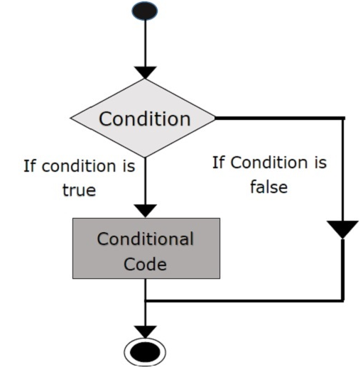
Conditionals : If Statement
Syntax
If condition
statement 1
statement 2
Note – Here, if the condition is true, if block will consider only
statement 1 to be inside its block.

Slide 41
Conditionals : If Else Statement
Syntax
if (condition):
# Runs this block if
# the condition is true
else:
# Runs this block if
# the condition is false

Slide 42
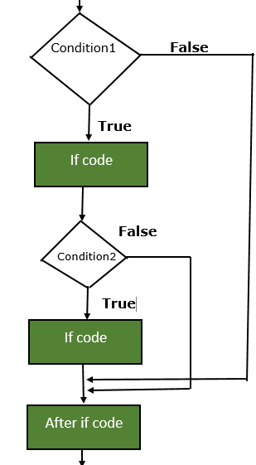
Conditionals : Nested If
Nested if statements mean an if statement inside another if statement.
Syntax
if (condition 1):
# Runs when condition 1 is true
if (condition 2):
# Runs when condition 2 is true
# internal if Block is ends here
# external if Block is ends here

Slide 43
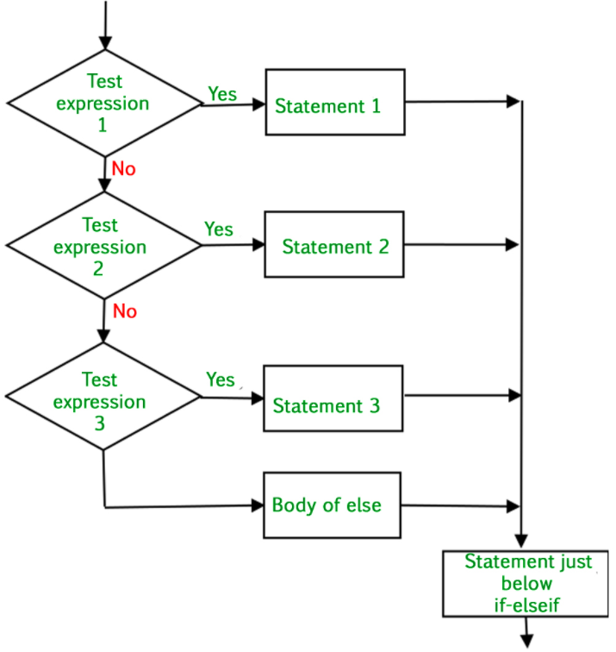
Conditionals : If-Elif-Else
The if statements are executed from the top down.
As soon as one of the conditions controlling the if is true,
the statement associated with that if is executed, and the
rest of the ladder is bypassed.
Syntax
if (condition):
statement
elif (condition):
statement
.
else:
statement

Slide 44
Lists – Today’s agenda
What is Lists?
How to access elements in Lists?
How to Add and Delete elements in a list?
What is Slices?
How to do Exception Handling?
Ranges
Looping ( For, While)

Slide 45
Lists
Lists are used to store multiple items in a single variable.
Almost like dynamically sized Arrays
Not homogeneous in nature (Integers, Strings, as well as Objects)
Mutable in nature (Means can be altered after creation)
Ordered (Indexed according to a definite sequence, 0 as the first index) with a definite count
You can have a List within a List
Syntax
List_name = [] or listname[index] or list = [item1, item2,……..and so on]

Slide 46
Lists – Adding elements
append() – For adding one element at a time, for adding multiple entries you can use loops.
insert() - append() method only works for the addition of elements at the end of the List, for the addition of elements at the desired position, insert() method is used. Unlike append() which takes only one argument, the insert() method requires two arguments(position, value).
extend() – This method is used to add multiple elements at the same time at the end of the list.
Note – append() and extend() methods can only add elements at the end.

Slide 47
Delete Elements – remove() and pop()
remove() - Elements can be removed from the List by using the remove() function. An Error will arise if the element does not exist in the List. Remove() method only removes one element at a time, to remove a range of elements, the iterator (loop) is used.
pop() – This function can also be used to remove and return an element from the List; by default it removes only the last element of the List. In order to remove an element from any specific location of the List, the index of the element is passed as an argument to the pop() method.

Slide 48
Slices
To access a portion of a list called a slice specify two indices separated by a colon within brackets, the slice starts at the first index and goes up to but does not include the last index. if the first index is omitted, 0 is assumed. if the second index is omitted, the number of items in the list is assumed
List [ index1 ] : [index2]
List [ : index2]
List [ index1 : ]

Slide 49
List - Finding/Searching an item
index() function will give the index of the item searched
dogs = [ ‘husky’, ‘rottweiler’, ‘shiba’]
dog_index = dogs.index(‘rottweiler’)
print(dog_index)
The results will be 1, rottweiler is at index 1, similarly husky is at 0, shiba is at 2

Slide 50
Range
Range() function store start, stop, and step values. There are three ways to represent it
A) range(stop_value) : This by default considers the starting point as zero.
B)range(start_value, stop_value) : This generates the sequence based on the start and stop value.
C) range(start_value, stop_value, step_size): It generates the sequence by incrementing the start value using the step size until it reaches the stop value.

Slide 51
Exception Handling
Errors are of two types
Syntax Errors – Problems due to which execution of program stops
Exceptions – It is raised when due to any event a program behaves abnormally. They are divided into 2 parts
Built-In exceptions – BaseException is the base class for all built-in exceptions.
Link - https://docs.python.org/3/library/exceptions.html
User defined/custom exceptions – You can create your own exceptions, if needed

Slide 52
Exception Handling – Try and Except
Syntax
try:
# Any statement(s)
except AnyError:
# Any statement(s)
except AnyError:
# Any statement(s)
Note : 1) Here AnyError is for catching any specific error. You can just use except: ,also
2) A Try statement can have more than one Except clause
3) You can also raise an exception manually

Slide 53
Exception Handling – Try, Except, Finally
Syntax
try:
# your code....
except:
# Handling of exception (if needed)
else:
# execute if no exception
finally:
# your code .....(this block will always execute)
Note : Finally - This is always executed after the try and except blocks. The final block will always be executed after normal termination of try or after try block terminates due to any exception occurred.

Slide 54
Control Statements - Loops
A loop is used for iterating over a sequence
(a list, a tuple, a dictionary, a set, or a string)
With the loops we can execute a set of statements,
once for each item in a sequence

Slide 55
Loops - Types
While
Repeats any statement or a group of statements while a given condition stands TRUE. It tests the condition before executing the loop body in which you write your code
Syntax : while expression:
statement(s)
For
Executes a sequence of statements multiple times depending on the loop variable
Syntax : for iterating_variable in sequence:
statement(s)

Slide 56
Loops – Types (contd)
Nested : You can use one or more loop inside any another while or for loop
Nested For Syntax : for iterating_var in sequence:
for iterating_var in sequence:
statements(s)
statements(s)
Nested While Syntax : while expression:
while expression:
statement(s)
statement(s)

Slide 57
Input Output & Loop Control
Input/Output - Python provides numerous built-in functions that are readily available to us at the Python prompt. These are used to take an input from the user and then we manipulate that value somewhere in our program.
Some of the functions like input() and print() are widely used for standard I/O operations respectively.
Loop control statements – These statements changes the execution of a program from its normal sequence to something else. When the execution leaves a scope inside a program, all automatic objects that were created in that scope are destroyed completely.
Python supports these 3 loop controls statements:
a) break – It’ll terminate the loop statement and transfers the execution to the statement immediately following the loop
b) continue – It’ll cause the loop to skip the remainder of its body and immediately retest its condition prior to reiterating
c) pass - It is used when generally a statement is required but you do not want any command or code to execute for now

Slide 58
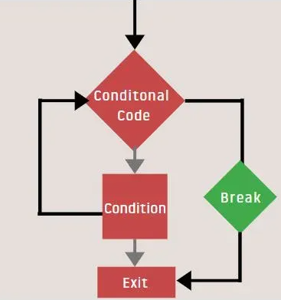
Loop Control – Comparison through Diagram
Break
Continue

Slide 59
Dictionaries - Agenda
What is a Dictionary?
Creation
Adding and Removing items
Accessing the items (Both Nested and Non-Nested)
Nesting
Looping

Slide 60
Dictionaries
Stores data values in a form of key:value, also known as items
If you store using a key that is already in use, the old value associated with that key is forgotten
Unordered collection of data values
Values in a dictionary can be of any data type and can be duplicated, whereas keys can’t be repeated and must be immutable. They are indexed by the keys
It does not allow duplicates

Slide 61
Nested Dictionaries
A Dictionary within a Dictionary

Slide 62
Removing items from Dictionaries
del keyword - Using this keyword we can delete specific values from a dictionary.
pop() method – Deletes the value of the specified key and returns the value
popitem() – The popitem() returns and removes an arbitrary element (key, value) pair from the dictionary.
clear() - All the items from a dictionary can be deleted at once by using clear() method.

Slide 63
Looping/Iterating in Dictionaries
You can loop through a dictionary by using a FOR loop
Note - When looping through a dictionary, the return value are the keys of the dictionary, but there are methods to return the values as well.
Syntax
For key_variable in dictionary:
# code block
# dictionary_name[key_variable]
Ways to iterate/loop
A) Looping through all Keys
B) Looping through all values
C) Looping through all Key-Value pairs

Slide 64
Tuples – What you will learn?
What is a Tuple?
Creation
Access
Update
Deletion
Basic Tuple operations
Conversion (To List)
Variable assignments with Tuple
Tuple functions

Slide 65
Tuples
A Tuple is a collection of objects
They are ordered
They are immutable
They’re just like Lists, the differences are :
Tuples cannot be changed.
Tuples uses parenthesis (), Lists use [] (Square brackets)
Syntax –
tup1 = (‘husky', ‘shiba', 1989, 1996);
tup2 = (1, 2, 3, 4, 5 );
tup3 = "a", "b", "c", "d";

Slide 66
Sets
What’s a Set?
Accessing Set items
Adding items
Removing set items
Looping
Joining
Methods in a Set

Slide 67
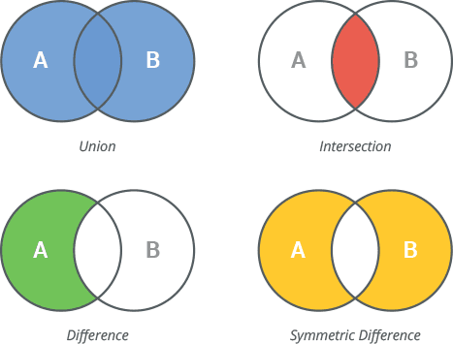
What are Sets?
Used to store multiple items in a single variable
No Duplicate elements in Sets (Unique Elements)
A collection which is unordered and unindexed
It represents mathematical notation of a Set

Slide 68
Sets - Methods

Slide 69
Sets – Methods (contd)

Slide 70
File Handling
Reading files
Writing files
Opening files
Closing files
File objects
Methods to read a file
Modes

Slide 71
Modes/Methods used for file handling
r : Read - Opens a file for reading (Gives you an Error if the file does not exist)
r+ Read and Write
a : Append - Opens a file for appending (Creates the file if it does not exist)
a+ Append and Read
w : Write - Opens a file for writing (It will create the file if it does not exist)
w+ Write and Read
x - Create - Creates the specified file (Gives you an error if the file exists)

Slide 72
Modules
What is a Module?
Creation
Using a module
Variables in a Module
Naming/Renaming
Built-in Modules

Slide 73
Modules (Contd)
A python module is something same as a code library.
It has an extension .py
It is a file containing a set of functions you want to include in your application
It contains definitions and statements
It can be used to define functions, classes, and variables

Slide 74
Python For Beginners Thank You
Logicops Lab

