Slide 1
Real-Time Database Management
Eng. Gharam Eskafi
Eng. Maisa’ Kuduair
Presented to :
Dr: Lo’ai Tawalbeh

Slide 2
Definition
Real-Time Data Base System can be defined as those computing systems that are designed to operate in a timely manner.
It must perform certain actions within specific timing constrains (producing results while meeting predefined deadlines)
Real-Time Data Base System can also be defined as Traditional Databases that uses an extension to give additional power to yield reliable response.

Slide 3
RTDBS Structure
Typical Real-Time Bata Base System consists of:
  Controlled System : the underlying application
  Controlling System:
    A Computer monitoring the state of the environment
    Supplying the environment with the appropriate driving
    signals.
The state of the environment as perceived by the controlling system must be consistent with the actual state of the environment.

Slide 4
Specifications
validity of data
Effective RTBDS must consider:
  Temporal-consistency: maintaining consistency between the actual state of the environment and the state as reflected or perceived by the system.
  Deadlines: timing constrains which must be met in addition to the desired computations
  Priority Scheduling: policy for ordering the execution of the outstanding processor according to some predefined criteria.
As a conclusion, Real Time Data Base Systems correctness do not only depends on the logical correctness, but on the timeliness of its actions
integrity of data

Slide 5
Services and Examples
Telecommunication Systems
  Routers and network management systems
  Telephone switching systems
Control Systems
  Automatic tracking and object positioning
  Engine control in automobiles
Multimedia servers for real-time streaming
E-commerce and e-buisness
  Stock market: program stock trading
  Financial services: credit card transactions
Web-based data services

Slide 6
System Models and Timing
Deadlines
Soft-Deadline:
  desirable but not critical
  missing a soft-deadline does not cause a system failure or compromises the system’s integrity
  Example: operator switchboard for a telephone
v(t)
Soft deadline
v₀
d₁
d₂
t

Slide 7
Deadlines
Firm-Deadline:
  Desirable but not critical (like Soft-Deadline case)
  It is not executed after its deadline and no value is gained by the system from the tasks that miss their deadlines
  Example: an autopilot system
v(t)
Firm deadline
v₀
d
t

Slide 8
Deadlines
Hard-Deadline:
  Timely and logically correct execution is considered to be critical
  Missing a hard-deadline can result in catastrophic consequences
  Also known as Safety-Critical
  Example: data gathered by a sensor
v(t)
Hard deadline
v₀
d
t

Slide 9
Design Paradigms
Time-Triggered (TT)
  Systems are initiated as predefined instances
  Assessments of resource requirements and resource availability is required
  TT architecture can provide predictable behavior due to its pre-planed execution pattern.

Slide 10
Design Paradigms
Event-Triggered (ET)
  Systems are initiated in response to the occurrence of particular events that are possibly caused by the environment
  The resource-need assessments in ET architecture is usually probabilistic
  ET is not as reliable as TT but provides more flexibility and ideal for more classes of applications
  ET behavior usually is not predictable.

Slide 11
Tasks Periodicity
Prosodic Tasks
  Executes at regular intervals of time
  Corresponds to TT architecture
  Have Hard-Deadlines characterized by their periods (requires worst-case analysis).
Aperiodic Tasks
  Execution time cannot be priori anticipated
  Activation of tasks is random event caused by a trigger
  Corresponds to ET architecture
  Have Soft-Deadlines (no worst-case analysis)

Slide 12
Tasks Periodicity
Sporadic Tasks
Tasks which are aperiodic in nature, but have Hard-Deadlines
Used to handle emergency conditions or exceptional situations
Worst-case calculations is done using Schedulability-Constraint
Schedulability-Constraint defines a minimum period between any two sporadic events from the same source.

Slide 13
Scheduling
Each task within a real-time system has
  Deadline
  An arrival time
  Possibly an estimated worst-case execution
A Scheduler can be defined as an algorithm or policy for ordering the execution of the outstanding process
Scheduler maybe:
  Preemptive
    Can arbitrarily suspend and resume the execution of the task without affecting its behavior

Slide 14
Scheduling (Cont)
  Non-preemptive
    A task must be rum without interruption until completion
    Hybrid
      Preemptive scheduler, but preemption is only allowed at certain points within the code of each task.
    Real-Time scheduling algorithms can be :
      Static
        Known as fixed-priority where priorities are computed off-line
        Requires complete priori knowledge of the real-time environment in which is deployed
        Inflexible: scheme is workable only if all the tasks are effectively periodic.
        Can work only for simple systems, performs inconsistently as the load increases.

Slide 15
Scheduling (Cont)
    Dynamic
      Assumes unpredictable task-arrival times
      Attempts to schedule tasks dynamically upon arrival
      Dynamically computes and assigns a priority value to each task
      Decisions are based on task characteristics and the current state of the system
      Flexible scheduler that can deal with unpredictable events.

Slide 16
Priority-Based Scheduling
Conventional scheduling algorithms aims at balancing the number of CPU-bound and I/O bound jobs to maximize system utilization and throughput
Real-Time tasks need to be scheduled according to their criticalness and timeliness
Real-Time system must ensure that the progress of higher-priority tasks (ideally) is never hindered by lower-priority tasks.

Slide 17
Priority-Based Scheduling
Methods
Earliest-Deadline-First (EDF):
  the task with the current closest (earliest) deadline is assigned the highest priority in the system and executed next
Value-Functions : highest value (benefit) first
  the scheduler is required to assign priorities as well as defining the system values of completing each task at any instant in time

Slide 18
Priority-Based Scheduling
Methods
Value-Density (VD): highest (value/computation) first
  The scheduler tends to select the tasks that earn more value per time unit they consume
  It is a greedy technique since it always schedules that task that has the highest expected value within the shortest possible time unit.
Complex functions of deadline, value and slack time.

Slide 19
Synchronization
Priority inversion problem: a higher-priority task can be blocked by a lower-priority task possibly for an unbounded number of times and for unbounded periods.
Solutions:
  The Priority Inheritance Protocol
    execute the blocking transaction (low priority) with the priority of the blocked transaction (high priority)
    The task inherits the highest priority level of all the tasks it blocks and executes its resource (critical section)
    “intermediate” blocking is eliminated

Slide 20
Synchronization (Cont)
Priority Abort Protocol
  abort the low priority transaction - no blocking at all
  quick resolution, but wasted resources
Conditional Priority Inheritance Protocol
  based on the estimated length of transaction
  inherit the priority only if blocking one is close to completion; otherwise abort.

Slide 21
Real Time Database Systems
Overview
Topics related to design of RTDBS in a centralized uni-processor system:
  RTDBS System Models
  Scheduling RTDB Transactions
    Concurrency Control
    Conflict Resolution
    Deadlocks
  Admission Control
  Memory Management
  I/O and Disk Scheduling

Slide 22
Conventional Databases:
Transactions and Serializability
Transaction: is a collection of read and write operations which comprises a consistent transformation of the system state.
When executed alone, each transaction transforms a consistent state into a new consistent state
Transactions preserve consistency of the database information
Schedule: a particular sequencing of the actions from different transactions.
Consistent Schedule: a schedule that gives each transaction a consistent view of the database-state.

Slide 23
Conventional Databases:
Transactions and Serializability
Database inconsistencies can be caused by:
  Failures
  Concurrency
Four properties associated with transactions known as ACID properties are used to prevent such problems

Slide 24
Conventional Databases:
ACID Properties
A Atomicity: Either all or none of the transactions operations are/is performed. All the operations of a transaction are treated as a single, indivisible, atomic unit.
C Consistency: A transaction maintains the integrity constraints on the database.
I Isolation: Transactions can execute concurrently but with no interference with each other’s operations.
D Durability: All changes made by a committed transaction become permanent in the database, surviving any subsequent failures.

Slide 25
Conventional Databases:
ACID Properties (Cont.)
Consistency of database is preserved by each transaction
Recovery Protocols are used to ensure the Atomicity and Durability properties
The difficulty of dealing with traditional transactions that different execution paths have significantly different requirement
Concurrent execution may violate the database integrity constrains regardless of the correctness of individual transactions.

Slide 26
Serializability
An execution is said to be serializiable if it produces the same output and has the same effect on the database as some serial execution of the same transactions.
Serializability is a notion of correctness in any DBMS
Conflict-Serializability:
  the simplest and most common form of Serializability
  ensures that conflicting operations appear in the same order in two equivalent executions
  Conflicts can happen in case of read and write operations on the same data object.
View Serializability
  Two executions are equivalent if each transaction reads the same values in the two executions.
  Final value of the databases is the same in both executions

Slide 27
Recoverable History
Cascading-Aborts: If a transaction Tj reads a value that was last written by an aborted transaction Ti, then Tj must also be aborted
To keep Durability, once a transaction commits, it could not subsequently be aborted nor its effects changed due to cascading-aborts.
to assure Atomicity and Durability, an execution must be Recoverable
An execution is Recoverable if, once a transaction is committed, the transaction is guaranteed not to be involved in cascading aborts.

Slide 28
Recoverable History (Cont)
Cascadeless: Read only committed written data. That is, if transaction Tj reads from Ti, then Ti must be an already committed transaction; i.e.,
  Wi [x] → Rj [x] ⇒ Ci → Cj
Strict: Read and write only committed written data. That is, if transaction Tj reads from Ti, or overwrites a data item that was last written by Ti, then Ti must be an already committed transaction; i.e.,
  Wi [x] → Rj [x] ⇒ Ci → Cj
  Wj [x] ⇒ Ci → Cj

Slide 29
RTBBS vs. Conventional DB
Conventional Transactions
Logically correct and consistent (ACID):
  atomicity
  consistency
  isolation
  durability
Real-Time Transactions
Logically correct and consistent (ACID)
“Approximately correct”
  trade quality or correctness for timeliness
Time correctness
  time constraints on transactions
  temporal constraints on data

Slide 30
Conventional DB vs. RTDBS
Conventional Databases:
Logical consistency
  ACID properties of transactions:
    Atomicity
    Isolation
    Consistency
    Durability
  Data integrity constraints
Real-Time Database Systems:
Logical consistency
  ACID properties (may be relaxed)
  Data integrity constraints
Enforce time constraints
  Deadlines of transaction
External consistency
  absolute validity interval (AVI)
Temporal consistency
  relative validity interval (RVI)
State of environment
and reflection in
database
Among data
used to derive
other data

Slide 31
Conventional DB vs. RTDBS
Real-time systems
Task centric
  Deadlines attached to tasks
Real-time databases
Data centric
  Data has temporal validity, i.e., deadlines also attached to data
  Transactions must be executed by deadline to keep the data valid, in addition to produce results in a timely manner

Slide 32
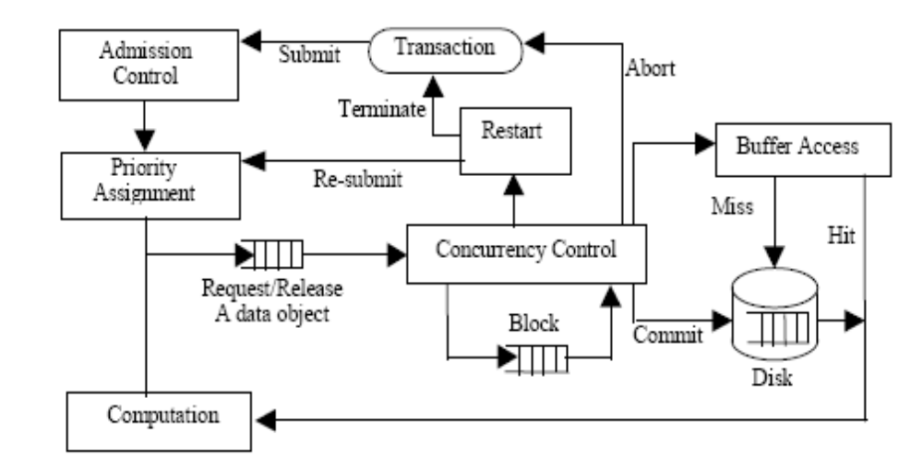
A Real-Time Database Model
Real-Time Database Model

Slide 33
A Real-Time Database Model
Any new transaction must pass through an Admission Control mechanism, which monitors and regulates the total number of concurrently active transactions within the system in order to avoid thrashing
Every new or resubmitted transaction is assigned a Priority Level, which orders its scheduling preference relative to the other concurrent transactions within the system
Before a transaction performs an operation on a data object, it must go through the Concurrency Control component in order to achieve the required synchronization. If the transaction’s request for a granule is denied, the transaction will be placed into a Wait Queue.
The waiting transaction will be reactivated when the requested granule becomes available, after which the transaction performs its operation.

Slide 34
A Real-Time Database Model
Similarly, if a transaction requests an item that is currently not in main-memory, an I/O request is initiated and the transaction will be placed into a wait queue.
The waiting transaction will be reactivated when the requested granule becomes available in main-memory, and there is no active higher-priority transaction.
When a transaction completes all of its operations, it commits its result(s) and releases all of the data items in its possession.

Slide 35
A Real-Time Database Model
A transaction may abort/restart a number of times before it commits. There are various types of aborts :
  Terminating abort:
    An abort due to missing a deadline, or
    Self-abort – a transaction may abort itself due to an exceptional condition.
  Non-terminating abort: An abort due to a deadlock or a data conflict. In this case, the transaction maybe restarted if its deadline remains feasible.

Slide 36
Scheduling RTDB Transactions
A special feature of RTDB systems, in addition to standard physical resources, is the data objects stored in the database, and transactions accessing this data have to be scheduled in accordance with real-time performance objectives.
The scheduling process of transactions in a RTDB system consists of:
  Concurrency Control
  Conflict Resolution

Slide 37
Scheduling RTDB Transactions
Concurrency Control Protocols
  Locking
  Time-stamping
  Multiversion
  Validation
all of which have the same goal; i.e., enforcing serializability.
These Protocols need to be modified and their trade-off(s) must be reevaluated under RTDB systems.

Slide 38
Scheduling RTDB Transactions
Concurrency Control Protocol
Locks are used to synchronize concurrent actions
Two-Phase Locking (2PL)
  all locking operations precedes the first unlock operation in the transaction
  expanding phase (locks are acquired)
  shrinking phase (locks are released)
  suffers from deadlock
  priority inversion

Slide 39
Scheduling RTDB Transactions
Conflict Resolution Protocol
Conflict Resolution Protocol
  Priority-based Wound-Wait Conflict Resolution
    The original scheme was designed to use timestamps.
    It was modified so that the scheme uses priorities instead of timestamps
    Modified scheme known as High-Priority (HP) and as Priority-Abort (PA)

Slide 40
Scheduling RTDB Transactions
Deadlocks
Deadlocks
  Whenever a set of transactions gets involved in a circular wait in what is known as a wait-for graph
  Five deadlock resolution policies that take into account :
    the timing properties of the transactions
    the cost of abort operations

Slide 41
Scheduling RTDB Transactions
Deadlocks
Policy 1:
  Always aborts the transaction invoking deadlock detection.
Policy 2:
  Trace the deadlock cycle
  abort the first tardy transaction encountered in a deadlock cycle.
  If no tardy transaction is found, abort the transaction with the furthest deadline.
Policy 3:
  Trace the deadlock cycle
  abort the first tardy transaction encountered in a deadlock cycle.
  If no tardy transaction is found, abort the transaction with the earliest deadline.

Slide 42
Scheduling RTDB Transactions
Deadlocks
Policy 4:
  Trace the deadlock cycle, and abort the first tardy transaction encountered in a deadlock cycle.
  If no tardy transaction is found, abort the transaction with the least criticalness.
Policy 5:
  Abort the infeasible transaction with the least criticalness.
  If all transactions are feasible, then abort a feasible transaction with the least criticalness.
  This policy is sensitive to the accuracy of the computation time because it requires information about remaining execution time
  So; Total execution time requirements at the start of each transaction must be known.

Slide 43
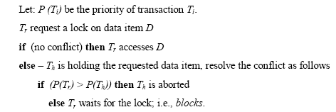
Scheduling RTDB Transactions
Conflict Resolution Protocol
  Outline of the Protocol:

Slide 44
Scheduling RTDB Transactions
Admission Control
Admission Controller:
  Reject transaction
  Admit contingency action
Scheduler:
  Drop transaction (firm/soft)
  Replace transaction with contingency action (hard)
  Postpone transaction execution (soft)

Slide 45
Scheduling RTDB Transactions Memory Management
Memory management is concerned with three types of decisions:
  transaction admission
  buffer allocation
  buffer replacement

Slide 46
Future Research Areas in RTDBS
Resource management and scheduling
Recovery
Concurrency Control
Fault tolerance and security models to interact with RTDBS
Query languages for explicit specification of real-time constraints -> RT-SQL
Distributed real-time databases
Data models to support complex multimedia objects
Schemes to process a mixture of hard, soft, and firm timing constraints and complex transaction structures
Support for more active features in real-time context
Interaction with legacy systems (conventional databases)

Slide 47
References
http://en.wikipedia.org/wiki/Real_time_database
Real-Time Database Systems and Data Services: Issues and Challenges, Sang H. Son ,Department of Computer Science, University of Virginia
Real-Time Database Systems: Concepts and Design, Saud A. Aldarmi Department of Computer Science,The University of York

