Slide 1
Skills System Design

Slide 2
Current Problem
Scenario: A user wants AI to do a Code Review. Even knowing how to write the prompt, they still must: manually upload the code, paste in standards, specify output format — every single time. "What to say" is no longer the bottleneck. "How to run the workflow end-to-end" is.
1
No execution orchestration
Complex tasks need multi-step flows (read file → check items → load standards → report). No way to define this — users guide manually.
2
Templates don’t manage tools
Can’t auto-bind tool permissions. Users manually handle file reads, data queries every time.
3
Reference materials can’t load on demand
Team standards & domain knowledge must be pasted into context each time — repetitive and token-wasteful.
2 / 15

Slide 3
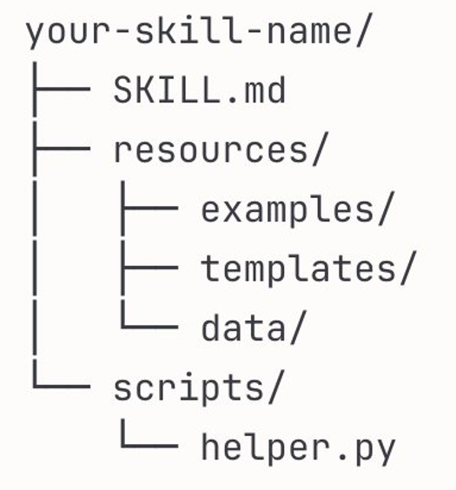
What is Skills?
Skill = A Reusable Expert-Level Prompt Package
Bundles task instructions, tool permissions, and reference materials into a single unit, loaded on demand.
Execution Instructions
Tool Permissions
Reference Materials
Standardized steps, judgment criteria, output format requirements
Authorized tools the Skill can invoke (read-file, grep, etc.)
Coding standards, document templates, domain knowledge
System Prompt: Skills are loaded on demand (not all at once), reusable across users (not personal), and include tool permission controls.
3 / 15

Slide 4
What Does a Skill.md Look Like?
↑ Metadata (L1)
---
name: code-review
description: Review code against team standards.
Check for security, performance, conventions.
allowed-tools: [read-file, grep, terminal]
scope: project
---
# Code Review Skill
When performing a code review, follow these steps:
1. Security Check: SQL injection, XSS, hardcoded keys
2. Performance: N+1 queries, unnecessary loops
3. Standards: Verify naming and structure
## Output Format
- Blocker: Must fix
- Warning: Recommended improvement
- Good: Noteworthy best practices
name + description
Loaded at startup for matching
allowed-tools: permission whitelist
↓ Execution Instructions (L2)
Markdown body
Loaded only when activated
Defines steps, criteria, output
📁 Reference Materials (L3)
Stored in sibling directories
e.g. references/style-guide.md
Loaded on demand during execution
4 / 15

Slide 5
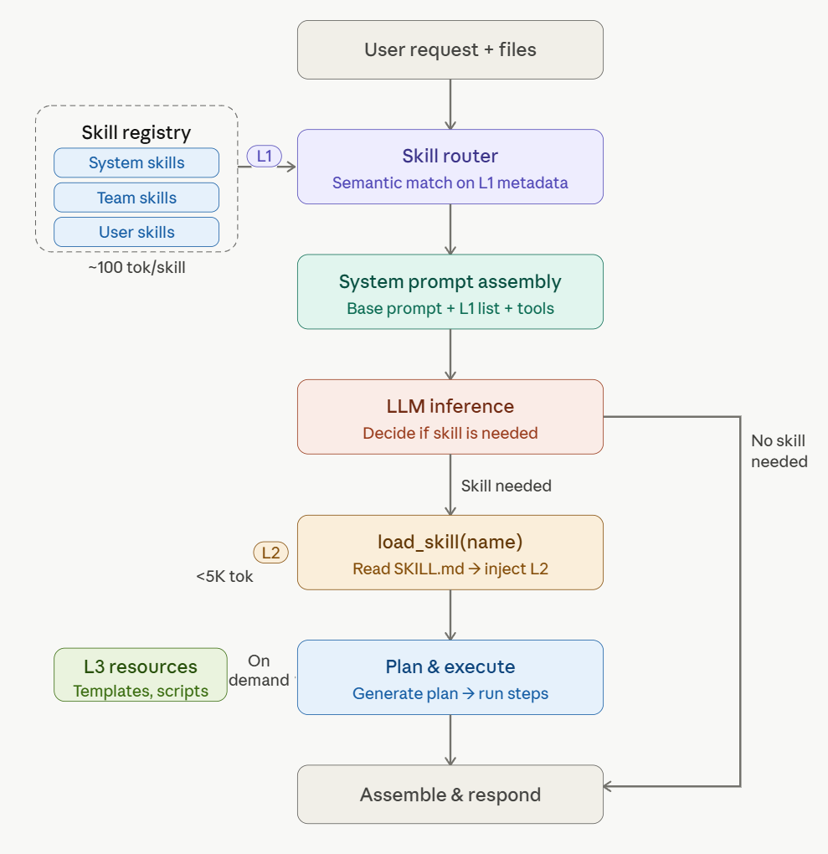
A Complete Skill Invocation
1
User Input
"Review this Python file"
↓
2
Auto-Match
Identifies code-review Skill
↓
3
Load Instructions
Review dimensions, output format
↓
4
Invoke Tools
read-file, check each item
↓
5
Load Resources
Team coding standards (L3)
↓
6
Output Report
Structured review results
Users just describe the task, system auto-matches the most relevant Skill
5 / 15

Slide 6
Three-Layer Progressive Loading
Layer | Content | When Loaded | Token Cost
L1 Metadata | Skill name + description | Fully loaded at startup | ~100 tokens/skill
L2 Instructions | Complete Markdown execution steps | When Skill is activated | <5,000 tokens
L3 Resources | Standards, templates, scripts | On demand during execution | Varies by file
Token Consumption Comparison
Full injection (50 Skills): ~150K tokens/turn
Three-layer loading (L1 only): ~5K tokens
↓ 90%+ reduction in token consumption
* Phase 1 (8 Skills): full injection ~24K vs three-layer ~800 tokens
8 / 15

Slide 7
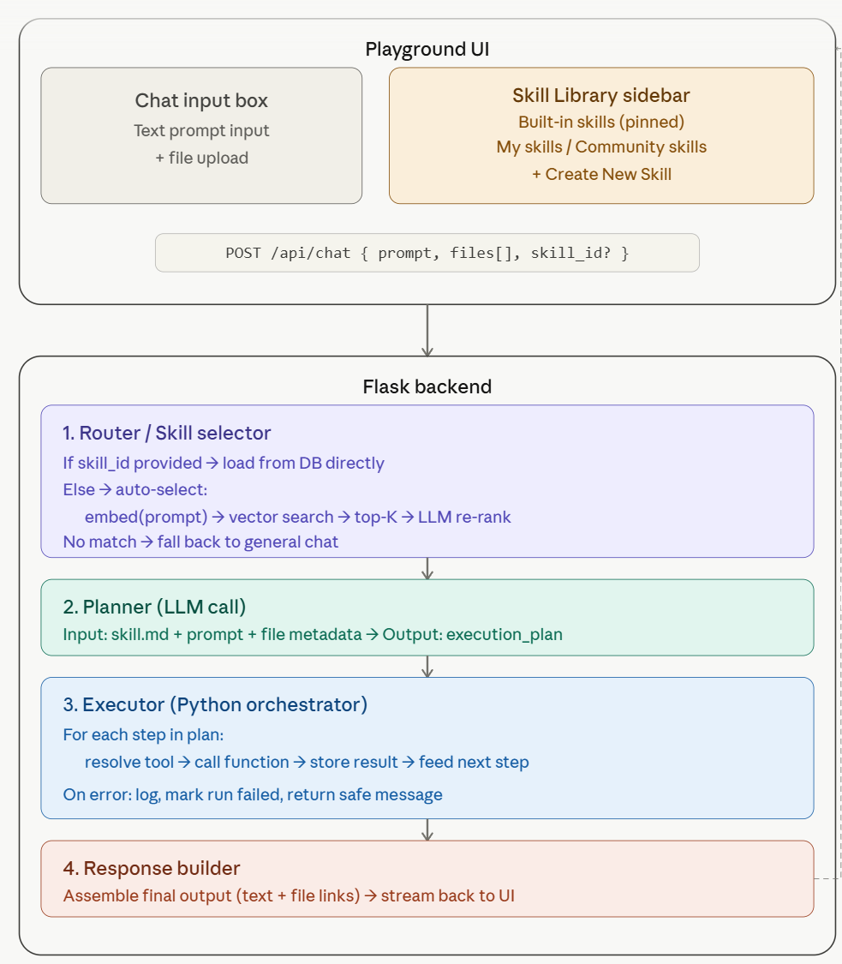
System Overview
6 / 15

Slide 8
Technical Design
①
User Interface
Skill Create & Management
②
Data Model
Three core tables and design rationale
③
API Design
Four API groups + integration approach
④
Context Budget Strategy
Three-zone partitioning, four-step control
10 / 15

Slide 9
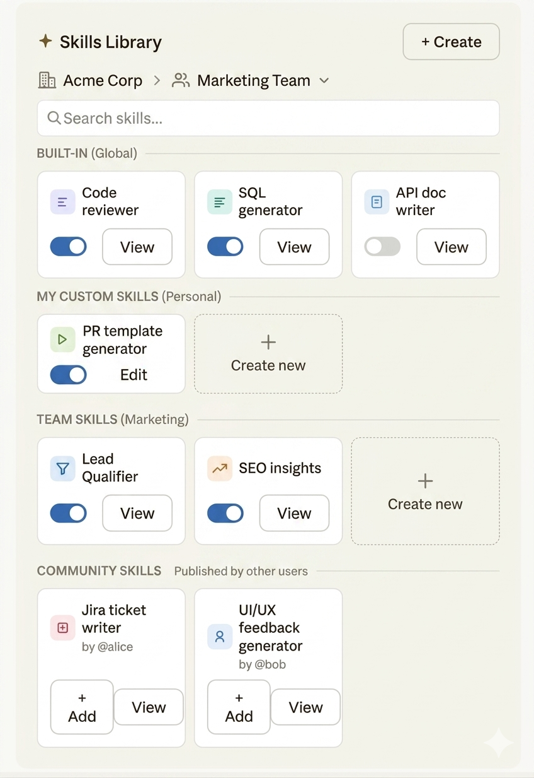
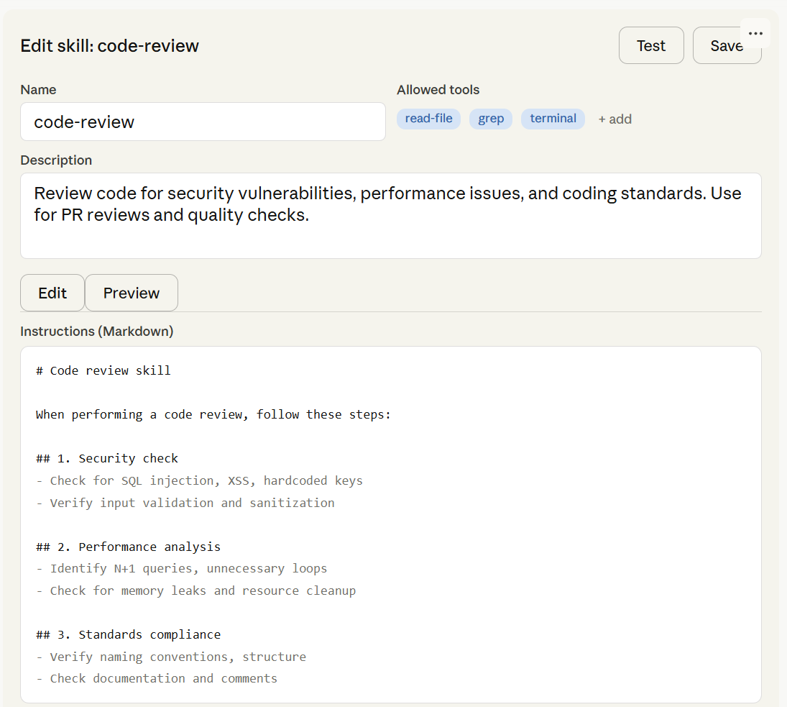
User Interface: Create & Manage
7 / 15

Slide 10
Data Model
skills table
skill_resources table
Field | Type | Description
id | TEXT PK | Unique identifier
name | TEXT UNIQUE | Skill identifier
description | TEXT | For L1 matching
content | TEXT | Markdown instructions (L2)
allowed_tools | JSON | Tool whitelist
scope | TEXT | user / project / org
enabled | BOOLEAN | Enabled status
Field | Type | Description
id | TEXT PK | Unique identifier
skill_id | TEXT FK | Associated skill
name | TEXT | Resource identifier
type | TEXT | reference / script / template
content | TEXT | Resource content
user_skill_settings table
Field | Type | Description
user_id | TEXT | User identifier
skill_id | TEXT FK | Associated skill
enabled | BOOLEAN | Per-user toggle
11 / 15

Slide 11
API Design + Integration
Skill CRUD
Resources & Config
Method | Path | Description
GET | /api/skills | List skills
GET | /api/skills/:id | Get details
POST | /api/skills | Create
PUT | /api/skills/:id | Update
DELETE | /api/skills/:id | Delete
Method | Path | Desc
GET | …/:id/resources | List
POST | …/:id/resources | Add
PUT | …/:id/resources/:rid | Update
DELETE | …/:id/resources/:rid | Delete
PUT | /api/skills/settings | Toggle
AI & Testing
LLM Tool Functions (model-invoked only)
Method | Path | Description
POST | …/generate | AI-generate draft
POST | …/:id/test | Test saved
POST | …/test | Test draft
load_skill(skill_name)
Returns complete execution instructions (L2)
load_skill_resource(skill, resource)
Returns auxiliary resource content (L3)
Integration: standard tool-use protocol, no new mechanism. L1 catalog injected into System Prompt at startup.
12 / 15

Slide 12
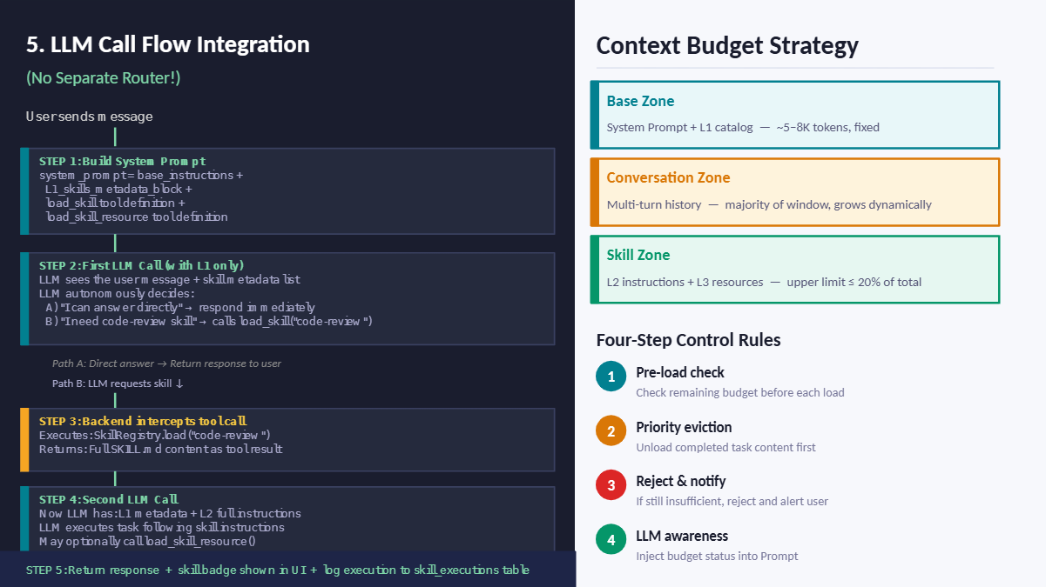
13 / 15

Slide 13
Phase 1:
Estimated timeline: 5 weeks
✅ Phase 1 Deliverables
1. L1/L2/L3 loading pipeline
2. load_skill / load_skill_resource integration
3. Dynamic L1 catalog injection
4. Full Skill Creator (AI + manual + test)
5. Skill Management UI
6. Context Budget management
7. 5–8 seed Skills
8. Basic execution step progress bar
9 / 15

Slide 14
Phase 2:
Estimated timeline: 5 weeks
✅ Phase 2
✗ Multi-Skill composition → Phase 2
✗ Version management & rollback → Phase 2
✗ Cross-team sharing / Marketplace → Future
✗ Automated effectiveness eval → Future
9 / 15

