Slide 1
Skills Auto Generation
identify recurring, high-value task patterns and workflows from these conversations, and capture them as reusable Skills

Slide 2
Value & Opportunities
Our Playground continuously accumulates a large volume of real user conversations every day, capturing users’ actual tasks, workflows, and patterns of AI usage. However, users still perform a significant amount of repetitive work that could otherwise be handled by the system, such as repeatedly providing the same context, correcting domain-specific knowledge, and adapting outputs to required formats. These issues arise because relevant context, rules, and practical knowledge are not effectively captured and systematized, leaving users to repeatedly provide and correct the same information across conversations.
1
Skill Mining provides an opportunity to identify recurring, high-value task patterns and workflows from these conversations, and systematically capture them as reusable Skills.
This can reduce repetitive effort, improve output consistency, and enable users to complete common tasks more efficiently.
2
2 / 15

Slide 3
What Kinds of Tasks Are Suitable for Distillation into Skills？
3. Three Necessary Conditions
For a task to have value for distillation into a Skill, it should in principle satisfy these three conditions
1
Repeated occurrence
Similar tasks appear repeatedly across multiple sessions, ideally across different users, rather than being a one-off individual request.
2
The model falls short by default
The task depends on company-specific conventions, terminology, business rules, processes, or API schemas. Without this information, the model is prone to errors or inconsistent results.
3
Stable execution and output pattern
The task can be abstracted into a relatively stable execution procedure, e.g., “When X occurs, execute A → B → C, and output in the form of D.”
Conversely, general knowledge Q&A, one-off tasks, and chit-chat requests that the model can already handle reliably generally do not warrant distillation into Skills.

Slide 4
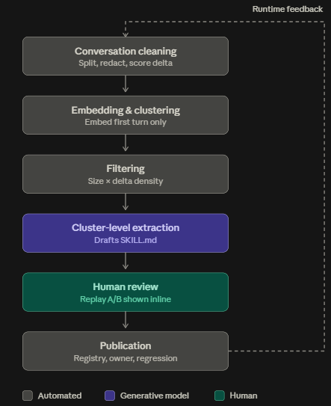
Skill Mining Pipeline
1
Conversation Cleaning
↓
2
Embedding & Clustering
↓
3
Filtering
↓
4
Cluster-level Skill Extraction
↓
5
Human Review
↓
6
Publication
5 / 15

