Slide 1


Slide 2
ALOIS
Data Leakage Detection Tool Intended to be a SIEM (Security Information and Event Management)
One central sink for all log events
Log splitting to database
Interactive analysis and correlation tool
Reporting and alarming

Slide 3
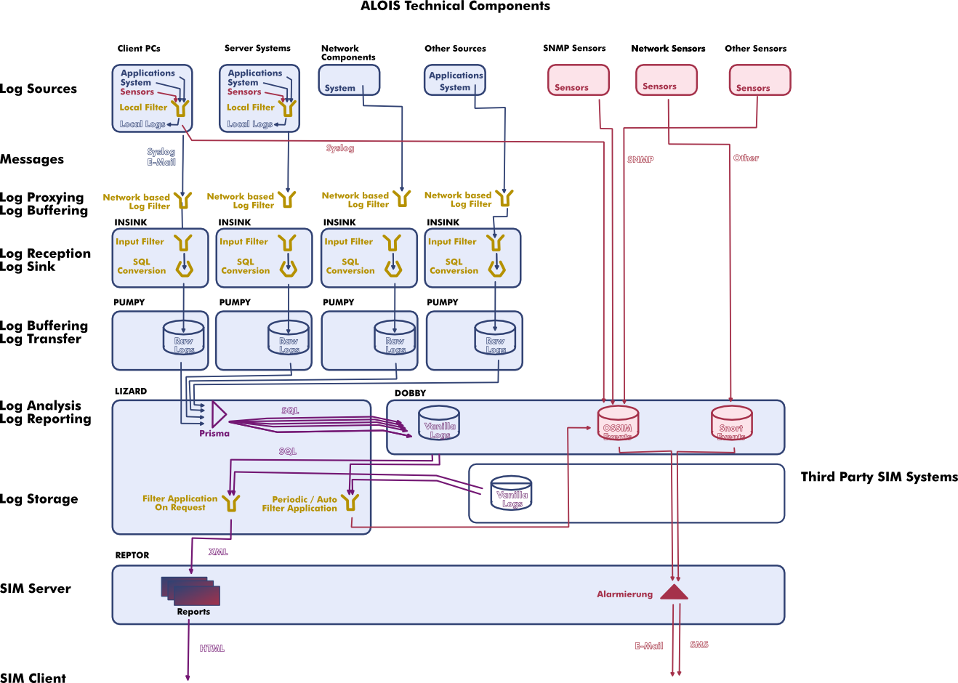

Slide 4
ALOIS Technology
Ruby on Rails, MySQL DB, AJAX Web-Frontend
OSS from the beginning, now an apache incubation project
Scalable, some redundance included
Strict separation of collection, splitting and database storage, analysis and reporting
Generation of graphics on the fly

Slide 5
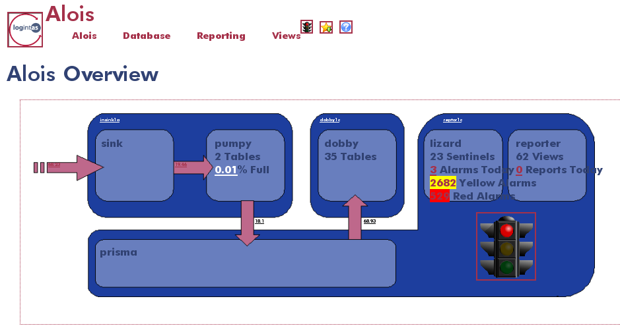

Slide 6
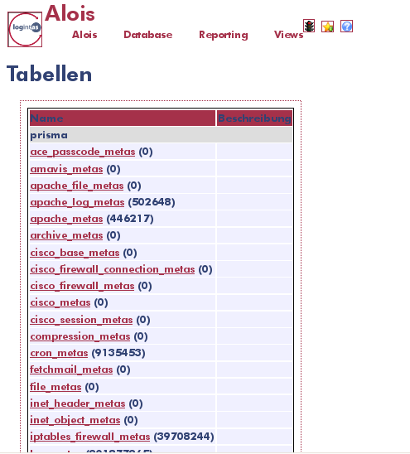

Slide 7
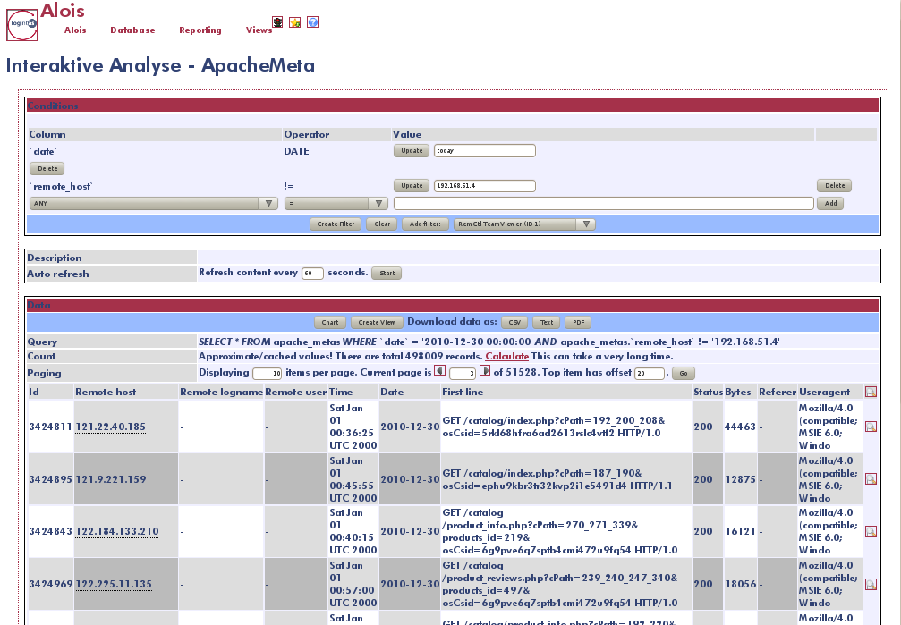

Slide 8
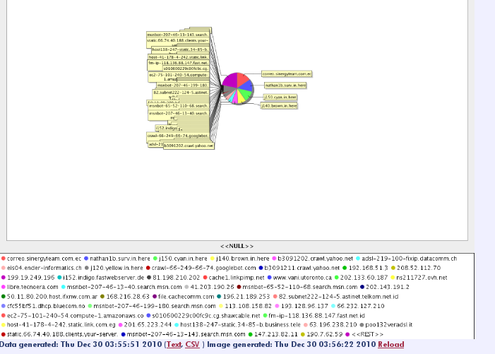

Slide 9
Integration Issues
Log volume at sources and targets
Source log formats, protocols, and ability
Learning phase
  Configuration errors
  Attacks
Data protection preparations
  ALOIS is going after data, not after users!

Slide 10
Advanced usage
Statistics
Logging personal activities
  Rasing awareness of what may be retended
Beware of dual use...

Slide 11
Where to?
After initial incubation, discussions for version 2 ahea start
Have fun!

