Slide 1
Intelligent Interactive Applications using IBM Watson

Slide 2
Contents
Components Involved
NLP Processing
Tone Analysis
Business Hit
Dynamic Response Generation
Flow Diagram

Slide 3
Components Involved
Conversation Service
Discovery Service
NLU Service
Tone Analyser
Orchestration Layer
Enterprise Application
UI Service

Slide 4
NLP Processing
User Input is processed by NLP Service
IBM Watson provides –
Conversation Service
Discovery Service
Conversation service process user inputs based on pre-defined intents and entities
Conversation service must be used as the initial step
User related intents such as balance, statements, transactions, payments must be configured in conversation service. Put it simple, all the menu options in IVR must fall in conversation service. Self-Service intentions are idle examples.
Discovery service uses natural language query processing against enterprise public data set
Discovery service should be used to answer questions that do not represent user-specific intentions.
Examples to discovery service usages are – loan/forex rates, store locations, general prescriptions etc.
Discovery service should be the second step in NLP processing service after Conversation Service.

Slide 5
Tone Analysis and Understanding the Emotion
Tone Analyser offers detailed emotion, social and language tone analysis
This service will be invoked when NLP processing service could not understand the user input
If the emotions and sentiments are negative, option to talk with an agent shall be provided
If the emotions and sentiments are positive, users shall be asked to repeat/rephrase the question

Slide 6
Orchestration Layer
Orchestration layer will reside between user interface and the services
The services include –
NLP Platform
Tone/Emotion Analyser
Enterprise Data-source
Orchestration layer will pass data across the other components in the architecture
Orchestration layer should not contain any data manipulation/application logic
Orchestration layer must be stateless, light and generic
Orchestration layer will perform business hit based on context based flags from Conversation Service

Slide 7
Dynamic Response Generation
Conversation service will perform the dialog operation and collect all the inputs from user as required
Any static response from conversation service or discovery service shall be passed directly to the UI Service through Orchestration Layer
When a business hit is needed, Orchestration layer will invoke enterprise services or perform data calls and the result shall be passed to Conversation Service for output formatting
The formatted output is passed from Conversation Service to the UI service through Orchestration Layer

Slide 8
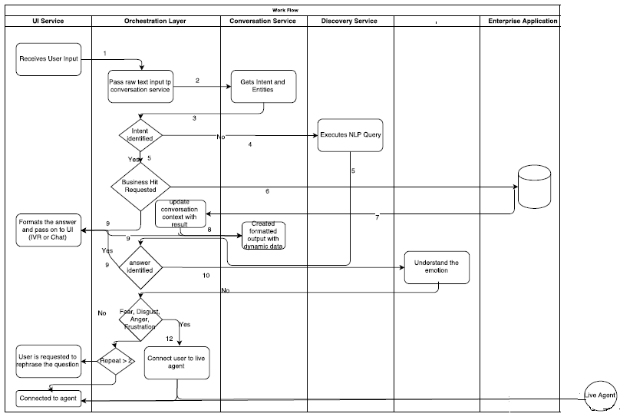
Flow Diagram

Slide 9
Thank you!

