Slide 1
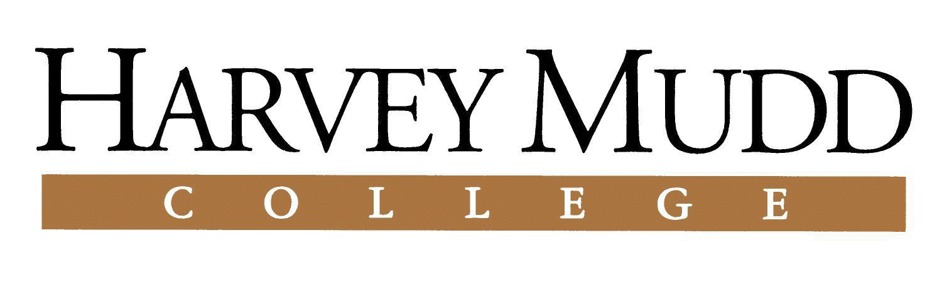


Converting a Single-Stroke Gesture Recognizer to a
Multiple-Stroke Symbol Recognizer
Martin Field Christine Alvarado Tom Stahovich
Background: In the context of computer interfaces, a gesture is a prescribed action that can then be interpreted as a command. Gestures are typically composed of one stroke and the direction and orientation of the stroke are very important to the meaning.
Approach: We wanted to know if users draw the same shapes differently based on the context in which they were asked to draw the shape. In order to assess this, we asked users to draw logic gates in three circumstances. First, we asked the users to draw 5 examples of each gate. Next, we asked them to copy a prescribed circuit. Finally, they were asked to create a circuit to satisfy a given logical expression. By training our gesture recognizers on one activity and testing on another, we were able to assess the difference in drawing styles.
Results: The multi-stroke modifications to Rubine decreased performance below acceptable levels. However, the $1 recognizer still performed fairly well. From the $1 results, we cannot conclude that there is a significant difference between sketching styles across the three activities we tested. However, we were able to identify a large benefit to recognition accuracy by including user-specific training examples.
Recognizers: We modified the Rubine¹ and $1² recognizers to handle multiple strokes by creating an algorithm to stitch a group of strokes together. We also tried to relax as many of the gesture requirements as possible such as the order and direction of strokes. This allowed us to train a general recognizer on the overall shape drawn, whether it was drawn top to bottom or left to right.
NSF Career Grant (IIS-0546809)

