Slide 1

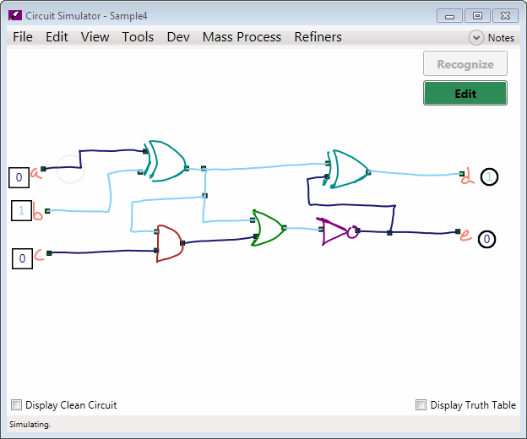
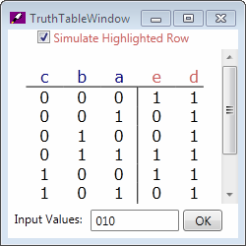
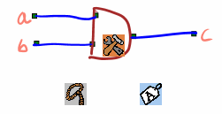
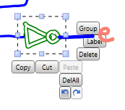
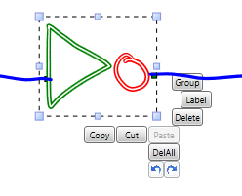
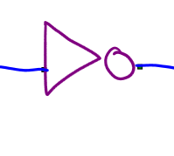
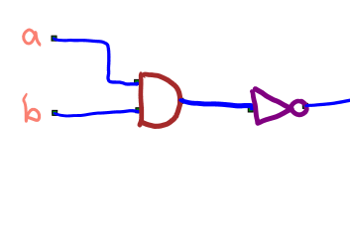
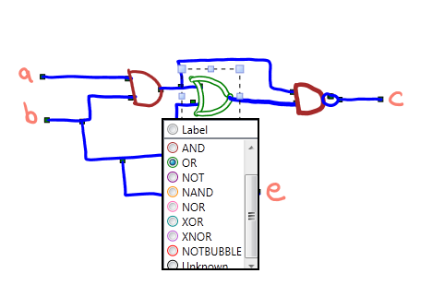

LogiSketch – An Intuitive System for Sketching and Simulating Logic Circuits
Kevin Chan, Lillian de Greef, Alexa Keizur, Brian Liao, Alice Paul, and June-Woo Suk
Recognition: Five Stages
Introduction
Our program seeks to provide users with an intuitive system for sketching, editing, recognizing, and simulating logic circuits in a tablet environment. It features:
A fluid means of switching between actions utilizing "hover space", the space above the tablet screen.
Automatic recognition of the drawn circuit with visual feedback.
Quick and intuitive recognition correction.
Circuit simulation, bringing the user’s drawing to life and providing useful information about the recognized circuit.
Our users for this program are college students in an introductory computer science or digital design class.
Color Coded Gates
The user can take notes on a separate window.
Stroke Classification: A decision tree uses 27 features of the drawn stroke to classify the stroke as a Wire, Gate, or Label.
Stroke Grouping: Goes through all pairs of similarly classified strokes and uses a decision tree based on 12 features of the pair to determine if the two strokes should be merged into the same shape.
Shape Recognition: The Wire Recognizer simply labels each shape as Wire. The Label Recognizer uses text recognition to interpret the label. The Gate Recognizer uses the results of a Rubine Recognizer and Image Recognizer as well as a Bayesian network to determine the gate type and associated probability.
Shape Connection: Looks at the wires of the circuit and identifies the closest shapes to the endpoints.
5. Refining: Recognition is refined using the context of connections between shapes to tweak the recognized type and stroke groupings.
Endpoint connections appear green (connected) or red (unconnected)
The user can switch between simulation and editing at any time. When the user is in editing, they can also re-recognize the sketch at any time.
The output values appear here.
Users can toggle inputs
The wires are colored according to what value they carry.
Simulation
For simulation, we create a graph of Circuit Elements, using the information about the recognized circuit and its connections. Each Circuit Element keeps track of its inputs and outputs, linking the graph nodes. Output values are computed using depth-first search. We can check for oscillation within the circuit by comparing the outputs over time.
A computer-generated image of the circuit can be displayed and interacted with.
Hovering over a row in the truth table will simulate that row. Alternatively, the inputs can be directly entered.
Editing: Hover Widgets
Future Work
Better refining of recognition. Current refining only improves recognition by a small amount but shows promise for future work.
Quantitative analysis on preferences and abilities of users regarding different selection methods.
Ways to permanently feed back into recognition perhaps by creating a user template
User studies on endpoint correction.
Use in an introductory computer science class.
Motivation
On a pen based interface, switching between an editing and ink mode can be disruptive to the design process and forces the user to remember which mode they are in.
Correcting Recognition
Recognition errors can be frustrating to the user so easy ways of correction are necessary. Our system seeks to give meaningful feedback about shape recognitions and connections to aid users in correction as well. We provide three main ways of correcting recognition errors: labeling, grouping, and connecting. User studies have shown that users find labeling and grouping intuitive and easy to use. Further work needs to be done on our endpoint connections, but we expect that our method will also yield positive feedback.
Grouping
Hover Space
Hover space is the space above the tablet where the stylus is still detected. Utilizing hover space allows us to centralize the editing process to where the user is focused.
Users can select strokes to group and re-recognize
Hover Widgets
An edit menu appears after selection
User Feedback
How Our Hover Widgets Work:
When the user hovers the pen above the tablet surface, the Hover Widgets appear around the location of the pen. If the user touches the tablet surface or moves the stylus away, the widgets disappear.
After hitting a widget, the user is in that mode until an action is performed. The user then goes back into inking mode. The selection, tool, and label widgets are shown above. The Hover Widgets are intended to allow the user a quick means of performing editing actions without mode toggles.
Users liked using the hover space..
Users thought the widgets were efficient and useful.
The widgets did not disrupt the design process.
Users want specific feedback about what mode they are in.
Users want fast access to edit options.
Stylus Button selection was more efficient.
Users liked labeling what was directly below their pen.
Users easily discovered the widgets and their purposes.
Mesh Highlighting and Wire Connections
The user drags red (unconnected) endpoints to the appropriate gate.
Acknowledgements:
We’d like to thank our research advisor, Prof. Christine Alvarado, all the students who have worked on this project in the past, and the HMC students who participated in the user studies.
This work is supported in part by an NSF CAREER award (IIS-0546809).
Label Menu
Users can specify shape types.

