Slide 1

An Intuitive System for Sketching and Simulating Logic Circuits
Kevin Chan, Lilian de Greef, Alexa Keizur, Alice Paul
Brian Liao, June Woo Suk; Troy High School
Professor Christine Alvarado

Slide 2
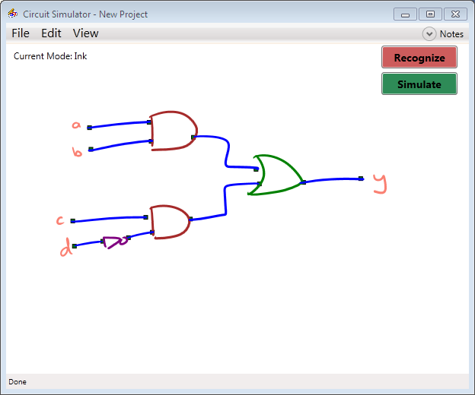
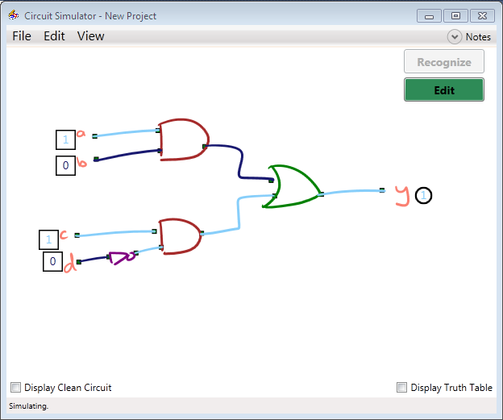
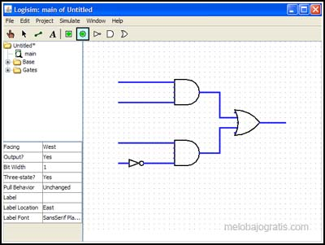

INTRODUCTION
http://www.melobajogratis.com/wp-content/uploads/2009/04/logs.jpg
Notes:
Drawing on paper is natural
Computers are useful for analysis and simulation
Sketch recognition seeks to combine the best of both worlds
We are looking at digital logic circuits, though this can be applied to many different domains

Slide 3
Draw Circuit
Stroke Classification
Stroke Grouping
Recognition
Shape Recognition
Shape Connection
Refining
Recognition Correction
Circuit Recognition
Simulation

Slide 4
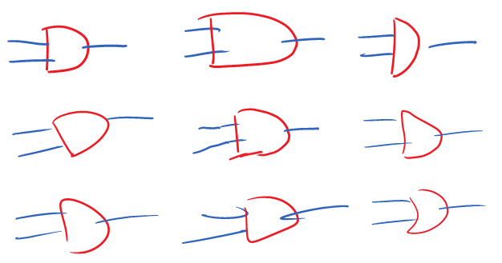
DIFFERENT DRAWING STYLES
Notes:
Pictures of differently drawn AND gates

Slide 5
SKETCH RECOGNITION
Q: How do you make sketch recognition reliable without restricting the user’s drawing style?
A: Allow the user to draw freely, then design the recognition engine based on common sketching styles.

Slide 6
Draw Circuit
Stroke Classification
Stroke Grouping
Recognition
Shape Recognition
Shape Connection
Refining
Recognition Correction
Circuit Recognition
Simulation

Slide 7
FIVE STAGE RECOGNITION
Single Stroke Recognition
Stroke Grouping
Shape Recognition
Shape Connection
Recognition Refinement

Slide 8
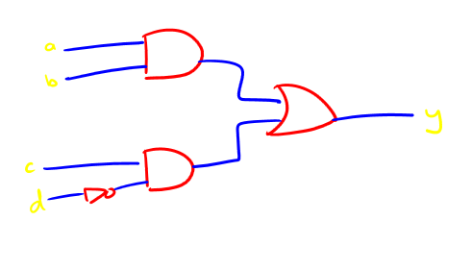
SINGLE STROKE RECOGNITION
Stylus-down to Stylus-up
Wire, Label, or Gate?
Decision Tree Classifier with 27 Features
  Stroke Length
  Curvature
  Pen speed

Slide 9
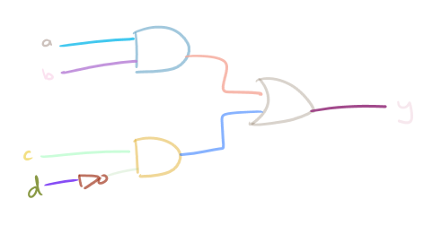
STROKE GROUPING
Should a pair of strokes be joined into a shape?
Decision Tree Classifier with 12 Features
  Time between strokes
  Distance between strokes

Slide 10
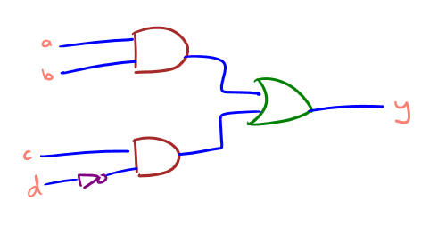
SHAPE RECOGNITION
Combination Recognizer
  Wire Recognizer
  Text Recognizer
  Gate Recognizer

Slide 11


COMBINATION GATE RECOGNIZER
Image Recognizer, Rubine Recognizer, $1 Recognizer, Zernike Moment Recognizer
Naïve Bayes Classifier
Bayes’ Theorem

Slide 12
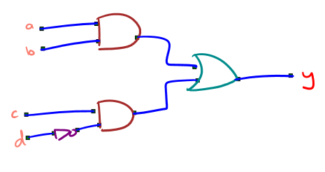
SHAPE CONNECTION

Slide 13
RECOGNITION REFINEMENT
Context
Stroke Steal
Stroke Shed

Slide 14
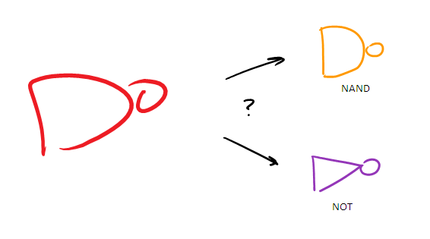



CONTEXT REFINE
Notes:
NOT gate must have 2 connecting wires (show pictures)

Slide 15
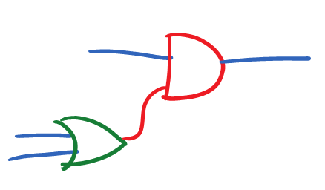
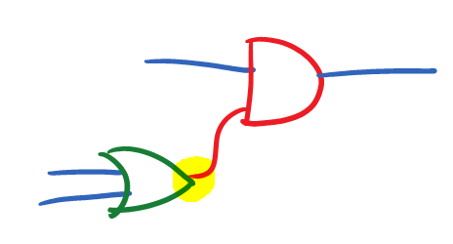
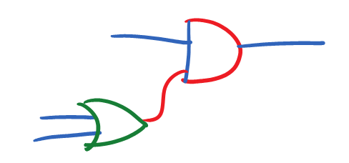
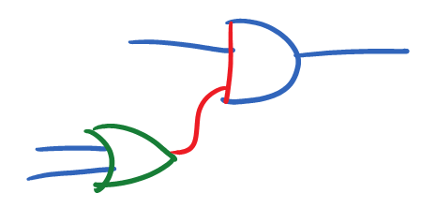
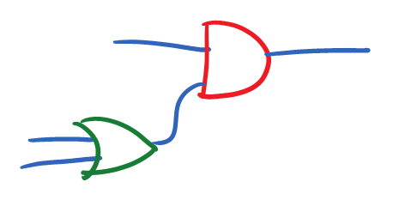
STROKE SHED REFINE
SUCCESS!
Notes:
Show picture
Regrouping difficulties (removing a stroke, then putting it back)?

Slide 16
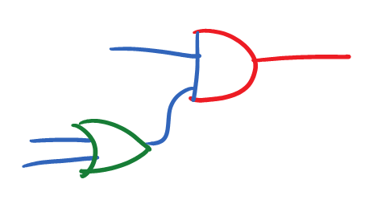
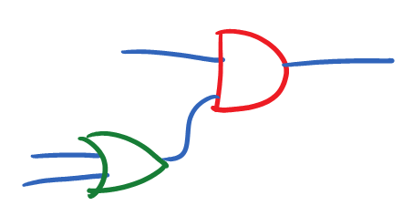
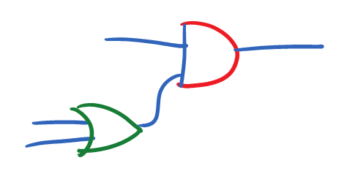
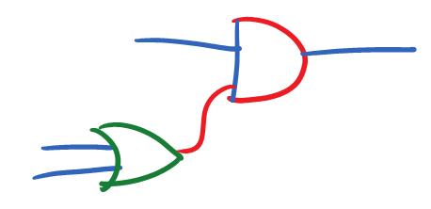
STROKE STEAL REFINE
SUCCESS!
Notes:
Show picture

Slide 17
REFINEMENT RESULTS
 | Original Recognition | Context Refine | Stroke Shed Refine | Stroke Steal Refine | Context→ Steal → Shed | Context → Shed → Steal
Total | 965 / 1116 | 977 / 1116 | 966 / 1116 | 963 / 1116 | 972 / 1116 | 976 / 1116
Percentage | 86.47% | 87.54 % | 86.56% | 86.29% | 87.10% | 87.46%

Slide 18
Draw Circuit
Stroke Classification
Stroke Grouping
Recognition
Shape Recognition
Shape Connection
Refining
Recognition Correction
Circuit Recognition
Simulation

Slide 19
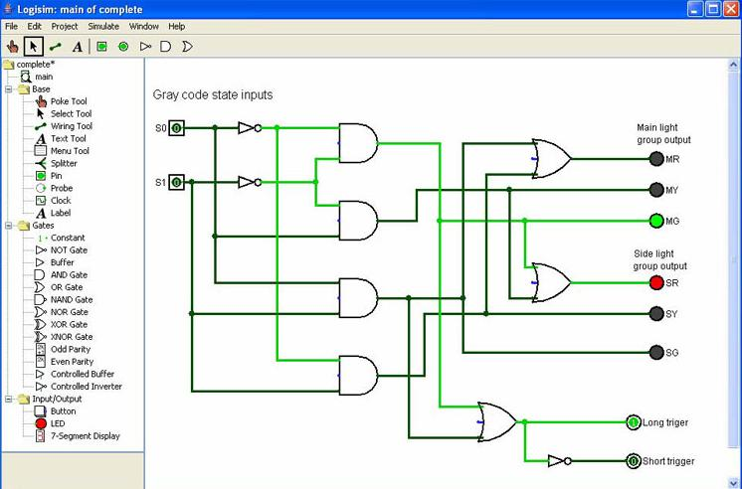
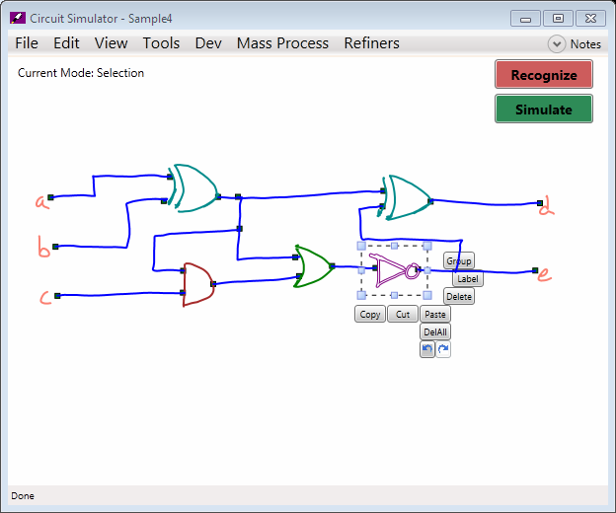
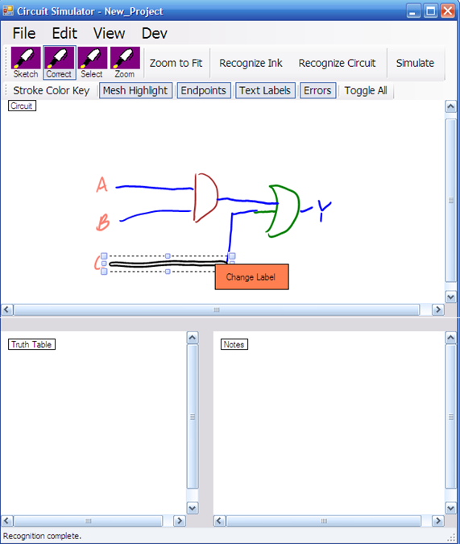
INTERFACE INTRODUCTION
http://rincones.educarex.es/ccnn/images/stories/logisim.jpg
2009 Sketchers Presentation
Notes:
Many different types of interfaces
Logsim was a bit clunky, lots of different options
The interface we started with had a lot of different modes, panels
Needed to go to menu for most things or right click
Want things to be intuitive, simple
Utilize hoverspace?

Slide 20
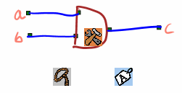
HOVER WIDGETS
Hover space – The space directly above the tablet surface
Hold pen above tablet surface, widgets pop up
Click a widget to use
Handles selection, editing commands, and recognition correction commands
Notes:
Hover above tablet surface to bring up
Tap widget to use, otherwise can ignore them
Selection widget: Clicking will start selection, lifting pen again will go back into drawing
Edit widget:

Slide 21
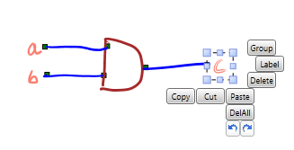
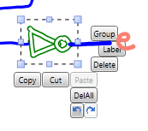
EDITING
Selection
  Drag a box to select contained strokes
  Tap strokes to add or remove them from selection
Edit Menu
  Context sensitive
  Appears when a selection is made or when tools widget is hit
Redrawing
  Draw over strokes to replace them
  Not in final version
Notes:
Selection:
* Use lasso? Drag-box? Tap-select?
Users seemed to like drag-box with taping to select and de-select individual strokes
Liked pressing stylus button more than choosing selection widget
Cut/copy/paste a selection
Redrawing (draw over existing strokes, will replace old strokes)
Users did not like/use this

Slide 22
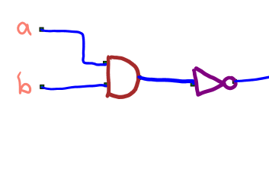
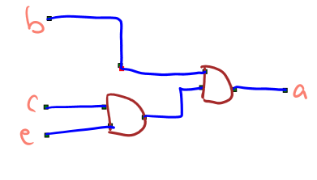
RECOGNITION FEEDBACK
Colored Strokes
Tooltips
Mesh Highlighting
Endpoint Highlighting
Notes:
Strokes colored according to what they have been recognized as
Mesh highlighting highlights components connected to moused-over component

Slide 23
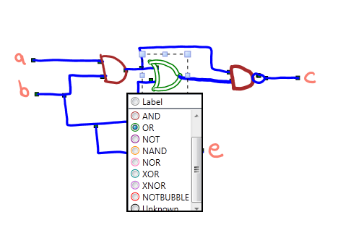
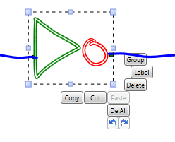
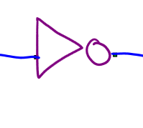
ERROR CORRECTION
Grouping
Labeling
Endpoint-connection
Selective re-recognition
Notes:
Add label menu picture

Slide 24
Draw Circuit
Stroke Classification
Stroke Grouping
Recognition
Shape Recognition
Shape Connection
Refining
Recognition Correction
Circuit Recognition
Simulation

Slide 25
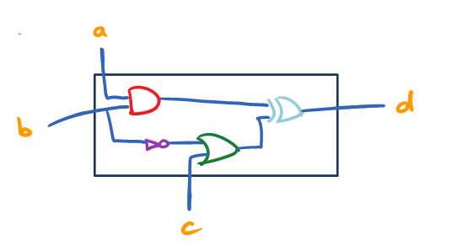
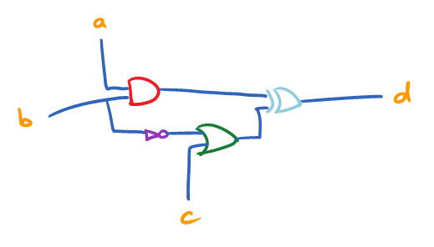
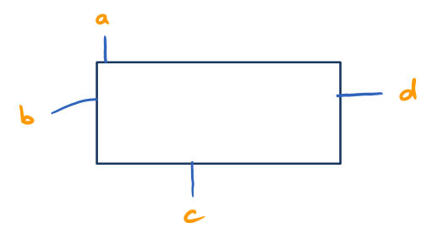
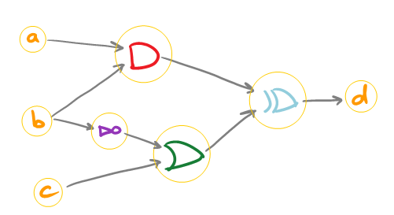
CIRCUIT RECOGNITION
Notes:
Take all wires and gates, translate them into “wire meshes” and “logic gates”
Load all labels (overall circuit inputs/outputs)
Organize circuit by connecting inputs and outputs
Determining inputs and outputs of gates by rotating the logic gate, and comparing the number of wires on one side vs the number of wires on the other side.

Slide 26
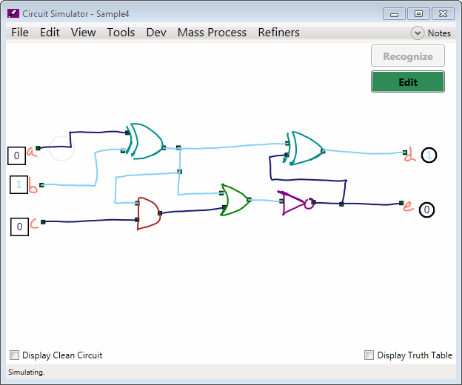
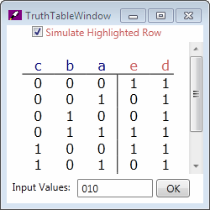
SIMULATION
Notes:
Click input toggles to change wire inputs
Wires are highlighted according to their value
Can bring up a truth table
Text input useful for larger circuits

Slide 27
LEARNING FROM ERROR CORRECTIONS
Single Stroke Decision Tree Classifier
Stroke Grouping Decision Tree Classifier
Shape Recognition Naïve Bayes Classifier
  Image Recognizer
  Rubine Recognizer
  $1 Recognizer
  Zernike Moment Recognizer
Notes:
When a recognition error occurs, the error could have come from any one of a number of classifiers. Ideally, learning would update all of these classifiers. So far, I’ve only implemented learning for the shape recognition naïve bayes classifier.

Slide 28
FUTURE WORK
Learning from error corrections
In-depth user studies
CS 5 or CS 42

Slide 29
QUESTIONS?

