Slide 1
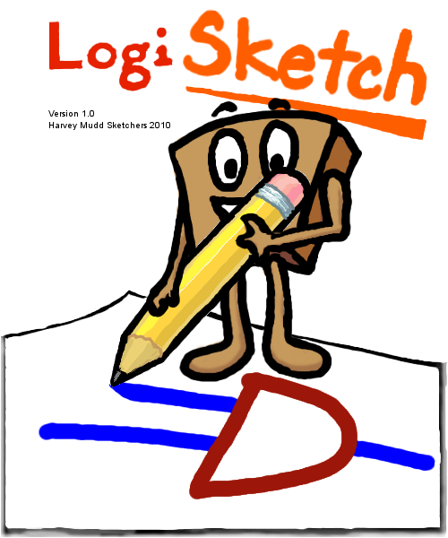
An Intuitive System for Sketching and Simulating Logic Circuits
Kevin Chan, Lilian de Greef, Alexa Keizur, Alice Paul
Brian Liao, June Woo Suk (Troy High School)
Professor Christine Alvarado

Slide 2

BIG PICTURE
Q: How do you make sketch recognition reliable without restricting the user’s drawing style?
A: Allow the user to draw freely, with no unnatural constraints. Then design the system based on common sketching styles.

Slide 3
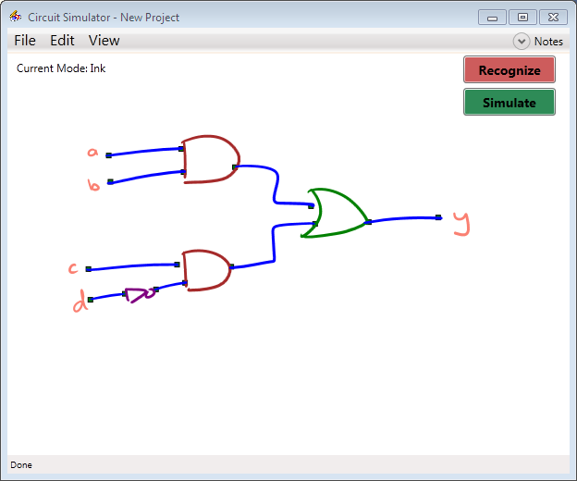
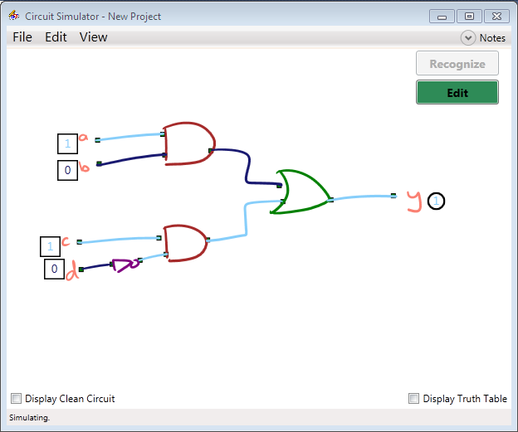
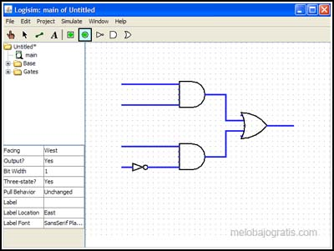
INTRODUCTION
http://www.melobajogratis.com/wp-content/uploads/2009/04/logs.jpg
Notes:
Drawing on paper is natural
Computers are useful for analysis and simulation
Sketch recognition seeks to combine the best of both worlds
We are looking at digital logic circuits, though this can be applied to many different domains

Slide 4
DEMO!

Slide 5
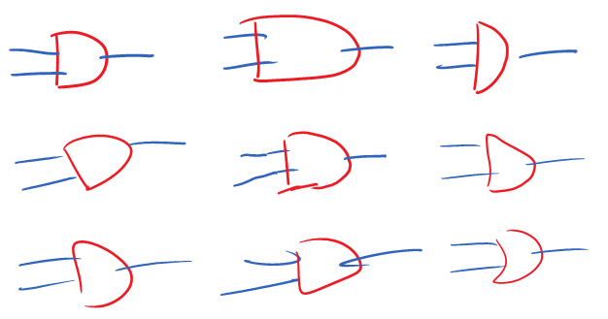
RECOGNITION CHALLENGES
Notes:
Pictures of differently drawn AND gates

Slide 6
Draw Circuit
Sketch Recognition
Circuit Interpretation
Recognition Correction (User)
Simulation

Slide 7
Draw Circuit
Sketch Recognition
Circuit Interpretation
Recognition Correction (User)
Simulation

Slide 8
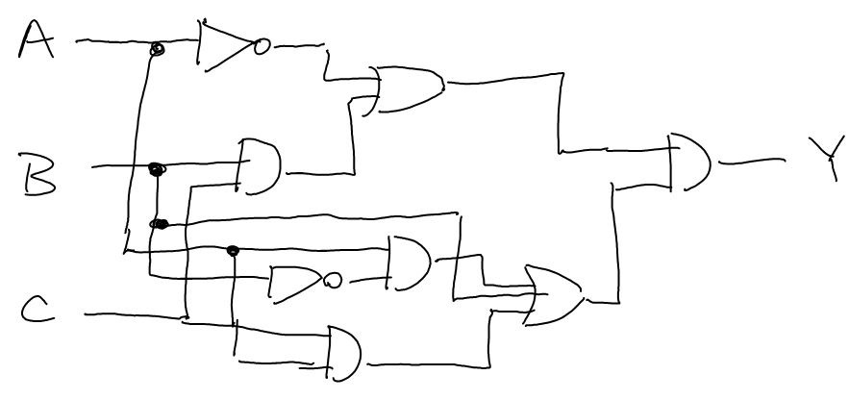
Notes:
Note the possible recognition difficulties

Slide 9
Draw Circuit
Sketch Recognition
Circuit Interpretation
Recognition Correction (User)
Simulation

Slide 10
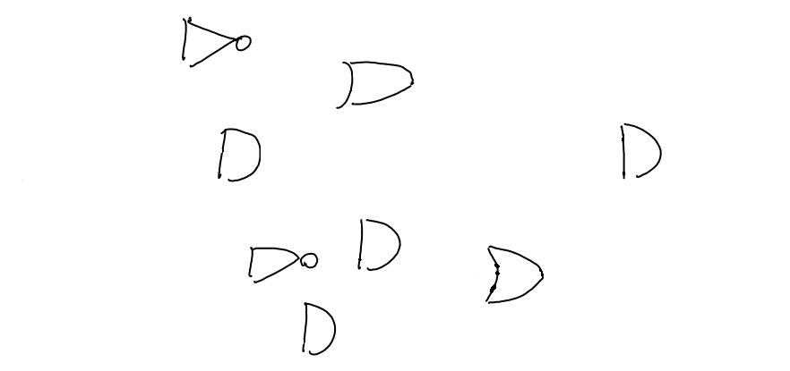
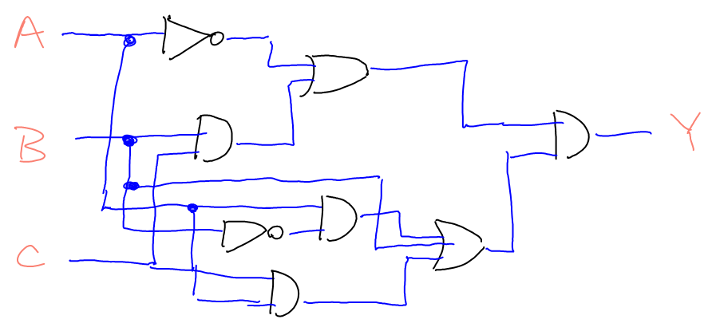
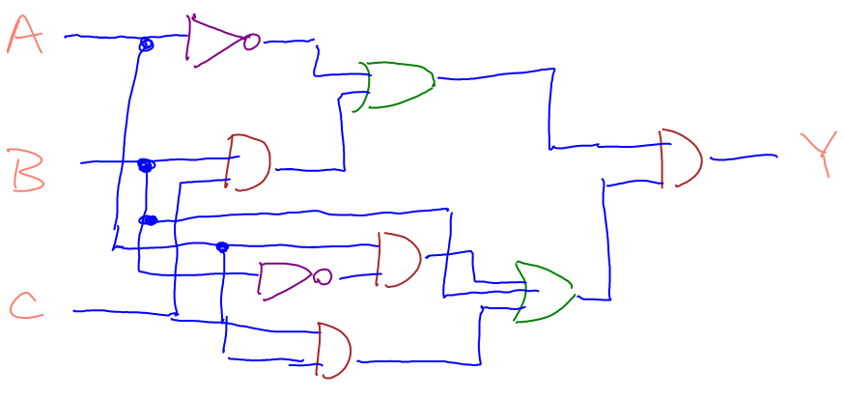
RECOGNITION OVERVIEW
2008 Sketchers Presentation
Notes:
Here, we have an unlabeled sketch.
First, we apply labels of “wire”, “gate”, or “label” to each stroke in the sketch.

Slide 11
PREVIOUS RECOGNITION METHOD
Stroke Classification
Stroke Grouping
Recognition
Shape Recognition
Shape Connection

Slide 12
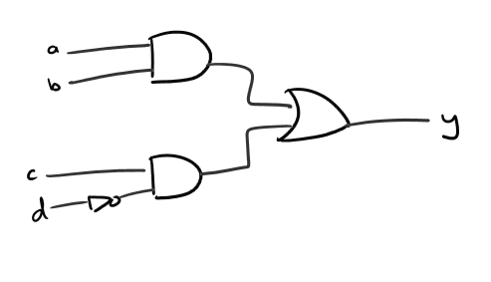
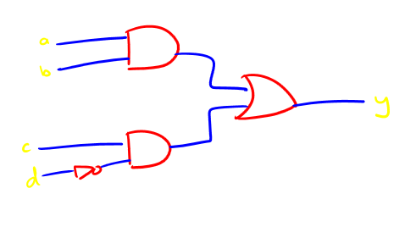
RECOGNITION
Stroke Classification
Stroke Classification
Stroke Grouping
Shape Recognition
Shape Connection

Slide 13
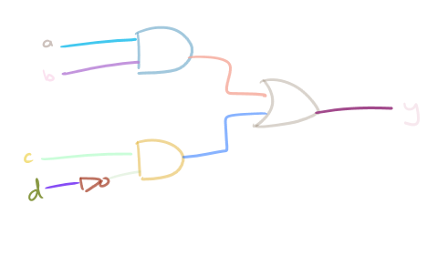
RECOGNITION
Stroke Classification
Stroke Grouping
Shape Recognition
Shape Connection

Slide 14
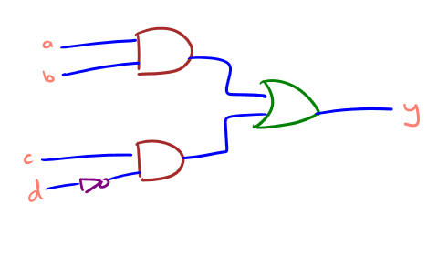
RECOGNITION
Stroke Classification
Stroke Grouping
Shape Recognition
Shape Connection

Slide 15
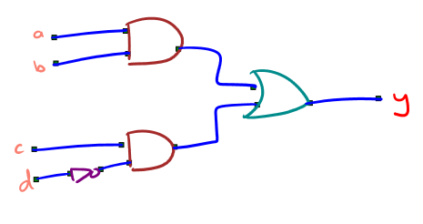
RECOGNITION
Stroke Classification
Stroke Grouping
Shape Recognition
Shape Connection

Slide 16
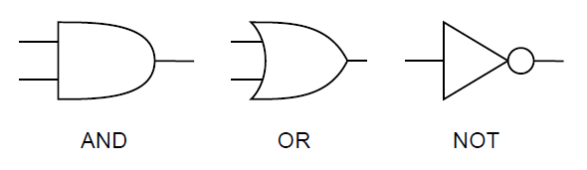
RECOGNITION
How does a computer recognize a shape?
How do you, as a person, recognize a shape?
Alvarado, Dodds, et al. CS For Scientists and Engineers

Slide 17


RECOGNITION WITH TEMPLATES
Alvarado, Dodds, et al. CS For Scientists and Engineers

Slide 18
RECOGNITION WITH FEATURES
Rather than storing a set of templates, store a set of features that describe the shape!
Examples:
  Area
  Curvature
  Pen Speed
Area
Pen Speed
Curvature

Slide 19
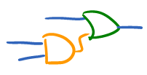
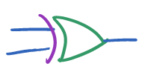
ROOM FOR IMPROVEMENT
Recognition can always be improved.

Slide 20
Stroke Classification
Stroke Grouping
Recognition
Shape Recognition
Shape Connection
Refining

Slide 21
RECOGNITION REFINEMENT
Context
Stroke Steal
Stroke Shed

Slide 22
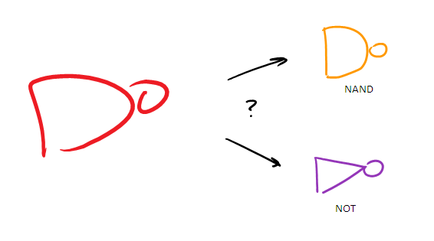
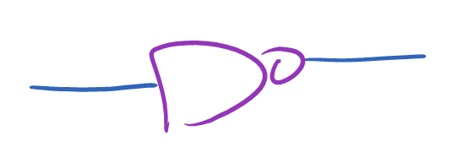


CONTEXT REFINE
Notes:
NOT gate must have 2 connecting wires (show pictures)

Slide 23
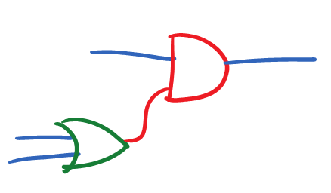
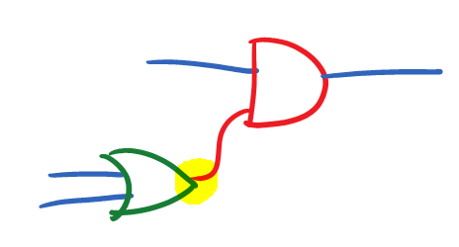
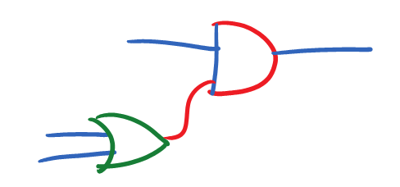
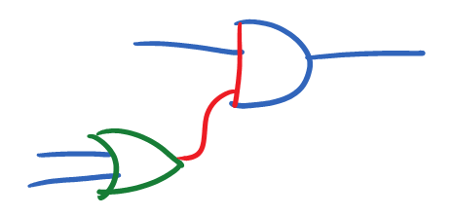
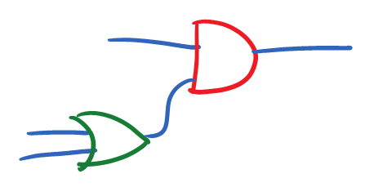
STROKE SHED REFINE
SUCCESS!
Notes:
Show picture
Regrouping difficulties (removing a stroke, then putting it back)?

Slide 24
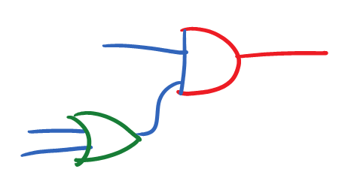
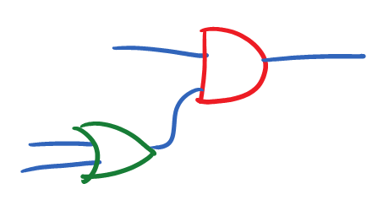
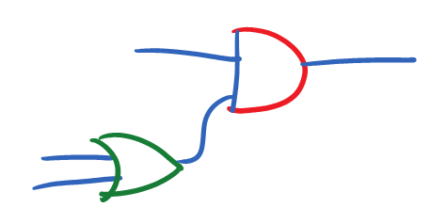
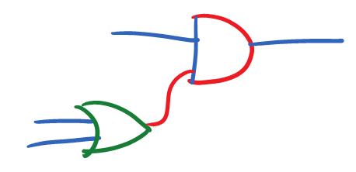
STROKE STEAL REFINE
SUCCESS!
Notes:
Show picture

Slide 25
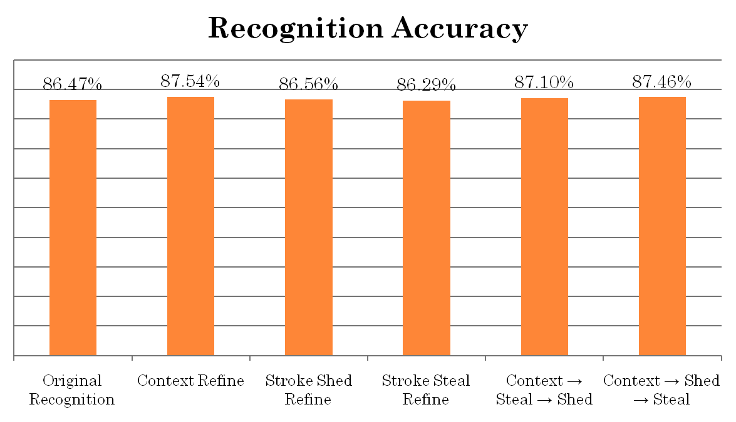
REFINEMENT RESULTS

Slide 26

PROBLEMS
Hard to tell…
  When to refine
  Which refiner to use
  Whether it refined correctly

Slide 27
Draw Circuit
Stroke Classification
Stroke Grouping
Recognition
Shape Recognition
Shape Connection
Refining
Circuit Recognition
Recognition Correction
Simulation

Slide 28
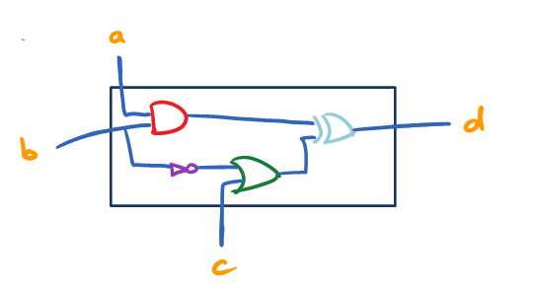
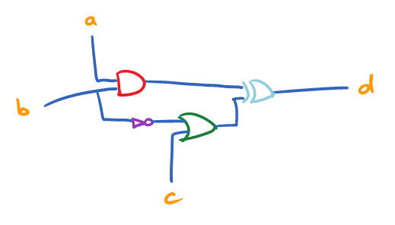
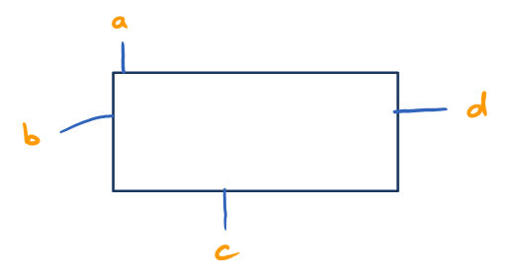
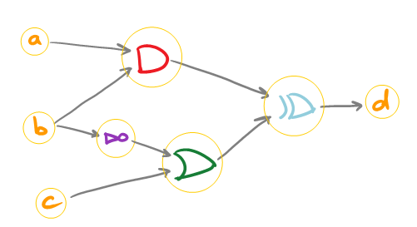
CIRCUIT RECOGNITION
Notes:
Take all wires and gates, translate them into “wire meshes” and “logic gates”
Load all labels (overall circuit inputs/outputs)
Organize circuit by connecting inputs and outputs
Determining inputs and outputs of gates by rotating the logic gate, and comparing the number of wires on one side vs the number of wires on the other side.

Slide 29
Draw Circuit
Stroke Classification
Stroke Grouping
Recognition
Shape Recognition
Shape Connection
Refining
Circuit Recognition
Recognition Correction
Simulation

Slide 30
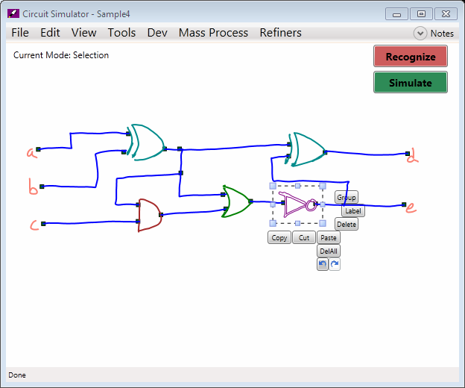
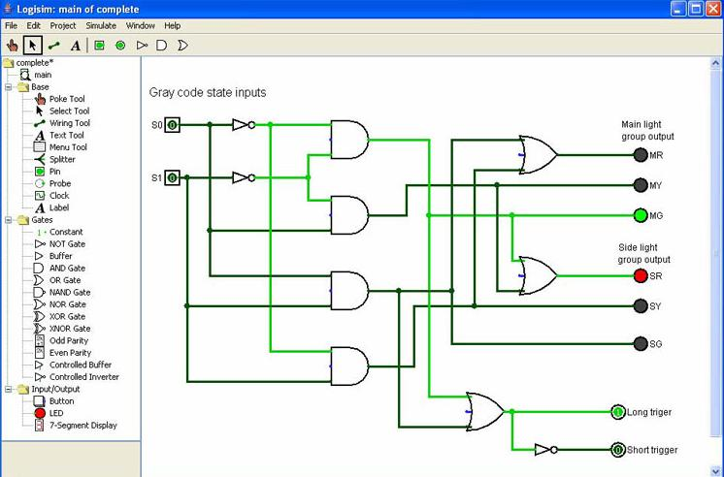
USER INTERFACE
http://rincones.educarex.es/ccnn/images/stories/logisim.jpg
Notes:
How did we go from Logisketch’s rather confusing and clunky interface to this?

Slide 31
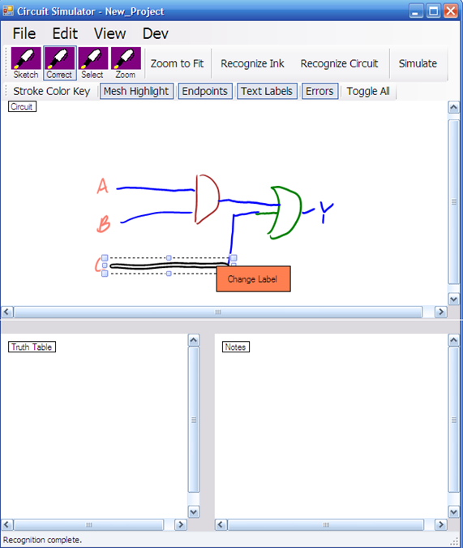
OLD DESIGN – PROBLEMS?
Modal Interface
Menus
Confusing options
2009 Sketchers Presentation
Notes:
Modes annoy people: it is easy to forget the mode they are in, draw when meaning to select
Menus take time, hae to go back up to the top to select options
What is the difference between recognize ink and recognize circuit?

Slide 32
DESIGN GOALS
“Magic Pen”
No modes
Avoid menus and toolbars
Easy to find and correct errors
Notes:
Users want the pen to do whatever they think it should at the time, draw, select, copy, etc.
No (explicit) modes makes it “magic”: rather, the mode is turned on and off by context rather than the user
Let users choose commands, etc locally rather than having to move across the screen
Recognition will never be 100%, so make it easy to see where errors are, how to correct them.

Slide 33
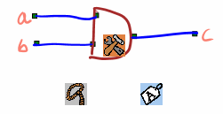
HOVER ICONS
Hover space – The space directly above the tablet surface
Based loosely on Hover Widgets (T. Grossman, et.al., 2006)
Hold pen above tablet surface, widgets pop up
Lets stylus be used for selection, correction, editing without a menu or modes
Notes:
Probably want to cite the name, or come up with a new term. Hover icons? Cite the paper and say it’s based on that. Explain how users just want to be able to draw all the time and use their stylus to do whatever they want. The “magic pen.” Unfortunately, computers aren’t that incredible and need a bit more from the user.
Hover above tablet surface to bring up
Tap widget to use, otherwise can ignore them
Selection widget: Clicking will start selection, lifting pen again will go back into drawing
Edit widget:

Slide 34
SELECTION
Problems
  Often requires a separate mode
  Many types: lasso, drag-box, tapping, others
Our solution
  Can begin selection through hover icon or stylus button
  Can draw again after a selection is made
  Users liked drag box with tapping

Slide 35
RECOGNITION FEEDBACK & CORRECTION
What is important here?
  Know if errors exist
  Easy to correct errors
  Correcting errors will not introduce more errors

Slide 36
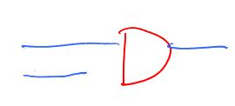
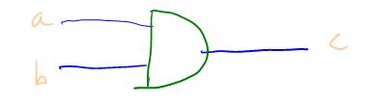

TYPES OF RECOGNITION ERRORS
Incorrect Labeling
Not Connected
Incorrect Grouping

Slide 37
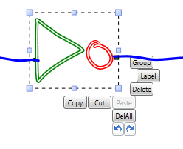
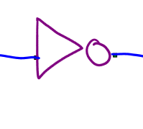
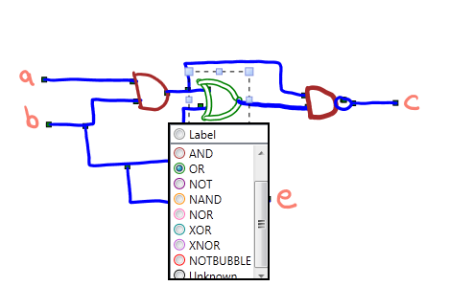
INCORRECT LABELING AND GROUPING
Identified by stroke coloring and tooltips
Fixed using relabeling and regrouping
Shapes connected to changed shape are re-recognized

Slide 38
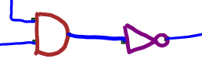
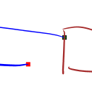
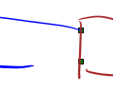
INCORRECT CONNECTIONS
Identified by mesh highlighting and endpoint highlighting
Fixed by dragging endpoints, drawing over connection

Slide 39
Draw Circuit
Stroke Classification
Stroke Grouping
Recognition
Shape Recognition
Shape Connection
Refining
Circuit Recognition
Recognition Correction
Simulation

Slide 40
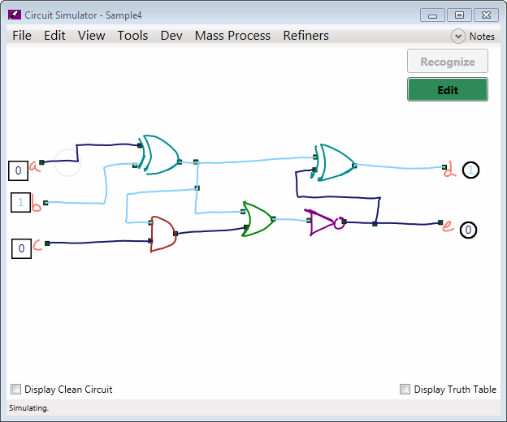
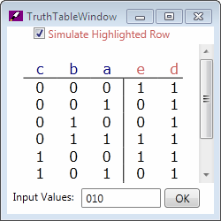
SIMULATION
Notes:
Click input toggles to change wire inputs
Wires are highlighted according to their value
Can bring up a truth table
Text input useful for larger circuits

Slide 41
USER PREFERENCES
Liked using hover icons over menus
Liked seeing their sketches “come to life”
Liked using stylus button for selection
Tended to use re-labeling over grouping
Would rather erase and re-draw rather than trace over existing strokes to replace them

Slide 42
DEMO!

Slide 43
LEARNING FROM ERROR CORRECTIONS
How do you use users’ corrections to improve recognition?
Area
Stroke Classification
Stroke Grouping
Recognition
Shape Recognition
Shape Connection
Pen Speed
Refining
Curvature
Notes:
When a recognition error occurs, the error could have come from any one of a number of classifiers. Ideally, learning would update all of these classifiers. So far, I’ve only implemented learning for the shape recognition naïve bayes classifier.

Slide 44
FUTURE WORK
Learning from error corrections
In-depth user studies
CS 5 or CS 42

Slide 45
QUESTIONS?

