Slide 1
Gate Classification in Sketches
Joe Simons
Notes:
Flip the order.
Start with why the problem’s hard.
Make the discussion a little more intuitive and a little less technical.

Slide 2
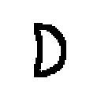
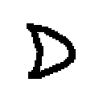
Classification
Goal:
Distinguish between visually similar symbols
vs

Slide 3


Classification
Goal:
Distinguish between visually similar symbols
vs
Notes:
Picture of two average images. We need a way to reduce within symbol var. and accentuate between symb var.

Slide 4

Congealing
Two aspects:
Final image
Legal transforms to get there
Notes:
Goal is to make symbols which are the same type more like eachother. Using:
Scale
Translate
Skew
Rotate

Slide 5


Classifying a test image
Combine test image with average image
Congeal the test image with the average image.
Notes:
Show test image. How do we get this to match the average image.

Slide 6
Results: No Congealing
Summary: Entropy | and | or | nand | nor | not
and | 1.00 | 0.00 | 0.00 | 0.00 | 0.00
or | 0.83 | 0.13 | 0.00 | 0.00 | 0.04
nand | 0.62 | 0.00 | 0.31 | 0.00 | 0.08
nor | 1.00 | 0.00 | 0.00 | 0.00 | 0.00
not | 0.75 | 0.00 | 0.00 | 0.00 | 0.25
Notes:
Show the confusion.

Slide 7
Results: Congealed
Summary: Entropy | and | or | nand | nor | not
and | 0.31 | 0.19 | 0.31 | 0.06 | 0.13
or | 0.30 | 0.43 | 0.13 | 0.04 | 0.09
nand | 0.85 | 0.08 | 0.00 | 0.00 | 0.08
nor | 0.17 | 0.00 | 0.00 | 0.33 | 0.50
not | 0.88 | 0.00 | 0.00 | 0.13 | 0.00

Slide 8


Problems
Typical Output
Desired Output

Slide 9
Future Work
Implement a “smarter” algorithm for choosing affine transforms to apply.
Use probability of transforms to help classification.

Slide 11
Results: No Congealing
SUMMARY: Hausdorff | and | or | nand | nor | not
and | 0.94 | 0.00 | 0.06 | 0.00 | 0.00
or | 0.04 | 0.83 | 0.04 | 0.09 | 0.00
nand | 0.00 | 0.00 | 0.92 | 0.08 | 0.00
nor | 0.00 | 0.83 | 0.00 | 0.17 | 0.00
not | 0.00 | 0.13 | 0.00 | 0.75 | 0.13
Notes:
Show the confusion.

Slide 12
Results: Congealed
SUMMARY: Hausdorff | and | or | nand | nor | not
and | 0.31 | 0.00 | 0.00 | 0.69 | 0.00
or | 0.00 | 0.22 | 0.13 | 0.65 | 0.00
nand | 0.00 | 0.00 | 0.69 | 0.31 | 0.00
nor | 0.00 | 0.00 | 0.00 | 1.00 | 0.00
not | 0.00 | 0.00 | 0.13 | 0.75 | 0.13

Slide 13




Questions?

Slide 14
Why Classification is Hard

Slide 15
Congealing
Method:
Reduce noise by applying affine transforms to the symbol.
Classify test image by comparing to average image.
Notes:
skip

Slide 16
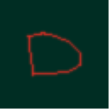
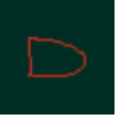
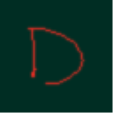
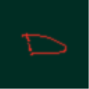
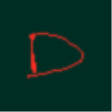
Average Image

Slide 17







Affine Transformations
Scale
Translate
Skew
Rotate
Notes:
skip

Slide 18
Algorithm
1 Apply affine transform to an individual image
2 If the transformation decreases the total entropy, keep it
3 Repeat 1 and 2 for each image and possible affine transform
4 Repeat 1-3 until improvement stops

Slide 19










Slide 20
Want a computer to be able to do find platonic images automatically
Assume that there is some transformation from the platonic image to any gate you draw
Given a set of gates, find the inverse of these transformations

Slide 21
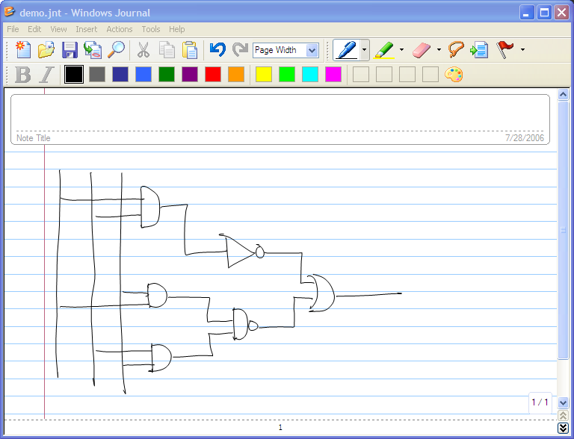

Slide 22
