Slide 1


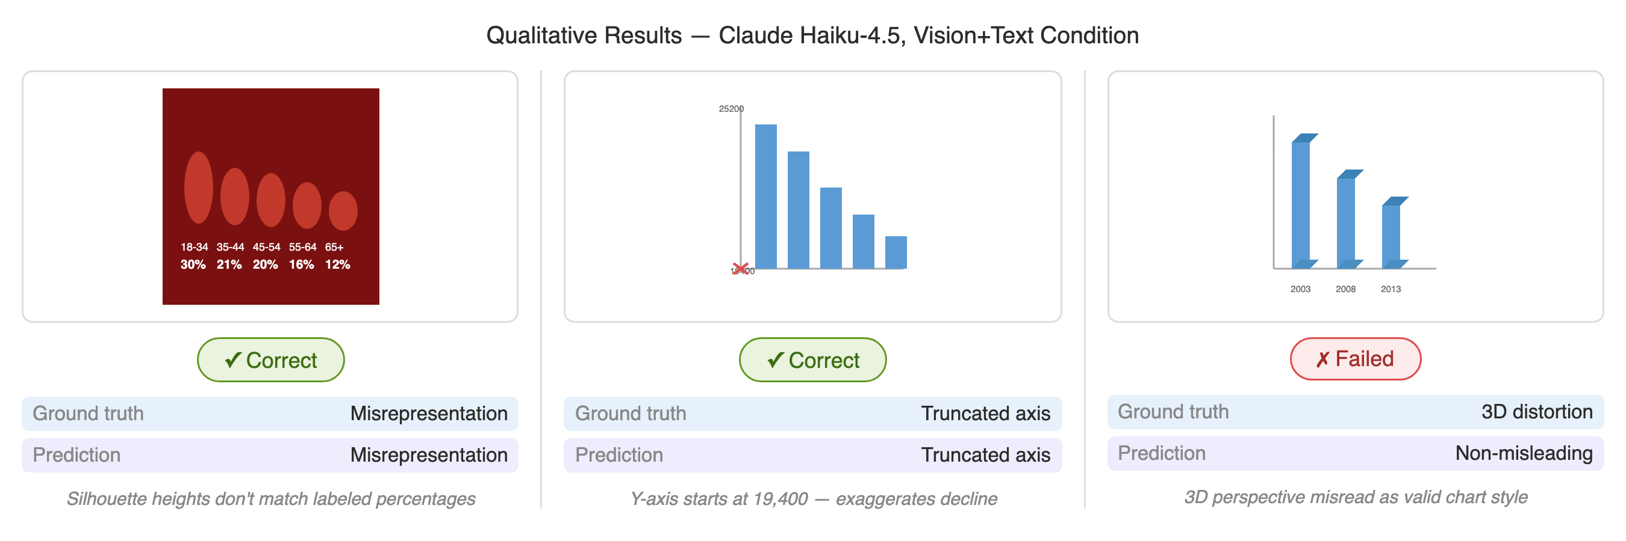
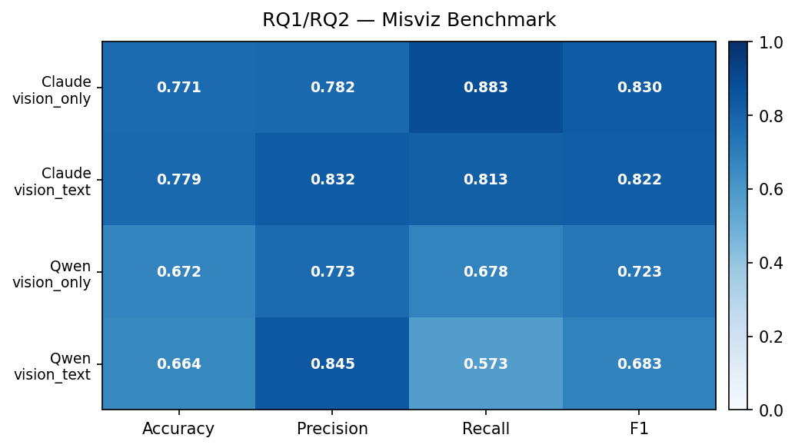
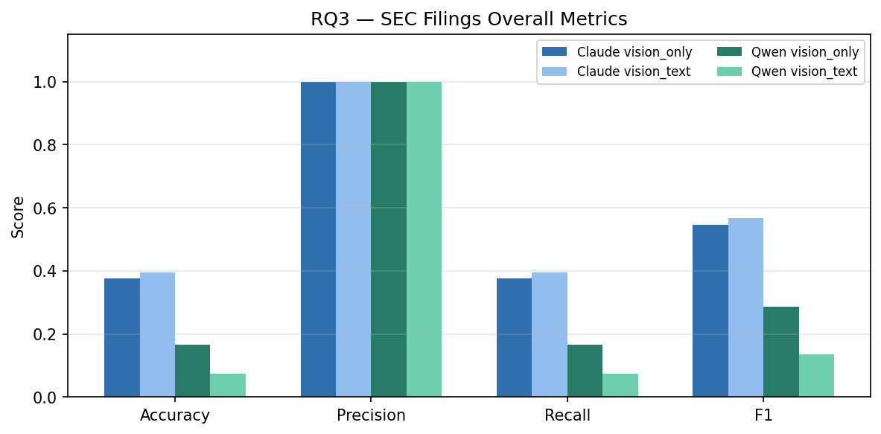
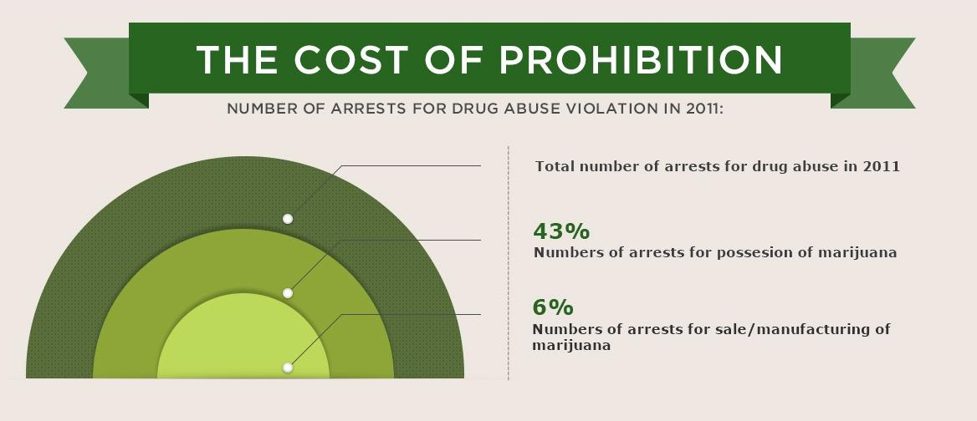
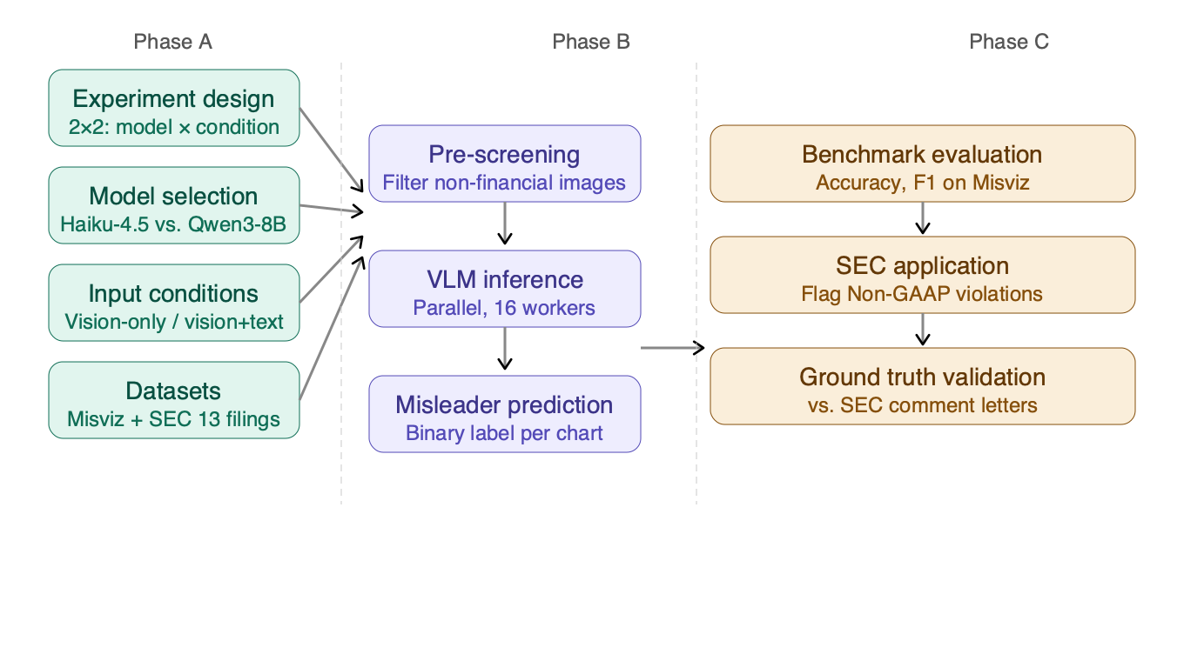


FinChartAudit: Detecting Misleading Financial Charts with Vision-Language Models
$$\text{Mengshan} \text{Li}\text{, }\text{Wenshuang} \text{Zhou}\text{, }\text{Wu} \text{Tong}$$
Khoury College of Computer Science, Northeastern University,
$$Supervised by:Prof Ryan Rad$$
1. Background
3. Methodology
4. Experimental Results
86% of S&P 500 companies include at least one misleading chart in their annual reports — truncated axes, selective time windows, or Non-GAAP metrics presented without GAAP context.
Non-GAAP prominence has been the #1 SEC comment letter topic for 9 consecutive years, yet detection remains entirely manual.
No existing work evaluates whether Vision-Language Models (VLMs) can automate this detection.
Claude Haiku-4.5 (vision+text) correctly identifies misrepresentation and truncated axis misleaders but misclassifies 3D distortion as non-misleading — treating perspective effects as valid chart styling.
A: Experiment Design
Experiment design — 2×2: model × condition
Model selection — Haiku-4.5 vs. Qwen3-8B
Input conditions — vision-only / vision+text
Datasets — Misviz (2,077) + SEC 13 filings
Qualitative Results:
 | vision-only | vison + text
Claude Haiku-4.5 | RQ1: Baseline accuracy | RQ2: Text grounding effect
Qwen3-VL-8B | RQ1: Baseline accuracy | RQ2: Text grounding effect
2. Motivations & Objectives
❌ Current Approach Manual review of financial charts — slow, subjective, and unscalable across thousands of SEC filings.
✓ Our Approach Automated detection using Vision-Language Models (VLMs), evaluated on a standardized benchmark and validated on real SEC filings.
📚 Related Work & Gap
Misviz (Tonglet et al., 2025): first large-scale benchmark — but no Claude evaluation, no textual grounding condition
MisVisFix (2025): LLM-based chart correction tool — general web domain only, not financial/SEC
VLMs achieve max 30% accuracy on misleading element detection (Pandey et al., 2025)
➡️ No existing work applies VLM misleading chart detection to SEC compliance
Research Questions
RQ1: How accurately can VLMs (Claude vs. Qwen3-VL) detect misleading charts across 12 misleader types?
RQ2: Does providing textual ground-truth context improve detection over vision-only input?
RQ3: Can validated VLM capabilities detect Non-GAAP violations in real SEC 10-K filings?
B: VLM Inference
Vision-only: chart image → prompt
Vision+text: chart image + bbox coords → prompt
12 misleader definitions in prompt
OpenRouter API, 16 workers, 30s timeout
Quantitative Results:
RQ1/RQ2: Claude (77.1%) outperforms Qwen (67.2%) on Misviz. Vision+text improves precision but reduces recall for both models.
RQ3: Claude achieves precision=1.0 on SEC filings but low recall, indicating conservative yet reliable flagging. STZ and UPS show highest violation rates.
C: Analysis & Validation
Benchmark evaluation
F1, accuracy per misleader type
2×2 model × condition comparison
SEC application
Pipeline applied to 13 SEC 10-K filings
Flag Non-GAAP violations
Ground truth validation
vs. SEC comment letter ground truth
Per-company error analysis
⚠️ Example: Radial area encoding distorts true proportions — 43% vs. 6% appears far more extreme than 7×
5. Conclusion & Future Work
Conclusion:
Claude outperforms Qwen (77.1% vs 67.2%); vision+text improves precision but hurts recall
Future Work:
fine-tune on financial charts; scale SEC coverage; optimize prompt for recall
Presenter
johndoe@edu

Slide 2
FinChartAudit: Detecting Misleading Financial Charts with Vision-Language Models and Textual Grounding
Group 5
Mengshan Li
Wenshuang Zhou
Tong Wu

Slide 3
Background
86% of S&P 500 companies include at least one misleading chart in their annual reports — truncated axes, selective time windows, or Non-GAAP metrics presented without GAAP context.
Non-GAAP prominence has been the #1 SEC comment letter topic for 9 consecutive years, yet detection remains entirely manual.
No existing work evaluates whether Vision-Language Models (VLMs) can automate this detection.

Slide 4
Motivation and Objectives
Current Problem
Misleading charts are common in financial reports
Detection is manual, slow, and subjective
Not scalable across thousands of SEC filings
Our Solution
Use Vision-Language Models (VLMs)
Automatically detect misleading charts
Improve accuracy on SEC filings
Enable scalable compliance checking

Slide 5



Progress So Far
Completed experiment setup, including model selection and dataset construction
Implemented the VLM pipeline and applied it to SEC filings
Obtained initial evaluation results using accuracy and F1

Slide 6
Results

Slide 7
Next Steps

