Slide 1
Demand Pulse
A replenishment response
workspace for planners
and suppliers
v31 progress briefing
Real model execution on synthetic business records
Demand Pulse / v31 team update / 24 October 2026
01
Notes:
0:00–0:25. Demand Pulse helps a retail planner decide whether an additional-supply inquiry is still worth pursuing. Responsive Network connects the planner and supplier workspaces around one inquiry. We now have real model execution and visible tool activity, with separate supplier disclosure and planner authorization. This briefing covers the current v31 demo, not a deployed service.
Evidence: local v31 session 810b310d736d406e839bb9549d301ce5; deliverable/competition_v31_activity_20261024/validation.json; v31 test_workbench.py; current local UI. Business records are synthetic. SAP integration and product benefits remain unvalidated.

Slide 2
One inquiry, one decision
CASE-1042 / OJ-250 / Toronto DC / NorthOrchard
Business question
Is additional supply still worth pursuing?
Demand boundary
Hidden demand remains unquantified.
No extra order quantity is justified.
Supply boundary
Conditional arrival depends on unresolved
operational requirements.
Demand Pulse / v31 team update / 24 October 2026
02
Notes:
0:25–1:00. The synthetic case is OJ-250 orange juice for Toronto DC, supplied by NorthOrchard. Demand may have moved beyond the original plan. Stockouts can hide demand, but the current demo does not establish the size of incremental demand. A conditional arrival is not a delivery commitment. The supplier must check carrier acceptance, capacity, a receiving slot and QA. The planner decides whether to investigate an alternative or stop. Original procurement remains unchanged.
Evidence: local v31 session 810b310d736d406e839bb9549d301ce5; deliverable/competition_v31_activity_20261024/validation.json; v31 test_workbench.py; current local UI. Business records are synthetic. SAP integration and product benefits remain unvalidated.

Slide 3
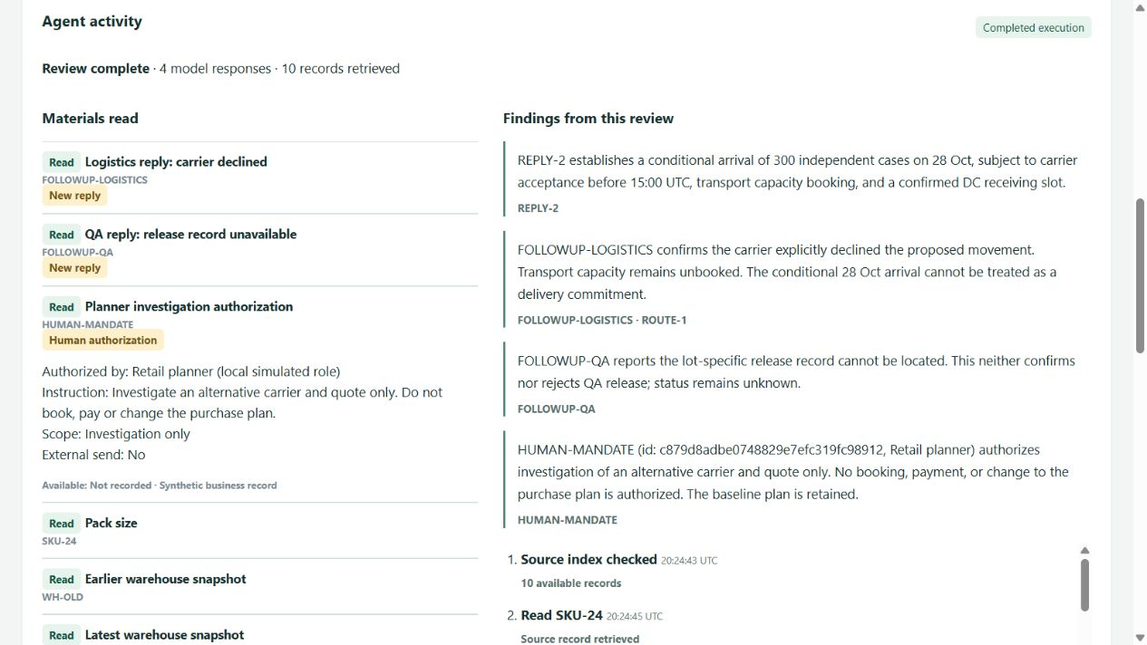
The Agent’s work is now visible
Real execution
Sources read
Cited findings
Visible rule corrections
Historical replay
Recorded output
No new model calls
Supplier view / real inference / synthetic business evidence
Demand Pulse / v31 team update / 24 October 2026
03
Notes:
1:00–1:45. Start at http://127.0.0.1:8794/ and choose a mode. Historical replay reuses recorded real outputs without new calls. Real execution calls Claude Sonnet 4.6 against the same frozen synthetic materials. In the supplier workspace, the activity panel displays actual source reads, expandable text, citations and rule correction events. Findings appear after a successful submission. The screenshot shows the completed real investigation reading the human mandate. Tool visibility is not a claim that the underlying business facts are real.
Evidence: local v31 session 810b310d736d406e839bb9549d301ce5; deliverable/competition_v31_activity_20261024/validation.json; v31 test_workbench.py; current local UI. Business records are synthetic. SAP integration and product benefits remain unvalidated.

Slide 4
New information changes the next action
Evidence received
Resulting next step
No carrier reply
Collect missing confirmation
Carrier explicitly declines
Planner chooses investigation or closure
Planner authorizes investigation
Prepare alternative inquiry
No booking or purchase
QA stays unknown. Rule-validated transitions do not prove a delivery outcome.
Demand Pulse / v31 team update / 24 October 2026
04
Notes:
1:45–2:25. The actual test began with carrier acceptance unknown and the Agent requesting confirmation. A simulated logistics reply then explicitly declined the movement. The next action changed to human choice. QA remained unknown because a missing release record is not rejection. After the planner authorized investigation, a new real call read that mandate and prepared an alternative inquiry. This comparison describes the supplier-side real execution sequence. The planner does not see the initial private draft. On first disclosure we show no prior authorized version.
Evidence: local v31 session 810b310d736d406e839bb9549d301ce5; deliverable/competition_v31_activity_20261024/validation.json; v31 test_workbench.py; current local UI. Business records are synthetic. SAP integration and product benefits remain unvalidated.

Slide 5
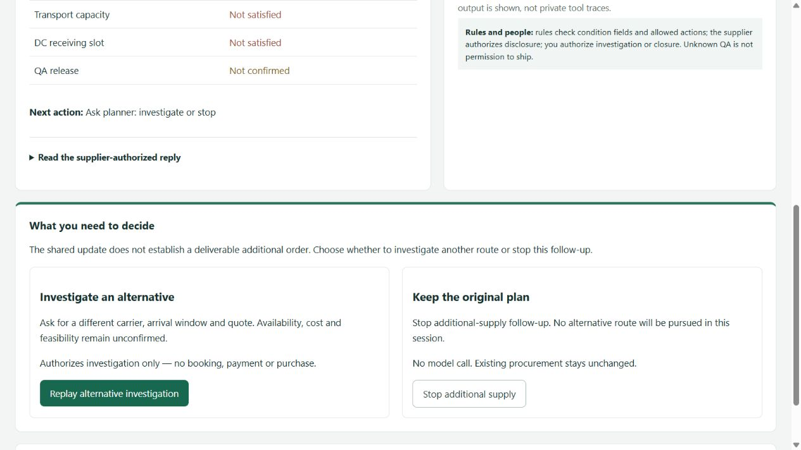
The planner keeps the business decision
Investigate
Request another route
and quote.
No commitment yet.
Stop additional supply
Retain the original plan
and the audit record.
Planner decision screen / historical replay / synthetic case
Demand Pulse / v31 team update / 24 October 2026
05
Notes:
2:25–3:10. The planner receives only a supplier-authorized summary and condition fields. The updated screen separates the shared assessment, available Agent work and the human decision. First disclosure has no invented before-and-after comparison. Later updates compare only authorized versions, and the previous shared version stays visible while a new draft awaits disclosure. Investigating authorizes another inquiry, not booking, payment or a purchase. Stopping closes follow-up while retaining the original plan. This screenshot is historical replay, which is clearly labeled in the live workbench.
Evidence: local v31 session 810b310d736d406e839bb9549d301ce5; deliverable/competition_v31_activity_20261024/validation.json; v31 test_workbench.py; current local UI. Business records are synthetic. SAP integration and product benefits remain unvalidated.

Slide 6
SAP connection and ecosystem value
Retailer procurement context
Supplier participation
Original plan and purchase item
Stock and inbound information
Retailer approval policy
Scoped response and authorization
Existing supplier tools stay in place
Participation cost still needs validation
Proposed SAP value
More supplier participation in the purchasing workflow
No live SAP connection or writeback. Revenue and adoption remain hypotheses.
Demand Pulse / v31 team update / 24 October 2026
06
Notes:
3:10–3:50. The proposed product complements retailer procurement in SAP. The retailer supplies baseline procurement context. Our workspace brings back a supplier-authorized response and the approved disposition. Supplier participation should not require replacing their internal system. However, v31 does not call SAP or send messages to suppliers. Earlier demo procurement reads and return records are simulated. We still need to verify the business-object mapping, approval policy and deployment cost. Possible SAP value is broader supplier participation and more complete procurement information. New SAP customers and paid projects are hypotheses, not established outcomes.
Evidence: local v31 session 810b310d736d406e839bb9549d301ce5; deliverable/competition_v31_activity_20261024/validation.json; v31 test_workbench.py; current local UI. Business records are synthetic. SAP integration and product benefits remain unvalidated.

Slide 7
What the demo establishes
Implemented
Still to validate
Real calls and observable tool activity
Evidence-linked operational summaries
Supplier authorization boundaries
Planner investigation and closure
Advantage over strong rules
Human time, errors and rework
Supplier adoption and integration cost
Fulfillment and financial outcomes
Synthetic inputs and local role links do not establish production readiness.
Demand Pulse / v31 team update / 24 October 2026
07
Notes:
3:50–4:30. We have real model calls, source reads, citations, visible correction events and local disclosure boundaries. The latest real walkthrough completed three reviews and twelve model requests. The planner update passed twenty-one automated checks, and browser checks exercised disclosure and decision branches. These are engineering checks rather than an estimate of task accuracy. Business evidence and department messages remain synthetic. We have no verified time saving, fulfillment gain, willingness to pay or incremental advantage over a strong rule baseline. The model can still produce imperfect prose, so unknown QA never grants permission to ship.
Evidence: local v31 session 810b310d736d406e839bb9549d301ce5; deliverable/competition_v31_activity_20261024/validation.json; v31 test_workbench.py; current local UI. Business records are synthetic. SAP integration and product benefits remain unvalidated.

Slide 8
The next milestone is a real task comparison
One recent replenishment task
Same evidence and information boundary
Current process
Form and rules
Agent assistance
Compare critical errors,
active human time
and correction effort
Demo: http://127.0.0.1:8794/ (local machine only)
Demand Pulse / v31 team update / 24 October 2026
08
Notes:
4:30–5:00. The next milestone is one recent replenishment task with a planner and supplier. Freeze the material, information timing, budget and scoring rules. Compare the current process, a strong form-and-rule workflow and Agent assistance. Measure critical errors, active human time and corrections before estimating commercial value. We can show v31 now. The next decision is whether to recruit those participants and validate that the workflow is worth using. For today, historical replay is available without new model spend.
Evidence: local v31 session 810b310d736d406e839bb9549d301ce5; deliverable/competition_v31_activity_20261024/validation.json; v31 test_workbench.py; current local UI. Business records are synthetic. SAP integration and product benefits remain unvalidated.

