Slide 1
IBM University Engagement Project Submission
“Exploring the Power of Agentic AI with IBM Granite and LangFlow”

Slide 2
Project Tile – [Write your project title here]
Domain of Project – [ like Agriculture / Education / Healthcare / … ]
Student Name | Recent Passport Photo | Email ID | Mobile number [WhatsApp]
SABARNI GUHA |  | sabarni.guha15@gmail.com | 9776389642

Slide 3
Problem Statement -
Problem Statement : NBA Accredition App (RAG)
The Challenge
Engineering colleges seeking accreditation from the National Board of Accreditation (NBA) are required to manage extensive academic and administrative data, including Course Outcomes (COs), Program Outcomes (POs), attainment calculations, Self-Assessment Reports (SARs), faculty information, student performance records, and continuous improvement activities.
Currently, most institutions rely on manual processes, spreadsheets, disconnected software tools, and paper-based documentation to handle accreditation requirements. This creates several challenges:
• Time-consuming CO–PO mapping and attainment calculations • Repetitive manual preparation of SAR documents • Difficulty in tracking accreditation readiness and compliance status • Data inconsistency across departments and programs • Limited visibility into performance trends and outcome achievement • Increased workload for faculty members and accreditation coordinators • Higher probability of human errors during report generation and audits
As accreditation standards become increasingly outcome-based and data-driven, institutions require a centralized, intelligent, and automated platform that can streamline accreditation workflows, provide real-time analytics, assist in compliance validation, and reduce the overall effort involved in NBA preparation.
The absence of such a system often results in inefficient resource utilization, delayed decision-making, and difficulties in maintaining continuous accreditation readiness.

Slide 4
Technology Used
Tech Stack:-
Frontend: React, Vite, Tailwind CSS, Redux Toolkit, Recharts Backend: Python, Fast API, SQL Alchemy, JWT AI Layer: LangGraph, OpenAI, IBM Granite, RAG, Sentence Transformers, GeminiAPI Databases: PostgreSQL, MongoDB, Redis, FAISS DevOps: Docker, Kubernetes, Nginx, Render, Vercel Monitoring: Prometheus, Grafana, OpenTelemetry

Slide 5
Proposed Solution (Brief)
The proposed solution is an AI-powered NBA Accreditation Management Platform that automates accreditation workflows for engineering institutions. The system integrates Artificial Intelligence, Retrieval-Augmented Generation (RAG), LangGraph orchestration, and analytics dashboards to streamline documentation, assessment, compliance validation, and report generation.
Key Features
AI Assistant: Provides instant guidance on NBA criteria, accreditation processes, and documentation.
CO–PO Mapping Automation: Generates and validates Course Outcome–Program Outcome mappings with AI recommendations.
Attainment Calculation: Automatically computes CO and PO attainment levels using NBA methodologies.
SAR Generation: Creates structured Self-Assessment Reports with minimal manual effort.
Continuous Improvement Tracking: Monitors feedback, gap analysis, action plans, and improvement cycles.
Analytics Dashboard: Displays readiness scores, attainment trends, compliance metrics, and performance insights.
RAG Knowledge Base: Uses NBA manuals and institutional documents for accurate, context-aware responses.
Workflow Orchestration: LangGraph-based execution pipeline ensures reliable, traceable, and scalable AI operations.
Benefits
Reduces manual accreditation effort.
Improves accuracy and compliance.
Accelerates report preparation.
Provides real-time accreditation readiness insights.
Centralizes data, evidence, and documentation management.
Summary: An intelligent platform that automates NBA accreditation processes, improves compliance management, and enables data-driven decision-making through AI and advanced analytics.

Slide 6
Lang Flow Components Used
The NBA Enterprise AI Platform leverages Lang Flow to visually design and orchestrate the complete AI workflow. The system begins with a Chat Input Component, which captures user queries related to accreditation processes such as CO-PO mapping, attainment calculation, SAR generation, and compliance analysis. The input is then processed through Prompt Template Components that structure the query into standardized prompts for AI processing. NBA manuals, accreditation documents, and institutional reports are loaded using Document Loader Components and segmented through Text Splitter Components to enable efficient knowledge retrieval. These document chunks are converted into vector embeddings using Sentence Transformer Embedding Components and stored in a FAISS Vector Store for semantic search. When a query is received, a Retriever Component fetches the most relevant accreditation guidelines and contextual information from the vector database. The retrieved context is then passed to LLM Components, including IBM Granite (watsonx.ai) and OpenAI models, which generate intelligent responses and recommendations. Specialized Agent Components such as the COPO Agent, Attainment Agent, SAR Agent, Continuous Improvement Agent, and Validation Agent perform domain-specific tasks and ensure compliance with NBA standards. The entire workflow is coordinated through LangGraph Orchestration Components, which manage intent classification, agent routing, validation, retrieval, and response generation. Finally, Output Parser Components structure the results into reports, analytics, dashboards, and actionable insights, while Memory Components maintain conversation context to support multi-turn interactions and a seamless user experience.

Slide 7
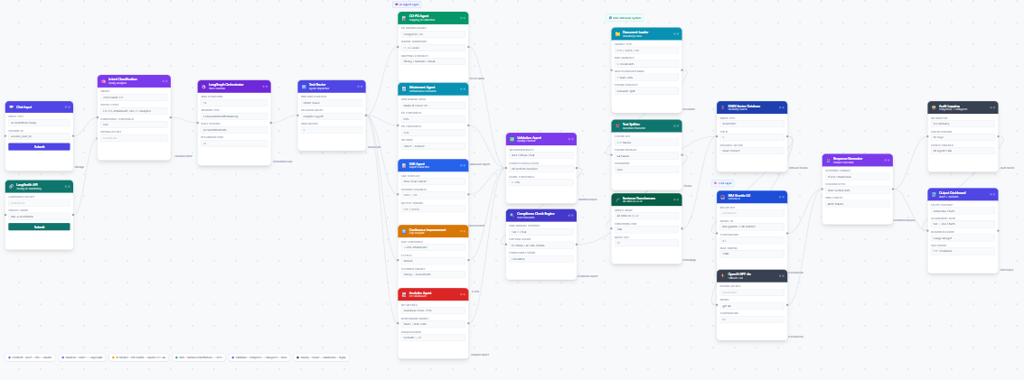
LANGFLOW

Slide 8
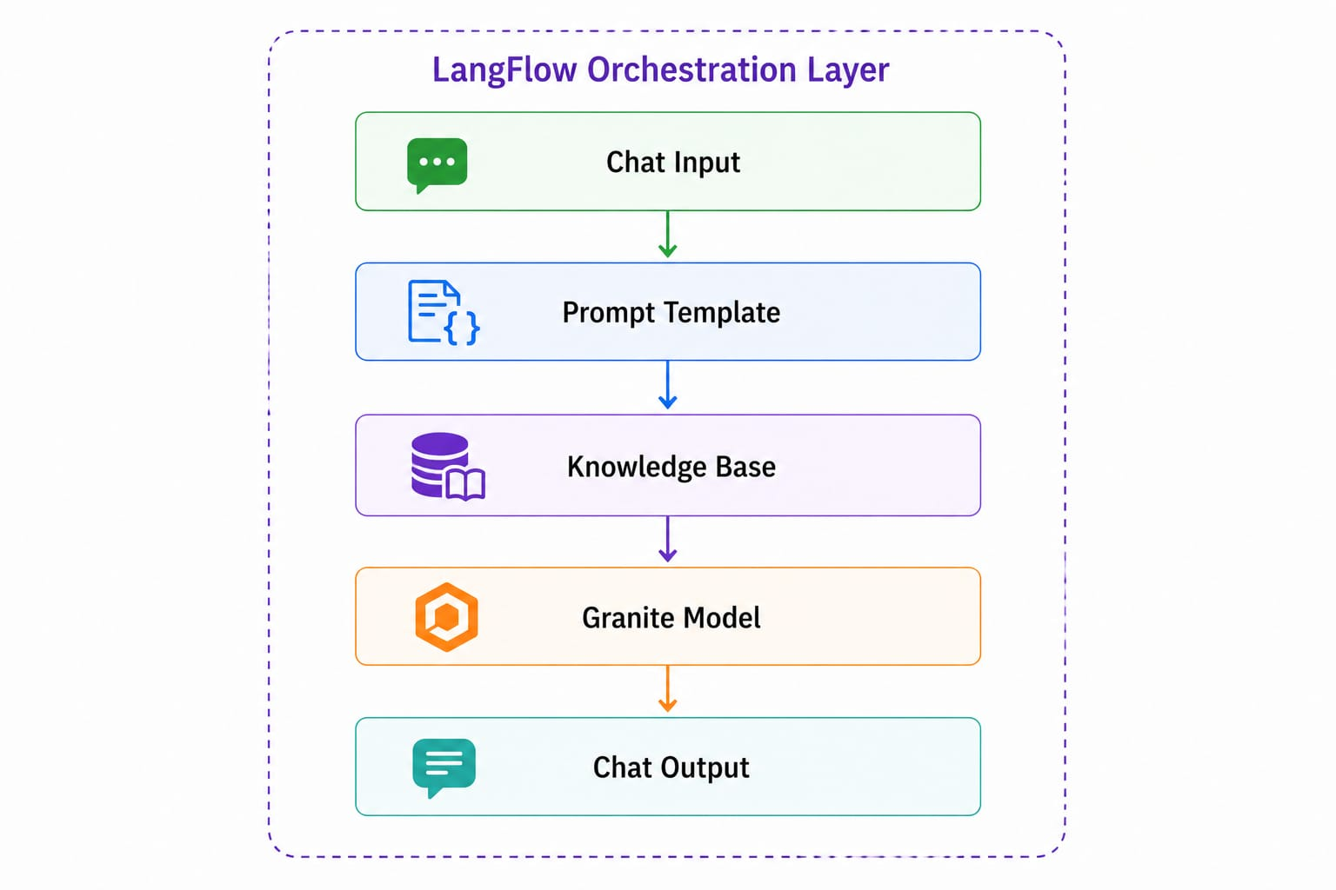
Architecture blueprint

Slide 9

Role of Agentic AI in the solution
Role of Agentic AI
Agentic AI serves as the core intelligence layer of the NBA Accreditation Management Platform. Instead of functioning as a simple chatbot, it operates through multiple specialized AI agents that can independently analyze data, make decisions, execute tasks, collaborate with other agents, and generate actionable outputs. This enables the platform to automate complex accreditation workflows that traditionally require significant manual effort and expertise.
Within the system, each agent is assigned a specific responsibility. The COPO Agent generates and validates CO–PO mappings, the Attainment Agent computes attainment scores and identifies performance gaps, the SAR Agent assists in preparing Self-Assessment Reports, the Continuous Improvement Agent recommends corrective actions based on attainment results and feedback, the Analytics Agent generates accreditation readiness insights, and the Validation Agent ensures compliance with NBA guidelines. These agents work together under a LangGraph orchestration framework, which intelligently routes user requests to the appropriate agent and coordinates the execution process.
By leveraging Agentic AI, the platform can automatically retrieve relevant accreditation knowledge through RAG, analyze institutional data, perform calculations, validate compliance requirements, generate reports, and provide recommendations with minimal human intervention. This significantly improves efficiency, accuracy, consistency, and decision-making while reducing the time and effort required for NBA accreditation activities.
In summary, Agentic AI transforms the platform from a passive information system into an intelligent, autonomous accreditation assistant capable of planning, reasoning, validating, and executing accreditation-related tasks end-to-end.

Slide 10
Technology Used
Frontend: React.js, Vite, Tailwind CSS, Recharts, React Router Backend & AI: Fast API, Python, LangGraph, Lang Flow, IBM watsonx.ai Granite, OpenAI GPT, RAG, FAISS, Sentence Transformers Database & Deployment: PostgreSQL, MongoDB, Redis, Docker, Kubernetes, Nginx, Render, Vercel, Prometheus, Grafana, Streamlit

Slide 11
Novelty and Uniqueness
The proposed NBA Accreditation AI Platform introduces a first-of-its-kind Agentic AI-driven approach to accreditation management by combining AI agents, LangGraph orchestration, Retrieval-Augmented Generation (RAG), and accreditation analytics within a single unified platform. Unlike traditional accreditation systems that primarily function as document repositories, this platform acts as an intelligent assistant capable of understanding accreditation requirements, automating workflows, validating compliance, generating reports, and providing actionable recommendations.
A key innovation is the use of multiple specialized AI agents that collaborate to perform domain-specific tasks such as CO-PO mapping, attainment analysis, SAR generation, continuous improvement tracking, and compliance validation. These agents are coordinated through LangGraph, enabling autonomous decision-making and workflow execution rather than simple question-answer interactions.
The platform also incorporates a RAG-based knowledge system that retrieves relevant information from NBA manuals, institutional records, and accreditation documents before generating responses. This ensures that recommendations and reports are context-aware, accurate, and aligned with NBA guidelines. Additionally, the system provides real-time accreditation readiness scoring, predictive analytics, and automated gap analysis, helping institutions proactively identify weaknesses and improve compliance before accreditation reviews.
Key Unique Features
Multi-Agent AI architecture for accreditation automation.
LangGraph-based workflow orchestration and decision routing.
RAG-powered contextual understanding of NBA guidelines.
Automated CO-PO mapping and attainment calculations.
AI-generated Self-Assessment Reports (SARs).
Continuous Improvement (CI) recommendation engine.
Real-time readiness scoring and compliance monitoring.
Unified platform integrating accreditation management, analytics, and AI assistance.

Slide 12
Git Hub Link
logitechsabarni/NBA-Accredition-App-RAG-
·
·
·

Slide 13
Future Scope
The NBA Accreditation AI Platform can be further enhanced into a comprehensive higher education quality assurance ecosystem by incorporating advanced AI capabilities, predictive analytics, and broader accreditation support. Future developments can focus on increasing automation, improving decision-making, and expanding the platform's applicability across multiple accreditation frameworks.
The platform can be extended to support NAAC, ABET, and international accreditation standards, enabling institutions to manage multiple accreditation processes through a single system. Advanced predictive analytics and machine learning models can be integrated to forecast accreditation outcomes, identify potential compliance risks, and recommend corrective actions well in advance. Future versions may also include multilingual AI assistants, voice-based interactions, and intelligent document processing for automated extraction of information from institutional records.
Integration with ERP, Learning Management Systems (LMS), and Student Information Systems (SIS) can enable real-time data synchronization, reducing manual data entry and improving accuracy. The platform can also leverage Generative AI for automated evidence generation, accreditation documentation, and strategic planning recommendations. Additionally, deploying AI-powered benchmarking and comparative analytics across institutions can help colleges identify best practices and continuously improve academic quality.
Key Future Enhancements
Support for NAAC, ABET, and international accreditation frameworks.
Predictive accreditation readiness and risk assessment.
AI-powered evidence and document generation.
Integration with ERP, LMS, and institutional databases.
Voice-enabled and multilingual AI assistant.
Advanced benchmarking and comparative analytics.
Mobile application for accreditation monitoring.
Cloud-native multi-tenant SaaS deployment for large-scale adoption.
·
·
·

Slide 14


