Slide 1

Academic Year 2026-2027
S7 PROJECT WORK I
Second Review
PROJECT TITLE
EDUPULSE AI: A COURSE-OUTCOME-LEVEL FRAMEWORK FOR EARLY ACADEMIC RISK DETECTION AND TARGETED INTERVENTION
PROJECT AREA
EDUCATIONAL DATA MINING
DEPARTMENT
COMPUTER SCIENCE AND DESIGN
BATCH MEMBERS
LOGITHKUMAR K R (7376231CD124)
RAMESH S (7376231CD141)
GUIDE
Dr. M. Karthiga
ASSOCIATE PROFESSOR
DEPARTMENT OF COMPUTER SCIENCE AND ENGINEERING
BANNARI AMMAN INSTITUTE OF TECHNOLOGY

Slide 2
LITERATURE SURVEY
Sl. No. | Reference | Methods / techniques | Relevance to EduPulse AI
1 | [2] Baker & Yacef (2009), “The state of EDM in 2009,” Journal of Educational Data Mining, 1(1), 3-17. | Review of educational data-mining methods and institutional records. | Historical analysis describes outcomes; internal assessment can support intervention during the semester.
2 | [3] Romero & Ventura (2013), “Data mining in education,” WIREs DMKD, 3(1), 12-27. | Survey of education data-mining methods for student performance. | Internal tests and lab scores can reveal difficulty before final exams.
3 | [4] Livieris et al. (2019), “Predicting students’ performance using an ensemble of neural networks and decision trees,” Knowledge and Information Systems, 61(1), 133-158. | Neural-network and decision-tree ensemble for performance prediction. | Supports ensemble methods for nonlinear academic patterns; the study is an offline experiment.

Slide 3
LITERATURE SURVEY
Sl. No. | Reference | Methods / techniques | Relevance to EduPulse AI
4 | [5] Chen & Guestrin (2016), “XGBoost: A scalable tree boosting system,” Proc. ACM SIGKDD, pp. 785-794. | Regularized gradient boosting for tabular classification with probability output. | Supports probability-based Safe, Medium Risk and High Risk bands.
5 | [6] Affolter et al. (2019); [7] Brown et al. (2020), database language interfaces and few-shot language models. | Survey of natural-language database interfaces; few-shot LLM results. | Motivates structured query plans checked against actual dataset columns.
6 | [8] Munzner (2014), Visualization Analysis and Design, CRC Press. | Task-based principles for choosing and evaluating visualizations. | Use interactive charts with clear labels and an export path for reports.

Slide 4
AIM & OBJECTIVES OF THE PROJECT
(Problem Statement)
AIM
Develop and validate an Academic Intelligence Platform that consolidates multi-department results, predicts failure risk from internal marks, and supports natural-language analytics through an interactive dashboard.
OBJECTIVES
Automated data ingestion
• Parse results from 20 departments and normalize internal marks recorded out of 40, 50 and 60.
Early risk prediction
• Use average and lowest internal percentages plus the number of courses below 50% in XGBoost.
Conversational analytics
• Answer routine questions locally; use Groq with key rotation and model fallback for other queries.
Interactive dashboard
• Present results with React, Vite and Recharts; export charts and data as PNG, SVG and CSV.

Slide 5
SCOPE OF THE PROJECT
IN SCOPE
Academic data: Parse result workbooks from 20 departments; normalize internal marks out of 40, 50 and 60 and map grades.
Risk prediction: Use XGBoost features for average, lowest and below-50% course marks; assign Safe (<30%), Medium (30-64.9%) and High (65-100%) bands.
Conversational analytics: Route routine queries locally; use Groq with API-key rotation and model fallback for other questions.
Dashboard: Show department, student, risk and AI analytics; export charts and data as PNG, SVG and CSV.

Slide 6
FEASIBILITY ANALYSIS
TECHNICAL FEASIBILITY
• Python 3.12/FastAPI, XGBoost and React/Vite/Recharts provide an open-source, cross-platform stack.
ECONOMIC FEASIBILITY
• No software licensing cost; the platform used standard campus hardware and less than 180 MB of memory.
OPERATIONAL FEASIBILITY
• 61 workbooks and 7,293 records loaded in 2.8 s; single-student inference averaged 11.4 ms.
FUNCTIONAL VALIDATION
• All nine test cases passed; a 281-student batch ran in 1.18 s and simulated API failover recovered in 220 ms.

Slide 7
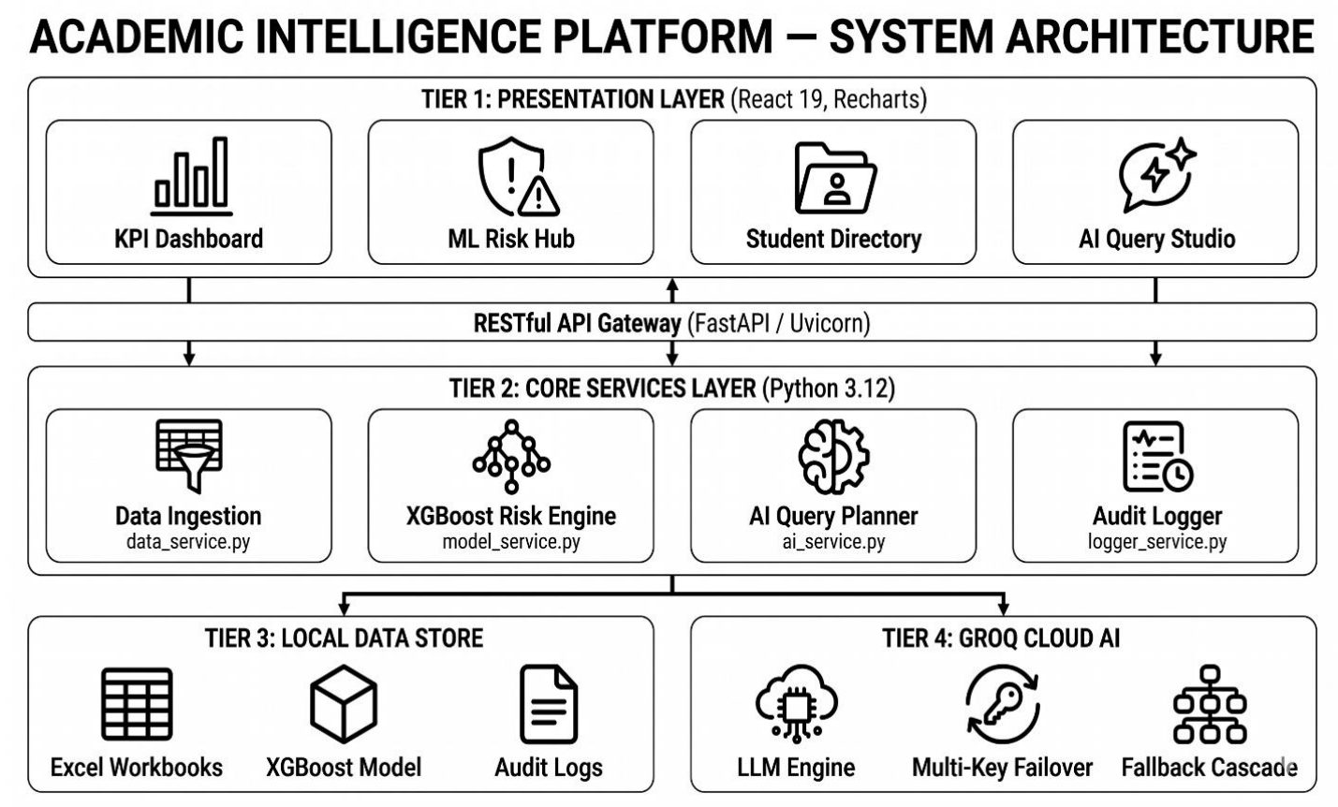

Slide 8
PROJECT METHODOLOGY (Data-to-dashboard workflow)
Workflow item
Find
Parse
Normalize
Grade map
Aggregate
Features
Predict
Route AI
Validate
Charts/export
Department workbooks
✓
✓
Headers and result fields
✓
Internal marks and grades
✓
✓
Unified student repository
✓
Risk feature vector
✓
Failure probability and risk band
✓
Natural-language analytics
✓
✓
Charts and exported files
✓

Slide 9
TECHNOLOGY STACK AND CORE MODULES
TECHNOLOGY STACK
Python 3.12 + FastAPI + Uvicorn - REST backend
pandas + OpenPyXL - spreadsheet ingestion and analytics
XGBoost 2.0+ + scikit-learn + Joblib - risk model
Groq Python SDK - conversational query planning and failover
React 19 + Vite 8 + Recharts - interactive dashboard
html2canvas + FileSaver - PNG, SVG and CSV exports
CORE MODULES
Academic record aggregator
XGBoost risk prediction engine
Conversational query and failover
Analytics dashboard and export

Slide 10
SOFTWARE ARCHITECTURE
PLATFORM ARCHITECTURE
• React 19 and Vite 8 communicate with the backend through REST endpoints.
Presentation Layer
• React dashboard: department overview, risk hub, student directory and AI query studio.
Application Layer
• Python 3.12/FastAPI services: data ingestion, XGBoost risk, AI query planning and audit logging.
Data and Cloud AI Layer
• Local workbooks, model artifacts and query logs connect to Groq LLMs with key rotation and model fallback.

Slide 11
INDIVIDUAL CONTRIBUTIONS TO THE WORK
LOGITHKUMAR K R (7376231CD124) - Frontend, visualization and ingestion
Led the React application, including routing, state management and reusable components.
Designed Recharts components for bar, stacked, line, area, pie, radar and scatter charts.
Implemented PNG, SVG and CSV export and accessible chart color palettes.
Collaborated on workbook traversal and dynamic header detection.

Slide 12
INDIVIDUAL CONTRIBUTIONS TO THE WORK
RAMESH S (7376231CD141) - Risk engine, conversational AI and backend
Formulated, trained and deployed the XGBoost failure-risk model.
Normalized 40, 50 and 60-point internal marks; generated risk probabilities and faculty recommendations.
Built local query routing, the Groq planner, key rotation and model fallback.
Developed FastAPI routes and audit logging; completed integration and performance testing.

Slide 13
RESULTS AND FUNCTIONAL VALIDATION
KEY RESULTS
61 workbooks across 20 departments: 7,293 records loaded in 2.8 s; memory below 180 MB.
Single-student inference averaged 11.4 ms; a 281-student cohort ran in 1.18 s.
Cohort risk bands: 173 Safe, 22 Medium Risk and 86 High Risk.
Dashboard: 90.06% overall pass rate, 838 students at risk and average SGPA 7.74.
Routine queries used 0 Groq tokens; simulated HTTP 429 failover succeeded in 220 ms.
All nine functional tests passed; PNG, SVG and CSV exports succeeded.
Limitation: held-out model metrics were not reported, and the 30%/65% risk thresholds remain unvalidated.

Slide 14
REFERENCES
(Selected studies and methods)
IEEE-style references
[1] National Board of Accreditation, Manual for Accreditation of Undergraduate Engineering Programmes, New Delhi, 2022.
[2] R. S. Baker and K. Yacef, “The state of educational data mining in 2009: A review and future visions,” J. Educational Data Mining, vol. 1, no. 1, pp. 3-17, 2009.
[3] C. Romero and S. Ventura, “Data mining in education,” Wiley Interdisciplinary Reviews: Data Mining and Knowledge Discovery, vol. 3, no. 1, pp. 12-27, 2013.
[4] I. E. Livieris, K. Drakopoulou, and P. Pintelas, “Predicting students’ performance using an ensemble of neural networks and decision trees,” Knowledge and Information Systems, vol. 61, no. 1, pp. 133-158, 2019.
[5] T. Chen and C. Guestrin, “XGBoost: A scalable tree boosting system,” in Proc. 22nd ACM SIGKDD, pp. 785-794, 2016.
[6] K. Affolter, K. Stockinger, and A. Bernstein, “A comparative survey of recent natural language interfaces for databases,” VLDB J., vol. 28, no. 5, pp. 793-819, 2019.
[7] T. Brown et al., “Language models are few-shot learners,” Advances in Neural Information Processing Systems, vol. 33, pp. 1877-1901, 2020.
[8] T. Munzner, Visualization Analysis and Design, CRC Press, 2014.

