Slide 1

Academic Year 2026-2027
S7 PROJECT WORK I
Second Review
PROJECT TITLE
BIT Campus Maintenance Request Desk with Geotagged Issue Uploads and Technician Dispatch
BIP PROJECT ID
2026AC176
CATERGORY
INTERNAL
BATCH MEMBERS
THAISEELAN C
SUBHAHSCHANDRA M
DHARANEENDHIRA A V
GUIDE
GOKUL M S
ASSISTANT PROFESSOR
CS11197

Slide 2
LITERATURE SURVEY
Sl.No. | Journal Paper Title with Author | Works carried out ( with details of Methods/ Materials/ Software/ Algorithms / fabrication / techniques/ components used ) | Information gathered relevant to your project
1 | K. Aravindhan, K. Periyakaruppan, K. Aswini, S. Vaishnavi, and L. Yamini, “Web Portal for Effective Student Grievance Support System,” in Proc. 2020 6th Int. Conf. Advanced Computing and Communication Systems (ICACCS), Mar. 2020. | Designed a web portal for students to log grievances and track their status through an admin panel. | Motivated the need for a centralized, trackable complaint submission portal instead of manual phone/verbal reporting.
2 | V. Oguntosin, M. Oluwadurotimi, A. Adoghe, A. Abdulkareem, and G. Adeyemi, “Development of a Web-Based Complaint Management Platform for a University Community,” J. Eng. Sci. Technol. Rev., vol. 14, no. 1, pp. 150–159, 2021. | Built and evaluated a web-based platform for university stakeholders to log and monitor facility complaints. | Confirmed core entities (complainant, category, status) and the value of status tracking for accountability.
3 | S. Jha and P. Sonawane, “Smart Student Grievance Redressal System with Foul Language Detection,” in Proc. 2022 8th Int. Conf. Advanced Computing and Communication Systems (ICACCS), 2022, pp. 187–192. | Extended a grievance system with automated content moderation before routing complaints to staff. | Reinforced a structured OPEN-to-CLOSED status workflow with defined complaint categories.

Slide 3
LITERATURE SURVEY
Sl.No. | References ( Journal Papers Only) | Works carried out ( with details of Methods/ Materials/ Software/ Algorithms / fabrication / techniques/ components used ) | Information gathered relevant to your project
4 | A. S. Manek, K. V. Shalini, K. Munot, T. Sri Harsha, B. Monika, and Shivalingayya, “Grievance Redressal System for Educational Institution,” Int. J. Electr. Electron. Comput., Special Issue NCASTEM-2025, pp. 45–49, Feb. 2026. | Implemented a role-based web grievance system for an educational institution with separate user/admin views. | Supported the role-separated dashboard design for Student/Staff, Technician and Admin.
5 | E. O. Boadu and G. K. Armah, “Role-Based Access Control (RBAC) Based in Hospital Management,” Int. Refereed J. Eng. Sci., vol. 3, no. 9, pp. 53–67, 2014. | Applied RBAC to restrict system functions by user role in a hospital management system. | Informed the STUDENT/STAFF/ADMIN/TECHNICIAN role separation enforced at the API level.
6 | N. Chagnon-Lessard et al., “Smart Campuses: Extensive Review of the Last Decade of Research and Current Challenges,” IEEE Access, vol. 9, pp. 124200–124234, 2021. | Reviewed a decade of smart-campus research across infrastructure, services and management systems. | Positioned facility-maintenance management as a recognized, valuable smart-campus service.

Slide 4
AIM & OBJECTIVES OF THE PROJECT
(Problem Statement)
AIM
To develop a centralized web-based campus maintenance management system that lets students and staff report issues, gives administrators centralized monitoring, automatically assigns suitable technicians, and keeps users informed until resolution.
OBJECTIVES
Centralize complaint registration
• Allow students/staff to submit complaints with category, description, location and photo evidence.
Automate technician assignment
• Match each complaint to an available technician by specialization using a rule-based algorithm.
Provide full traceability
• Maintain a status history for every complaint from submission to closure.
Keep users informed
• Send automatic email notifications at every stage of the complaint lifecycle.

Slide 5
SCOPE OF THE PROJECT
IN SCOPE
Digital Complaint Registration – Students and staff can report campus maintenance issues online.
Geotagged Issue Reporting – Capture complaints using predefined Building → Floor → Room locations.
Automated Technician Dispatch – Assign technicians based on specialization, availability and workload.
Complaint Tracking – Track complaints through OPEN → ASSIGNED → IN_PROGRESS → RESOLVED → CLOSED.
SLA Monitoring – Monitor priority-based resolution deadlines and identify overdue complaints.
Email Notifications – Notify users and administrators about important complaint updates.
Admin Monitoring – Provide a centralized dashboard for complaints, technicians, workload and SLA status.
Complaint History – Maintain a complete record of status changes, remarks and resolution details.

Slide 6
FEASIBILITY ANALYSIS
TECHNICAL FEASIBILITY
• Built using mature, well-documented and open-source technologies — Java, Spring Boot, React and PostgreSQL — aligned with the team's existing technical skills.
ECONOMIC FEASIBILITY
• Requires no software licensing cost, as the complete technology stack is open-source; local development and storage minimize infrastructure expenses.
OPERATIONAL FEASIBILITY
• Provides simple role-based workflows for students, staff, technicians and administrators, making the system practical to operate and maintain within the campus environment.
SCHEDULE FEASIBILITY
• The project is structured into clearly defined weekly milestones covering design, development, integration and testing, making the complete system achievable within the 10-week academic timeline.

Slide 7
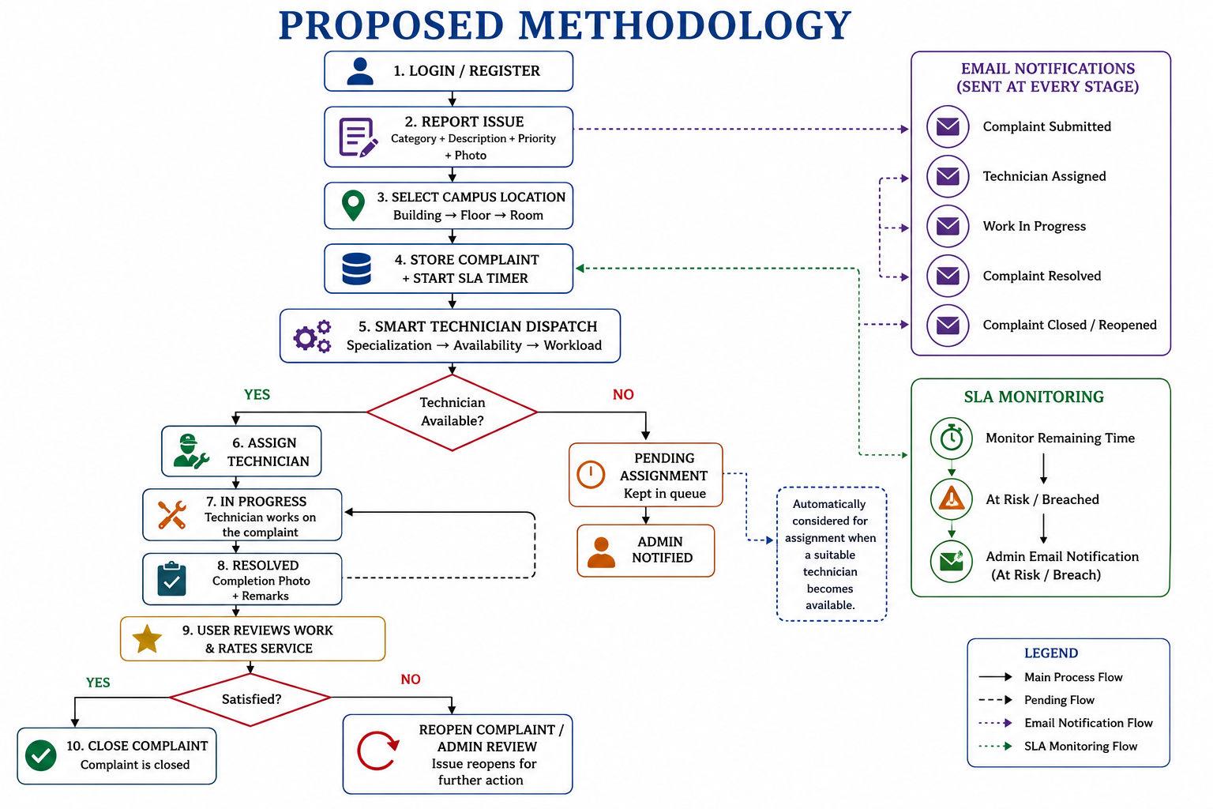

Slide 8
PROPOSED METHODOLOGY ( Gantt Chart)
Project Phase
W1
W2
W3
W4
W5
W6
W7
W8
W9
W10
Setup & Environment
Database Design & Entities
Authentication & Authorization
Complaint Management Core
Technician Assignment Engine
Admin Dashboard
Email Notifications
Testing, Deploy & Report

Slide 9
CHOICE OF COMPONENTS / MODULE USED FOR PROJECT DEVELOPMENT
Software Components
React + Vite – Frontend development
Tailwind CSS – Responsive UI design
Java + Spring Boot – Backend and REST APIs
Spring Security + JWT – Authentication and role-based access
PostgreSQL – Database management
Axios – Frontend–backend communication
Core Modules
User Authentication & Authorization
Complaint Management
Campus Location Management
Smart Technician Dispatch
SLA Monitoring & Escalation
Notification Management

Slide 10
DESIGN(S) ( SOFTWARE ARCHITECTURE)
THREE-TIER CLIENT-SERVER ARCHITECTURE
• React frontend communicates with the Spring Boot backend over REST APIs secured with JWT.
Presentation Layer
• React single-page app - role-specific dashboards for Student/Staff, Technician and Admin.
Application Layer
• Spring Boot - Controller, Service, Repository and Security layers with a rule-based assignment engine.
Data Layer
• PostgreSQL relational database (User, Complaint, Location, Technician, Assignment, Attachment, StatusHistory, Notification) plus an SMTP email service.

Slide 11
INDIVIDUAL CONTRIBUTIONS TO THE WORK
Batch Member 1 : ( 7376231CD159 & THAISEELAN C)
Project architecture and overall system design
Spring Boot backend and REST API development
PostgreSQL database design and integration
JWT authentication and role-based authorization
Smart technician dispatch logic
SLA monitoring and escalation mechanism
Backend–frontend API integration

Slide 12
INDIVIDUAL CONTRIBUTIONS TO THE WORK
Batch Member 2 : (7376231CD152 & SUBHASHCHANDRA M )
React frontend development and responsive UI design
Student/Staff complaint submission and tracking interfaces
Technician task management interface
Admin dashboard and complaint monitoring UI
REST API integration using Axios
Form validation and error/loading state handling
Frontend testing and integration with the backend

Slide 13
INDIVIDUAL CONTRIBUTIONS TO THE WORK
Batch Member 3 : (7376231CD111 & DHARANEENDHIRA A V)
1. API testing and validation using Postman
Database design, management and verification
Validation of complaint lifecycle and SLA workflows
Identification and reporting of functional issues
Project documentation and testing reports

Slide 14
REFERENCES
( Journal Papers/ Books/ Website References )
As per IEEE Format
[1] K. Aravindhan, K. Periyakaruppan, K. Aswini, S. Vaishnavi, and L. Yamini, “Web Portal for Effective Student Grievance Support System,” in Proc. 2020 6th Int. Conf. Advanced Computing and Communication Systems (ICACCS), Mar. 2020.
[2] V. Oguntosin, M. Oluwadurotimi, A. Adoghe, A. Abdulkareem, and G. Adeyemi, “Development of a Web-Based Complaint Management Platform for a University Community,” J. Eng. Sci. Technol. Rev., vol. 14, no. 1, pp. 150–159, 2021.
[3] S. Jha and P. Sonawane, “Smart Student Grievance Redressal System with Foul Language Detection,” in Proc. 2022 8th Int. Conf. Advanced Computing and Communication Systems (ICACCS), 2022, pp. 187–192.
[4] A. Khalfay, A. Crispin, and K. Crockett, “A Review of Technician and Task Scheduling Problems, Datasets and Solution Approaches,” in Proc. 2017 Intelligent Systems Conf. (IntelliSys), 2017, pp. 288–296.
[5] S. Mamidi, “Building Secure REST APIs in Spring Boot: Techniques and Tools,” Int. J. Emerging Trends Comput. Sci. Inf. Technol., vol. 7, no. 1, pp. 87–91, 2026.
[6] A. S. Manek, K. V. Shalini, K. Munot, T. Sri Harsha, B. Monika, and Shivalingayya, “Grievance Redressal System for Educational Institution,” Int. J. Electr. Electron. Comput., Special Issue NCASTEM-2025, pp. 45–49, Feb. 2026.
[7] A. Krishna, R. Dhanalakshmi, and A. Kannan, “Smart City: Crowd Sourced Geo-Tagged Mobile Application for Civic Issue Reporting,” Procedia Comput. Sci., vol. 152, pp. 80–87, 2020.
[8] E. O. Boadu and G. K. Armah, “Role-Based Access Control (RBAC) Based in Hospital Management,” Int. Refereed J. Eng. Sci., vol. 3, no. 9, pp. 53–67, 2014.

