Slide 1
Job Management with Boost.Asio
Lan Anh Nguyen
Systems and Storage Laboratory
Department of Computer Science and Engineering
Chung-Ang University
31/10/2022

Slide 2
Contents
Job management application
Implementation with Boost Asio

Slide 3
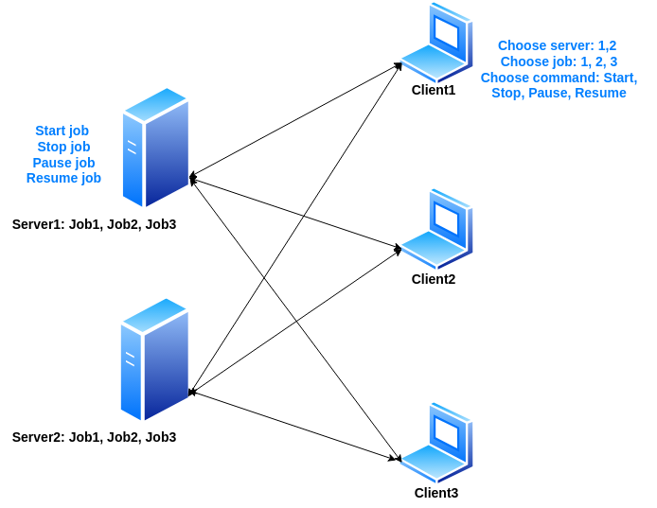
1. Job Management Application
be implemented in asynchronous programming
be implemented in asynchronous programming for guaranteeing the concurrency requirement of servers
Figure1. Job management application

Slide 4
1. Job Management Application
Synchronous I/O in client side
Pull-like connection (client requests, server answers):
Client pulls what it needs from the server.
Eg: server1, server2, server3
Choose server()
Eg: read file 1, read file 2, read file 3
Choose job()
Eg: Start, Stop, Pause, Resume
Choose command()
Write to the socket()
Write(), Read(): Write and read data from streams (socket is one of types of streams)
Write() messages
Read() messages
Read the socket()
Figure2. Synchronous I/O in Clients

Slide 5
1. Job Management Application
Asynchronous I/O in server side
Pull-like connection (client requests, server answers):
Client pulls what it needs from the server.
Read()
Boost.Asio
Handler functions in asynchronous manner:
Called when operations completes.
Callback functions ~ Handler functions ~ Completion functions.
Must be used in asynchronous programming.
At the end of each asynchronous operation, another asynchronous operation should be started.
OnRead()
This is a handler function
Process request()
A
B
C
…
Write() to client
This is a handler function
Boost.Asio
OnWrite()
Figure3. Asynchronous I/O in Servers

Slide 6
1. Job Management Application
Asynchronous I/O in server side
Read()
Thread always listens to the socket in asynchronous way
Boost.Asio
OnRead()
Another thread for processing request
Process request()
A
B
C
…
Write() to client
Boost.Asio
OnWrite()
Figure3. Asynchronous I/O in Servers

Slide 7
1. Job Management Application
Process Request() in server side
“id_client, id_job, command”
Ex: “1, 3, Start”
Client 1 wants to work on the reading job of file 3 with the start command ~ Start reading file 3.
Read()
Receive commands
Take information from metadata file
Read metadata file
Metadata file stores status of jobs requested by clients.
Ex: With job 1, client 1 and client 2 have requested to start
Yes
id_job
No
id_client
No
Add client()
Yes
Execute command()
Update metadata()
Write()
Take information from metadata to decide to start, stop, pause, resume jobs.
Figure4. Process request() at Servers

Slide 8
1. Job Management Application
Metadata format - Server side
{
“file1”: {
“client1”: {
“lastcommand”: “Stop”,
“currentreading”: 0},
“client2”: {
“lastcommand”: “Stop”,
“currentreading”: 0}},
“file2”: {
“client1”: {
“lastcommand”: “Stop”,
“currentreading” 0},
“client3”: {
“lastcommand”: “Stop”,
“currentreading”: 0}}
}
Reading file 1 job:
2 clients have requested to this job.
Reading file 1 job, and reading file 2 job
With each client:
Its last command is stored. It can be [Start, Stop, Pause, Resume].
Current line in reading is stored. It can be in range of (0, len(file)).
Figure5. Metadata format for job management application

Slide 9
1. Job Management Application
Command-to-command cycle at server side
(Action to job)
(Actions to metadata)
Job is terminated
(1)
Job is running
(1): Update last command to metadata file
(2): Update current reading line to metadata file
Stop
(1),(2)
Start
Other command-to-commands do not change status of job, and metadata file!!!
(1),(2)
(1),(2)
(1),(2)
Each command forces to do an action to the job
Resume
(1)
Pause
Job is running from the previous point
(1),(2)
Job is stopped at a point
Figure6. From command-to-command cycle

Slide 10
1. Job Management Application
Job status-to-status cycle at server side
Start
Terminated
Running
Done
Stop
Stop
Pause
Resume
Just blue arrows can lead to the “Done” job = Just the Running status can lead to the “Done” job
Temp-terminated
Figure7. From job status-to-status cycle
The last commands (Start, Resume) can lead to the “Done” job
The last commands (Stop, Pause, Stop) can not lead to the “Done” job
From last commands can refer the status of jobs to inform to the clients.
Ex: Start, Resume => “Running” / “Done”
Pause => “Temp-terminated”
Stop => “Terminated”

Slide 11
1. Job Management Application
Implement job commands: Stop, Start, Pause, Resume
Start
Start the thread of reading file from the first line.
Update “ lastcmd : “Start” ” of the client with the job.
Stop
Stop the running thread.
Update “ lastcmd: “Stop” “ of the client with the job.
Update “ currentreading: 0 “ of the client with the job.

Slide 12
1. Job Management Application
Implement job commands: Stop, Start, Pause, Resume
Pause
Stop the running thread.
Update “ lastcmd: “Pause” “.
Update “ currentreading: lines_temp_ “.
Resume
Take the currentreading.
Start the thread of reading file from a specific line.
Update “ lastcmd: “Resume” “.

Slide 13
2. Implementation with Boost Asio
Clients:
Connect sockets
Give commands
Write sockets
Read sockets

Slide 14
2. Implementation with Boost Asio
Servers:
Connect sockets
Read sockets
Write sockets
Start thread for request processing
Stop thread for request processing
Update metadata, read metadata
Stop jobs: Stop threads, update lastcmd, update current reading
Start jobs: Start threads, update lastcmd
Pause jobs: Stop threads, update lastcmd, update current reading
Resume jobs: Start threads of reading at the previous read line, update lastcmd

Slide 15
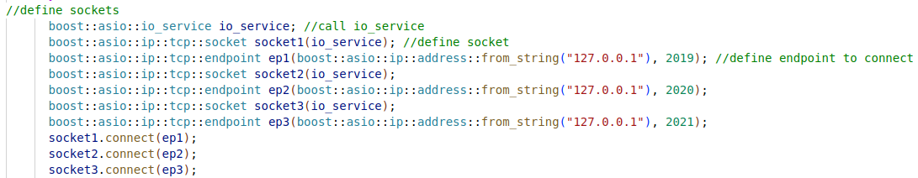
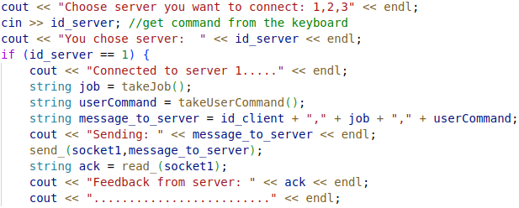
2. Implementation with Boost Asio
Clients:
Connect to sockets
Give commands
Take id of job!!
Take commands!!
Message to servers “id_client, job, command”

Slide 16
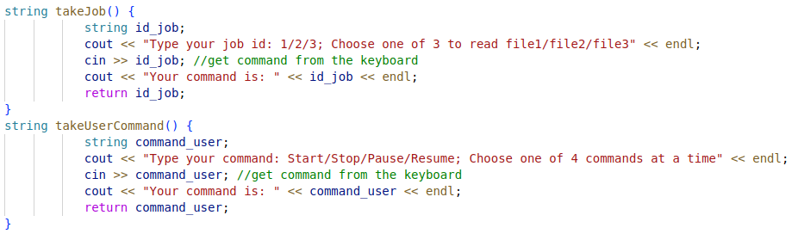
2. Implementation with Boost Asio
Clients:
Give commands
Take id of job!!
Take commands!!

Slide 17
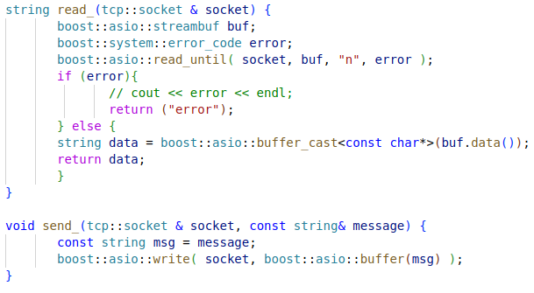
2. Implementation with Boost Asio
Clients:
Read and Write sockets
Read message from the buffer of socket, and return the message
Write a message to the buffer of socket

Slide 18
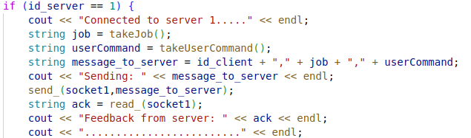
2. Implementation with Boost Asio
Clients:
Read and Write sockets: with the server1
[1] Write the “message_to_server” to socket of server 1
[1]
[2]
[2] Read the message from socket of server 1

Slide 19
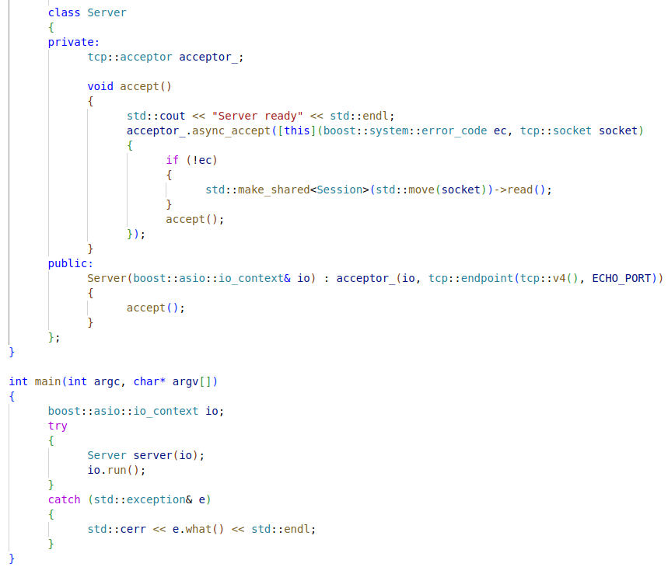
2. Implementation with Boost Asio
Servers:
Connect sockets
Create a Server class
For accepting new socket connections
Accept asynchronously sockets
An object of io_context providing the core I/O functionality for users (socket, acceptor, …)
A server accepts sockets
Run the io_context object’s event processing loop

Slide 20
2. Implementation with Boost Asio
Servers:
A class named Session gives properties, functions of sockets
Read() function in class Session:
Read message from clients
Convert message from client into an array of items [id_client, id_job, command]
Convert id_client, id_job into fields in metadata file. Ex: “client1”, “file1”
Read last command, current reading from the metadata file with the id_client, id_job
Create keyword/id for the thread of id_client, id_job
Execute command

Slide 21
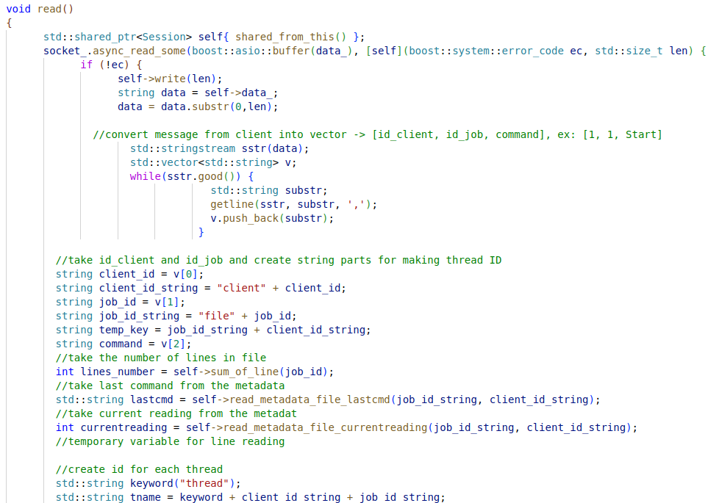
2. Implementation with Boost Asio
Servers:
Read():
Read message from socket
Convert message into an array
Convert client_id, job_id into fields in metadata
Take the last command and current reading
Create id of thread

Slide 22
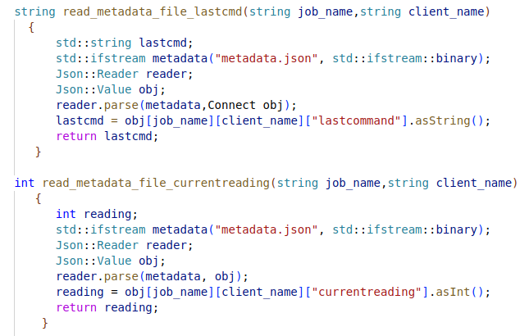
2. Implementation with Boost Asio
Servers:
Read():
Take last command and current reading

Slide 23
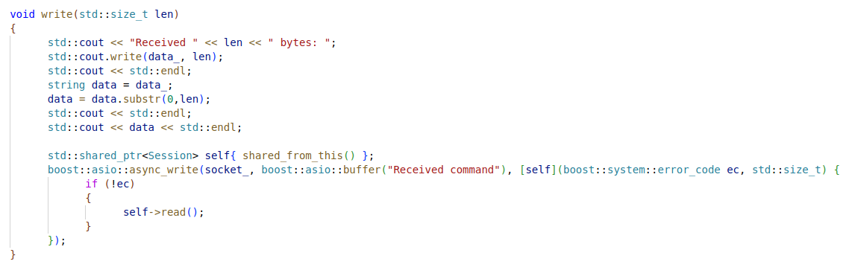
2. Implementation with Boost Asio
Servers:
Write():
Write to the socket

Slide 24

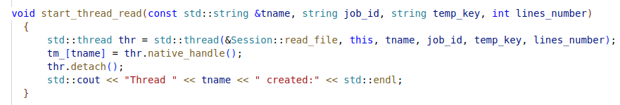
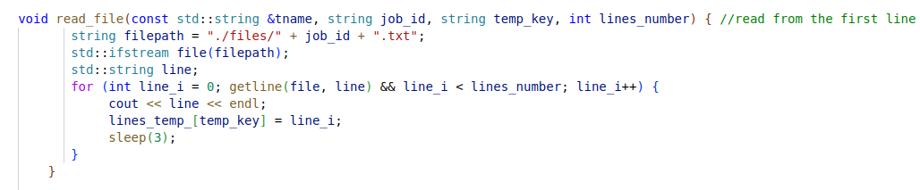
2. Implementation with Boost Asio
Servers:
Execute commands from clients: Stop -> Start
Temporary variable stores the current line which is being read
The number of lines in file
lines_temp_ is a list of temporary reading lines which stores number of line everytime it changes

Slide 25
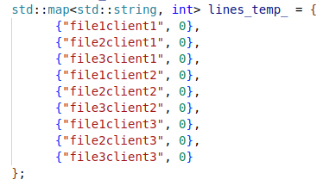
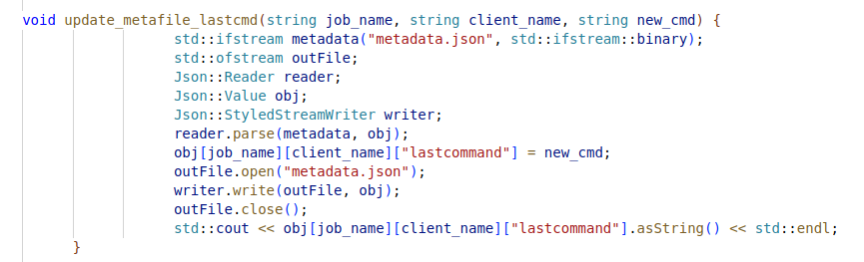
2. Implementation with Boost Asio
Servers:
Execute commands from clients: Stop -> Start
lines_temp_ list
Function for updating last command

Slide 26
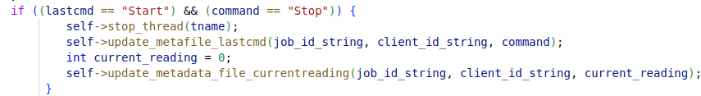
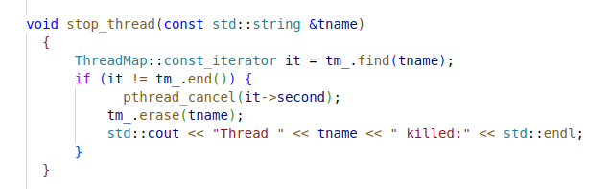
2. Implementation with Boost Asio
Servers:
Execute commands from clients: Start -> Stop
Function for stopping thread

Slide 27
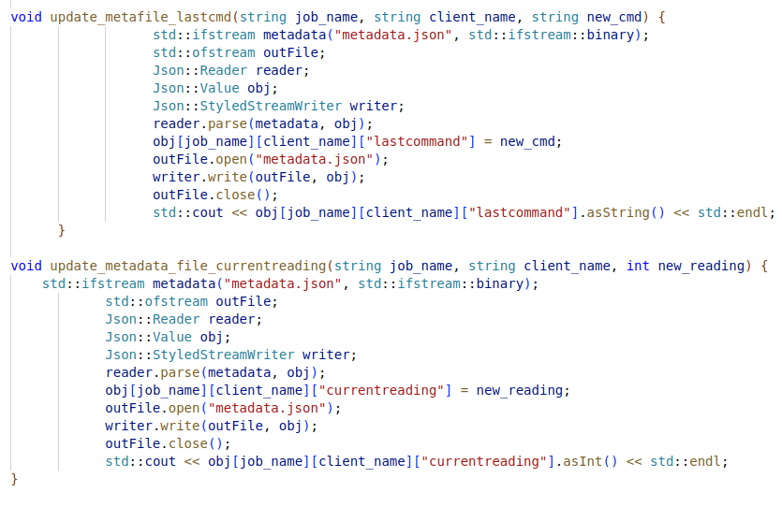
2. Implementation with Boost Asio
Servers:
Execute commands from clients: Start -> Stop
Functions for updating last command, and current reading

Slide 28
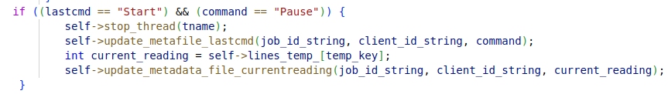

2. Implementation with Boost Asio
Servers:
Execute commands from clients: Start -> Pause
Execute commands from clients: Pause -> Resume

Slide 29
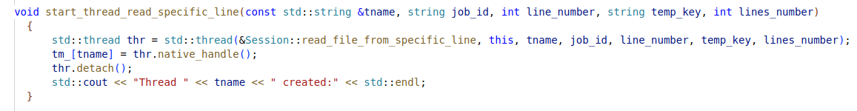
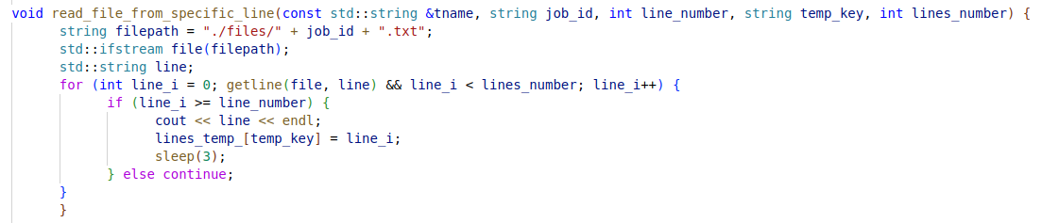
2. Implementation with Boost Asio
Servers:
Execute commands from clients: Pause -> Resume

Slide 30
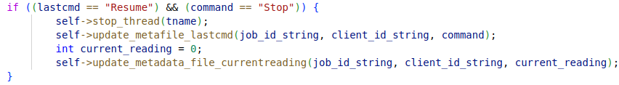
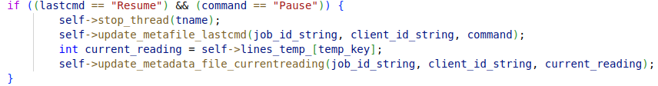
2. Implementation with Boost Asio
Servers:
Execute commands from clients: Resume -> Stop
Execute commands from clients: Resume -> Pause

Slide 31

2. Implementation with Boost Asio
Servers:
Execute commands from clients: Pause -> Stop

Slide 32
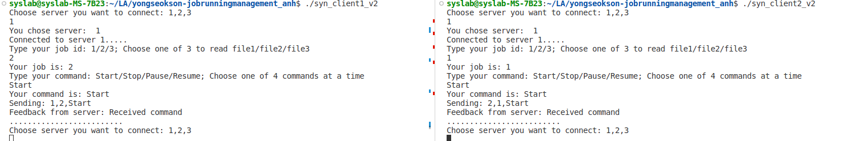
3. Implementation with Boost Asio
Clients:
2 clients connect to server 1.
Client1 starts job2
Client2 start job1

Slide 33
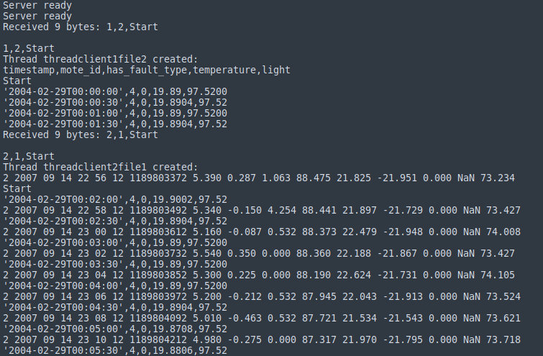
3. Implementation with Boost Asio
Servers:
At server1

Slide 34
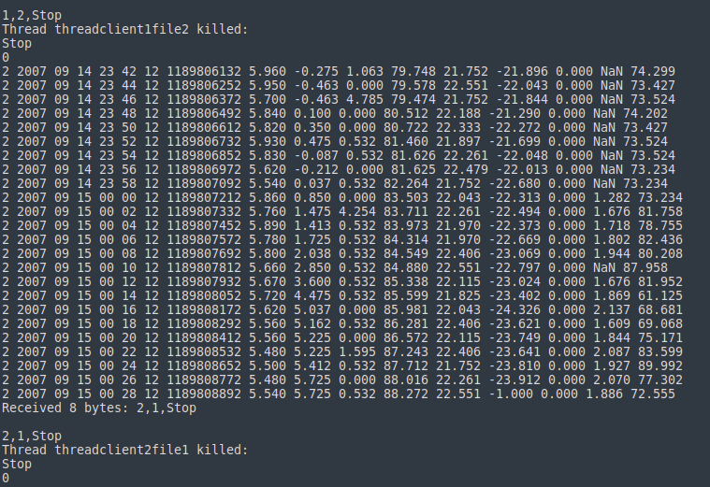
3. Implementation with Boost Asio
Servers:
Stop job of client1, but not stop job of client 2. Job of client2 is still running tills it is stopped

Slide 35
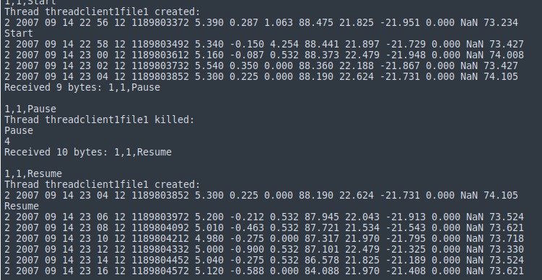
3. Implementation with Boost Asio
Servers:
Client1 starts job1.
Pause when it reaches at the line with index = 4
Continue reading at this line

