Slide 1
OFFLY
By,
VISHUDHA.R
JOSEPHINE JEENA.A
LOGANATHAN.P

Slide 2

OFFLY -an offline lyrics viewer

Slide 3
Introduction
Offly is an lyrics viewer mainly developed to view lyrics without internet.It is a basic implementation inplemented for a particular artist songs

Slide 4
OBJECTIVE
The main aim of this project is to develop an android mobile application on lyrics viewer offline for an particular artist and developed further.

Slide 5
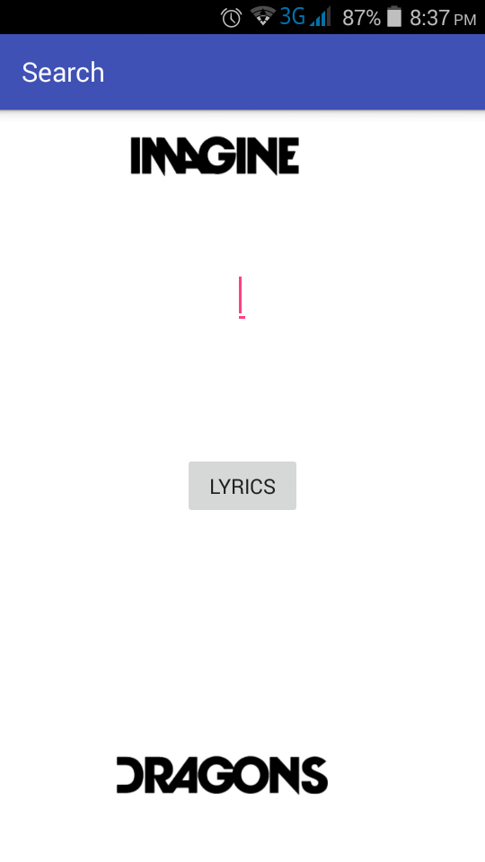
WORKING OF OFFLY
The first word of the song is given in the text field
It is then matched with the songs in the database
The matched result is displayed

Slide 6
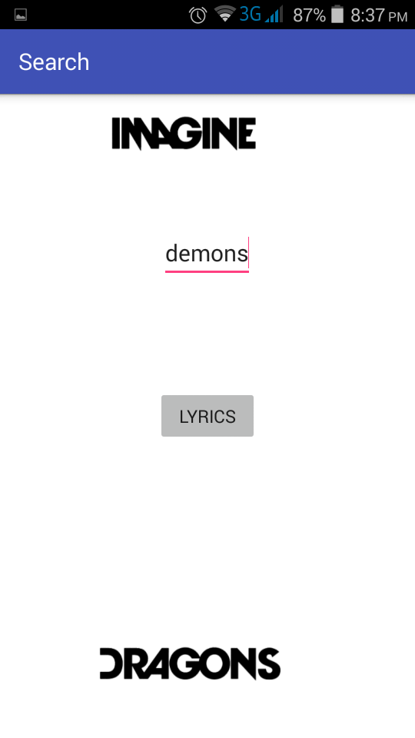
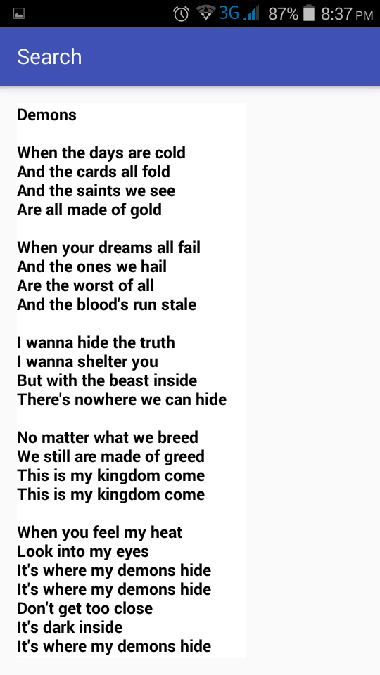
Continue…

Slide 7
ADVANTAGES
No internet
Faster
Efficient
Customizable

Slide 8
CONCLUSION
It’s just an basic implementation, further it can be developed with lot of features like customizable, additional lyrics can be added by the user.
It’s not like already existing applications and no need of internet connection.
Anytime and anywhere the user can access this application.

Slide 9
THANK YOU

