Slide 1

Defense Presentation
By Logan Ferguson
Project Advisor: Dr. Sean Hayes
Major: Cybersecurity
April 17, 2024

Slide 2
Agenda
Background
Purpose
What is KeyGuardian?
Major Requirements
Testing Results
Challenges Overcome
Future Enhancements
Questions

Slide 3
Introduction
Software solution to a problem in Cybersecurity
Landed upon passwords
The first line of defense
Include personally identifiable information (PII)
Gaining legitimate access
Notes:
Researched many topics and issues in cybersecurity
Kept coming up was passwords
Legit access is easiest way to breach an account

Slide 4
Background
Simple passwords are still common
Reused between accounts
Attackers guess or brute force
Importance of secure passwords
Notes:
Such as Password123 or ilikepizza
Often written down on paper or reused and not stored at all
Many users do not understand importance of secure passwords

Slide 5
Purpose
Solution for poor password management
Educate users on best practices
Everyone should use a password manager!
Goal: To create a password manager that provides security, integrity, and ease of usability
Notes:
Password best practices and security

Slide 6
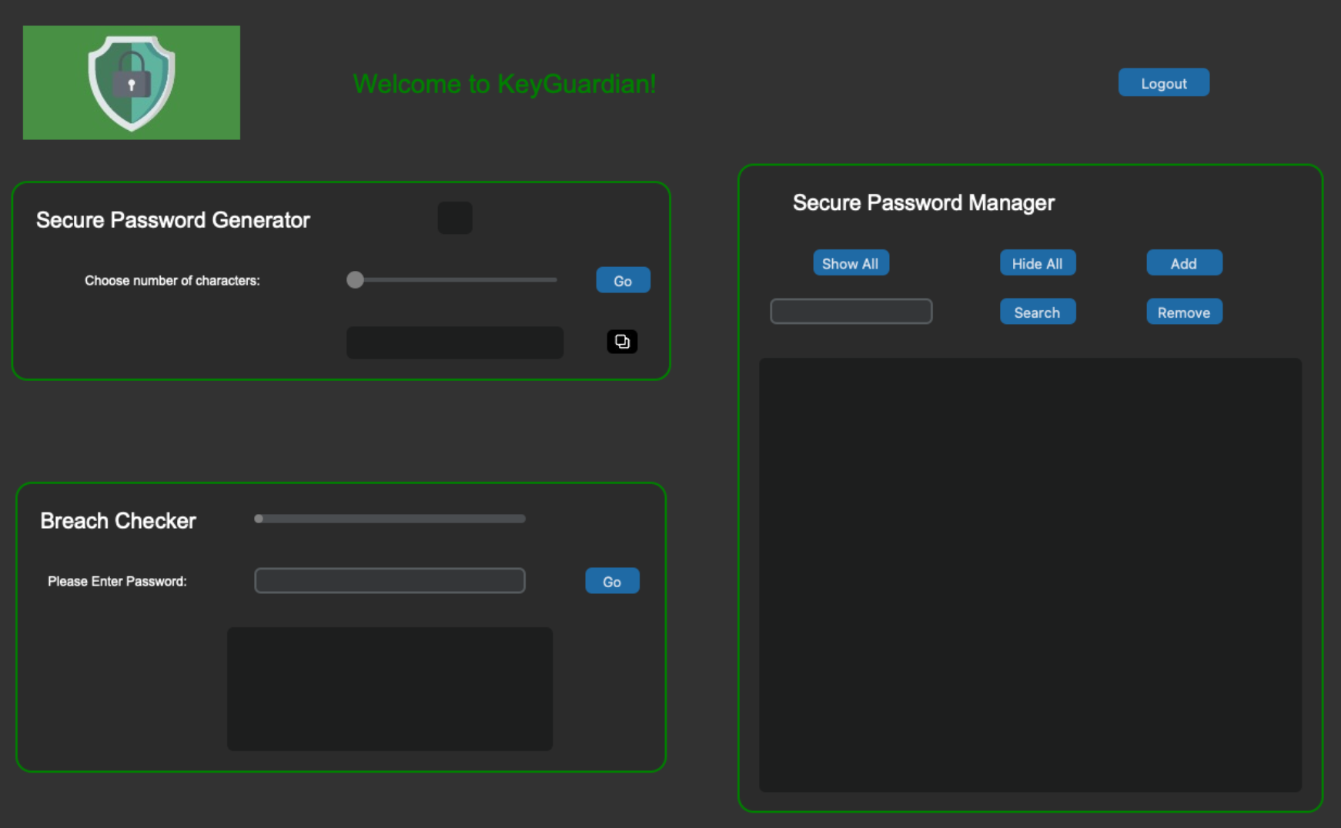
What is Keyguardian?
Secure password manager, generator, and breach checker
Developed in Python with many libraries
Includes a GUI
Storage database is local
Generates passwords with length up to 35 characters
Checks for common breached passwords
Notes:
Libraries for UI, encryption, etc.
Does not connect to the internet
Generated password must have 300 bits of entropy
Uses common breaches like rockyou

Slide 7
Major Requirements
Store passwords securely for online accounts (ID#7)
Full industry standard encryption for the database (ID#25)
Access only through a master password (ID#24)
Passwords only displayed if requirements met (ID#26)
Notes:
Bcrypt and PBKDF2
AES encryption for database and SHA-256 for encryption key
Fernet uses 128 bits but I generated a 256 bit key
Only displayed if the password policy is met and includes entropy = 85 bits

Slide 8
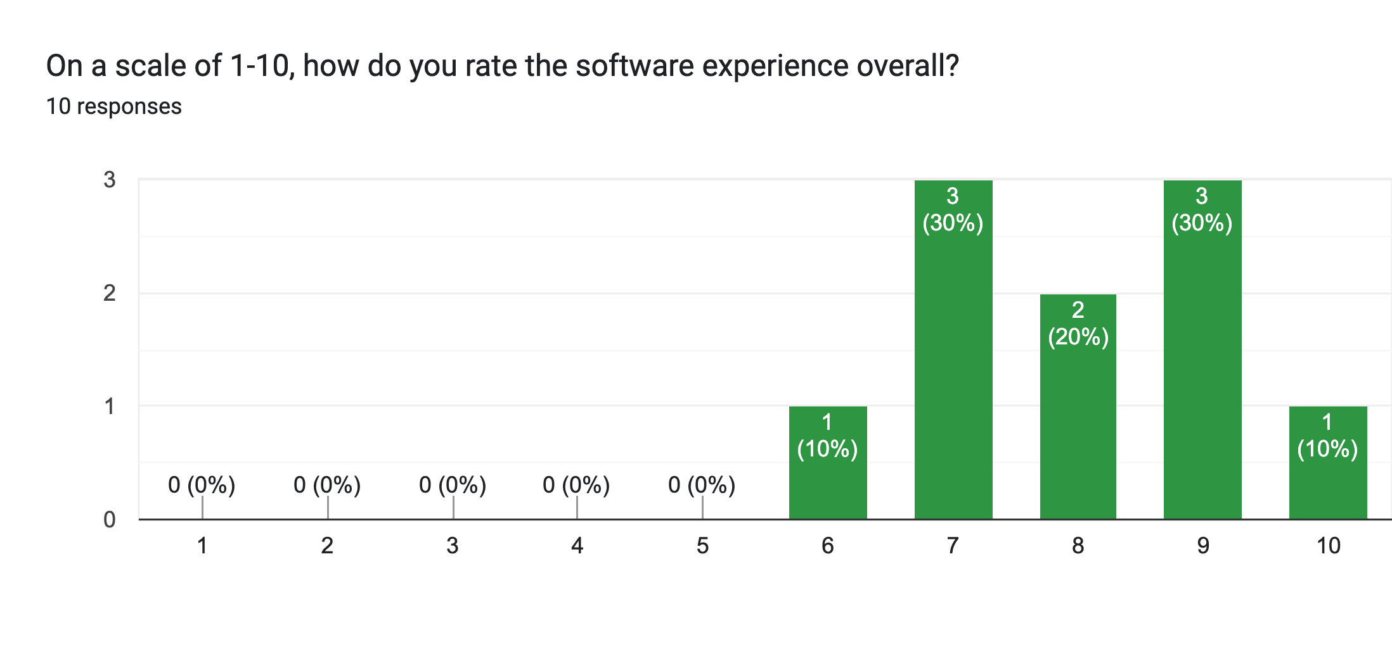
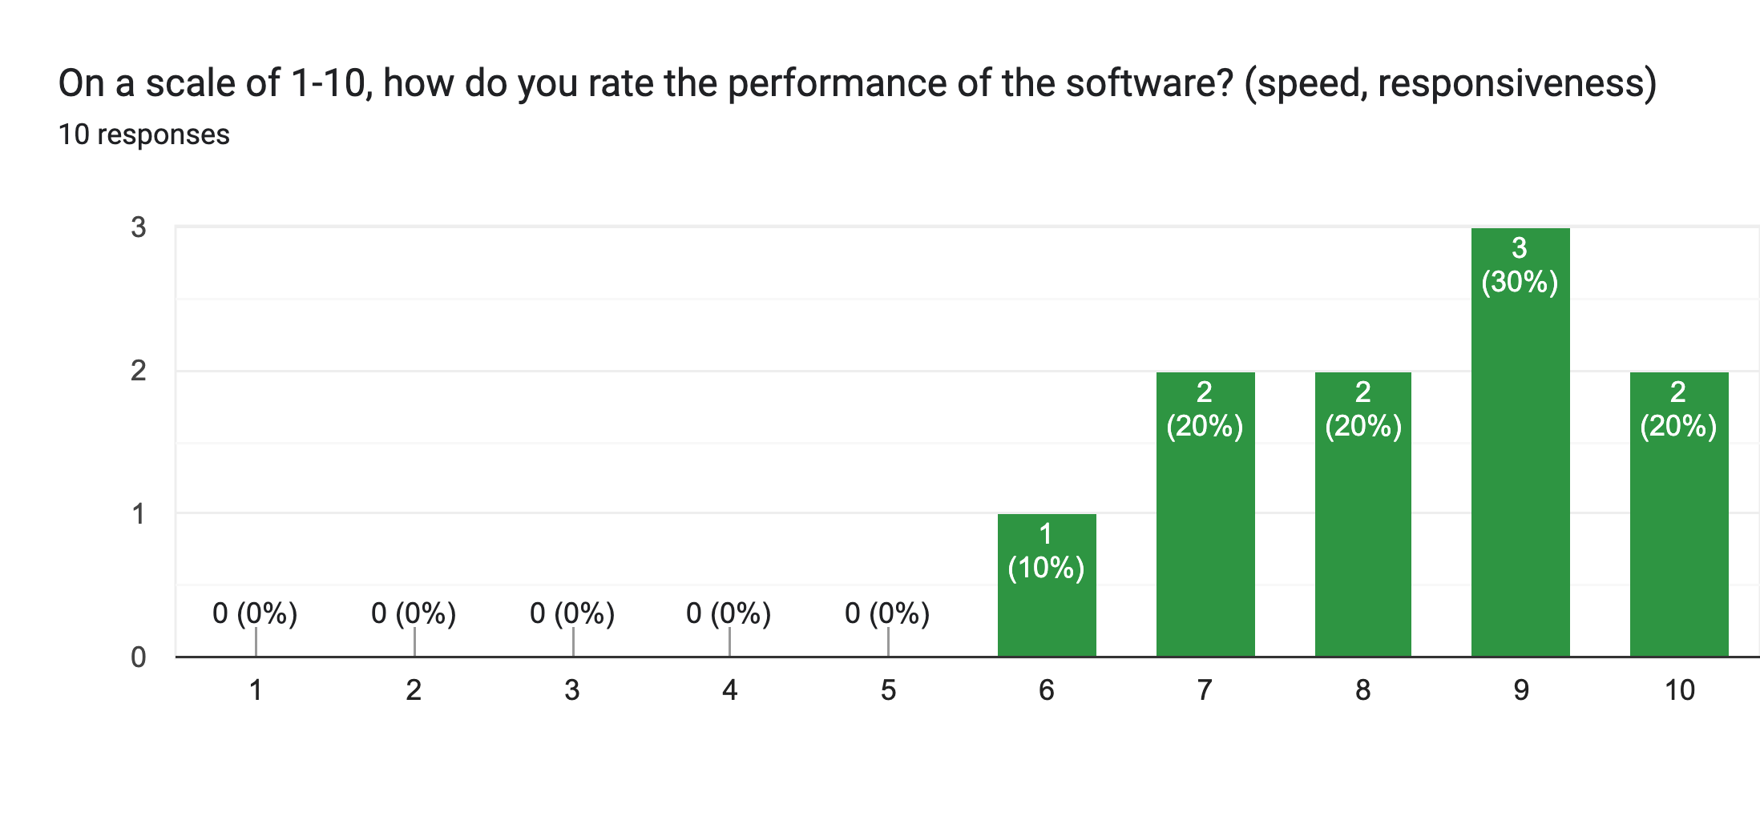
Testing results
Overall positive feedback
User experience improved
More help options
Occasional delay on logout
Notes:
Common feedback was more help options and more clear directions
Ability to change password
Some also found delay when logging out
No major bugs or errors found

Slide 9
Challenges Overcome
Learning customtkinter for GUI
Database issues
Database encryption
Deriving key from master password
Package versions
Notes:
Tkinter came with a learning curve
The database would make the UI flashy and would print random spaces
New updated packages stopped working so I hard coded the package versions that I knew worked

Slide 10
Future enhancements
Create an App
Add more user accounts
Profile page with user options
Help options and tooltips
More options for passwords
Change reminders
Updated breach lists
Interface customization
Notes:
User options like changing password or deleting account
Changing passwords, easier to copy or delete
Choose theme or scale

Slide 11
Questions?

