Slide 1


HTML5 IndexedDB NodeJS
A responsive HTML5 Application using a NodeJS REST API
1/5

Slide 2
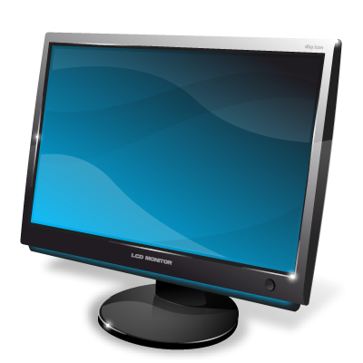
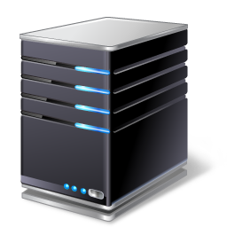

How the project works
Client application
NodeJS REST API
Server
Mobile support
Using a client or mobile application, or only the API with tools like Postman, a user can connect and modify data in a remote database.
Using IndexedDB, which is a local Database within the client’s web browser, the client application can persist changes even if the remote server’s database can’t be reached. Upon reconnection, the client application synchronises both databases.
2/5

Slide 3
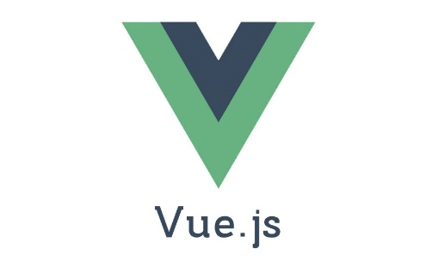


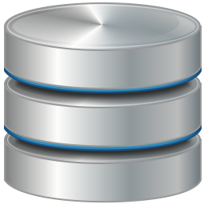
The client application
Client application
Server
NodeJS REST API
The client application edits a local database (IndexedDB) with the Dexie.js wrapper then attemps to synchronise it to the server’s database through a NodeJS REST API.
After having received the server’s database through the API, its data is displayed on the Client application with Vue.js.
IndexedDB
3/5

Slide 4


The server application
NodeJS REST API
Web framework for NodeJS
Server
Client application
Receiving data from the client application through its NodeJS REST API, the server application can update its SQLite database and transmit a response (in JSON) to the client application.
To display templates and to make the different API routes work, the server application uses the Express NodeJS framework.
SQLite
4/5

Slide 5
Technologies used
Languages:
JavaScript
https://en.wikipedia.org/wiki/JavaScript
HTML
https://en.wikipedia.org/wiki/Hypertext_Markup_Language
Environement:
NodeJS
https://nodejs.org/en/
Databases:
SQLite
https://www.sqlite.org/
IndexedDB
https://en.wikipedia.org/wiki/Indexed_Database_API
Wrapper:
Dexie.js
http://dexie.org/
Frameworks:
Vue.js
https://vuejs.org/
Express
http://expressjs.com/
5/5

