Slide 1
Use of various machine learning techniques to explore trends in online dating profiles
David Logsdon

Slide 2
Question 1
Can the income of a user be predicted using education level, drinking habits, and drug use?
Education level should correlate well with income (that’s why we’re on Codecademy), and one might also assume that heavy drug and alcohol use would correlate negatively with income…but do they?
Since income is a continuous variable, this question can be answered with linear regression

Slide 3
Creation of the ‘education_code’ column, which contains a numerical representation of education level
Only users who had graduated from a program were chosen
This makes the progression in education level clearer
Descriptions such as ‘some college’ are ambiguous and difficult to compare
Graduated from high school was assigned the lowest value (0), followed by two-year college (1), college (2), and masters (3)
Graduated from Law school, Med school, and PhD program were combined into the highest level (4) because differentiating among them is difficult

Slide 4
Creation of the ‘drinks_code’ and ‘drugs_code’ columns, which contains a numerical representation of drinking habits and drug use
The ‘drinks_code’ column was prepared in the same way as in the file capstone_instructions.md
The ‘drugs_code’ column was prepared by assigning ‘never’ the lowest value (0), followed by ‘sometimes’ (1), and ‘often’ (2)
Users with an income value of -1 were removed because it is unclear what this value represents

Slide 5
Graphs used to explore the dataset
Education level, drinking habits, and drug use were all plotted vs income
These plots allow one to visualize if there are linear trends in the data
This helps determine if these features will be good for a multiple linear regression model

Slide 6
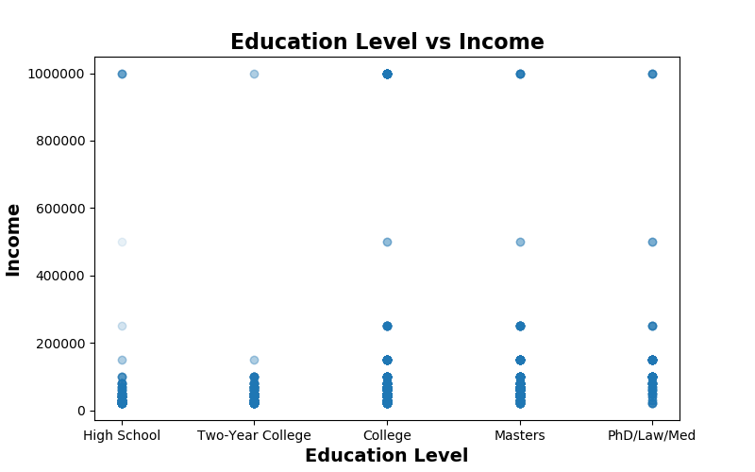
Graphs used to explore the dataset

Slide 7
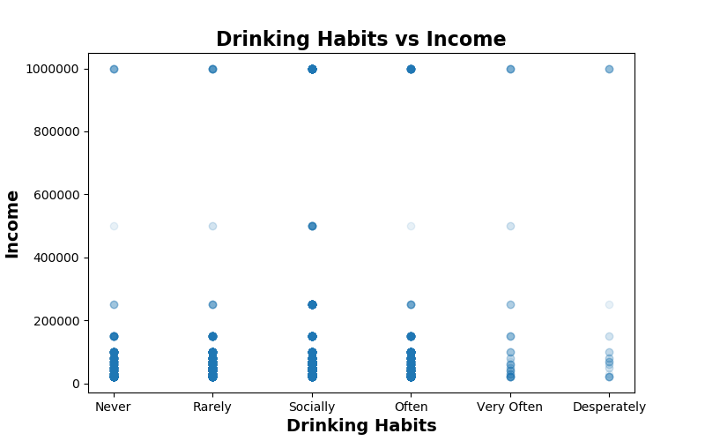
Graphs used to explore the dataset

Slide 8
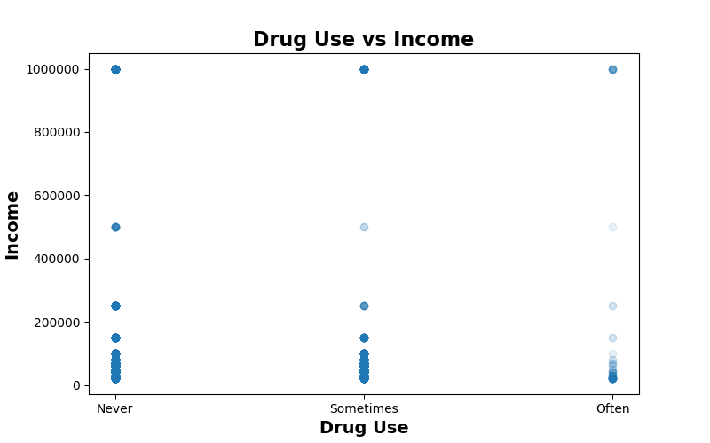
Graphs used to explore the dataset

Slide 9
Graphs used to explore the dataset
The education level vs income plot shows an increase in the frequency of high incomes as the education level increases
The drinking habits vs income plot shows more of a normal distribution where income peaks around ‘socially’
The drug use vs income plot appears to show a negative correlation between drug use and income
These plots indicate that these features might be amenable to linear regression; however, with discreet variables like these, the trends are often difficult to clearly delineate from a plot

Slide 10
The linear regression was preformed using two models: Multiple Linear Regression (MLR) and K-Nearest Neighbors Regression (KNR)
Given the lack of obvious, linear trends in the data and the poor correlation that education level, drinking habits, and drug use have with income (0.113, 0.0957, and 0.0515 respectively), MLR is unlikely to provide accurate predictions
KNR does not rely on linear trends in the data but rather that related data points are in close proximity with one another

Slide 11
The effectiveness of the MLR model was evaluated by calculating percent error and examining the r² values
The percent error for each predicted income was calculated
Percent error = ((predicted – actual)/actual)*100
The mean error was 97.9%
The median error was 56.3%
The r² values for the training and testing data were 0.0213 and 0.0260 respectively
The high median error and low r² values indicate that MLR is unable to accurately predict income using the chosen features

Slide 12
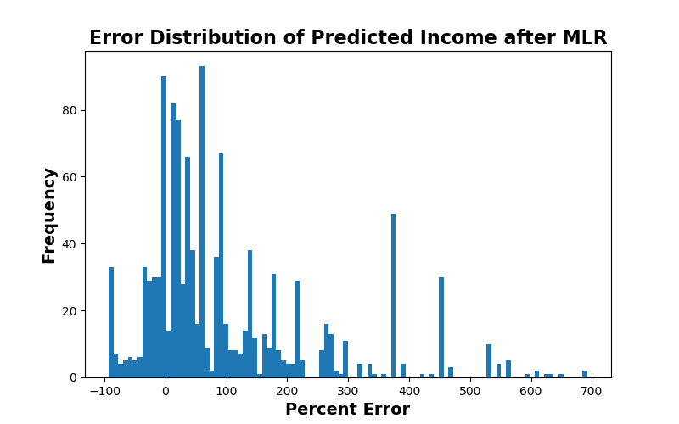
Using MLR, the error values for the predicted incomes had a broad distribution with a high number of errors over 100%

Slide 13
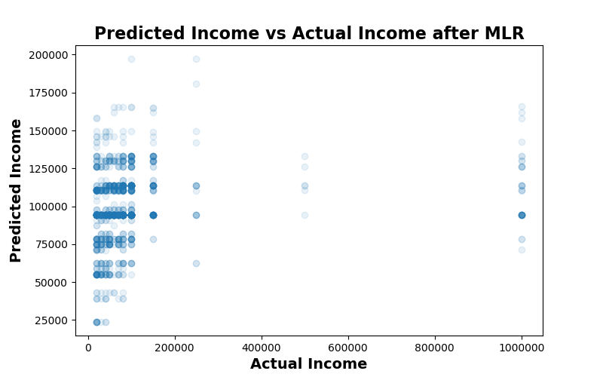
When predicted income was plotted vs actual income, the majority of the points were above the line y=x

Slide 14
The effectiveness of the KNR model was evaluated by calculating percent error
The percent error for each predicted income was calculated
Percent error = ((predicted – actual)/actual)*100
The mean error was 30.1%
The median error was -2.78%
The low median error value indicates that KNR can be use to accurately predict income based on the chose features

Slide 15
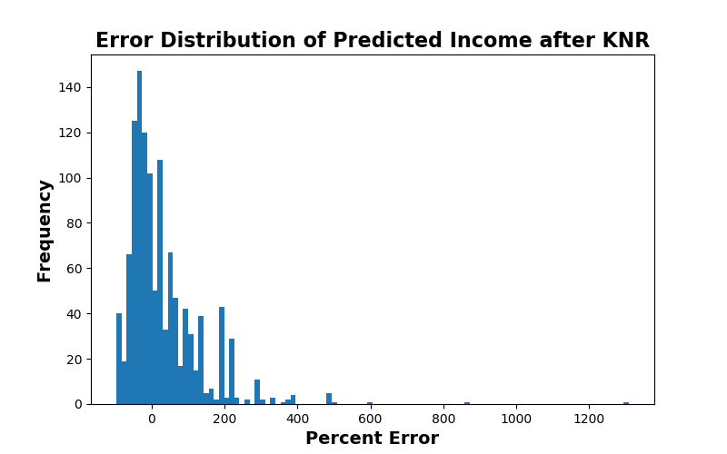
Using KNR, the error values for the predicted incomes had a narrower distribution with fewer errors over 100%

Slide 16
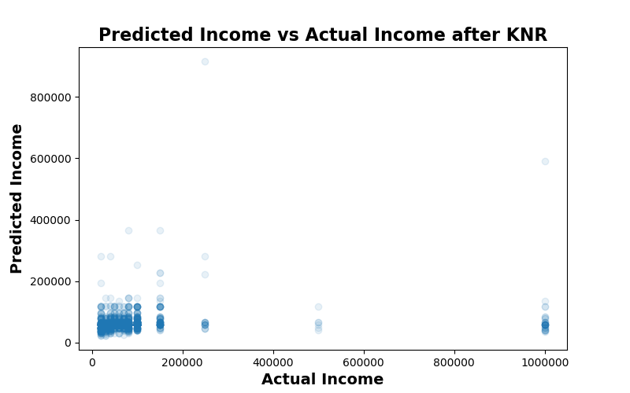
When predicted income was plotted vs actual income, the points are much closer the line y=x

Slide 17
Comparison between the two regression models
MLR
KNR
Simpler and faster
No need to find an optimal value of k
Requires linear trends in the data
Since there were weak linear correlations with income for the chosen features, MLR was poor at predicting income
Slower and more complex
The optimal value of k must be found, which increases the complexity of the code and the time to run the model
No requirement for linear trends
KNR was able to accurately predict income based on the chosen features despite the lack of linear trends

Slide 18
Conclusions for Question 1
Using K-Nearest Neighbors regression, income can be accurately predicted from a user’s education level, drinking habits, and drug use
Surprisingly, all three features show a positive (albeit weak) correlation with income
More honest answers would likely improve the accuracy of this model
Users may not indicate true drug use levels for fear of discrimination
Users likely exaggerated their income levels
There were a surprising number of individuals with an income of $1,000,000 for a free online dating site

Slide 19
Question 2
Can the sex of a user be predicted from his/her essays or his/her income and education level?
Women and men are often perceived as thinking differently. Will this show up in their writing style?
Women and men are not compensated equally, and women are often underrepresented in post-graduate education programs. Are these trends evident in OkCupid’s users?
Since we are deciding between male or female, this question can be answered with classification

Slide 20
The classification was preformed using two models: Naïve Bayes and K-Nearest Neighbors
The classification of male or female based on the essays written was performed using a Naïve Bayes classifier
All essays were combined together in the same manner as in the file capstone_instructions.md
The classification of male or female based on income and education level was performed using a K-Nearest Neighbors classifier
Numerical values for education level (education_code) were created as described previously
The education_code and income were normalized using z-scores due to the outliers present in income

Slide 21
The effectiveness of the Naïve Bayes model was evaluated by calculating accuracy, recall, precision, and F1 score
The accuracy was 73.1%
The recall was 81.3%
The precision was 62.3%
The F1 score was 70.6%
The confusion matrix was:
True Male
4894 | 2336
892 | 3868
True Female
Predicted Male
Predicted Female

Slide 22
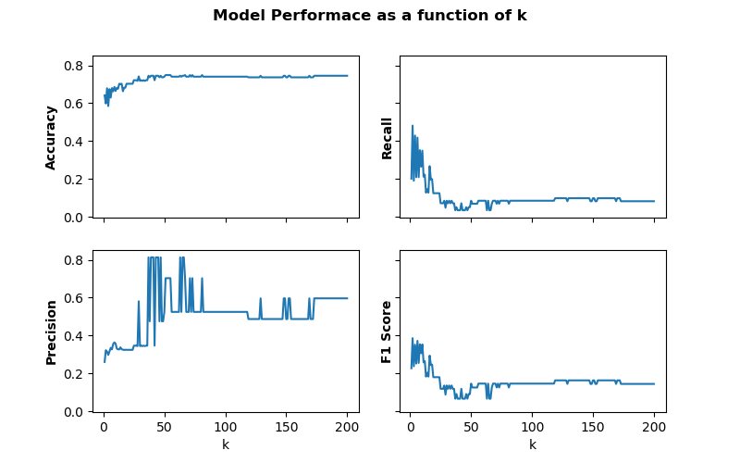
The performance of the K-Nearest Neighbors classifier was evaluated as a function of k

Slide 23
A k value of 51 resulted in a classifier with the highest accuracy, and at this k value, the overall performance of the model was evaluated
With a k value of 51:
The accuracy was 74.8%
The recall was 6.89%
The precision was 70.3%
The F1 score was 12.5%
The confusion matrix was:
True Male
1053 | 11
352 | 26
True Female
Predicted Male
Predicted Female

Slide 24
Conclusions for Question 2
A user’s gender can be accurately predicted from a user’s essay contents using a Naïve Bayes classifier
The accuracy, recall, and F1 score were all relatively high indicating that the model performed well
A user’s gender cannot be effectively predicted from the user’s income and education level
The accuracy and precision of the model were high, but the recall and F1 score were low
The dataset contained predominantly male users, and an evaluation of the confusion matrix reveals that the model achieved its high accuracy by predicting male most of the time
The user pool was reduced significantly by only choosing users who had graduated from a program
Perhaps a better method of delineating education level which includes users who have not graduated from a program would expand the user pool and improve the models

