Slide 1
MeshX identity platform for banking
Who signs in. How they prove identity. What the platform records.

Slide 2
Three outcomes for the bank
The results after the platform is set up.
Control access
Prove what happened
Run it with discipline
Enforce MFA, block high-risk sign-up domains, and federate staff through the bank’s own identity provider.
Every token and admin change is recorded. The bank can export and review the records.
Stacks deploy from approved templates. Health, capacity, and cost are shown in one place.

Slide 3
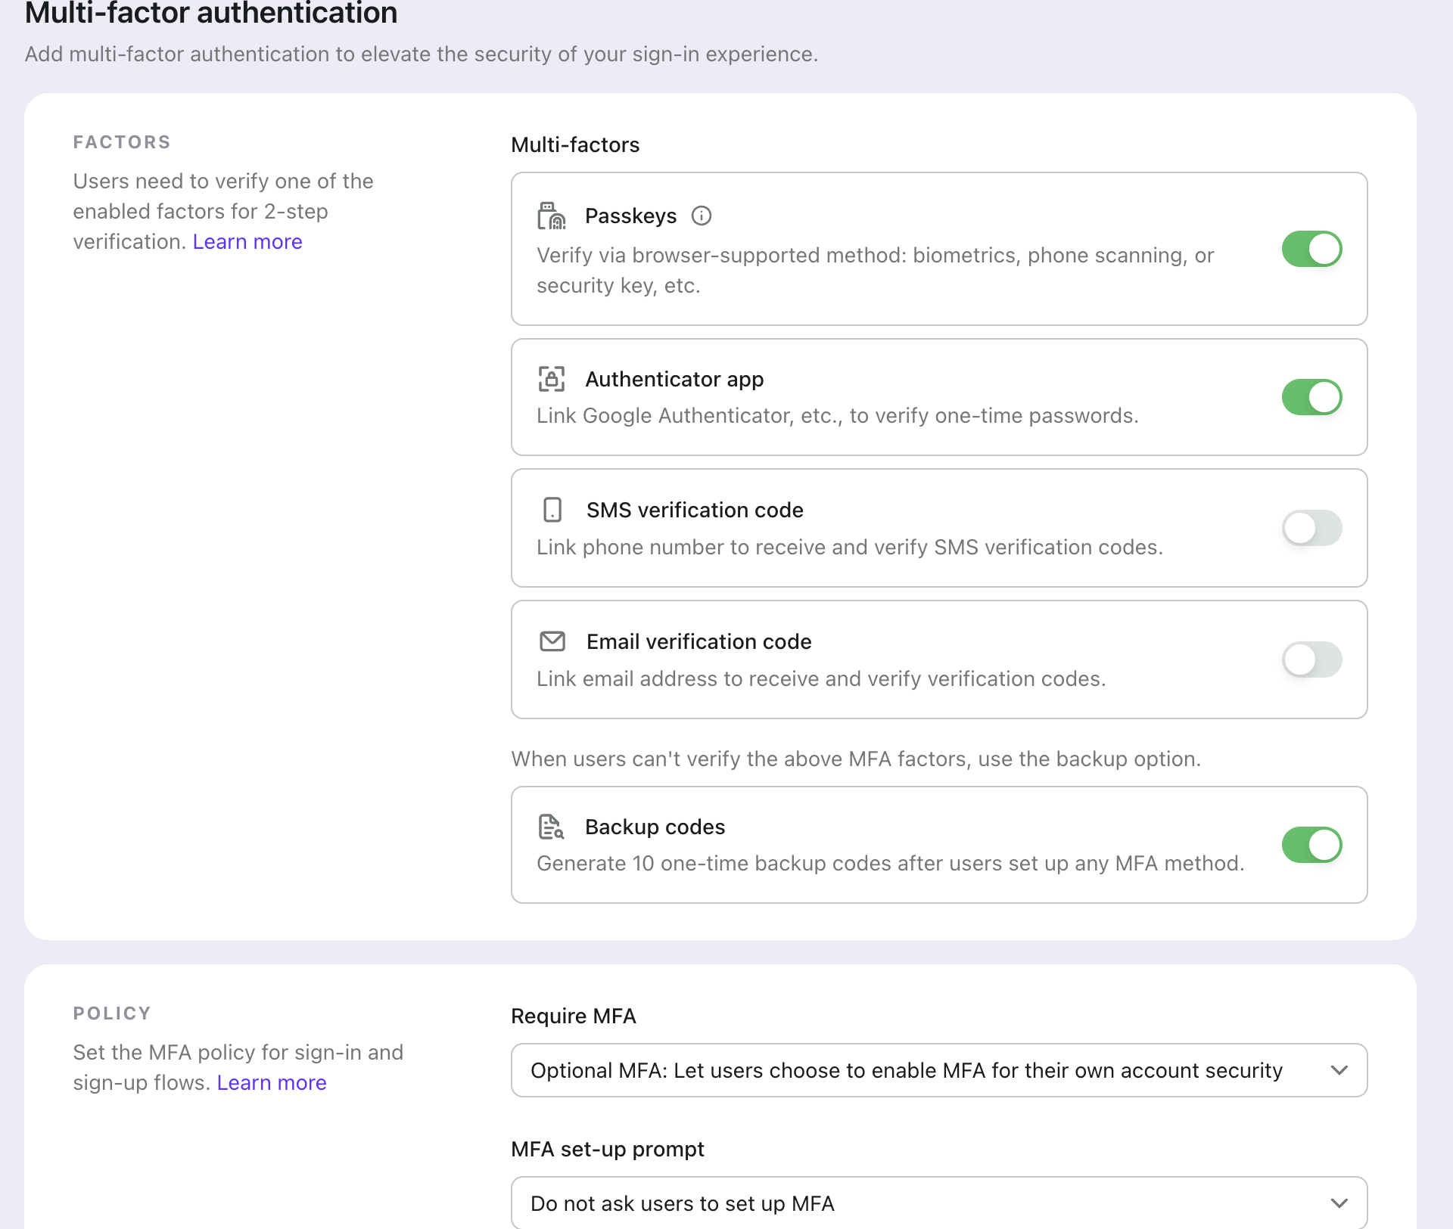
Strong sign-in for staff and customers
MFA is set once for each tenant.
Set when MFA is required: optional or enforced.
Select the factors the bank accepts, for example one-time codes.
Backup codes give a recovery path. The policy stays strong.
Notes:
Lead with the risk: a stolen password alone should not open a bank system. Show the factor list, then the policy choice.

Slide 4
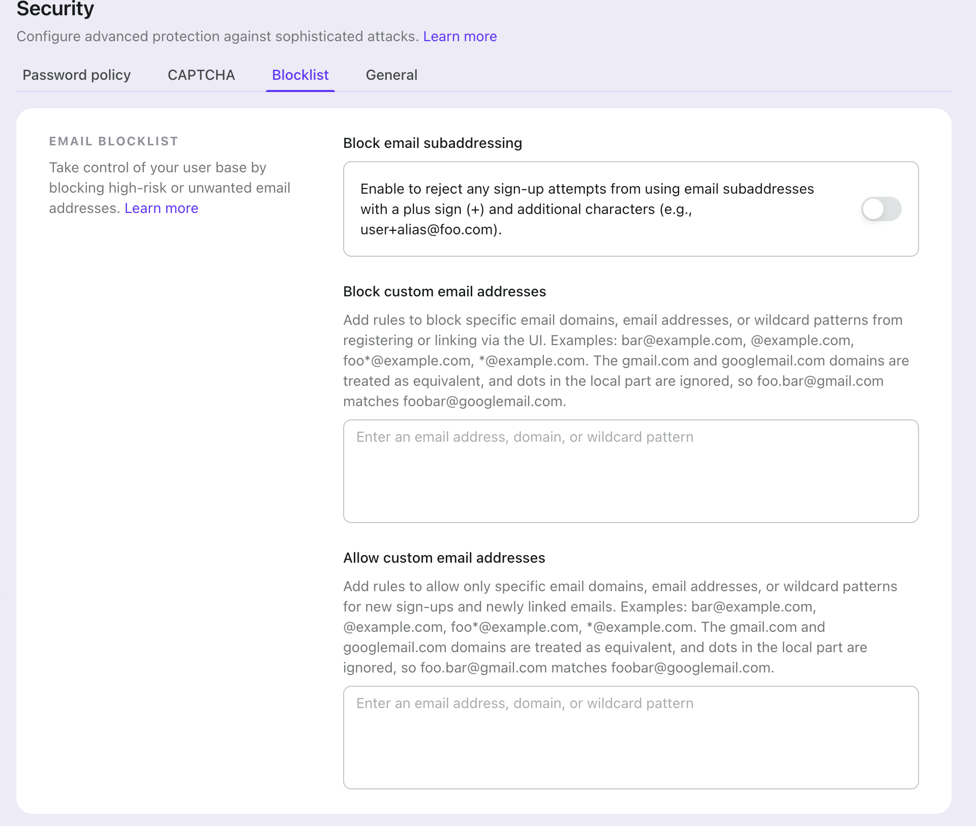
Control who can open an account
Block high-risk email domains at sign-up.
Reject disposable domains and subaddresses. Example: name+alias@domain.
Allow only the partner domains the bank approves.
Rules apply to new sign-ups and new linked emails.
Notes:
Disposable and alias addresses are a common route for fake accounts. The blocklist and allowlist are set once and apply to every sign-up.

Slide 5
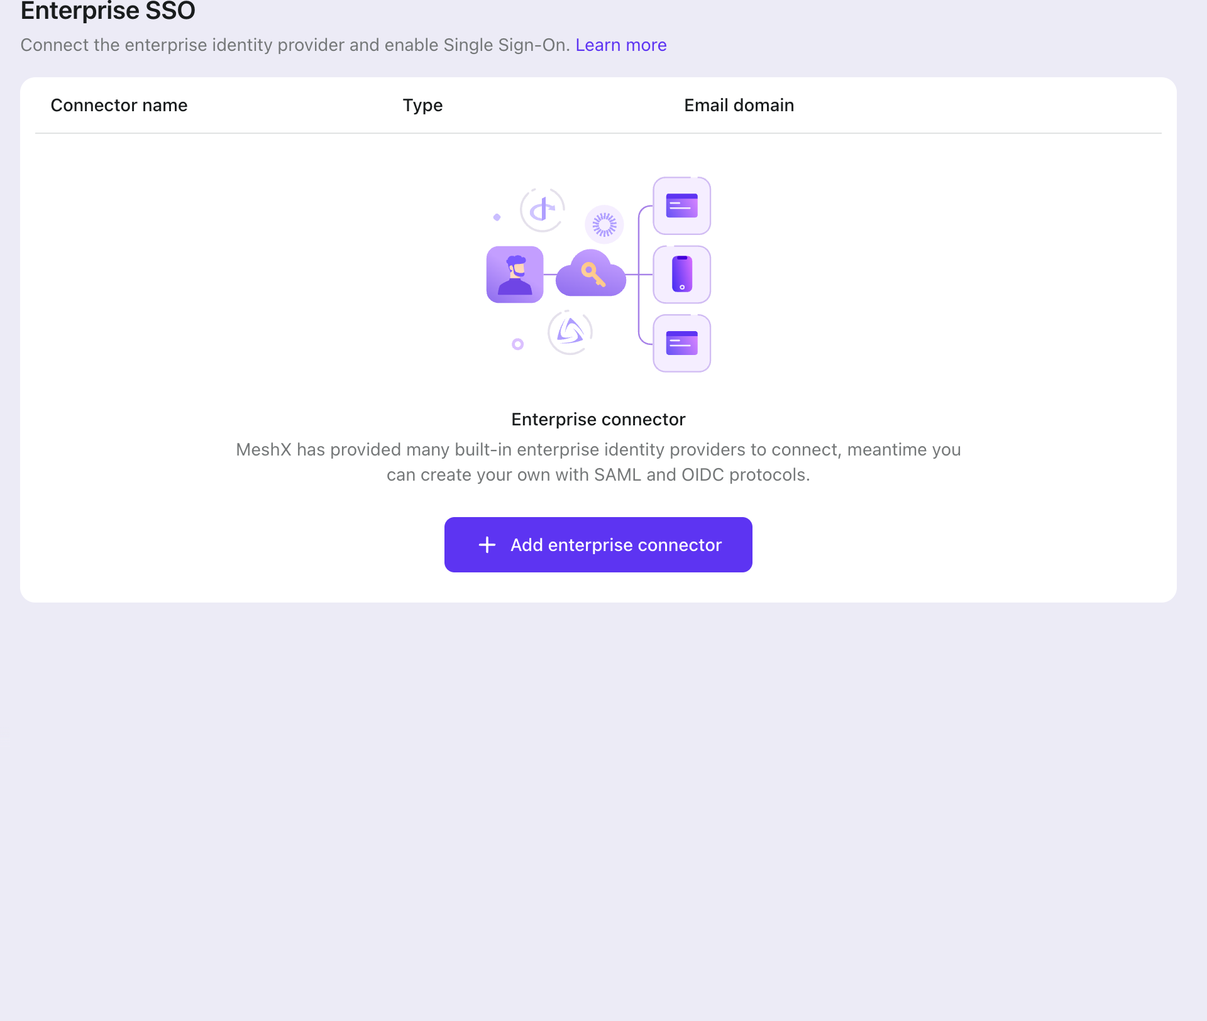
Use the bank’s own identity provider
Enterprise SSO connects to SAML and OIDC providers.
Staff sign in with their current identity provider.
Each connector is linked to an email domain. Routing is automatic.
No separate password store for employees.

Slide 6
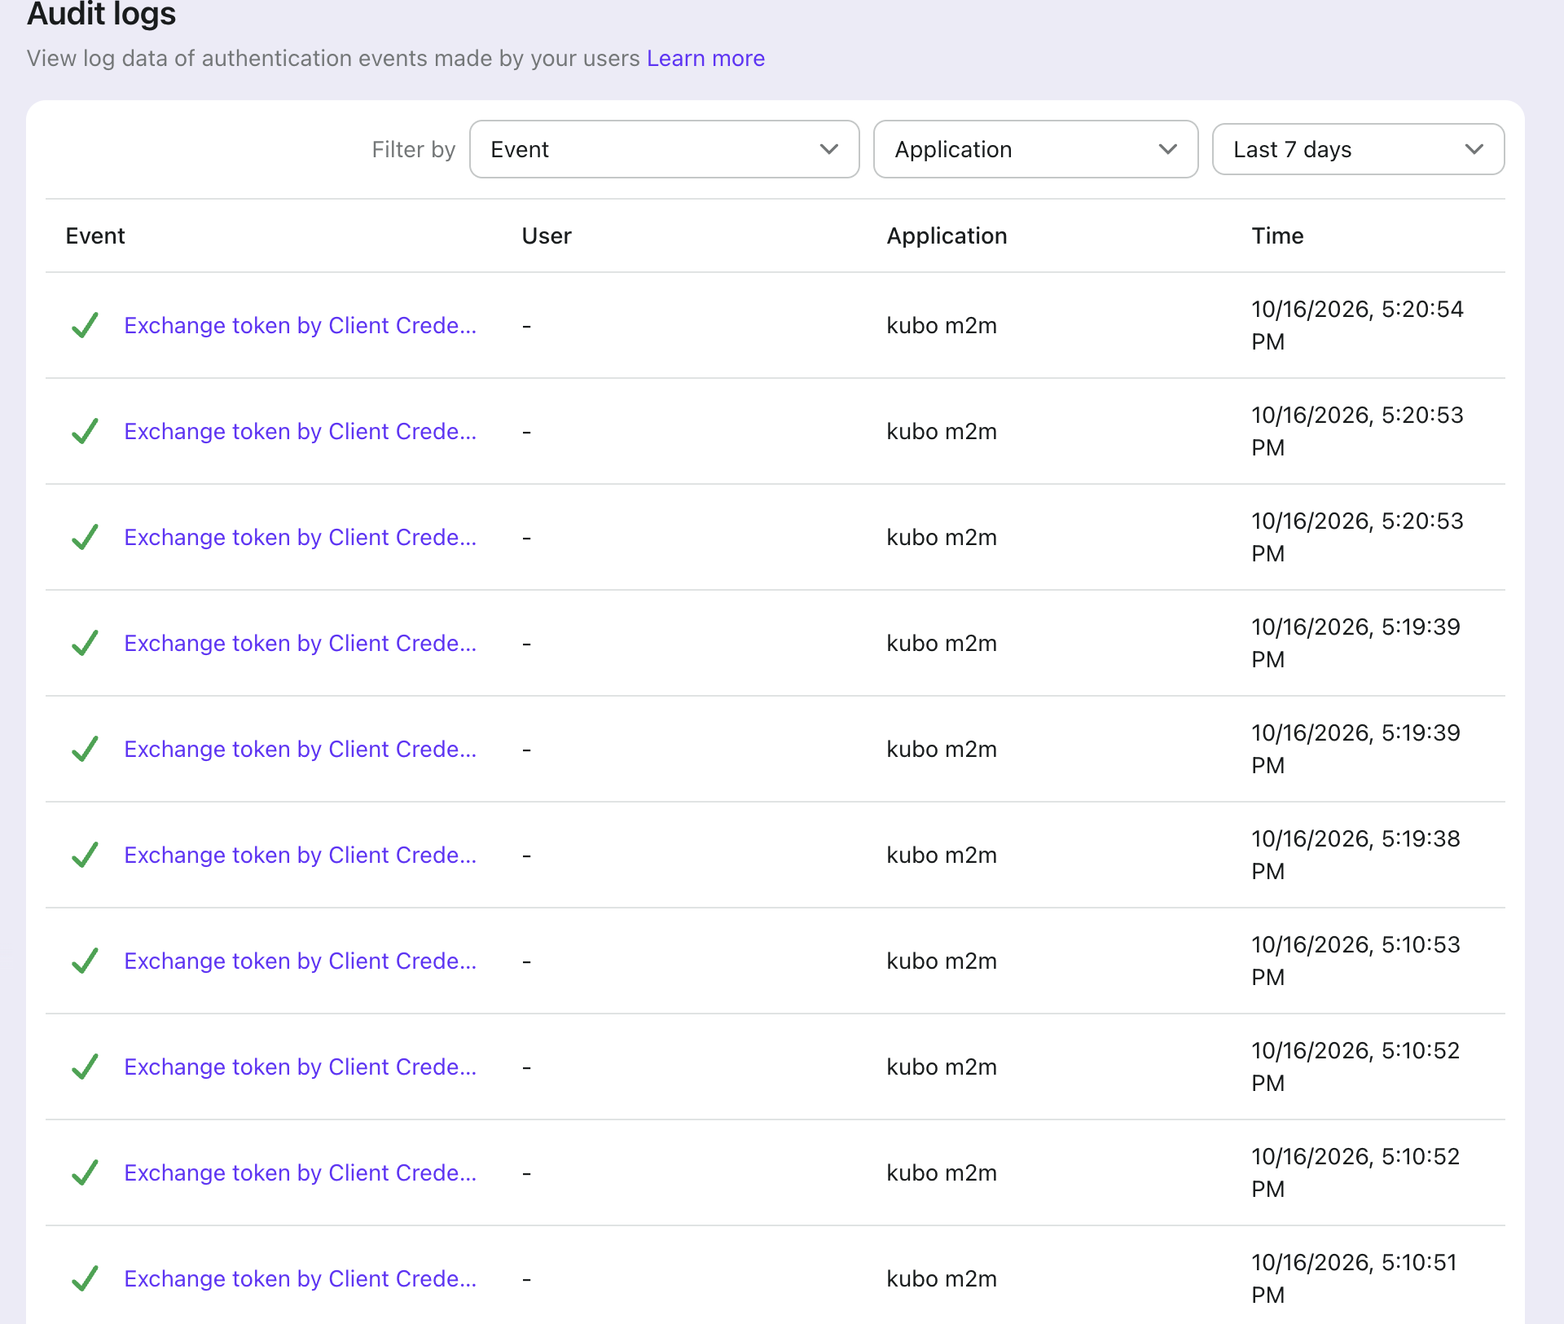
A record of each sign-in event.
The audit log shows each token, by application and time.
Filter by event, application, and time.
Each row is a token exchange. The bank can trace it to an application.
Export the log for internal audit and regulator requests.
Notes:
This is the page for the audit team. Every row is a token exchange tied to an application and a time.

Slide 7
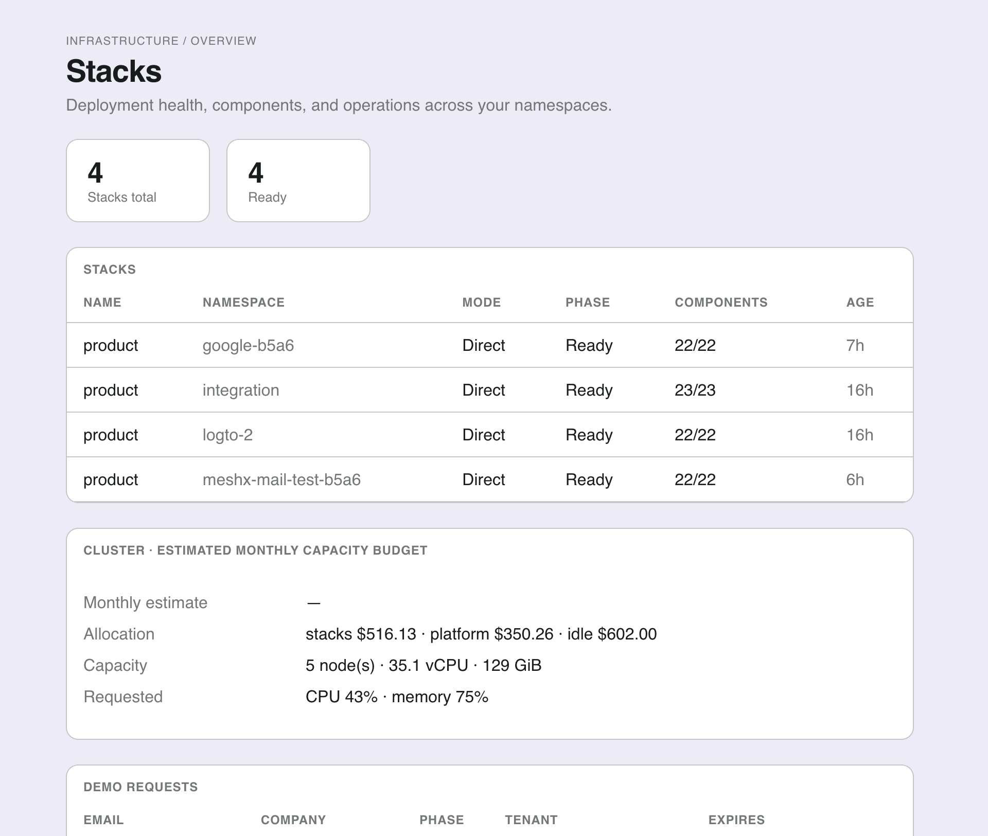
Only approved deployments run.
Stacks show phase and component status for each environment.
Each stack uses an approved template: Full, Lite, or Dashboard AI only.
Component status, such as 22/22, shows if a deployment is complete.
New environments use the same templates. There is one path to production.
Notes:
For operations: each environment shows whether it is complete, and new environments start from the same templates.

Slide 8
Proposed next steps
A pilot proves the controls before wider rollout.
1. Pilot one application
Connect one staff application to the bank identity provider. Enforce MFA.
2. Confirm the audit export
Agree the log format and retention with the bank’s audit team.
3. Expand by stack
Move the next environment to approved templates after the pilot passes review.

