Slide 1
MeshX platform for banking
Admin console and stack operations, mapped to bank use cases

Slide 2
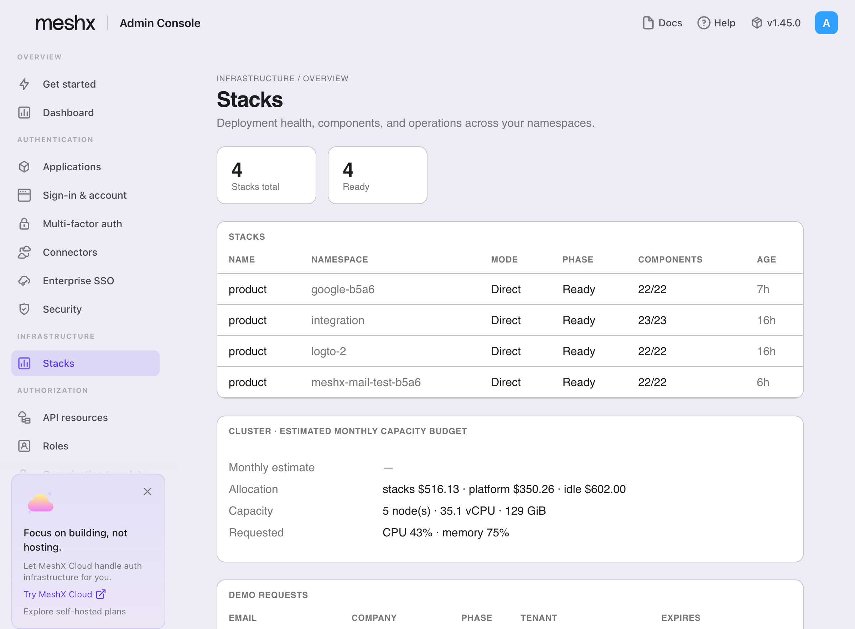
Stack health across environments
One view of every deployed stack, its phase, and component readiness
Each stack shows phase, mode, and component readiness (for example 22/22).
Use it to evidence that production runs the approved stack versions.
Stacks are created from approved templates (Full, Lite, Dashboard AI only).

Slide 3
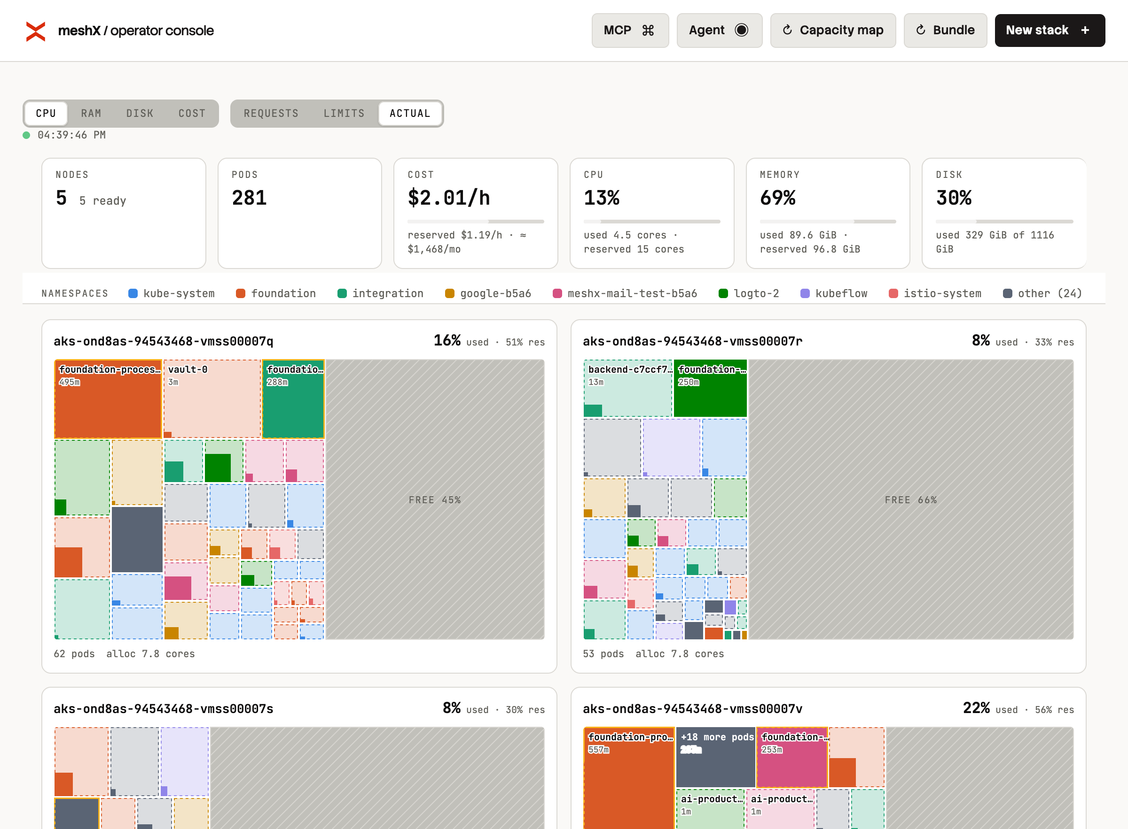
Cluster capacity and cost control
Node and pod usage, reserved capacity, and monthly estimate
Live CPU and memory use per node, refreshed every 10 seconds.
Reserved and idle capacity are shown separately, so cost owners can act on idle spend.
Supports capacity planning evidence for audit and budget reviews.

Slide 4
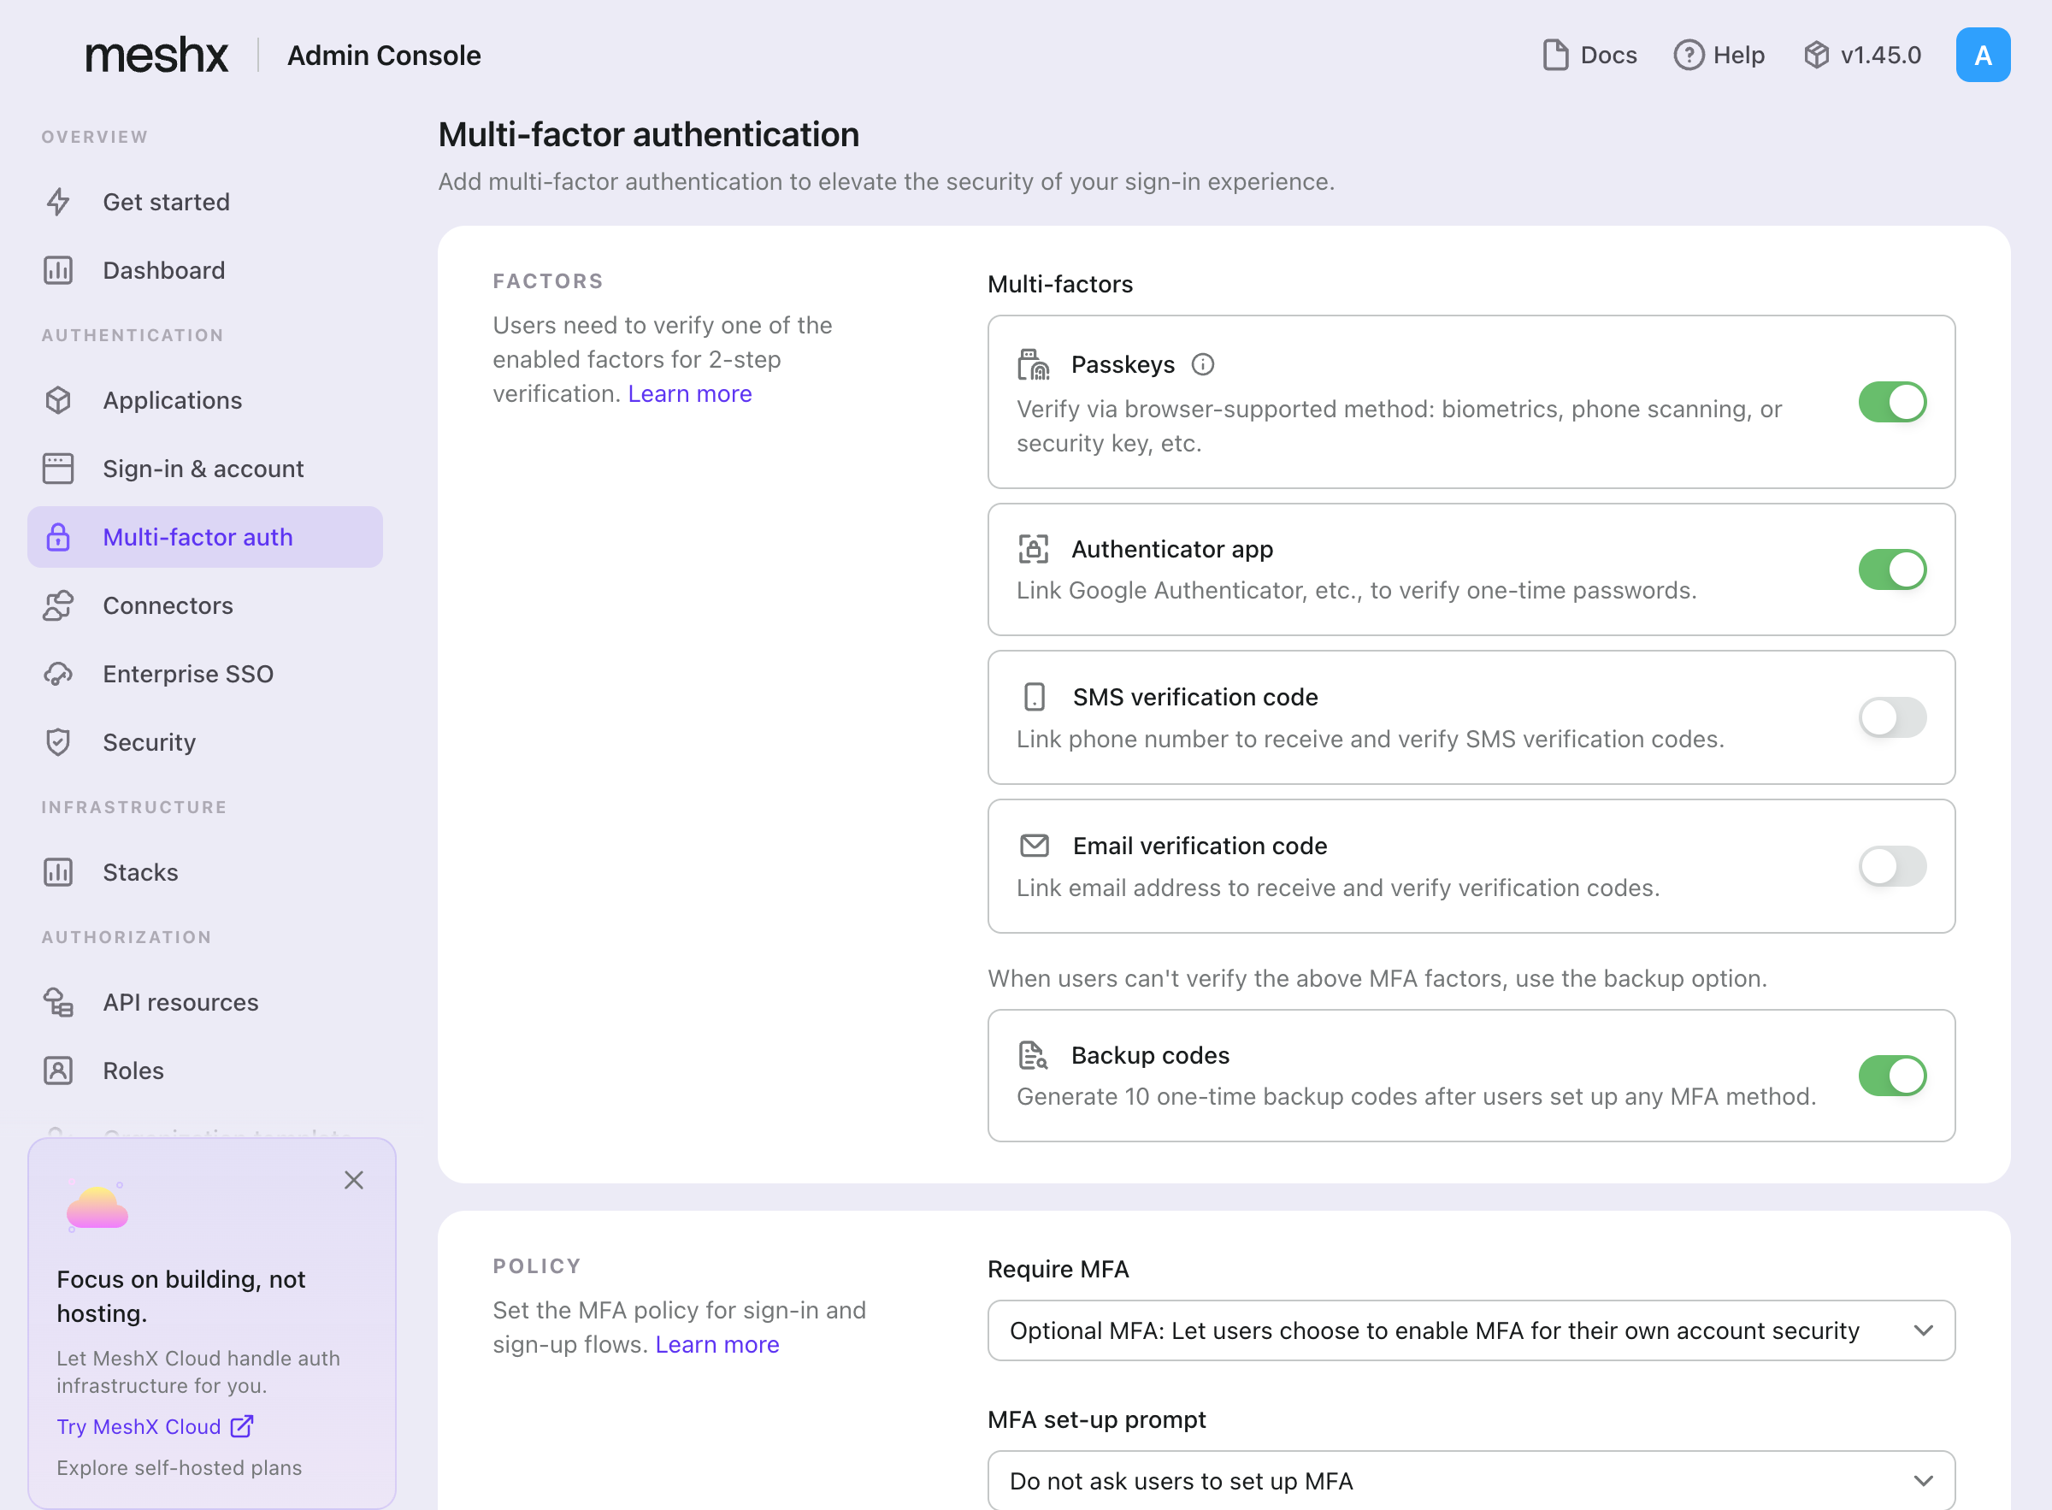
Strong authentication for staff and customers
Multi-factor authentication configured in the admin console
Enforce MFA for administrators and customer sign-in.
Choose factors such as one-time passcodes and backup codes.
Policy changes are logged in the admin audit trail.

Slide 5
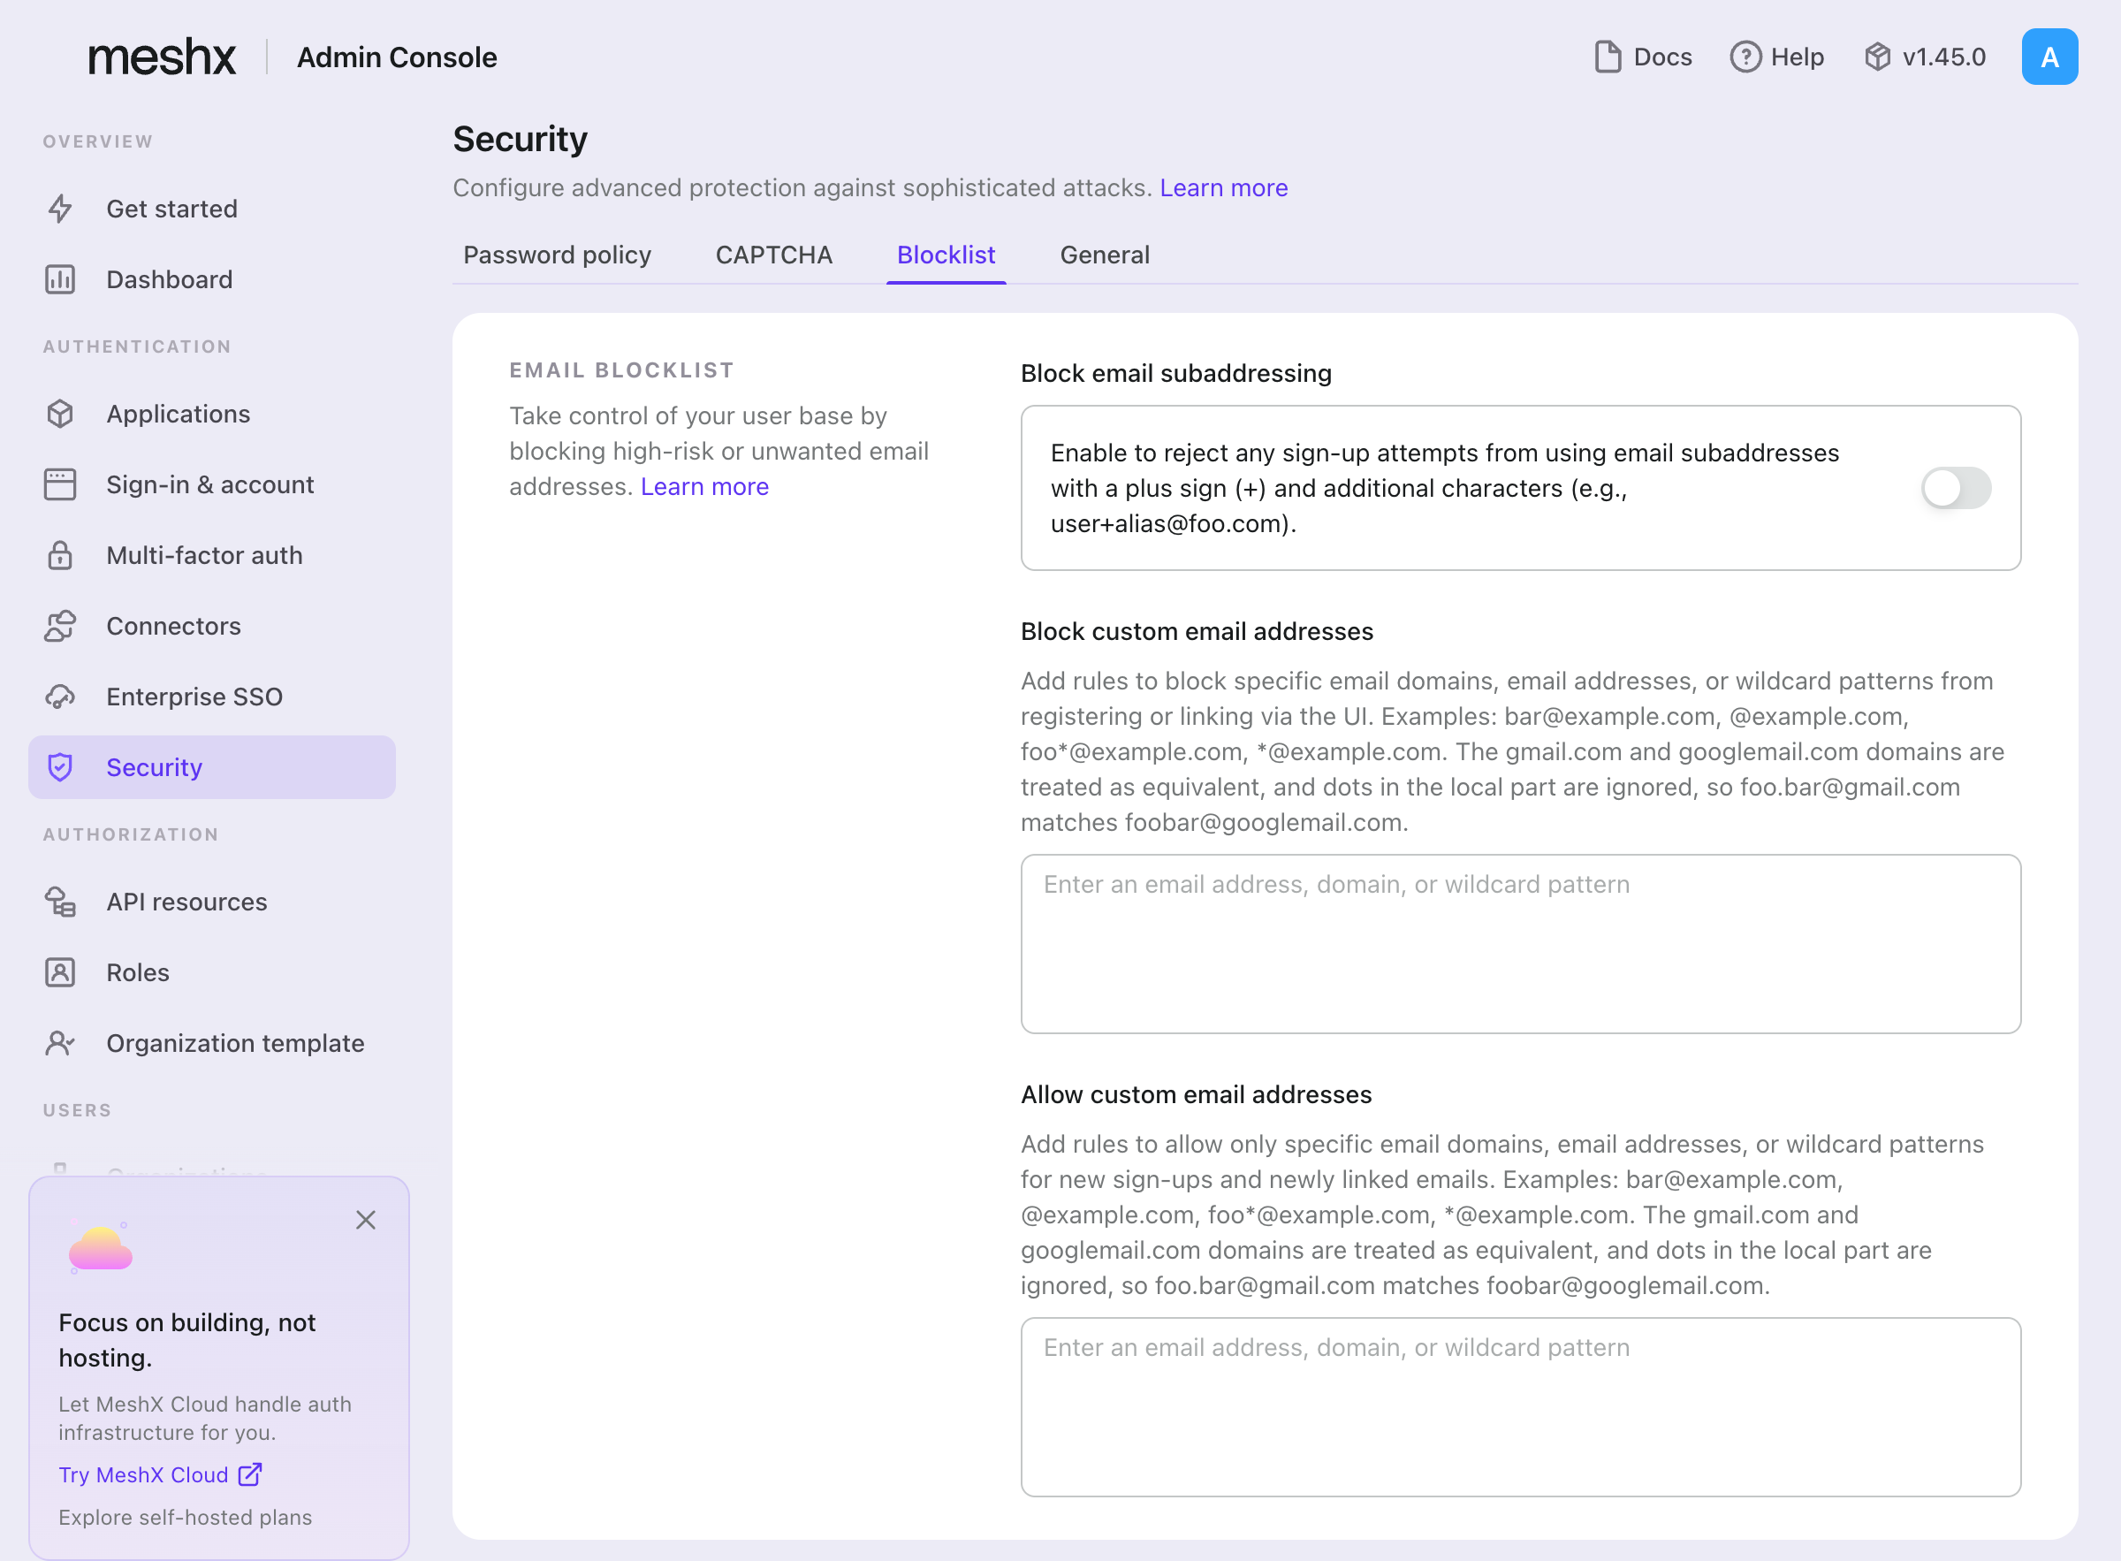
Restrict who can register and sign in
Email blocklist and allowlist rules applied at sign-up
Block disposable or high-risk email domains and subaddresses.
Allowlist specific domains for employee or partner onboarding.
Rules apply to sign-up and to newly linked emails.

Slide 6
Summary
Where each capability maps to a banking requirement
Requirement | Capability
Access control for staff | Roles, MFA, admin audit log
Customer onboarding restrictions | Email blocklist and allowlist
Evidence of approved deployments | Stacks with phase and component status
Cost and capacity governance | Capacity map and monthly estimate

