Slide 1
MeshX platform for Barclays
Technical scope: what runs in your VPC, what is built, and what is not yet started

Slide 2
Purpose of this session
Barclays asked whether Foundation can run in its own VPC, without a meshX-operated control plane
Leave with a capability map. It shows which services Barclays supplies and which run in the cluster.
Leave with an honest list of what is built, designed, and not started.
Agree next steps, with owners, for the parts not yet built.
Out of scope: commercial terms, staffing, and legal terms.

Slide 3
Capability map
Status of each capability, based on the repository today
Capability | Status | What exists
Stack operator (pull-based reconcile) | Proven | Kubernetes operator; Direct (Helm) or Flux mode; dependency-ordered deploys
Helm chart set | Proven | 23 charts, including CloudNativePG, Redis, Kafka, NATS, Trino and S3-compatible storage
Air-gap bundle import | Partial | Upload and import APIs, SHA256 checks, in-cluster registry; image references not yet rewritten
Identity (Logto) | Partial | Logto chart and OAuth integration; product templates still default to Auth0
LLM access | Partial | LiteLLM gateway; default is the public Anthropic API; Bedrock not yet tested
Cost visibility | Proven | Per-request price tables and cost per call; visibility only
Model routing | Gap | Host-to-upstream mapping only; no model selection
GPU and on-prem models | Gap | No GPU requests; no path to an on-prem model endpoint
Federation across entities | Gap | One namespace per tenant; no federation code
Operator access | Gap | Only Tailscale found; bastion and break-glass not defined

Slide 4
Release and delivery in an air-gapped VPC
Six steps, with the current state of each
Step | State | Note
1. Build and sign the stack bundle (OCI) | Partial | OCI bundles are supported; signing is not yet verified
2. Push the bundle to the customer registry | Designed | The cluster does not yet pull from a customer registry in an air-gap install
3. Operator detects the new version | Proven | Pull-based reconcile in Direct or Flux mode
4. Customer approval gate | Gap | Not built
5. Promotion to the target stack | Partial | Dependency-ordered apply and pruning; no promotion across environments
6. Rollback to a prior version | Gap | Helm rollback is used only to recover stuck releases
Release cadence: a train agreed with Barclays change management, plus a separate lane for critical security patches. No SLA is quoted yet.

Slide 5
Inference inside the Barclays boundary
Bedrock-only operation. Not yet verified in a running environment.
Requirement | State | Pass test in the AWS test environment
Bedrock as the LiteLLM provider | Gap | A chat request completes with no public endpoint call
Approved model list and region | Gap | Only Barclays-approved model IDs are reachable
IAM role for the service account | Gap | Requests are signed with the role; no static API key
PrivateLink endpoint and private DNS | Gap | The Bedrock name resolves to the private endpoint
Logging and encryption keys | Gap | Invocation logs land in the customer account, encrypted with a customer key
The test environment will be built and the results reported before the session.

Slide 6
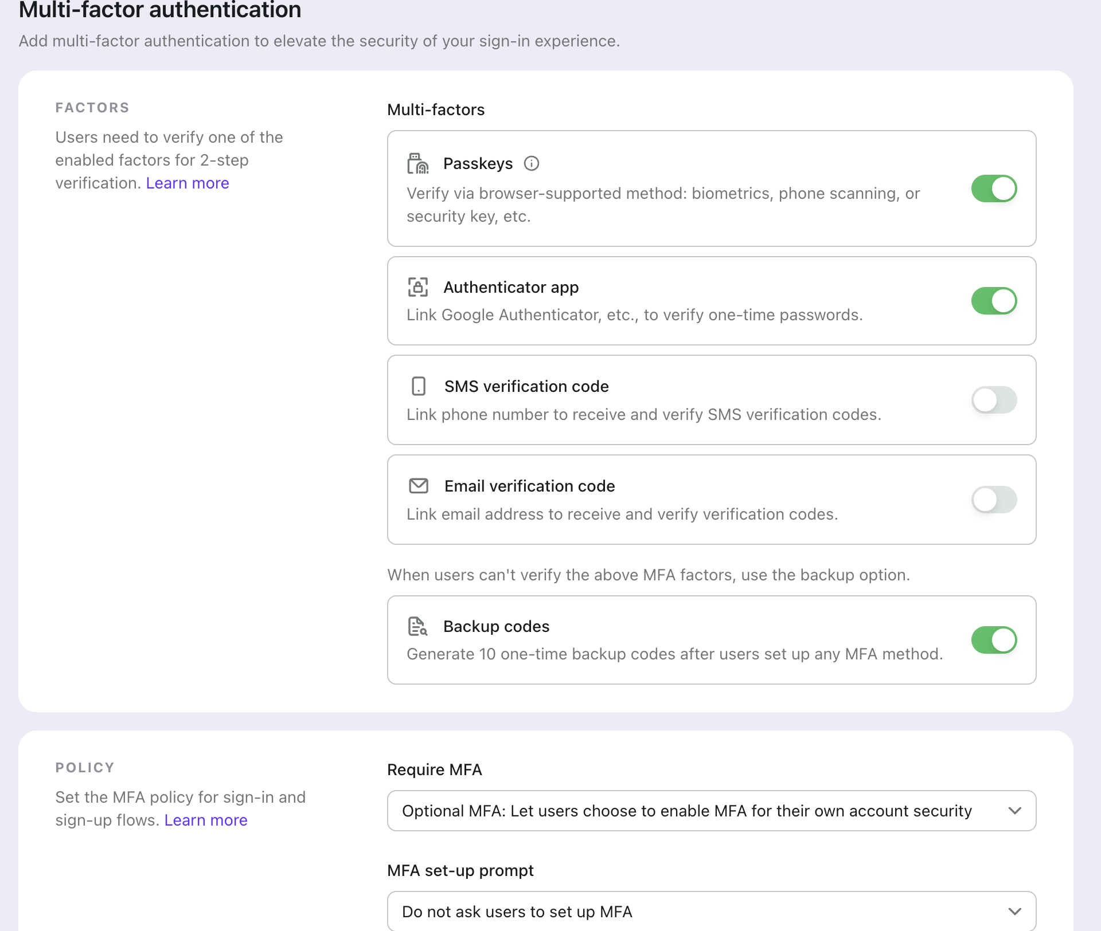
Identity: sign-in controls
MFA and sign-up controls are set in the admin console
Set when MFA is required: optional or enforced.
Select the factors the bank accepts.
Backup codes give a recovery path. The policy stays strong.
Auth0 defaults in the product templates must be removed before a Barclays install.

Slide 7
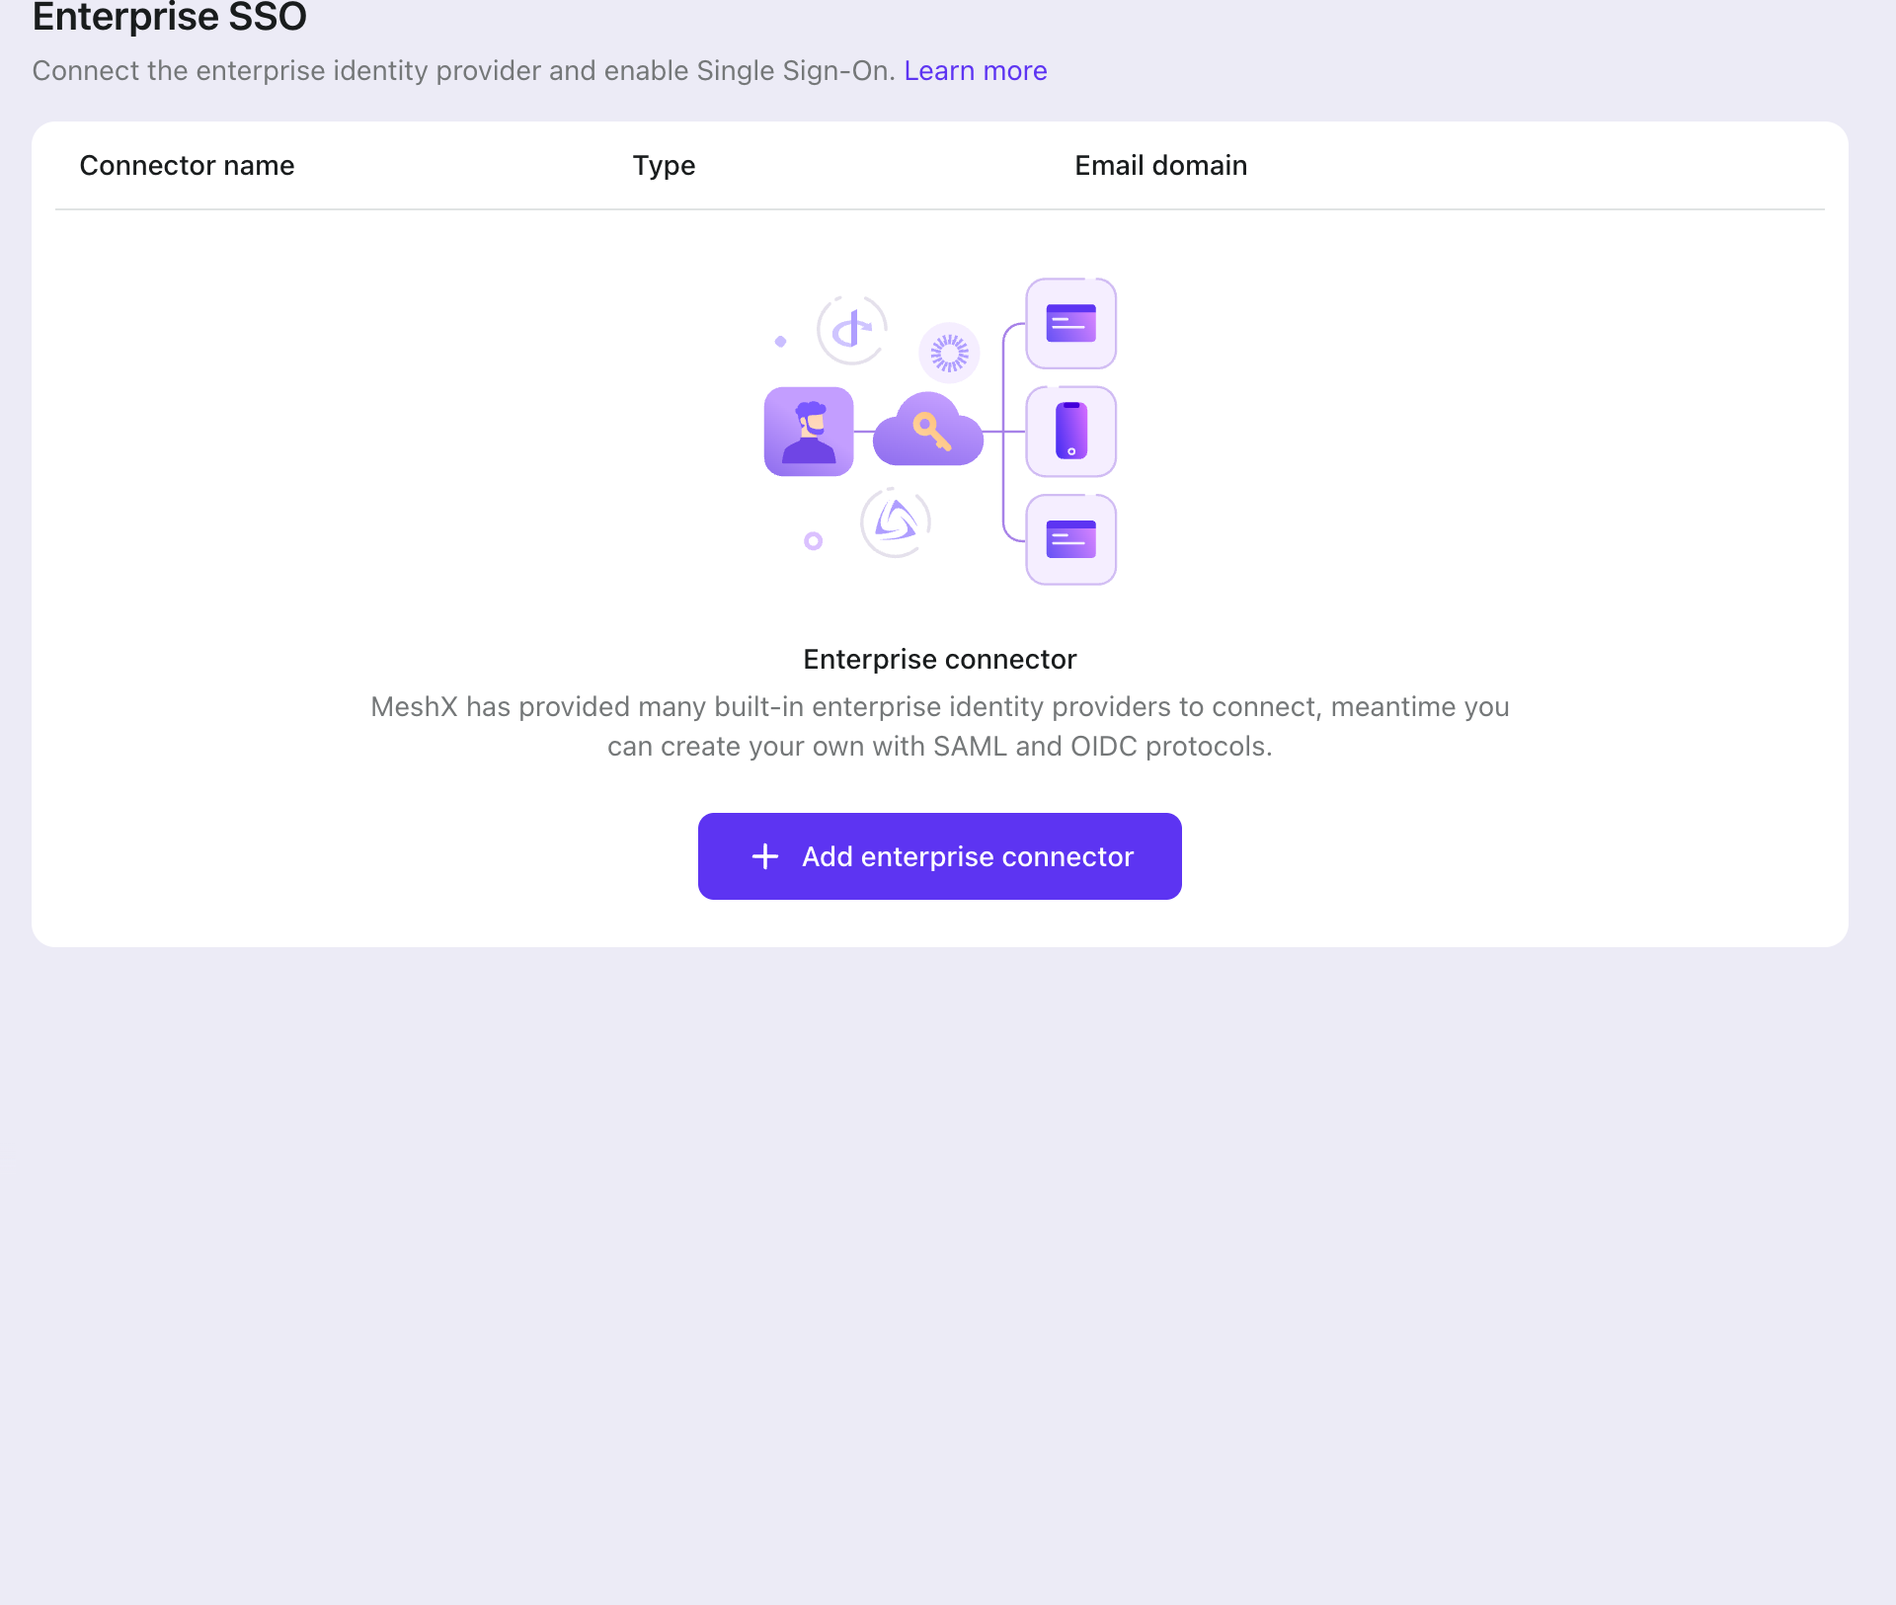
Identity: federation and sign-up control
Staff use their identity provider. Sign-up domains are controlled.
Enterprise SSO connects to SAML and OIDC providers.
Each connector is linked to an email domain.
Block disposable and high-risk domains at sign-up.

Slide 8
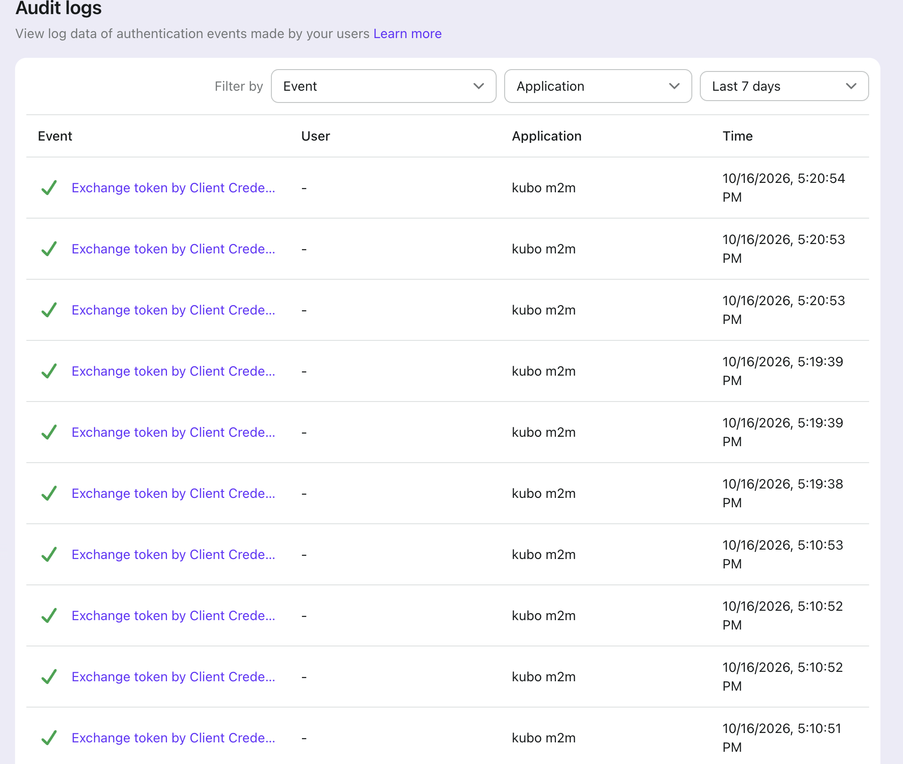
Audit trail
Each token exchange is recorded by application and time
Filter by event, application, and time.
Export the log for internal audit and regulator requests.
Audit evidence inside the cluster needs a mapping to each control. This is to be completed before the review.

Slide 9
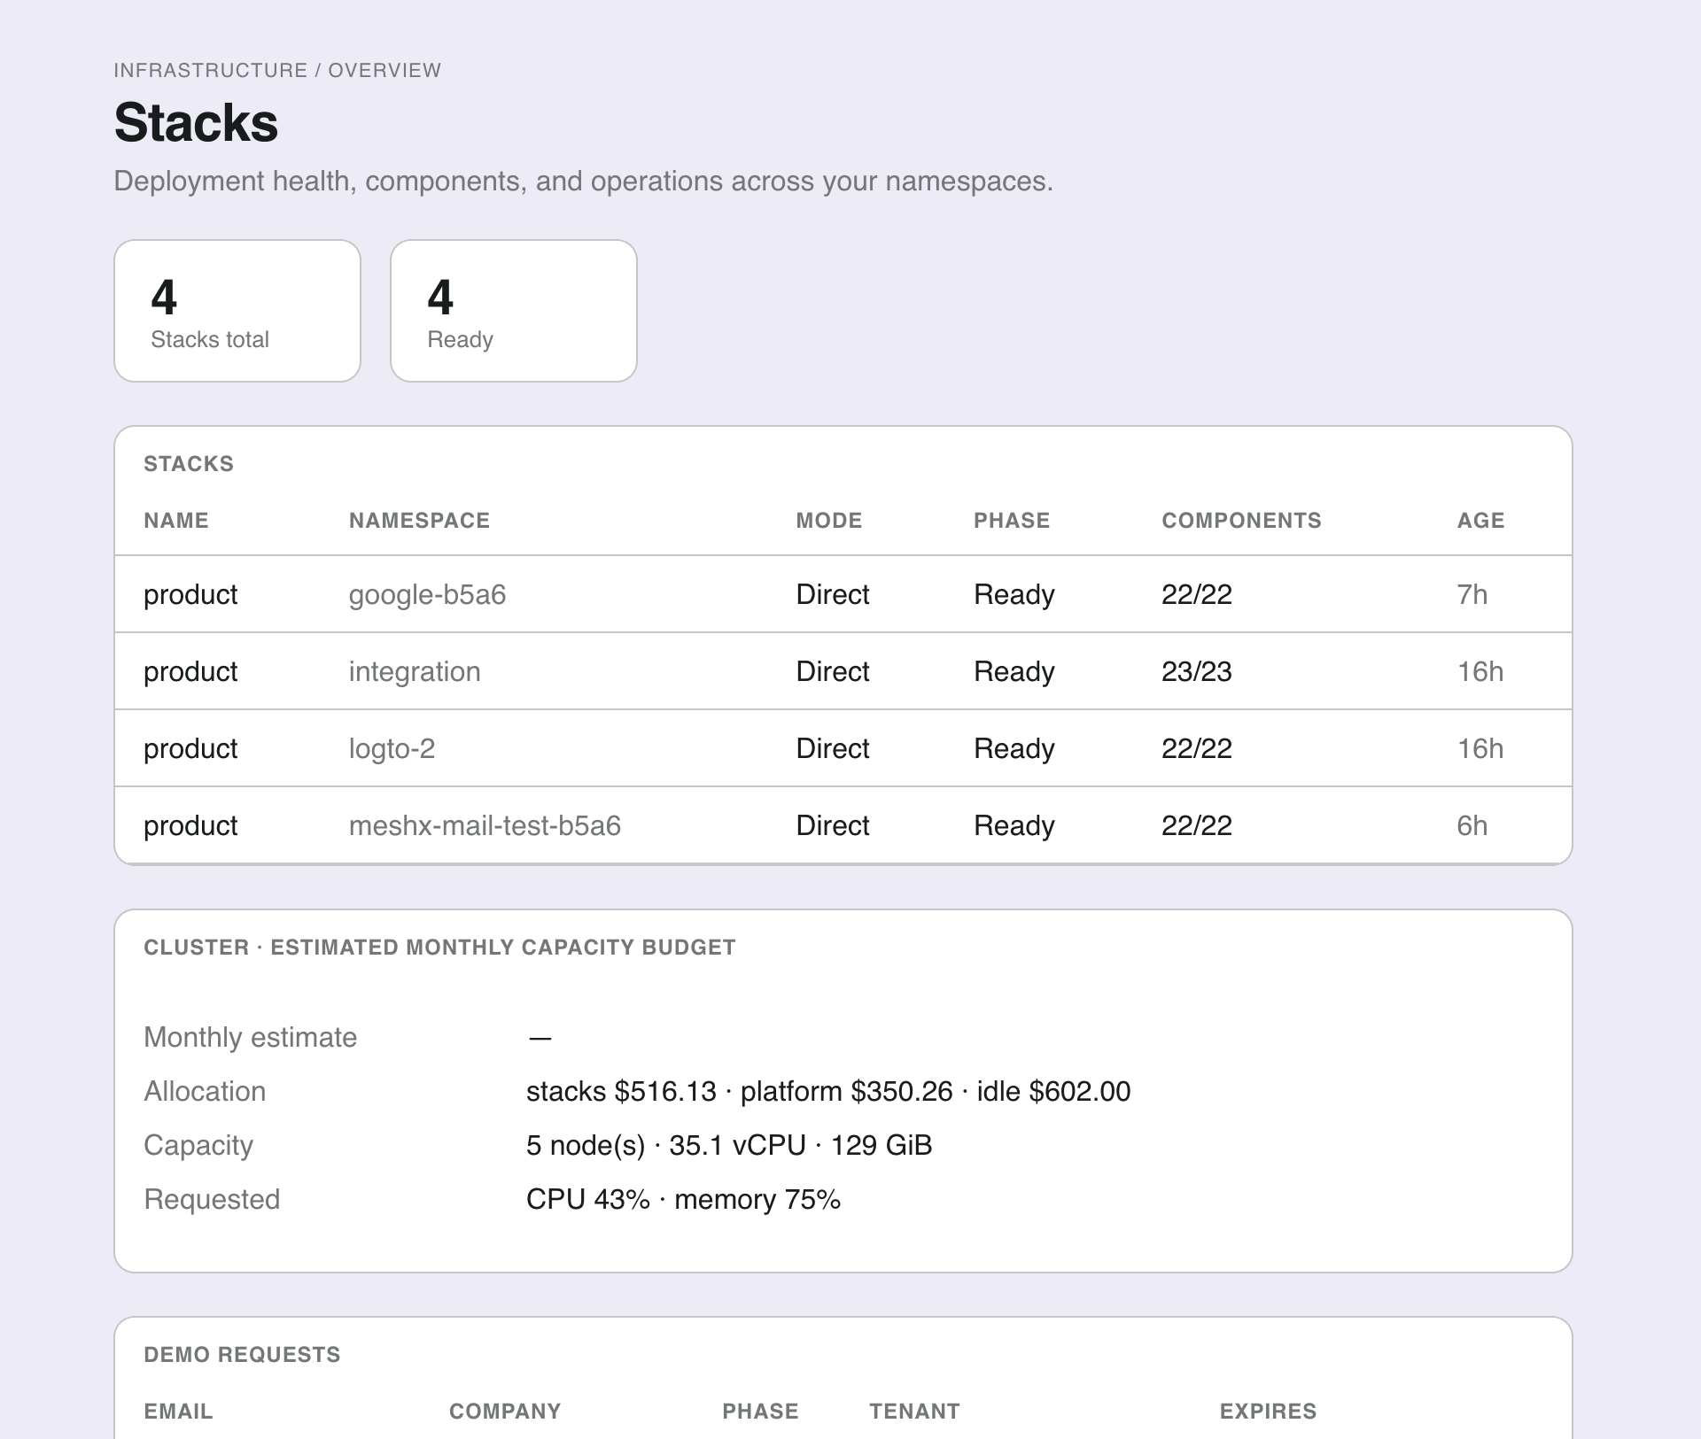
Stacks and operations
Stack phase and component status for each environment
Each stack uses an approved template: Full, Lite, or Dashboard AI only.
Component status, such as 22/22, shows if a deployment is complete.
Security hardening: the core charts still need their settings confirmed before we make a hardening claim.

Slide 10
Decisions we need from Barclays
Answers set the order of the work
Which AWS services are approved, and in which region?
Does Foundation run in AWS, on-prem, or both?
Do you need GPU nodes for Foundation, or access to your existing model endpoint?
Which Bedrock models are approved, and is access by PrivateLink or an internal gateway?
Who runs the platform day to day: Barclays, meshX, or shared?
Which operator access model do you require: bastion, break-glass, or neither?
Is identity federation to your provider needed from day one?
Where does the Databricks target run, and who owns the network path?

Slide 11
Next steps
Items not yet built, with owners and dates to confirm
Action | Owner | Timing
Prove Bedrock-only operation in a new AWS test environment | meshX | Before the session
Wire the air-gap image pull path to the in-cluster registry, with a no-egress test | meshX platform | To confirm
Default to Logto for air-gap profiles | meshX platform | To confirm
Add a customer approval gate and promotion workflow to the release flow | To assign | To confirm
Build a user-facing rollback workflow | To assign | To confirm
Confirm GPU and on-prem model design after question 3 | To assign | After Barclays answers
Choose the Open Sharing network option with Barclays network architects | meshX with Barclays network team | After Barclays answers

