Slide 1
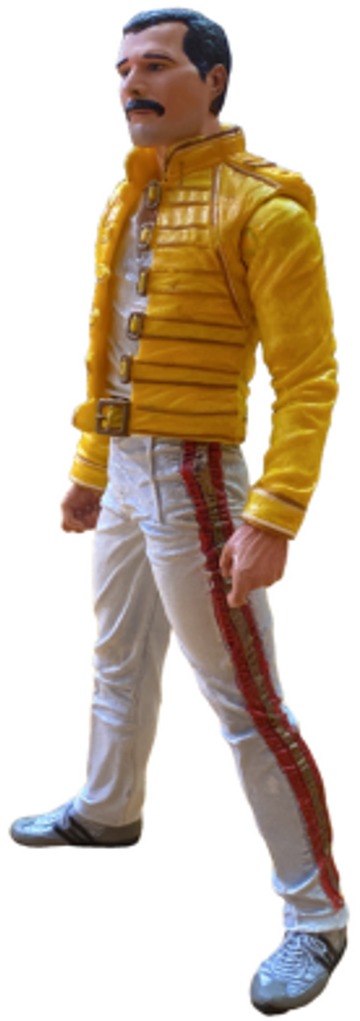
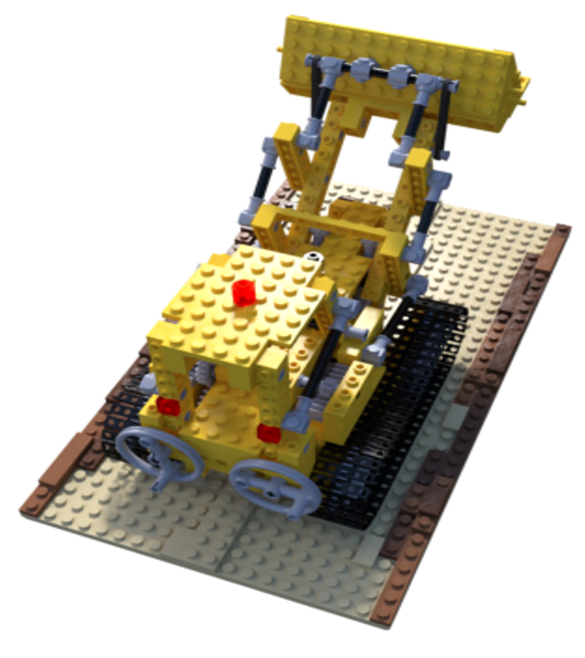
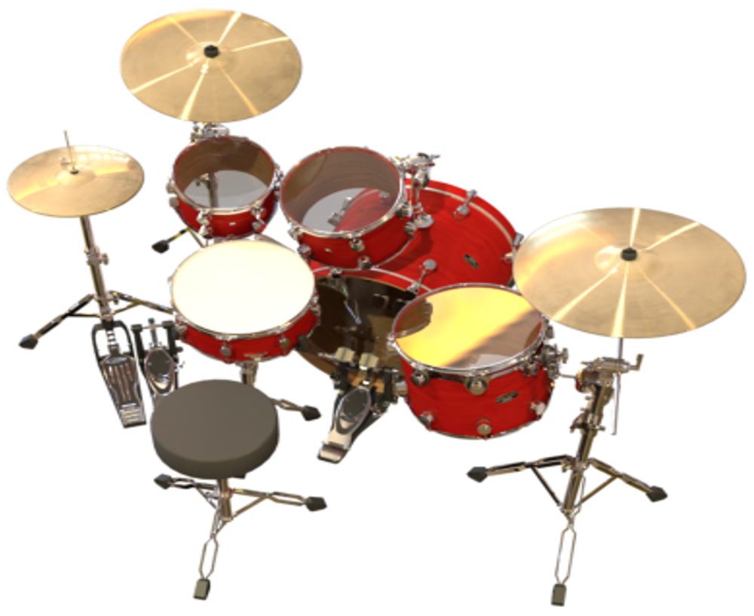
Optimization for 3D Scene Reconstruction
A Comparative Study of Optimizers, Losses, and Representations
for NeRF and 3D Gaussian Splatting
António Cruz (140129), Duarte Cabrita (120058)

Slide 2
Introduction
This project’s chosen application is Computer Vision (from Lesson 1 slides): "segmentation, reconstruction, pose estimation, calibration and matching can be formulated as minimization of geometric or photometric error“.
Our implementation uses NeRF and Gaussian Splatting as differentiable photometric reconstructions of a 3D scene from posed photographs.
Although the primary application is computer vision, the project approaches several other items on the assignment's list:
Supervised model training and DNN training (NeRF MLP)
SGD and its variants (optimizers)
Hyperparameter and Bayesian optimization (TPE/Optuna)
Structure-from-Motion bundle adjustment (COLMAP)

Slide 3
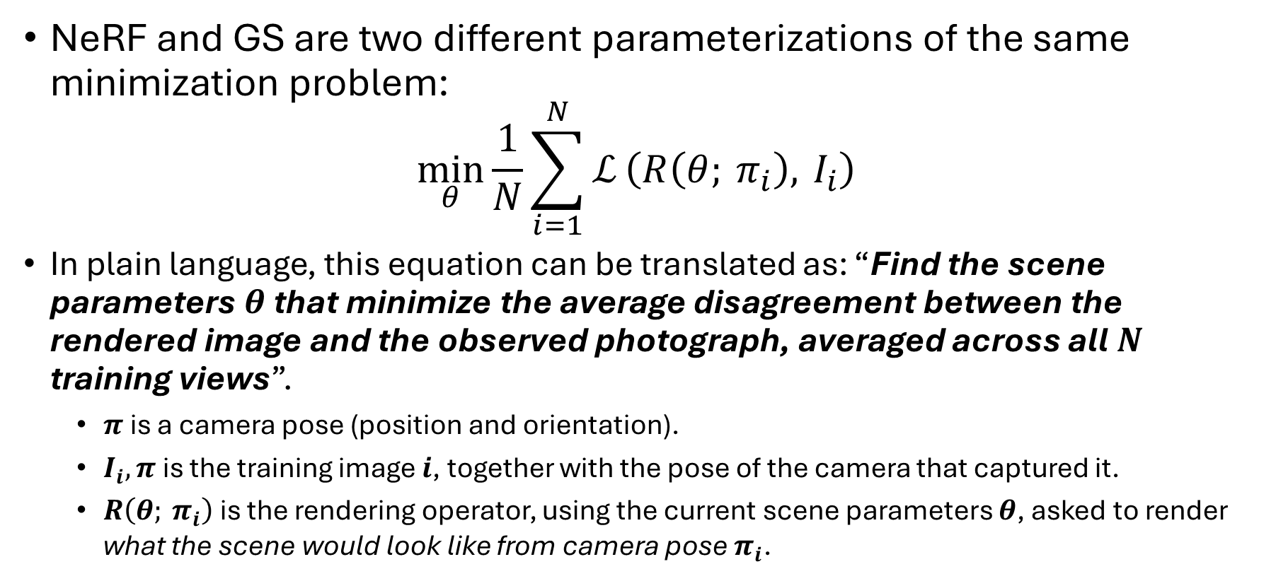
NeRF vs Gaussian Splatting (1/2)
NeRF and GS are two different parameterizations of the same minimization problem:
$$\min_{θ}{\frac{1}{N}\sum_{i=1}^{N}{ℒ}​\left(R\left(θ; π_{i}\right), I_{i}\right)}$$
In plain language, this equation can be translated as: “Find the scene parameters$θ$that minimize the average disagreement between the rendered image and the observed photograph, averaged across all$N$ training views”.
$π$ is a camera pose (position and orientation).
$I_{i},π$ is the training image $i$, together with the pose of the camera that captured it.
$R\left(θ; π_{i}\right)$ is the rendering operator, using the current scene parameters $θ$, asked to render what the scene would look like from camera pose $π_{i}$.

Slide 4
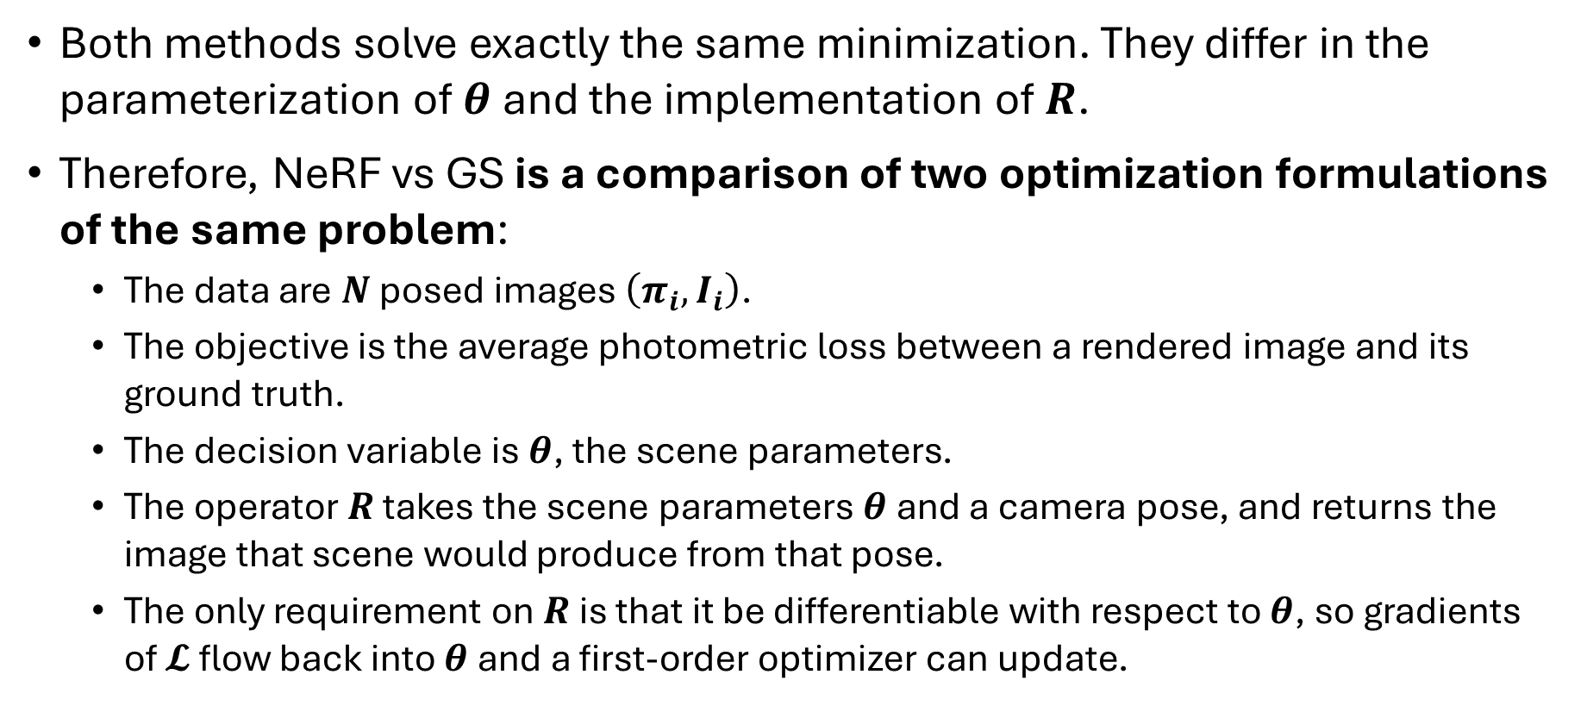
NeRF vs Gaussian Splatting (2/2)
Both methods solve exactly the same minimization. They differ in the parameterization of$θ$and the implementation of $R$.
Therefore, NeRF vs GS is a comparison of two optimization formulations of the same problem:
The data are $N$ posed images $\left(π_{i},I_{i}\right)$.
The objective is the average photometric loss between a rendered image and its ground truth.
The decision variable is $θ$, the scene parameters.
The operator $R$ takes the scene parameters $θ$ and a camera pose, and returns the image that scene would produce from that pose.
The only requirement on $R$ is that it be differentiable with respect to $θ$, so gradients of $𝓛$ flow back into $θ$ and a first-order optimizer can update.

Slide 5
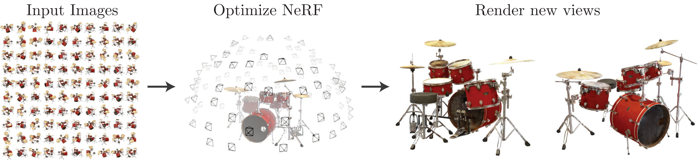
NeRF (Neural Radiance Fields)
A scene reconstruction method that represents a 3D scene as a small multi-layer perceptron mapping any 3D point and viewing direction to a density and color.
The scene parameters are the MLP weights, and they are fitted by gradient descent through a differentiable volume-rendering operator that composites samples along each pixel ray into the final image.
https://arxiv.org/pdf/2003.08934

Slide 6
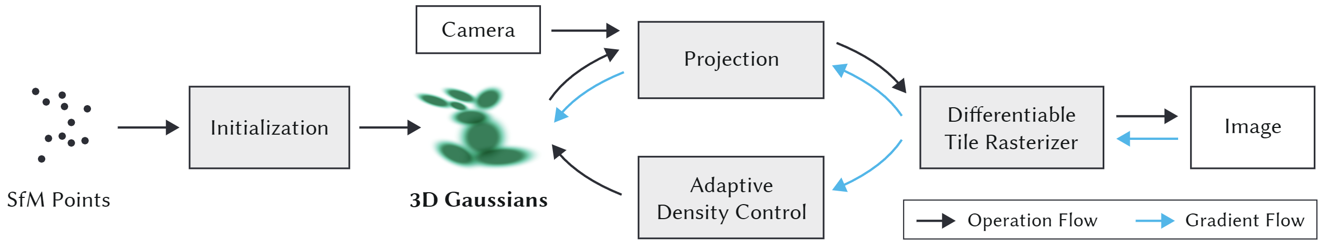
3D Gaussian Splatting (3DGS)
A scene reconstruction method that represents a 3D scene as an explicit collection of 3D Gaussian primitives, each carrying a position, scale, rotation, opacity, and color.
The scene parameters are the per-Gaussian tuples, and they are fitted by gradient descent through a differentiable tile-based rasterizer that projects and alpha-composites the primitives into the final image.
https://dl.acm.org/doi/epdf/10.1145/3592433

Slide 7
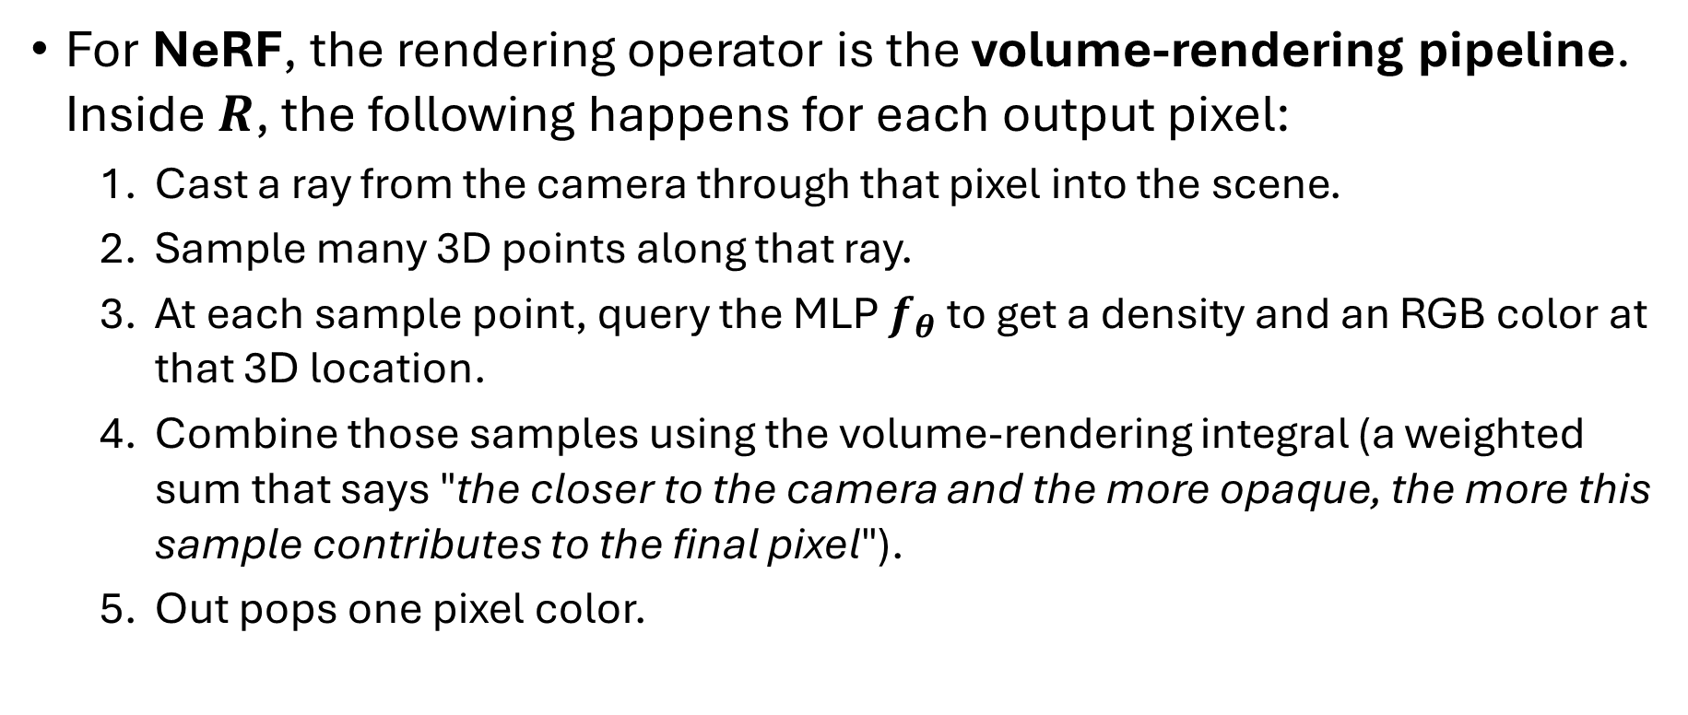
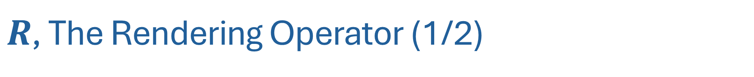
$R$, The Rendering Operator (1/2)
For NeRF, the rendering operator is the volume-rendering pipeline. Inside $R$, the following happens for each output pixel:
Cast a ray from the camera through that pixel into the scene.
Sample many 3D points along that ray.
At each sample point, query the MLP $f_{θ}$ to get a density and an RGB color at that 3D location.
Combine those samples using the volume-rendering integral (a weighted sum that says "the closer to the camera and the more opaque, the more this sample contributes to the final pixel").
Out pops one pixel color.

Slide 8
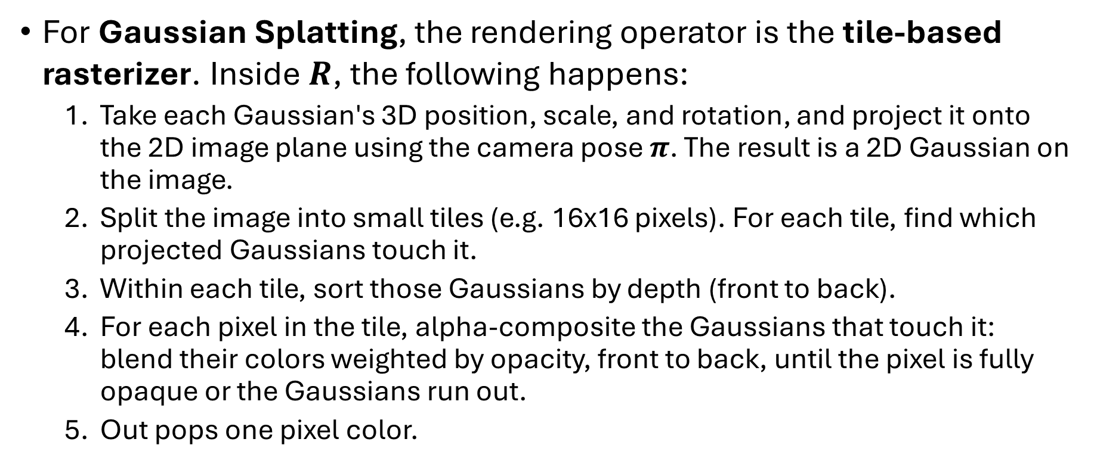
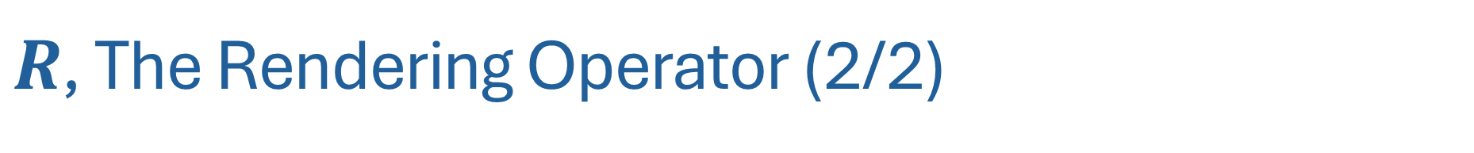
$R$, The Rendering Operator (2/2)
For Gaussian Splatting, the rendering operator is the tile-based rasterizer. Inside $R$, the following happens:
Take each Gaussian's 3D position, scale, and rotation, and project it onto the 2D image plane using the camera pose $π$. The result is a 2D Gaussian on the image.
Split the image into small tiles (e.g. 16x16 pixels). For each tile, find which projected Gaussians touch it.
Within each tile, sort those Gaussians by depth (front to back).
For each pixel in the tile, alpha-composite the Gaussians that touch it: blend their colors weighted by opacity, front to back, until the pixel is fully opaque or the Gaussians run out.
Out pops one pixel color.

Slide 9
Optimizers
SGD - Step in the direction of the negative gradient, with a fixed learning rate (simplest possible recipe).
SGD with momentum - Keep a running average of past gradients and step in that smoothed direction, which dampens noise and accelerates along consistent descent directions.
SGD with Nesterov - A variant of momentum that "looks ahead" before taking the step, giving slightly better convergence on convex problems.
Adam - Keep a running average of past gradients and a running average of past squared gradients, then divide the smoothed gradient by the smoothed magnitude. The effect is a per-parameter adaptive learning rate.
AdamW: Same as Adam, but with weight decay applied as a separate term outside the adaptive scaling, which fixes a subtle interaction in the original Adam formulation.

