Slide 1
Section 4
Key Findings: Performance Metrics and Alignment Tax
Mitigation

Slide 2
Evaluation Strategy
The researchers evaluated the model according to alignment, that is, acting according user’s intention. The evaluation metrics are mainly composed by labelers.
This alignment was measured across three domains:
Helpful;
Truthfulness;
Toxicity and Bias.
The evaluations conducted were split into two parts:
Evaluations on API Distribution (User’s Scenario / Use case);
NLP Benchmark Datasets.

Slide 3
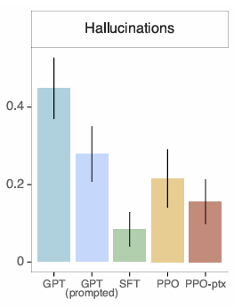
Evaluation - Truthfulness and Hallucination Reduction
InstructGPT generates truthful and informative outputs about twice as often as GPT-3.
When instructed to respond with “I have no comment”, it reported a slight increase compared to GPT-3.
In regard to hallucination, InstructGPT halved hallucination rates (21% vs. 41% on closed domain tasks)

Slide 4
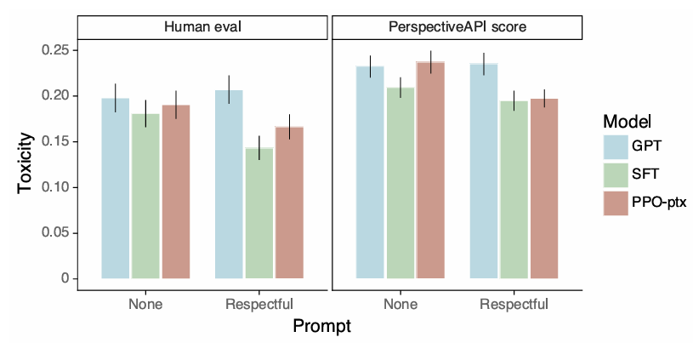
Evaluation- Toxicity and Bias
The InstructGPT obtained similar toxicity rates in a “no prompt” setting;
When instructed to output a safe and respectful output “respectful prompt”, the InstructGPT generated fewer toxic outputs then GPT-3;
In contrast, when explicitly prompted to produce toxic outputs, it resulted in much more toxic outputs then GPT-3
Relatively to bias, the models weren’t less biased then GPT-3.
The InstructGPT models, when told to be respectful, it exhibited a higher bias

Slide 5
Evaluation- Alignment Tax
On RLHF fine-tuning, there were performance regressions compared to GPT-3 on certain public NLP datasets (example of “alignment tax”).
The mixing of pretraining gradients (PPO-ptx) largely removed these regressions without reducing alignment quality.
This approach helps the model keep or even improve its performance on those benchmarks, reducing the alignment tax.
Definition: LLMs acquire a wide range of abilities during pre-training, but aligning LLMs under Reinforcement Learning with Human Feedback (RLHF) can lead to forgetting pretrained abilities, which is also known as the alignment tax.

