Slide 1

Projeto 1 – Metodologias em Modelos de Linguagem
This Summary Report aims to review the following article: https://arxiv.org/abs/2203.02155
António Cruz (140129), Ricardo Kayseller (95813), Ricardo Pereira (120052), Ivan Magalhães (106586), Erik Daskalyuk (120062)

Slide 2
Section 1
Objectives of Research

Slide 3
The Problem: Misalignment in LLMs
LLMs like GPT-3 are powerful → but often fail to follow human instructions
Trained to predict next word → leads to unhelpful or harmful outputs
Core problem:
Misalignment between model behavior and human intent

Slide 4
Motivation for the Study
The authors propose → Reinforcement Learning from Human Feedback (RLHF)
LLMs lack alignment with human intent
Aim: Improve model helpfulness, honesty, and safety

Slide 5
Objective of the Study
Investigate whether LLMs can be aligned with human intent effectively and at scale
RLHF used to incorporate human preferences
Improve output quality beyond increasing model

Slide 6
Section 2
Methodology Phase 1: Supervised Fine-Tuning (SFT) &
Data Collection

Slide 7
Methodology Overview
The InstructGPT methodology employs three main stages:
Helpful
Honest
Harmless
"Making language models bigger does not inherently make them better at following a user's intent. For example, large language models can generate outputs that are untruthful, toxic, or simply not helpful to the user.“
This approach uses Reinforcement Learning from Human Feedback (RLHF)
Notes:
This approach uses Reinforcement Learning from Human Feedback (RLHF) to fine-tune a pretrained GPT-3 model.

Slide 8
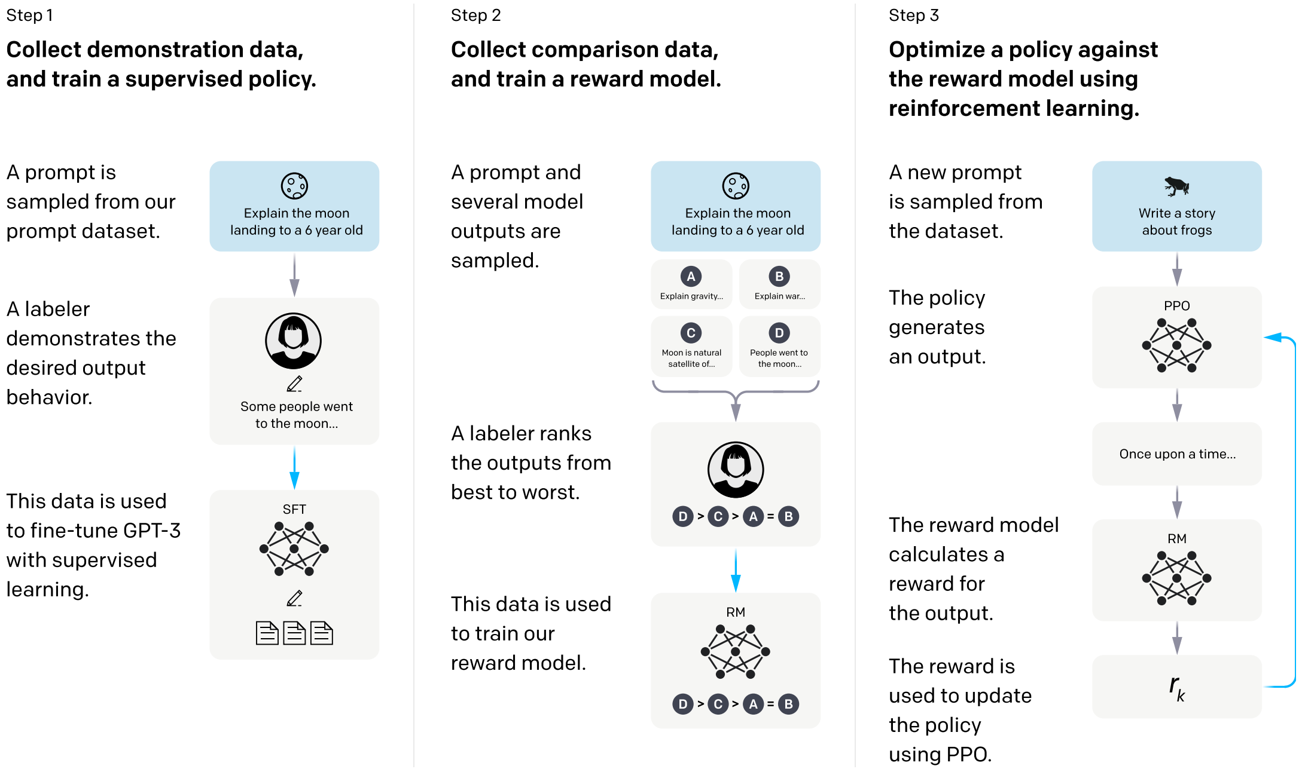
Methodology Overview – The 3 Steps
(Fig. 2, Page 3)
Notes:
Supervised Fine-Tuning (SFT): A pretrained GPT-3 model is fine-tuned on a dataset consisting of prompts paired with human-written demonstrations of the desired output. (Section 3.1, p. 6)
Reward Model (RM) Training: Human labelers rank multiple candidate model outputs for a given prompt, creating a dataset of human preferences. A separate model (the RM) is trained to predict which outputs humans prefer. (Section 3.1, p. 6)
Reinforcement Learning (RL) via PPO: The SFT model is further fine-tuned using Proximal Policy Optimization (PPO), leveraging the RM's prediction score as a reward signal. (Section 3.1, p. 6)
"Step 1: Collect demonstration data and train a supervised policy. Our labelers provide demonstrations of the desired behavior on the input prompt distribution... We then fine-tune a pretrained GPT-3 model on this data using supervised learning.“ (Section 3.1, p. 6) Supervised Fine-Tuning (SFT) is the initial phase of the InstructGPT pipeline, establishing the crucial base policy.
The primary goal is to use Behavior Cloning (BC) to fine-tune a pretrained GPT-3 model on human demonstrations, teaching it basic instruction-following behavior. (Section 3.1, p. 6)
Human labelers wrote responses demonstrating the desired output behavior. The GPT-3 model was fine-tuned on these prompt-demonstration pairs using standard supervised learning techniques. (Section 3.1, p. 6; Section 3.4, p. 7)
While SFT models began to overfit on the validation loss after only 1 epoch, the authors chose to continue training for up to 16 epochs. This was because training longer, despite the validation loss increasing, improved the Reward Model (RM) score and the final human preference ratings. This highlights that standard validation loss was not the best proxy for alignment quality. (Section 3.4, p. 7)
This step results in the SFT model, which serves as the supervised policy used for generating samples in the subsequent RLHF steps. (Section 3.1, p. 6)
The SFT dataset was built from two primary, complementary sources:
Source 1: API Prompts (Bulk Data)
The majority were text prompts submitted to the OpenAI API, gathered from users interacting with earlier InstructGPT models on the API Playground. (Section 3.2, p. 6; Appendix A.2.2, p. 30)
Data Cleaning: This API data was subject to stringent cleaning: it was filtered to remove Personally Identifiable Information (PII) and heuristically de-duplicated (checking for long common prefixes, and limiting the number of prompts to 200 per user ID). (Section 3.2, p. 6)
Source 2: Labeler-Written Examples (Bootstrapping)
These were necessary to bootstrap the process, as the base GPT-3 did not initially receive many instruction-like prompts. It included:
"Plain" arbitrary tasks.
"Few-shot" instruction/query pairs.
"User-based" prompts corresponding to waitlist use cases. (Section 3.2, p. 7; Appendix A.1, p. 26)
Dataset Composition and Diversity
The final SFT dataset was heavily geared toward generative tasks, with major categories including Generation (45.6%), Open QA (12.4%), and Brainstorming (11.2%). (Table 1, p. 6; Appendix A.4, p. 33)
The alignment process fundamentally relies on human judgment, necessitating a carefully selected workforce and a measured volume of data.
The Human Labelers: A team of about 40 trained contractors was hired through vendors (Upwork and ScaleAI) to generate the high-quality demonstrations and rankings. (Section 3.4, p. 7; Appendix B.1, p. 36)
Selection Criteria: Labelers were chosen through a screening test that emphasized sensitivity to the preferences of different demographic groups and their ability to identify and respond appropriately to potentially harmful outputs. (Section 3.4, p. 7; Appendix B.1, p. 36)
Agreement: The training labelers demonstrated strong inter-annotator agreement, agreeing with each other 72.6 ± 1.5% of the time, validating the quality and consistency of the demonstrations. (Section 3.4, p. 8)
SFT Dataset Volume: The supervised fine-tuning step used approximately 13,000 training prompts (including 11,295 labeler-written and 1,430 customer API prompts). This data volume initialized the supervised policy. (Section 3.2, p. 7; Table 6, p. 33). For comparison, the later Reward Model (RM) step used approximately 33,000 prompts for ranking comparisons, and the final RLHF (PPO) stage used 31,000 unlabeled prompts. (Section 3.2, p. 7; Table 6, p. 33)

Slide 9
Section 3
Methodology Phases 2 and 3: Reward Modeling (RM) and RLHF (PPO)

Slide 10
Reward Model (RM) Training via Ranking
Goal: Create a model capable of predicting which outputs humans prefer.
Process:
Human labelers rank several model responses (1=worst → 7=best)
Rankings are converted into a Reward Model (RM)
RM predicts a numerical “reward” for each output
Training Process:
The SFT model generates multiple answers for the same prompt
RM learns to give higher rewards to preferred outputs

Slide 11

The Reward Model Loss Function
Loss Function:
$$loss(θ)= −Ε_{\left(x,y_{w},y_{l}\right)}[\log\left(σ\left(r_{θ}\left(x,y_{w}\right)−r_{θ}\left(x,y_{l}\right)\right)\right)]$$
$Ε_{\left(x,y_{w},y_{l}\right)}$: Average over all samples;
$r_{θ}\left(x, y\right)$: reward that the RM gives to response $y$ for prompt $x$;
$y_{w}$: preferred (winning) output;
$y_{l}$: less preferred (losing) output;
$σ$: sigmoid function → forces higher score for preferred output
Intuition:
RM learns: “If humans like A more than B → give A a higher reward.”

Slide 12
Reinforcement Learning (RLHF) via PPO
Goal: Fine-tune the model to maximize the RM’s reward signal.
Feedback loop: SFT model generates outputs → RM evaluates them → RLHF model learns to maximize the reward.
Challenge: Model may “forget” what it learned in SFT.
Solution: Add a penalty term to keep it close to the SFT policy.

Slide 13

Reinforcement Learning (RLHF) via PPO - Penalty
Penalty Function:
$$penalty= β ∙log\frac{π_{RL}(y|x)}{π_{SFT}(y|x)}$$
$π_{RL}(y|x)$: Current model (being trained)
$π_{SFT}\left(y | x\right)$: Base Model
$β$: Controls how much deviation is penalized
Intuition:
Penalty teaches the model: “Increase rewards from human feedback but stay close to the original SFT behavior.”

Slide 14

Reinforcement Learning (RLHF) via PPO - Objective
Objective Function:
$$Objective\left(Φ\right)= Ε_{x,y}[r_{θ}\left(x,y_{w}\right)−penalty]$$
$r_{θ}\left(x, y\right)$: reward from the RM;
Intuition:
Objective teaches the model: “Generate responses that humans like the most, while staying faithful to the original model’s style.”

Slide 15
Reinforcement Learning (RLHF-ptx) via PPO-ptx
Goal: Maintain good generalization for other NLP problems
Process:
PPO-ptx is an upgrade to the PPO Model
Mix pretraining gradientes with PPO
Result:
Keeps the model aligned and good at general NLP tasks
The model stays polite, aligned, and still capable in language tasks

Slide 16
Section 4
Key Findings: Performance Metrics and Alignment Tax
Mitigation

Slide 17
Evaluation Strategy
The researchers evaluated the model according to alignment, i.e., acting according to user’s intention.
This alignment was measured across three domains:
Helpful
Truthfulness
Toxicity and Bias
The evaluations conducted were split into two parts:
Evaluations on API Distribution (prompts submitted by users)
NLP Benchmark Datasets

Slide 18
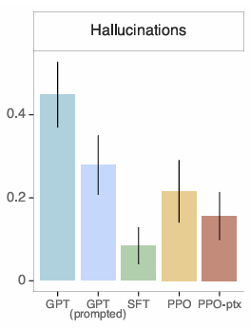
Evaluation - Truthfulness and Hallucination Reduction
InstructGPT generates truthful and informative outputs about twice as often as GPT-3.
When instructed to respond with “I have no comment”, it reported a slight increase compared to GPT-3.
In regard to hallucination, InstructGPT halved hallucination rates (21% vs. 41% on closed domain tasks)

Slide 19
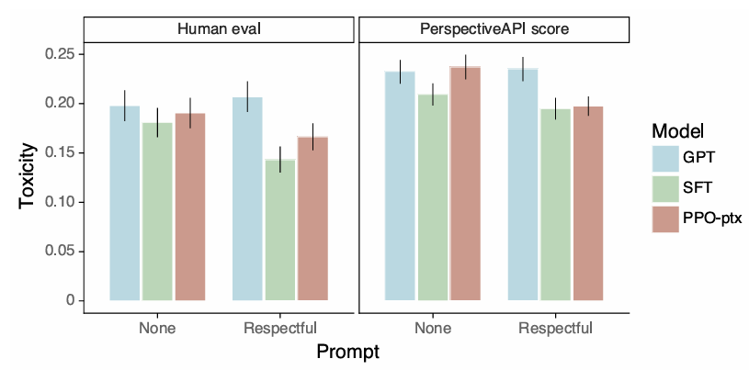
Evaluation- Toxicity and Bias
Similar toxicity rates in a “no prompt” setting:
When instructed to output a safe and respectful output “respectful prompt”, the InstructGPT generated fewer toxic outputs then GPT-3;
In contrast, when explicitly prompted to produce toxic outputs, it resulted in much more toxic outputs then GPT-3
Relatively to bias, the models weren’t less biased then GPT-3.
The InstructGPT models, when told to be respectful, it exhibited a higher bias

Slide 20
Evaluation - Alignment Tax
On RLHF fine-tuning, there were performance regressions compared to GPT-3 on certain public NLP datasets (example of “alignment tax”)
The mixing of pretraining gradients (PPO-ptx) largely removed these regressions without reducing alignment quality
This approach helps the model keep or even improve its performance on those benchmarks, reducing the alignment tax
Definition: LLMs acquire a wide range of abilities during pre-training, but aligning LLMs under Reinforcement Learning with Human Feedback (RLHF) can lead to forgetting pretrained abilities, which is also known as the alignment tax.

Slide 21
Section 5
Limitations, Generalization, and Broader Implications

Slide 22
Implications for alignment research
The cost of increasing model alignment is modest to relative to pretraining
The model generalizes instructions to settings that it wasn’t supervised in
Performance degradation was mitigated by the fine-tuning
The techniques were validated from research of the real world

Slide 23
Who are we aligning to?
The model is aligned to the labeller’s demonstrations and preferences. The labellers were mostly English‐speaking people
The labelling instructions are created by the researchers, creating an inherent bias to their preferences.
The training data is determined by prompts sent by customers, and as such, implicitly aligning with what customers think is valuable
The customers of OpenAI are not representative of all potential users, nor by all individuals and groups impacted by language model use

Slide 24
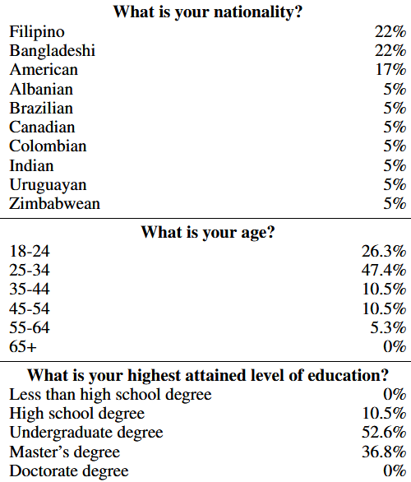
Limitations
The labeller population is not fully representative of all users or all cultural/linguistic backgrounds
Most prompts and data were in English, and many of the comparisons were labelled by only one annotator
The model sometimes fail to follow instructions, hallucinate facts, generate biased outputs
There can be a difference between what the user intended and what the labeller thought was intended

Slide 25
Open questions
Collection of worst-case scenarios, filtering pre-training data, and combining different methods to reduce the propensity to generate toxic outputs
Whether an output is harmful will depend on the context. Also, harmful outputs can be beneficial for data augmentation
To improve the controllability of the model it may be useful to allow users to specify preferences
Making comparisons of text may not be the best way to align models

Slide 26
Broader impact
Deployment carries risks of bias, misalignment with under‐represented groups, or unintended consequences.
Persuasive text may increase usage time, which may not be good for the user’s well-being.
Ensure models are used responsibly, that their alignment target is revisited as deployment contexts change
Data filtering, monitoring, refusing harmful instructions are also necessary.

Slide 27
Thank You!
António Cruz (140129), Ricardo Kayseller (95813), Ricardo Pereira (120052), Ivan Magalhães (106586), Erik Daskalyuk (120062)

