Slide 1
Section 3
Methodology Phases 2 & 3: Reward Modeling (RM) and
RLHF (PPO)

Slide 2
Reward Model (RM) Training via Ranking
Goal: Create a model capable of predicting which outputs humans prefer.
Process:
Human labelers rank several model responses (1=worst → 7=best)
Rankings are converted into a Reward Model (RM)
RM predicts a numerical “reward” for each output
Training Process:
The SFT model generates multiple answers for the same prompt
RM learns to give higher rewards to preferred outputs

Slide 3
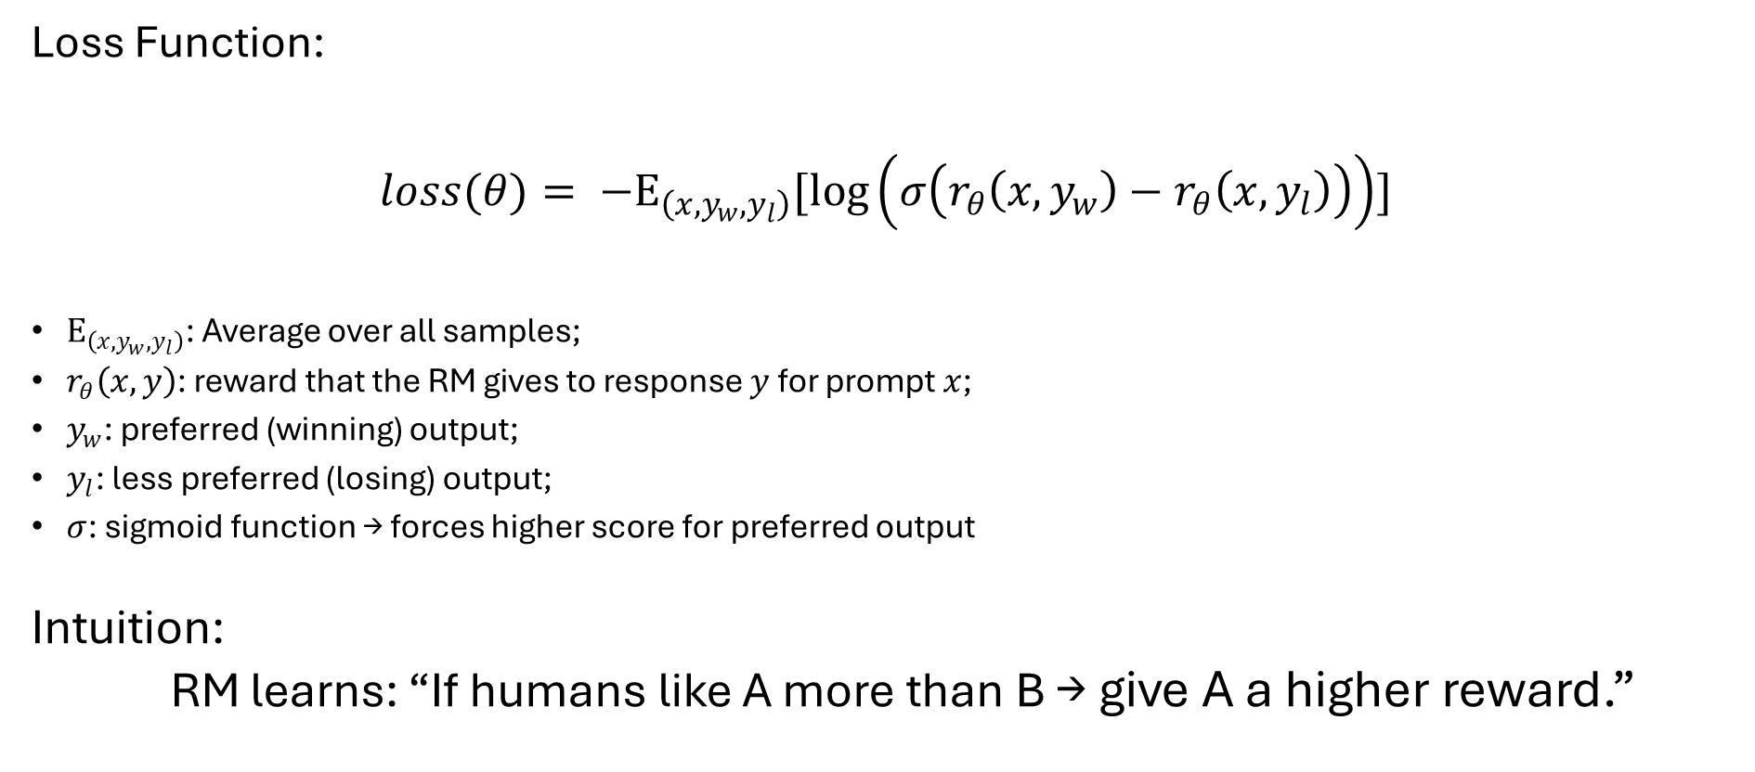
The Reward Model Loss Function
Loss Function:
$$loss(θ)= −Ε_{\left(x,y_{w},y_{l}\right)}[\log\left(σ\left(r_{θ}\left(x,y_{w}\right)−r_{θ}\left(x,y_{l}\right)\right)\right)]$$
$Ε_{\left(x,y_{w},y_{l}\right)}$: Average over all samples;
$r_{θ}\left(x, y\right)$: reward that the RM gives to response $y$ for prompt $x$;
$y_{w}$: preferred (winning) output;
$y_{l}$: less preferred (losing) output;
$σ$: sigmoid function → forces higher score for preferred output
Intuition:
RM learns: “If humans like A more than B → give A a higher reward.”

Slide 4
Reinforcement Learning (RLHF) via PPO
Goal: Fine-tune the model to maximize the RM’s reward signal.
Feedback loop:
SFT model generates outputs → RM evaluates them → RLHF model learns to maximize the reward.
Challenge: Model may “forget” what it learned in SFT.
Solution: Add a penalty term to keep it close to the SFT policy.

Slide 5
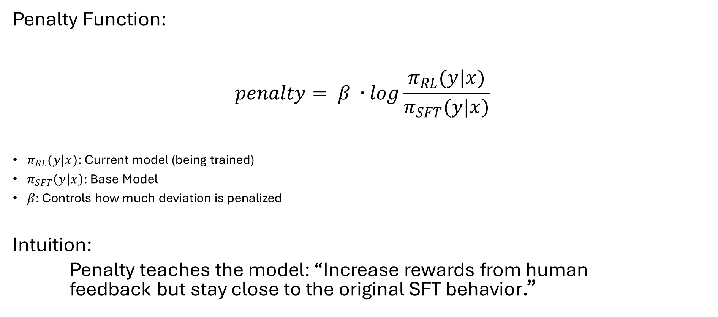
Reinforcement Learning (RLHF) via PPO - Penalty
Penalty Function:
$$penalty= β ∙log\frac{π_{RL}(y|x)}{π_{SFT}(y|x)}$$
$π_{RL}(y|x)$: Current model (being trained)
$π_{SFT}\left(y | x\right)$: Base Model
$β$: Controls how much deviation is penalized
Intuition:
Penalty teaches the model: “Increase rewards from human feedback but stay close to the original SFT behavior.”

Slide 6

Reinforcement Learning (RLHF) via PPO - Objective
Objective Function:
$$Objective\left(Φ\right)= Ε_{x,y}[r_{θ}\left(x,y_{w}\right)−penalty]$$
$r_{θ}\left(x, y\right)$: reward from the RM;

Slide 7
Reinforcement Learning (RLHF-ptx) via PPO-ptx
Goal: Maintain good generalization for other NLP problems
Process:
Mix pretraining gradientes with PPO
Result:
Keeps the model aligned and good at general NLP tasks
The model stays polite, aligned, and still capable in language tasks

