Slide 1

Web Development
By Platon Kokhno
(40712598)

Slide 2


About Web Development
Web development – the art and science of building websites, that connect, inform and inspire.

Slide 3

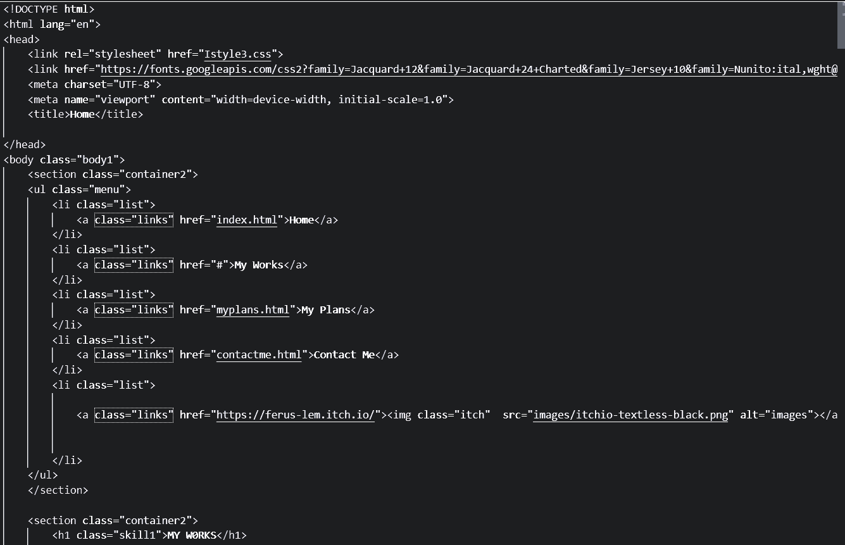
Purpose
A web developer is responsible for creating, maintaining, and optimizing websites and web applications. Their work ensures users have a seamless online experience

Slide 4

Production Plan
Planning
Coding
Testing
Launching

Slide 5
Production (1.Planning)
Firstly, Developer must create a layout and wireframe for the future website. It is possible to make it on paper or use websites like Figma or Adobe to create visualization of the structure
Planning
Coding
Testing
Launching

Slide 6
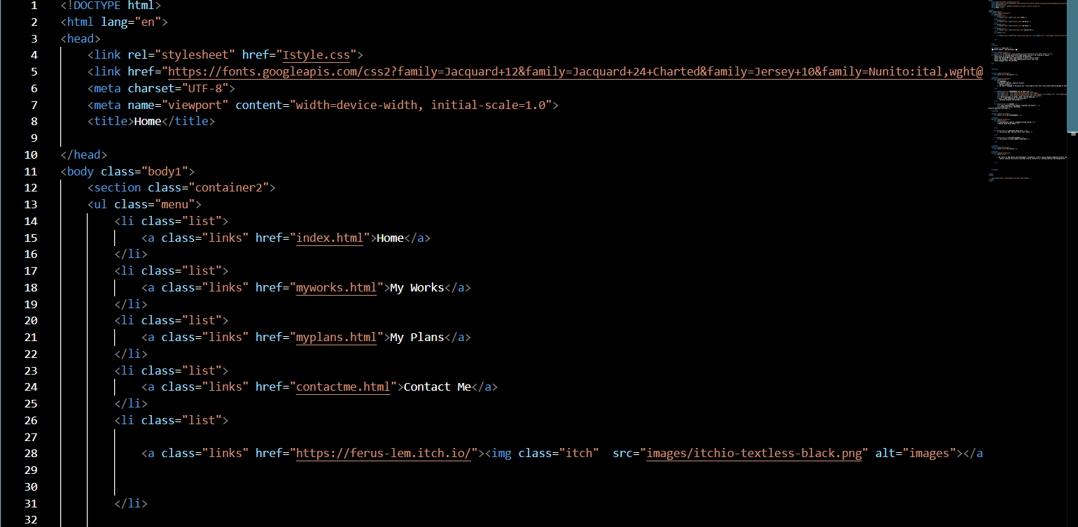
Production (2.Coding)
After creating layouts, it is possible to build the website. We use HTML to structure the content, CSS to style it, and JavaScript to add interactivity.
Planning
Coding
Testing
Launching

Slide 7
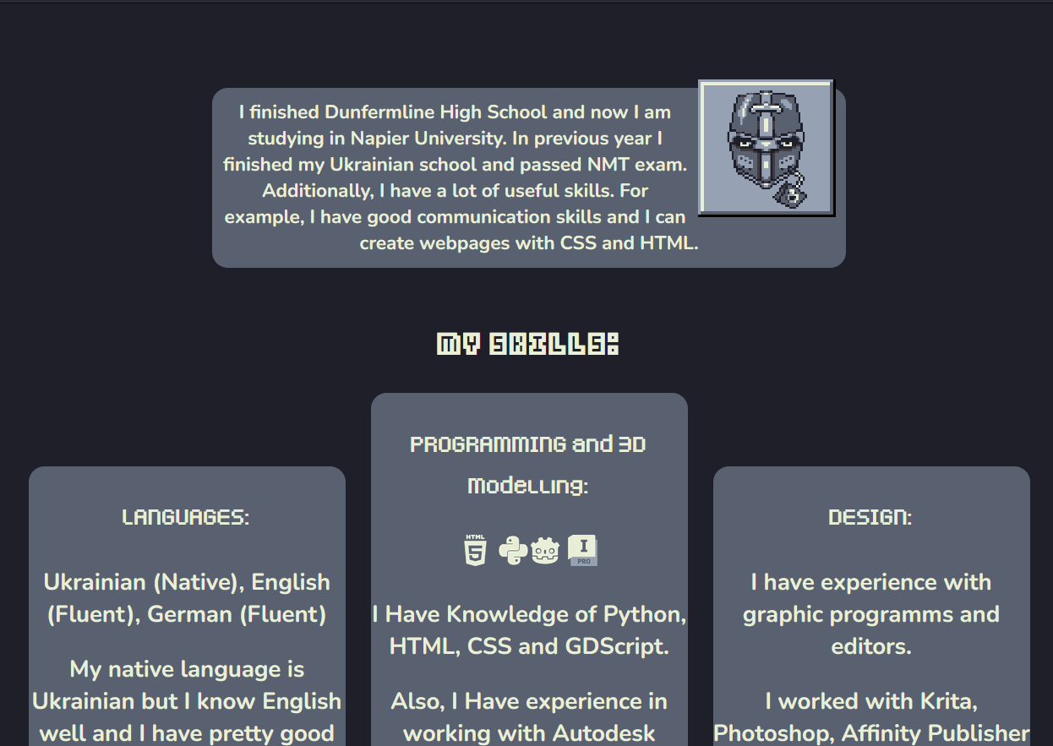
Production (3.Testing)
After coding, developers must test it across devices and browsers to ensure compatibility. In addition, Developers could make any changes and fix bugs to improve functionality, navigation and performance.
Planning
Coding
Testing
Launching

Slide 8
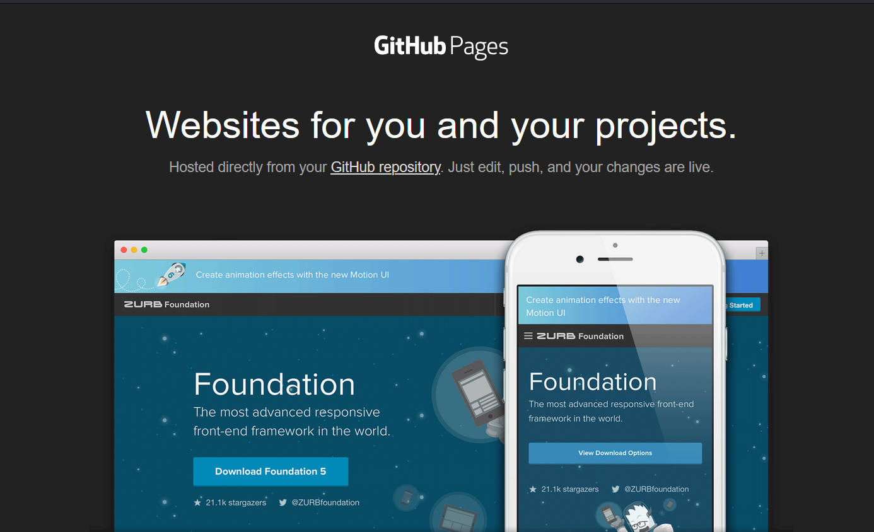
Production (4.Launching)
Finally, after going a long way, it is possible to launch the website. using hosting platforms like Netlify, GitHub Pages or other platforms.
Planning
Coding
Testing
Launching

Slide 9
Thank You

