Slide 1

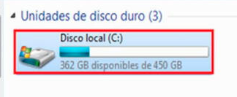


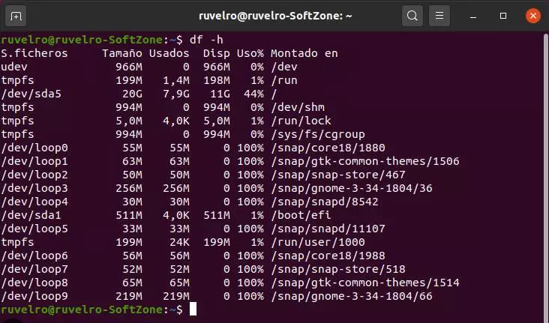
Azure Storage Account (Blob): Upload / Download
file_size = # bytes
file_checksum_content_md5 = ###
Azure Storage Account
Container
AzureStorageAccountBlobManagement
Upload
Download
blob
verify_file_integrity:bool=True
blob_size = # bytes
blob_checksum_content_md5 = ###
file_size = # bytes
file_checksum_content_md5 = ###

Slide 2
Azure Storage Account (Blob): Controls
AzureStorageAccountBlobManagement
container_blob_upload_staging_blocks_commit → verify_file_integrity=True,print_charge_percentage=True
upload the file using block preparation and commit, and use the md5 checksum of the file content to verify the integrity of the uploaded blob content.
This function allows you to limit the ram memory used by reading in chunks but not the network connections to be used to improve the upload speed.
It can show the status progress.
Formats that failed (InvalidBlobOrBlock): mp4, backup
container_blob_upload_data_transfer_options → max_concurrency=2,verify_file_integrity=True
Upload file using multiple network upload connections, and use the md5 checksum of the file content to verify the integrity of the uploaded blob content.
This function allows you to limit the ram memory used by reading in chunks and the network connections to be used to improve the upload speed.
container_blob_download_data_transfer_options → max_concurrency=2,verify_file_integrity=True
You can set configuration options when instantiating a client to optimize performance for data transfer operations.
This function use the md5 checksum of the file content to verify the integrity of the downloaded blob content.
Control vRAM=True
Control Broadband = False, max_concurrency=1
Control vRAM=True
Control Broadband = True
Control vRAM=True
Control Broadband = True

